Slide 1
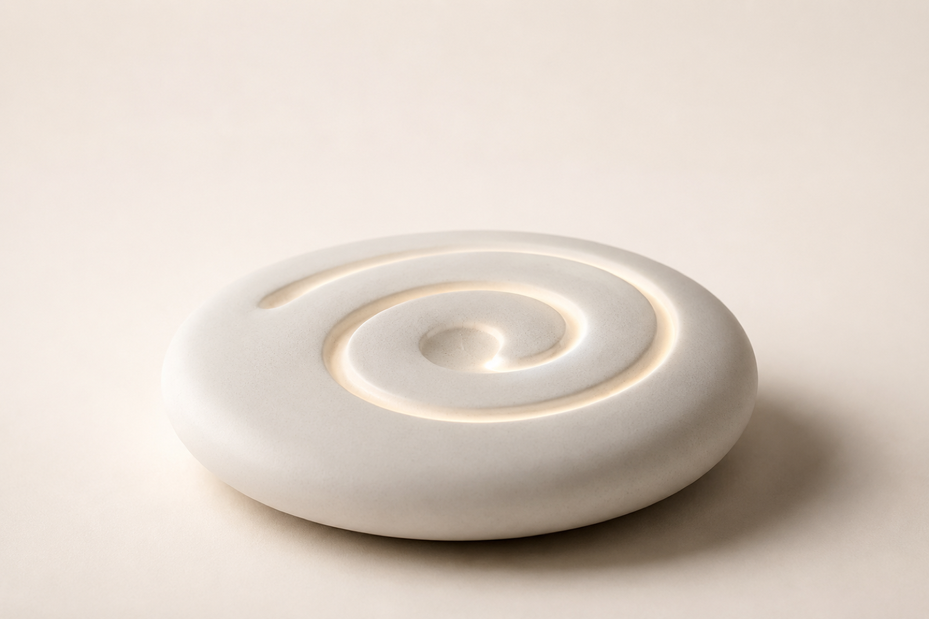
DESIGNING AN EXPERIENCE, NOT JUST AN OBJECT
Labyrinth
A desk ritual that gives a busy executive three minutes to breathe, trace, and come back down.
Notes:
Hey — so this is Labyrinth. The brief was simple on paper: a desk device that helps busy executives find a little calm in the middle of the day. But the more I dug in, the more I realized the hard part isn't relaxation — it's everything around it. Let me walk you through it.

Slide 2
THE INTENT
We set out to shape a moment, not a machine.
A meditation app asks for your attention. Labyrinth asks for almost nothing.
You reach out, your finger falls into the groove, a warm light breathes ahead of it, and for three minutes the day goes quiet.
That feeling is the product; the ceramic disc is just how it reaches you.
Notes:
First, the mindset I went in with. I didn't want to design a machine. I wanted to design a moment — three quiet minutes someone can actually take at their desk. So the whole time, the question wasn't 'what features does it have,' it was 'what does that pause feel like.'

Slide 3
THE PROBLEM
Executives don't lack breaks. They lack a break they're allowed to take.
Fragmented — 3–8 min between meetings, easily interrupted.
Low-key — open, glass-walled offices; the reset has to stay discreet.
Zero setup — no pairing, no screen, one gesture.
Notes:
Here's the real problem. Executives don't actually lack breaks — they lack a break they feel allowed to take. Their day is chopped into three-to-eight-minute gaps. They're often in a glass office, so anything they do is on show. And they've got zero patience for setup. So the bar was high: fast, low-key, basically invisible.

Slide 4
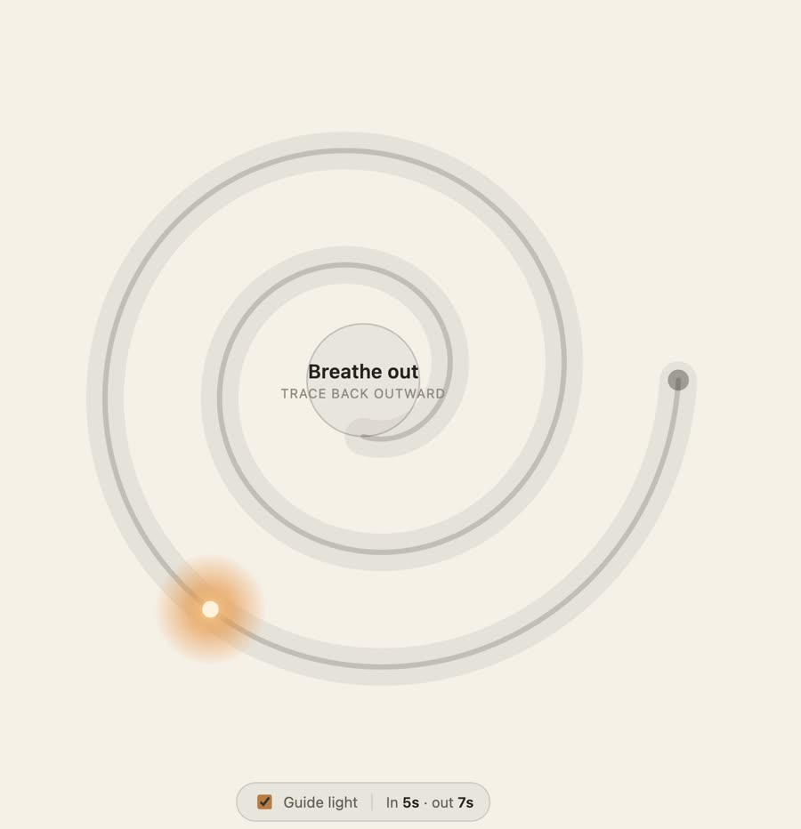
USER STUDY
What people told us — and what it changed
“I never step away.” → a reset right at the desk, under 3 minutes.
“Apps? Too long, another screen.” → no screen, no audio.
“It has to be low-key.” → reads as touching a desk object.
“It sits on my desk.” → aesthetics & material matter.
Hands already fidget → give them a groove to trace.
“Can't switch off on command.” → the light leads the breath.
Notes:
To get there I kept the research small but real — desk research, a short survey, a couple interviews, and usability testing. And every quote pointed at a design move. 'I never actually step away' — so it happens right at the desk. 'Apps? too long, another screen' — so no screen, no audio. 'It has to be low-key' — so it looks like you're just touching an object. And here's the prototype — you follow this warm light: inward as you breathe in, back out as you breathe out. No instructions, nothing to learn.

Slide 5
WHAT WE LEARNED
Six truths that became design constraints
01 It has to be low-key
02 Apps get abandoned
03 Hands already fidget
Discreet in a shared office — touching an object, not “doing wellness.”
Too long, needs headphones, another screen. So: no screen, no audio, <3 min.
Pens, phones. Redirect the behaviour, don't invent a habit.
04 Guide me, don't ask me
05 Stop & resume anytime
06 Taste & material matter
No willpower left to relax on command — the light leads.
Breaks get cut short — no timer, no “session failed” guilt.
It lives on their desk — finish and material carry the value.
Notes:
Those conversations boiled down to six truths — and I treated each as a hard constraint. It has to be low-key. Apps get abandoned, so no screen. Hands already fidget, so give them something better to do. People can't just decide to relax, so something external should lead. It has to survive interruption — stop and resume, no guilt. And taste and material matter, because this lives on their desk.

Slide 6
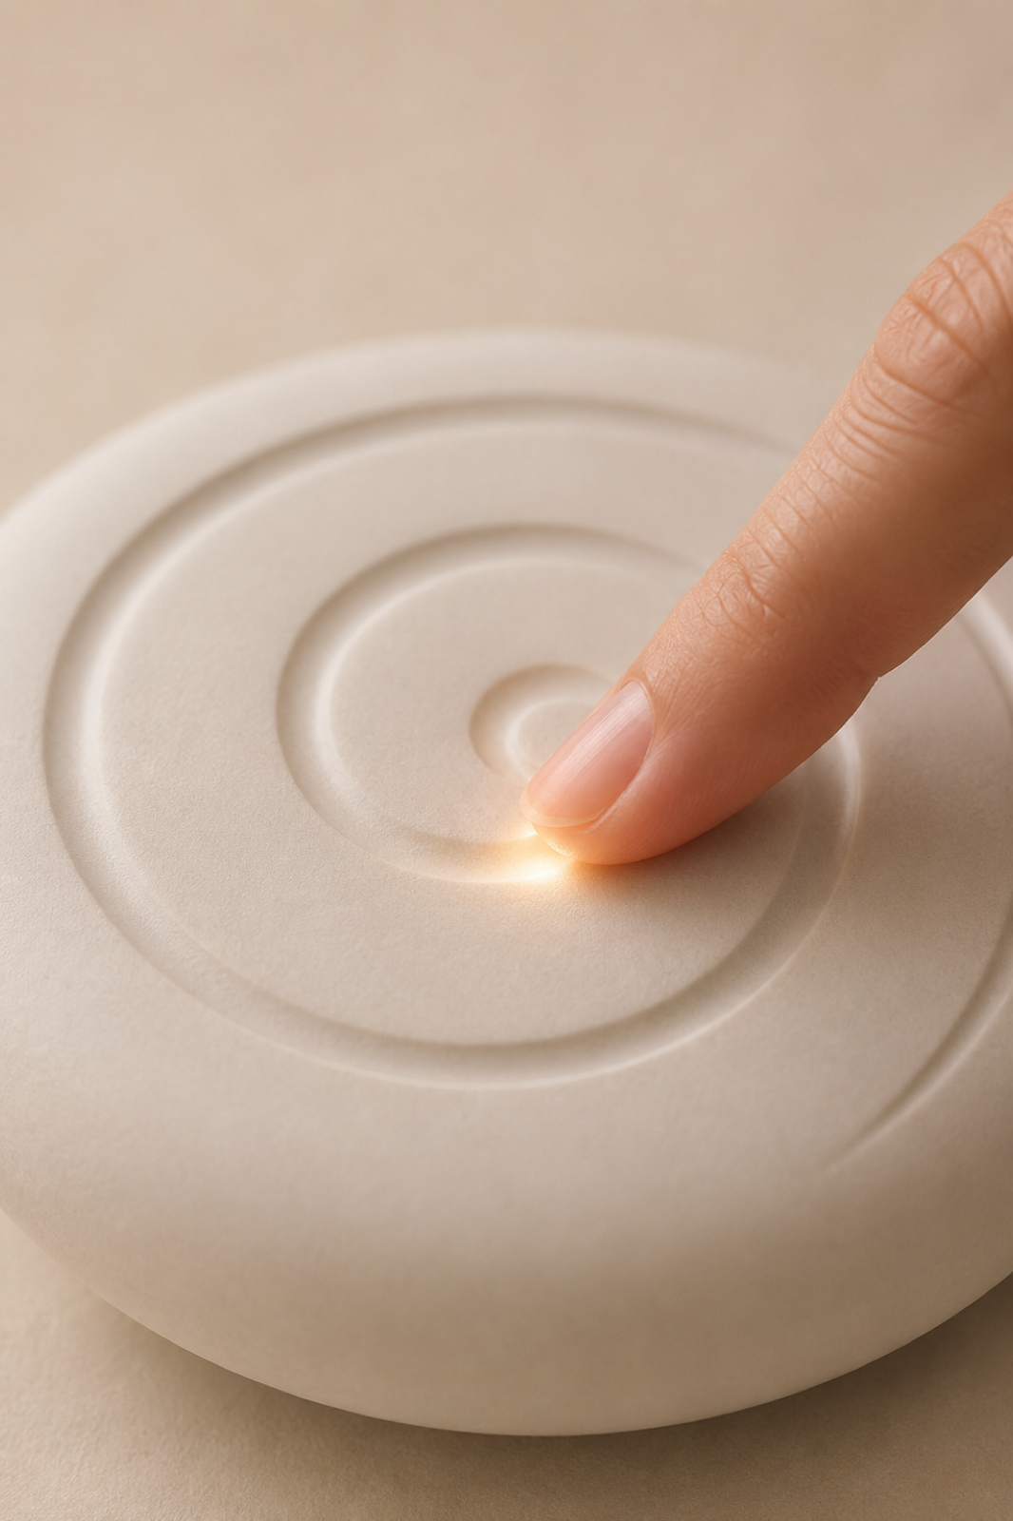
THE INTERACTION
One gesture. Trace, and slow down.
Your finger follows a warm light inward as you breathe in, outward as you breathe out.
The groove limits your speed, so you can't rush.
Keep pace and the path glows warmer — a quiet “you've got it.”
Notes:
So the interaction is one gesture. Your finger falls into a single spiral groove and follows the light. The groove limits how fast you can move, so you slow down whether you mean to or not. And when you keep pace, the path glows warmer — a quiet 'you've got it.'

Slide 7
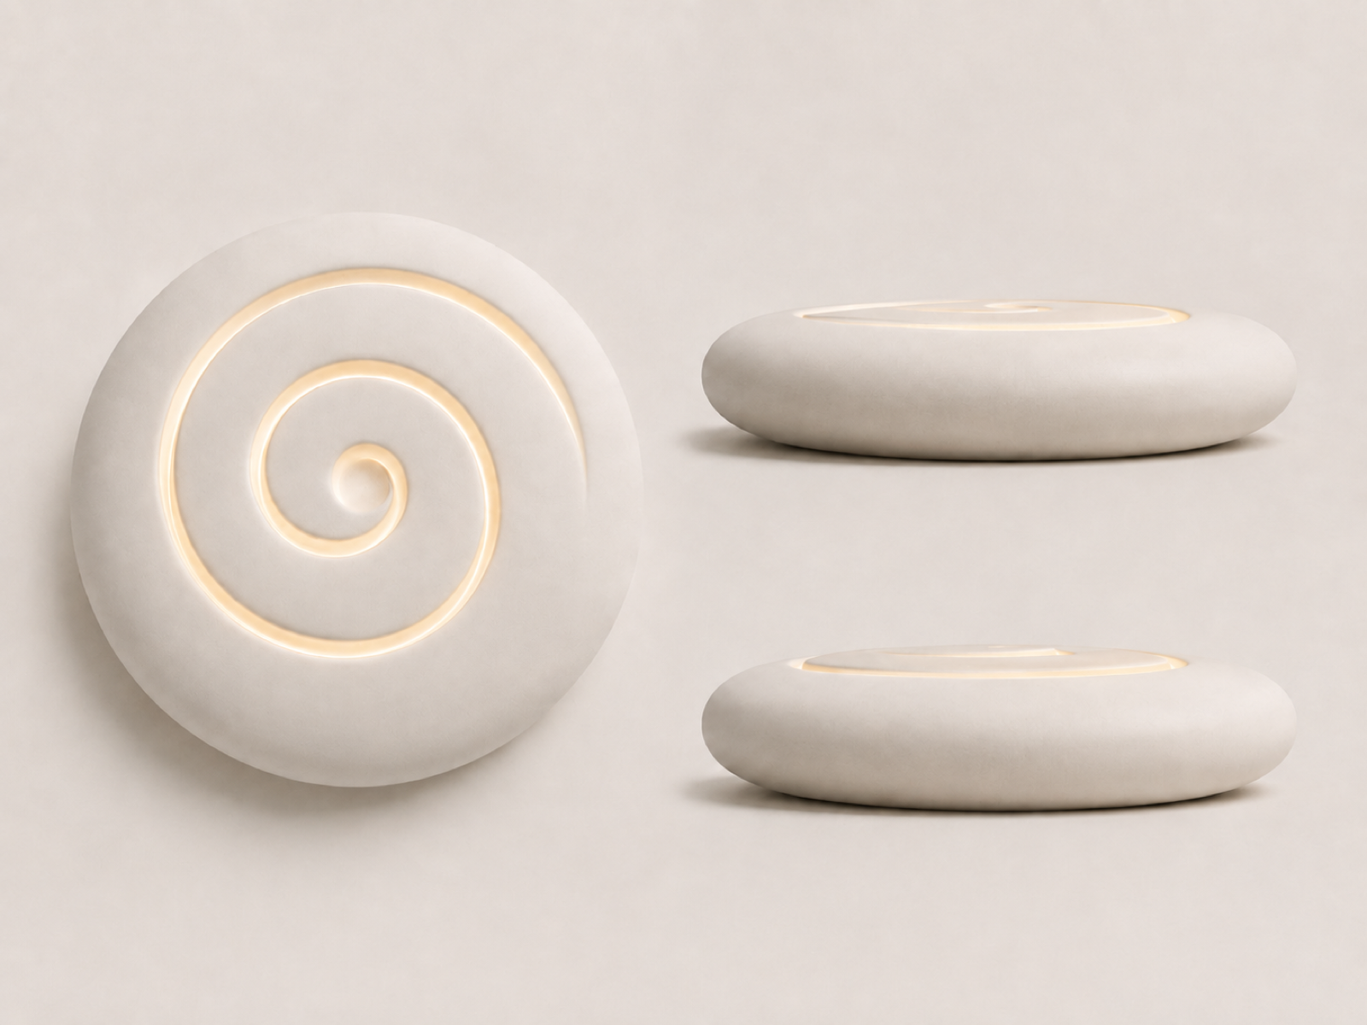
FORM
A soft pebble, not a device.
Ø140 × 24 mm smooth white-ceramic saucer.
Rounded everywhere — no sharp corner.
One spiral groove flowing into a center dish.
Lift-to-wake, no visible buttons.
Notes:
Form-wise, I wanted a soft pebble, not a device. A smooth white-ceramic saucer, palm-sized, rounded everywhere — no sharp edges. One spiral groove flowing into a little dish in the center. And no buttons on show — you just lift it to wake it.

Slide 8
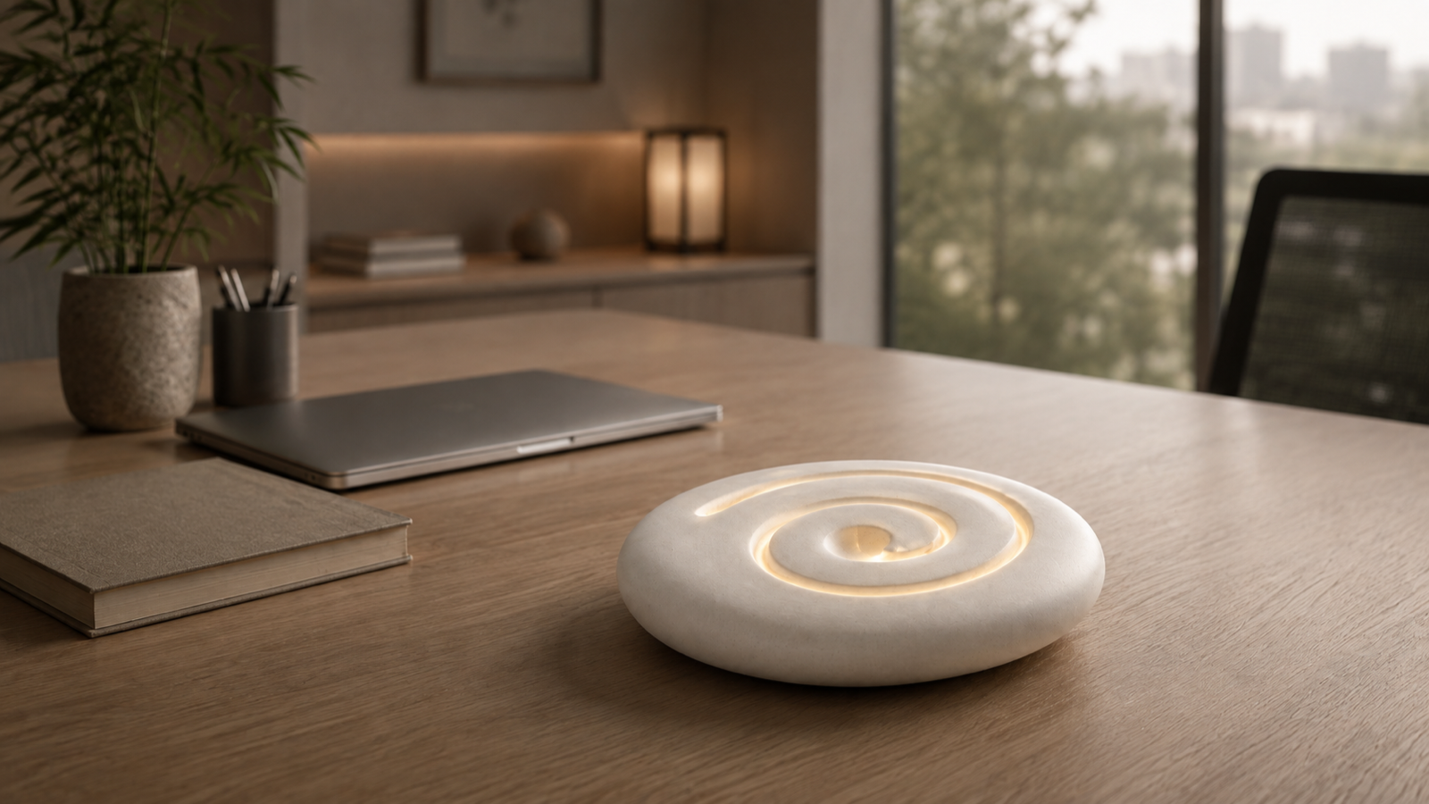
IN CONTEXT
It lives on the desk like a quiet invitation.
Notes:
This is it on a desk. It doesn't read as tech — it reads as a quiet object you'd want to keep there. That was the point: it invites you in without demanding anything.

Slide 9
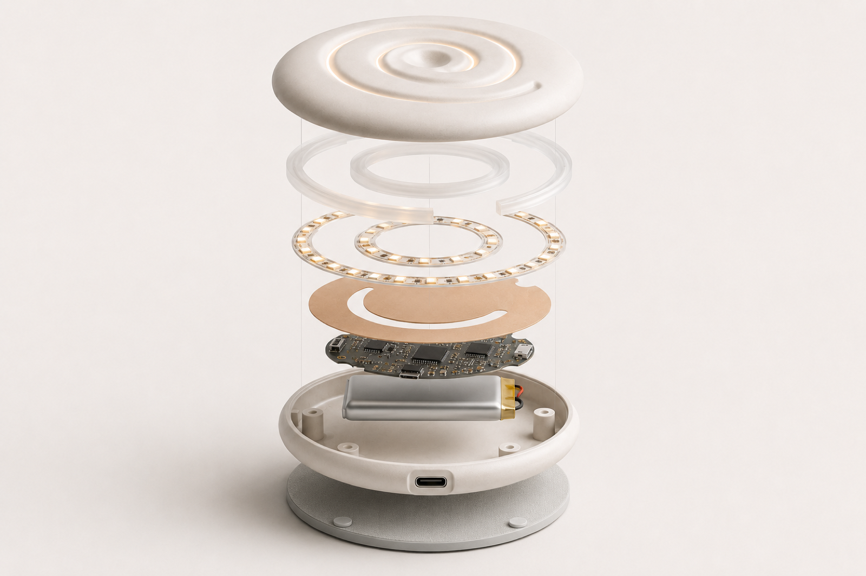
LIGHT & BUILD
The calm is engineered.
LEDs feed a diffuser in the groove floor — light lives inside the channel, no visible bulbs.
A soft point travels the groove to set the breath; warm amber, never a cold notification.
Warming layer + weighted base; USB-C, lift-to-wake.
Notes:
Under the calm, it is engineered. A ring of LEDs feeds a diffuser in the floor of the groove, so the light looks like it lives inside the channel — you never see a bulb. A soft point travels the groove to pace your breath, in warm amber, never a cold notification. Plus a gentle warming layer and a weighted base.

Slide 10
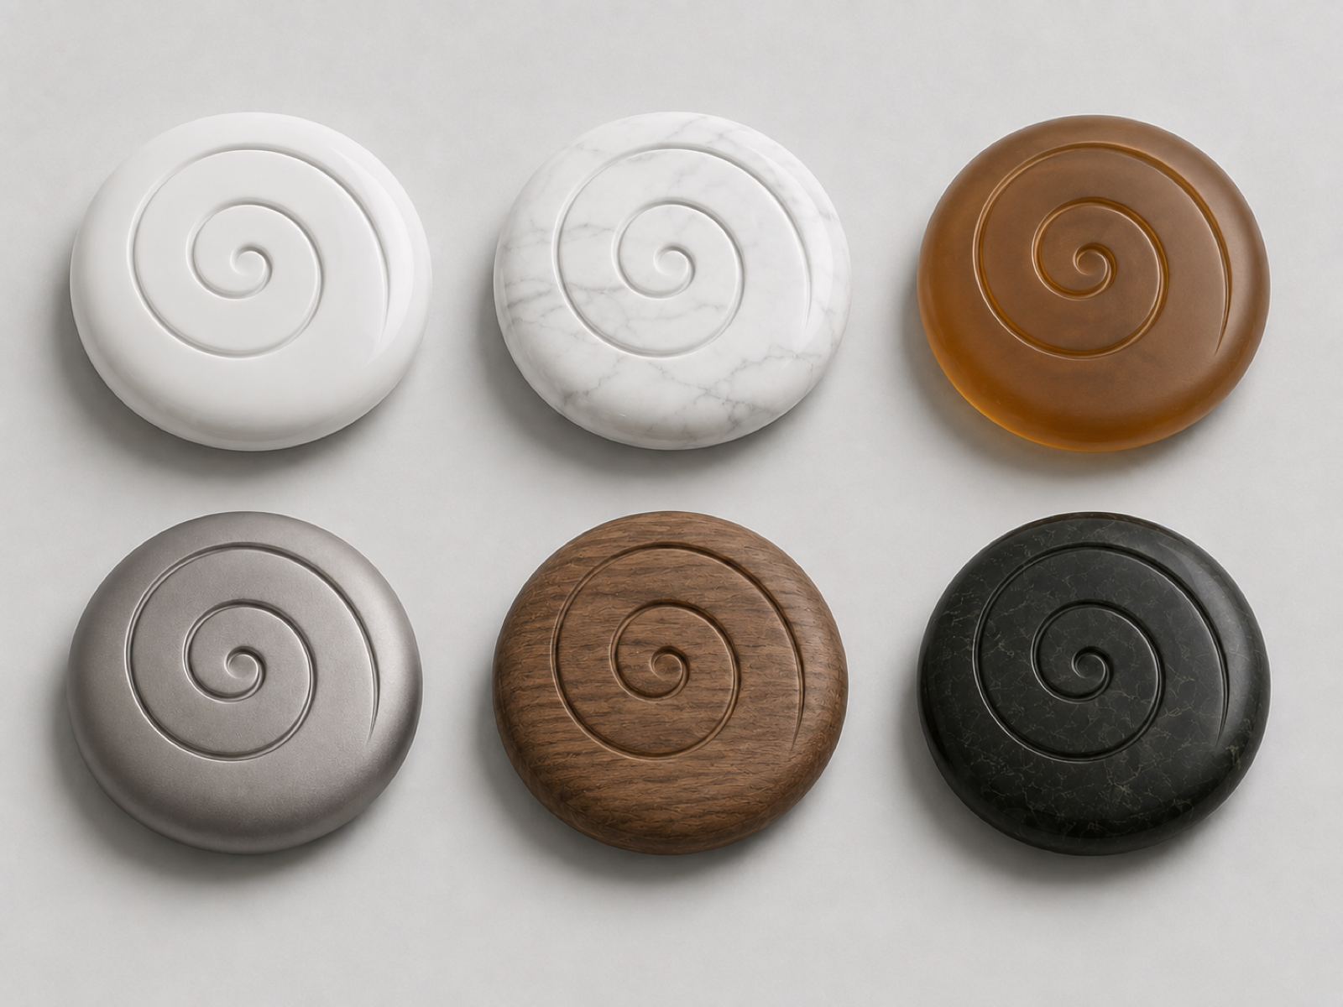
MATERIALS
One ritual, made for any desk.
Notes:
One ritual, but it can suit any desk — ceramic, marble, amber resin, aluminium, walnut, dark stone. Same object, different personalities.

Slide 11
THE TAKEAWAY
We didn't design a disc. We designed three quiet minutes.
Next: a physical prototype with a real engraved groove and warm light band,
HRV validation of the calm effect, and a short field study to see if it survives the novelty-fade.
Notes:
So to wrap up — I didn't really design a disc. I designed three quiet minutes. Next would be a physical prototype with the real engraved groove and light, and validating the calming effect with heart-rate data. But the core idea is here: something small and beautiful that gives a busy person permission to breathe. Thanks — happy to take questions.

