Slide 1
Python For Kids
Lesson 03 – Play with Number and Variables in Math

Slide 2
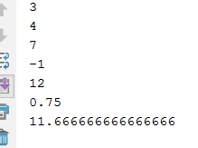
Variables—Example: Just like in your math class
x = 3
y = 4
answerPlus = x+y
answerMinus = x-y
answerMutipl = x*y
answerDivid = x/y
answerWhatEver = (x*y)+(x-y)/x
print(x)
print(y)
print(answerPlus)
print(answerMinus)
print(answerMutipl)
print(answerDivid)
print(answerWhatEver)

Slide 3

Variables—Assign a Number to a variable and print it
x=3
print(x)
print ("x="+x) # not work, will get error
print ("x="+str(x))
We'll explain the expression str(a) later in the course

Slide 4

Variables—Assign more Numbers to more variables
x = 3
y = x+2
# this call chain assignment
a = b = x*(y+x)
print("a = " + str(a))
print("b = " + str(b))

Slide 5
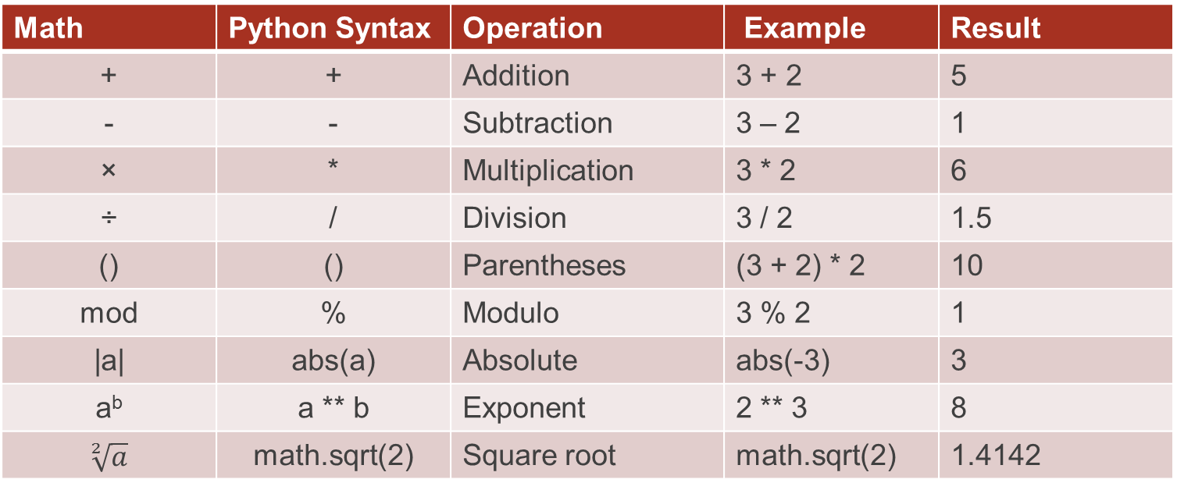
Basic Math Operators in Python
Math | Python Syntax | Operation | Example | Result
+ | + | Addition | 3 + 2 | 5
- | - | Subtraction | 3 – 2 | 1
× | * | Multiplication | 3 * 2 | 6
÷ | / | Division | 3 / 2 | 1.5
() | () | Parentheses | (3 + 2) * 2 | 10
mod | % | Modulo | 3 % 2 | 1
|a| | abs(a) | Absolute | abs(-3) | 3
a^{b} | a ** b | Exponent | 2 ** 3 | 8
$$\sqrt[2]{a}$$ | math.sqrt(2) | Square root | math.sqrt(2) | 1.4142

Slide 6
Do some excise: try it your self
Use python get the answer of below math
  3 + 8 × 9 ÷ 7 × ( 5 +6 )
Update your previous turtle drawing project, using some math to change the graphic.

Slide 7
Advance Learning: Number Types: Integer and float number
number = 9
print(type(number)) # print type of variable "number"
float_number = 9.0
print(type(float_number))
<class 'int'>
<class 'float'>

Slide 8
Advance Leaning: Number Types conversion
number = 9
print(type(number)) # print type of variable "number"
print(number)
print(float(number))
<class 'int'>
9
9.0

Slide 9
Advanced learning: Number Augmented assignment
number = 9.0
print("number = " + str(number))
number -= 2
print("number = " + str(number))
number += 5
print("number = " + str(number))
number = 9.0
number = 7.0
number = 12.0
a -= 2
a = a - 2
a *= 2
a = a * 2

Slide 10
Advanced learning: Boolean operators
two = 2
three = 3
is_equal = (two == three)
print(is_equal)
False
2 == 2
True
2 < 2
False
2 > 2
False
2 != 2
False

