Slide 1
3- Scratch -Animation
Teacher: Wei Sun

Slide 2
3.1 Build A Band
Check the print out 3.1BuildABand.pdf
Events: When this sprite clicked
Loops: the sound repeat-> repeat
Parallelism: different instrument can play same time to make a band

Slide 3
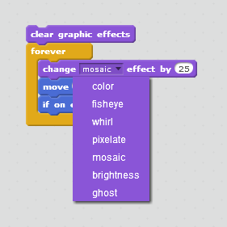
3.2 Orange Square, Purple Circle
Draw your own sprite
Bitmap
Vector
Try different effect
Control:
if on<something>
<doSomething>

Slide 4
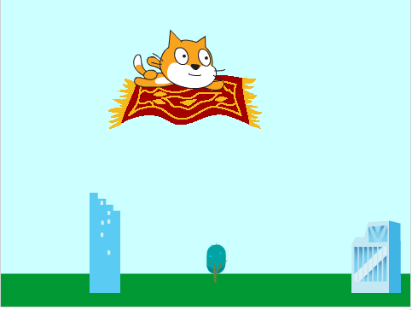
3.3 it’s alive
Costumes
Loop “next”
Add more move
Flip?
Show fly.sb2
show bird.sb2

Slide 5
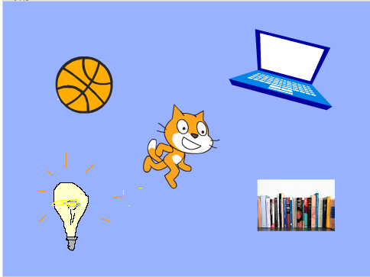
3.4 Music Video
Load a music
Get some fun move!
Show Music video change from about me.
Completed your Music Video as your home work

