Slide 1
3- Scratch -Stories
Teacher: Wei Sun

Slide 2
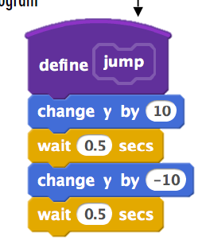
4.1 Characters
Define Jump
Press S for a small jump
Press B for a big jump
Press A to ask how high to jump

Slide 3
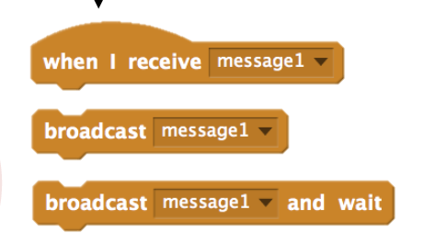
4.2 conversation
Use time to show character dialog
Use broadcast message and received message to make the dialog going.

Slide 4
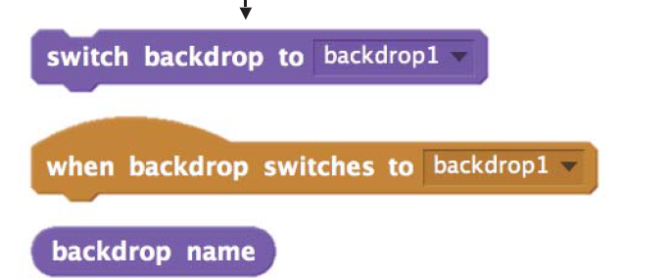
4.3 Scenes
Chose from library, paint or upload a backdrops in to project
Switch backdrops in your project when some event happen
When backdrop switched…

Slide 5
4.4 Story project and Pass On
Work on a story project that focuses on characters, scenes and with dialog between charters
Utilize the skill you learned before
Pass your project to your team mate and let hem/her add more on the story.

