Slide 1
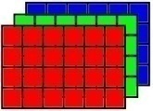
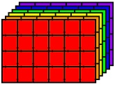

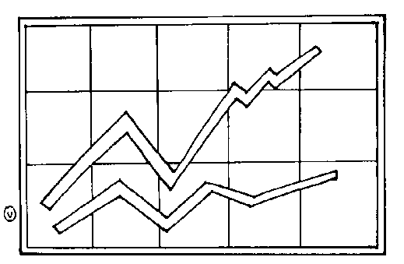
Demosaic
Module
Image
Acquisition
Module
Denoise
Module
Multispectral
Scene
Joint
Demosaic-
Denoise
Image-Noise
Evaluation
Module
Data
Analysis
Module

Slide 2

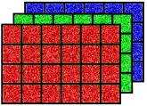

Noise
Color
Filter
Image
Sensor
Multispectral
Scene
RGB Image
RAW Image
Noisy
RGB Image
Noisy
RAW Image

Slide 3
Noise
RGB Image
CFA Image
Noisy
RGB Image
Noisy
CFA Image

Slide 4
Demosaic
Denoise
Noisy
RAW Image
RGB Image
RGB Image
Denoise
Demosaic
Noisy
RAW Image
CFA Image
RGB Image
Joint
Demosaic-Denoise
Noisy
RAW Image
RGB Image
RGB Image
RAW Image

Slide 5
Demosaic
Clean
CFA Image
RGB Image
True
RGB Image
Demosaic
Noisy
CFA Image
RGB Image
Denoise
True
RGB Image
RGB Image
RGB Image
Denoise
True
RAW Image
Noisy
RAW Image
RAW Image
RAW Image

Slide 6
Demosaic
Denoise
Noisy
RAW Image
RGB Image
RGB Image
AWGN Noise
RGB Image
Noisy
RGB Image
RGB Image
Color-correlated Noise
RGB Image
Noisy
RGB Image
RGB Image

Slide 7
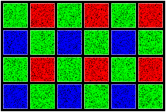
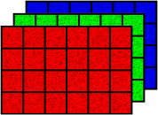
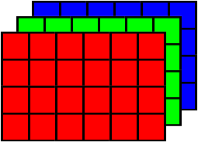
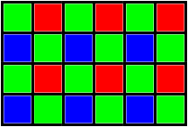
Demosaic
Denoise
Noisy
CFA Image
Noisy RGB Image
Denoised
RGB Image
Denoise
Demosaic
Noisy
CFA Image
Denoised CFA Image
Denoised
RGB Image

Slide 8
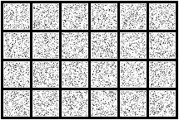
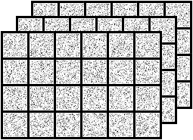
Noise
True RGB
Image
CFA
Image
Total Error
Demosaic
Decompose
True RGB
Image
CFA
Image
Demosaic Component
Demosaic
Decompose
Noise Component

Slide 9
True RGB Image
Noisy RGB Image
Denoised RGB Image
Denoise
Noise
Independent
Color-Correlated
Noisy
CFA Image
Noisy RGB Image
Denoised RGB Image
Demosaic
Denoise

Slide 10
True RGB Image
Denoised RGB Image
Denoise
Noise
Independent
Color-Correlated

Slide 11
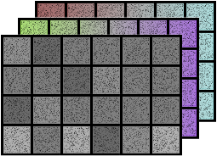
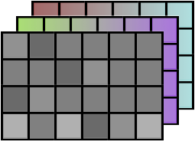
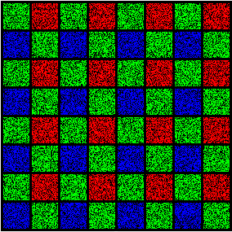
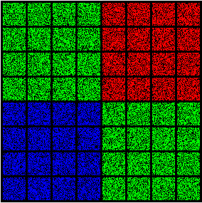
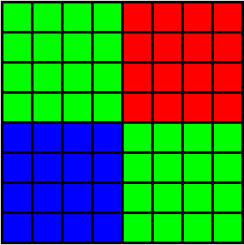
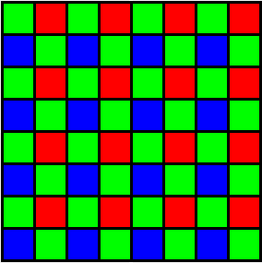
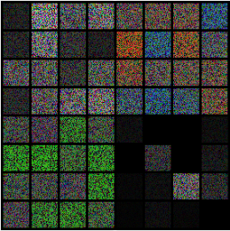
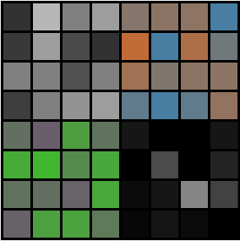
Inverse Color Transform
Color Transform
Gray Scale Denoiser
Noisy
RGB Image
Noisy
YCbCr Image
Denoised YCbCr Image
Denoised RGB Image
Rearrange
Rearrange
Noisy CFA Image
Color Transform
Inverse Color Transform
Denoised CFA Image
Gray Scale Denoiser

Slide 12
Image Capturing System
Image Display System
True RGB
Image
Image Sensor
Display
Color Filter Array
Demosaic
Compression
Decompression
Transmission
or Storage

Slide 13
Image Capturing System
Image Display System
True RGB
Image
Image Sensor
Display
Color Filter Array
Demosaic
Compression
Decompression
Transmission
or Storage

Slide 14
Demosaic
Error
Component
Compression
Decompression
Demosaic

Slide 15
Compression
Decompression
Error
Component

Slide 16
Lossy Compression
(e.g. JPEG)
Compressed
Image
Lossy Compression
(e.g. JPEG)
Compressed
Image
Rearrage
Color Space Conversion
Lossy Compression
(e.g. JPEG)
Compressed
Image

