Slide 1



A Simulation TOol for Neural Network Engines
José L. Abellán, PhD
jlabellan@um.es
University of Murcia

Slide 2
Agenda
Time (PT) | Topic | Presenter
1:40 – 2:00 | Flexible Accelerators | José L. Abellán
2:00 – 2:20 | Cycle accurate simulation and Overview of STONNE | José L. Abellán
2:20 – 3:20 | (Hands-on) STONNE | Francisco Muñoz-Martínez
3:20 – 3:40 | Coffee Break
3:40 – 4:10 | (Hands-on) SST-STONNE | Francisco Muñoz-Martínez
4:10 – 4:40 | (Hands-on) OMEGA | Raveesh Garg
4:40 – 5:00 | Roadmap and Concluding Remarks | Tushar Krishna
https://stonne-simulator.github.io/ASPLOSTUT.html

Slide 3
Outline
Motivation
STONNE Framework
Validation
Uses Cases of STONNE
Conclusions

Slide 4
Outline
Motivation
STONNE Framework
Validation
Uses Cases of STONNE
Conclusions

Slide 5
Cycle-level Architectural Simulation
Chip-Designing Process
Architectural Simulation
Architectural Design Ideas
2
Architectural Design Ideas
RTL Design
High-level Lang. Design (e.g., C++)
1
Physical Design
Simulator Implementation
Verification
SW Testing
Manufacture
Accurate Architectural Design Prototyping!

Slide 6
Cycle-level Architectural Simulators
Microarchitectural simulators have been extensively used during the design process of CPUs (Gem5) and GPUs (MGPUSim)
However, how can we simulate the wide diversity of DNN accelerators (i.e., rigid, flexible and data-dependent optimizations)?
We need cycle-level simulation.
We need to support flexible (dense and sparse) and rigid accelerators.
We need to perform end-to-end simulation.

Slide 7
Cycle-level Architectural Simulators
Microarchitectural simulators have been extensively used during the design process of CPUs (Gem5) and GPUs (MGPUSim)
However, how can we simulate the wide diversity of DNN accelerators (i.e., rigid, flexible and data-dependent optimizations)?
We need cycle-level simulation.
We need to support flexible (dense and sparse) and rigid accelerators.
We need to perform end-to-end simulation.
STONNE (A Simulation Tool for Neural Network Engines)

Slide 8
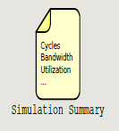
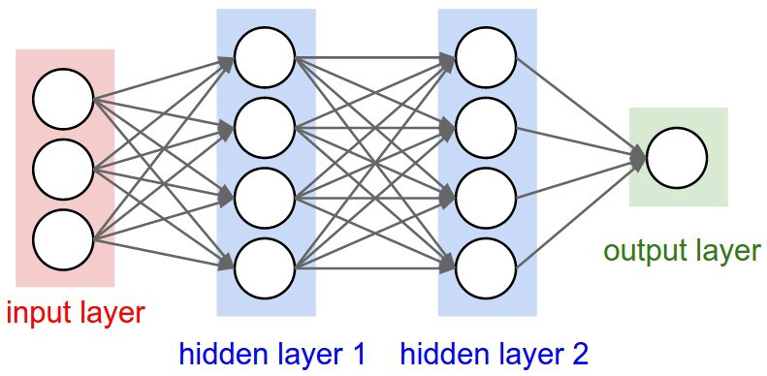



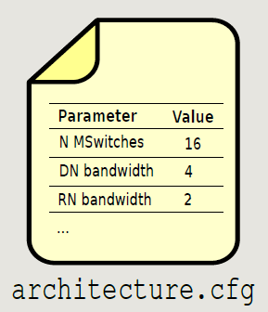


Cycle-level Architectural Simulators
Microarchitectural simulators have been extensively used during the design process of CPUs (Gem5) and GPUs (MGPUSim)
However, how can we simulate the wide diversity of DNN accelerators (i.e., rigid, flexible and data-dependent optimizations)?
We need cycle-level simulation.
We need to support flexible (dense and sparse) and rigid accelerators.
We need to perform end-to-end simulation.
AREA
DOG (0.9), CAT (0.09), BIRD (0.01)

Slide 9
Why another simulator for DNN accelerators?

Slide 10
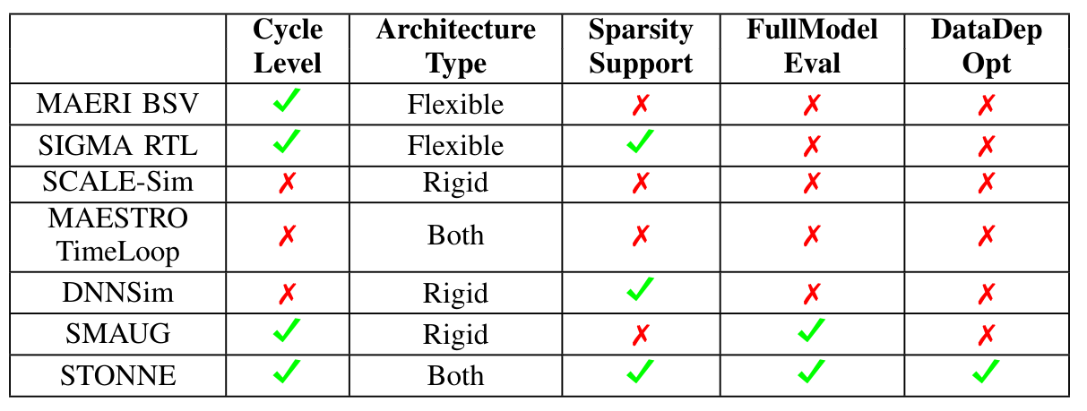
Why another simulator for DNN accelerators?
F. Muñoz-Martínez, J. L. Abellán, M. E. Acacio and T. Krishna, "STONNE: Enabling Cycle-Level Microarchitectural Simulation for DNN Inference Accelerators”. Proc. of IISWC 2021.​
State-of-the-art Simulators for DNN Accelerators

Slide 11
Why another simulator for DNN accelerators?
F. Muñoz-Martínez, J. L. Abellán, M. E. Acacio and T. Krishna, "STONNE: Enabling Cycle-Level Microarchitectural Simulation for DNN Inference Accelerators”. Proc. of IISWC 2021.​
RTL implementations are
slow to modify
State-of-the-art Simulators for DNN Accelerators

Slide 12
Why another simulator for DNN accelerators?
F. Muñoz-Martínez, J. L. Abellán, M. E. Acacio and T. Krishna, "STONNE: Enabling Cycle-Level Microarchitectural Simulation for DNN Inference Accelerators”. Proc. of IISWC 2021.​
Analytical models are not accurate for complex designs
State-of-the-art Simulators for DNN Accelerators

Slide 13
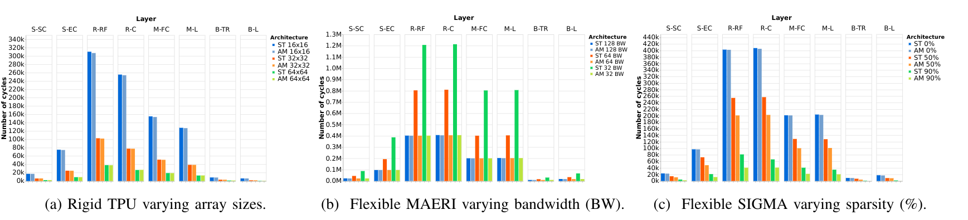
Why another simulator for DNN accelerators?
F. Muñoz-Martínez, J. L. Abellán, M. E. Acacio and T. Krishna, "STONNE: Enabling Cycle-Level Microarchitectural Simulation for DNN Inference Accelerators”. Proc. of IISWC 2021.​
Cycle-level simulation is required to faithfully model complex DNN architectures

Slide 14
Outline
Motivation
STONNE Framework
Validation
Uses Cases of STONNE
Conclusions

Slide 15
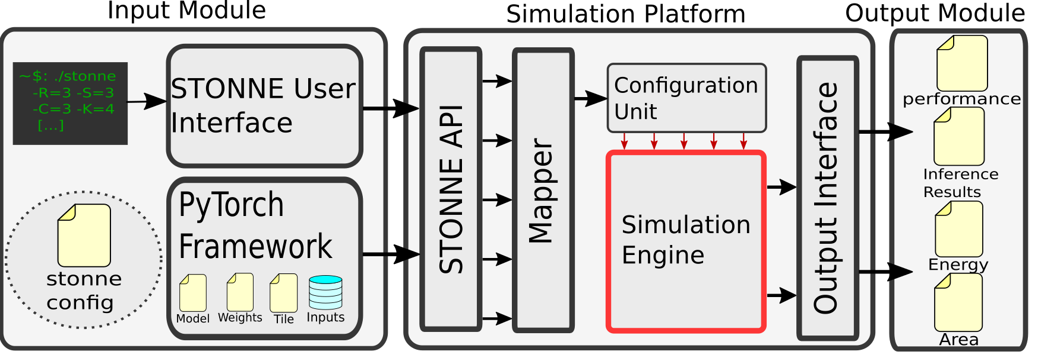
STONNE Framework
STONNE is a cycle-level microarchitectural simulator written in C++ for DNN inference accelerators.
Open-Sourced under the MIT License:
https://github.com/stonne-simulator/stonne
STONNE is composed of 3 main building blocks:

Slide 16
Input Module
STONNE is a cycle-level microarchitectural simulator written in C++ for DNN inference accelerators.
Open-Sourced under the MIT License:
https://github.com/stonne-simulator/stonne
STONNE is composed of 3 main building blocks:

Slide 17
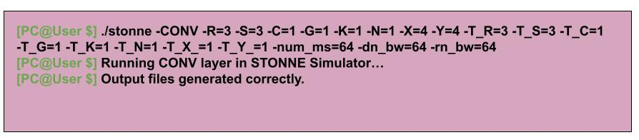
Input Module
STONNE User Interface: A command line that the user can use to run an instance of the simulator with random input values.

Slide 18
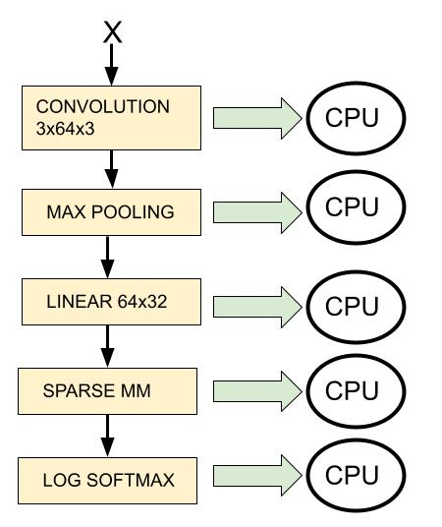
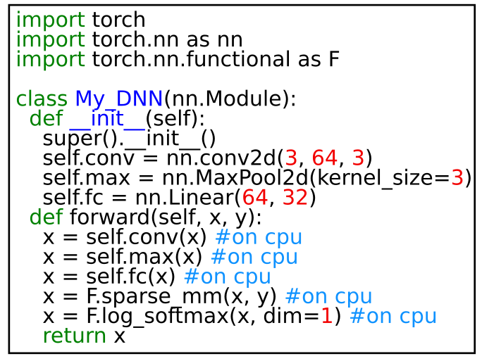
Input Module
PyTorch Framework: We integrate Pytorch with STONNE so that instances of operations are off-loaded to the simulator.

Slide 19
Input Module
PyTorch Framework: We integrate Pytorch with STONNE so that instances of operations are off-loaded to the simulator.

Slide 20
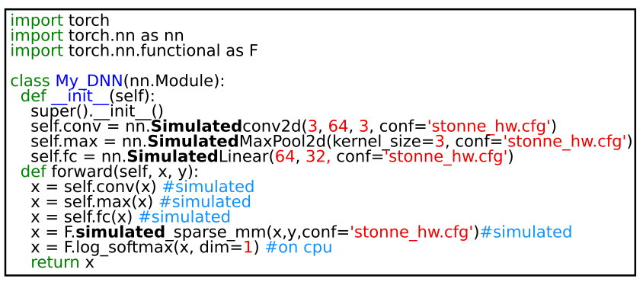
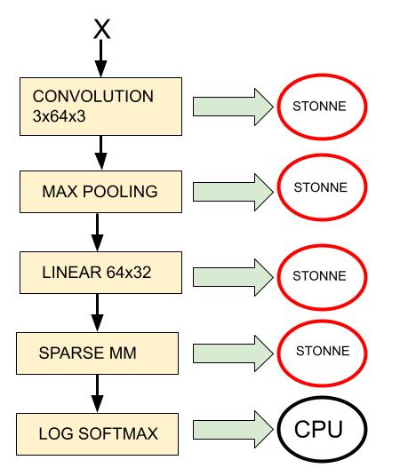
Input Module
PyTorch Framework: We integrate Pytorch with STONNE so that instances of operations are off-loaded to the simulator.

Slide 21
Output Module
STONNE is a cycle-level microarchitectural simulator written in C++ for DNN inference accelerators.
Open-Sourced under the MIT License:
https://github.com/stonne-simulator/stonne
STONNE is constituted by 3 main building blocks:

Slide 22
Output Module
This module reports simulation statistics such as performance, compute unit utilization, and activity counts of different components such as wires, FIFOs or SRAM usage.
"MSNetworkStats" : {
"MSwitchStats" : [
{
"Total_cycles" : 396168,
"Idle_cycles" : 1896,
"N_multiplications" : 394272,
"N_input_forwardings_send" : 0,
"N_input_forwardings_receive" : 392496,
"N_inputs_receive_from_memory" : 1776,
"N_weights_receive_from_memory" : 8,
"N_weight_fifo_flush" : 7,
"N_psums_receive" : 0,
"N_psum_forwarding_send" : 0,
"N_configurations" : 1
,"ActivationFifo" : {
"N_pops" : 1776,
"N_pushes" : 1776,
"N_fronts" : 0,
"Max_occupancy" : 1
…..
[MSNetwork]
MN_WIRE WRITE=392496 READ=0
MN_WIRE WRITE=392496 READ=0
MN_WIRE WRITE=0 READ=0
MN_WIRE WRITE=392496 READ=0
MN_WIRE WRITE=392496 READ=0
MN_WIRE WRITE=0 READ=0
MN_WIRE WRITE=392496 READ=0
MN_WIRE WRITE=392496 READ=0
MN_WIRE WRITE=0 READ=0
MN_WIRE WRITE=392496 READ=0
MN_WIRE WRITE=392496 READ=0
[GlobalBuffer]
GLOBALBUFFER READ=3582144 WRITE=3154176
….
Statistics.json
Statistics.counters

Slide 23
Output Module
AREA
This module reports simulation statistics such as performance, compute unit utilization, and activity counts of different components such as wires, FIFOs or SRAM usage.
Statistics.json
Energy
Table-Based Model
Energy
Statistics.counters
Area
Table-Based Model
Statistics.counters
Chip Area

Slide 24
Simulation Platform
STONNE is a cycle-level microarchitectural simulator written in C++ for DNN inference accelerators.
Open-Sourced under the MIT License:
https://github.com/stonne-simulator/stonne
STONNE is constituted by 3 main building blocks:

Slide 25
STONNE API, Mapper and Configuration Unit
The Mapper generates a set of signals based on the tile and layer parameters (i.e., it determines the required signals to configure the virtual neurons).
The Configuration Unit delivers the signals to the simulation engine, configuring the hardware.
Instruction | Description
CreateInstance | Creates an instance of STONNE
ConfigureCONV | Configures the accelerator to run a convolution operation
ConfigureLinear | Configures the accelerator to run a fully-connected layer
ConfigureDMM | Configures the accelerator to run a matrix multiplication
ConfigureSpMM | Configures the accelerator to run a sparse matrix multipl.
ConfigureMaxPool | Configures the accelerator to run a max pooling layer
ConfigureData | Configures weights, input and outputs addresses from the CPU to the accelerator memory
RunOperation | Launches the simulation according to the current configuration of the architecture

Slide 26
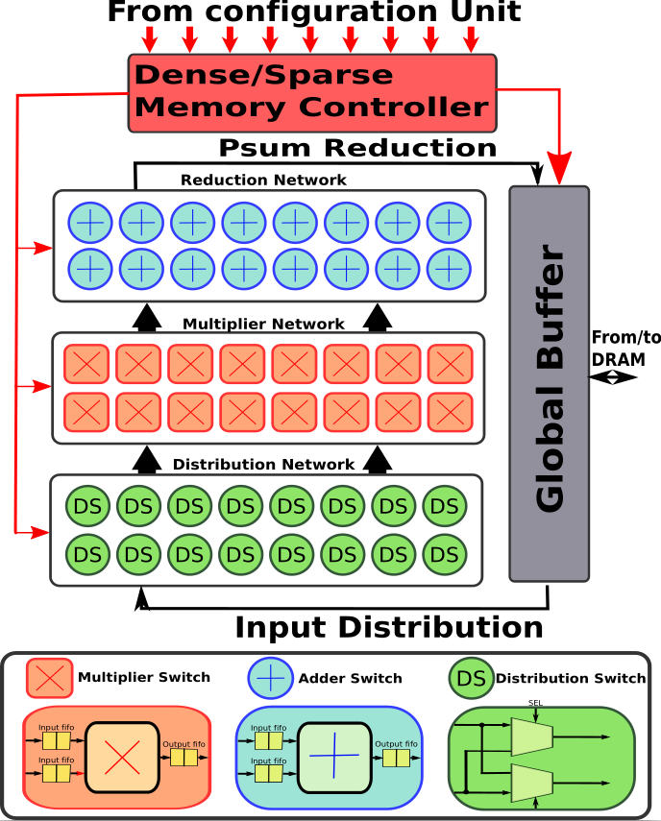
Simulation Engine
Most current DNN accelerator architectures can be logically organized as three configurable network fabrics:
Distribution Network
Multiplier Network
Reduction Network

Slide 27
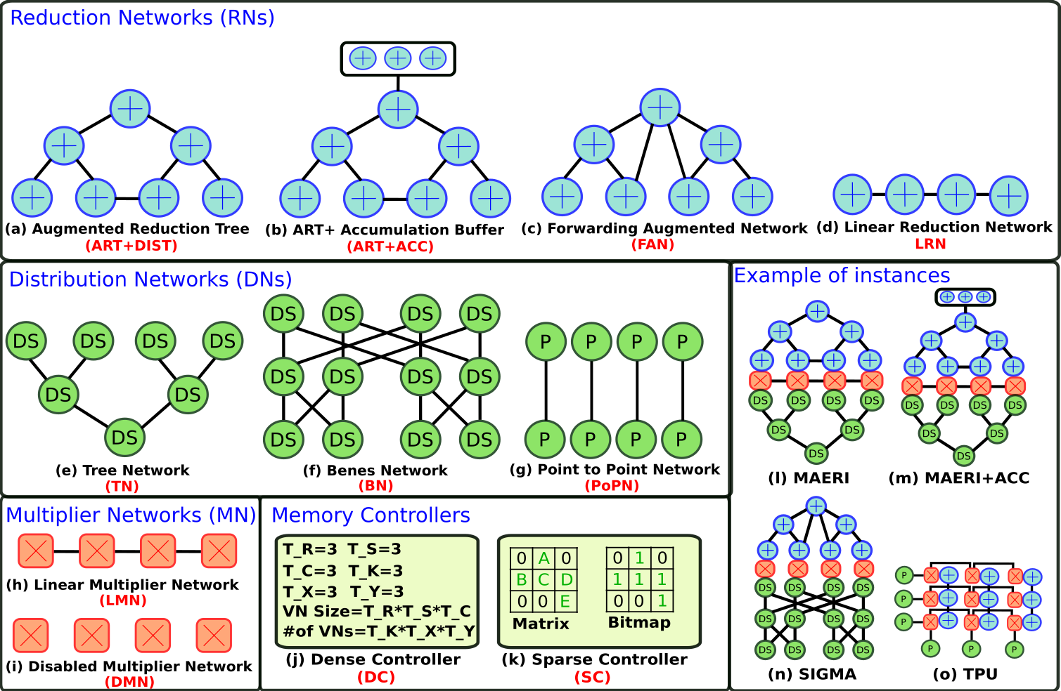
Simulation Engine

Slide 28
Simulation Engine

Slide 29
Simulation Engine

Slide 30
Simulation Engine

Slide 31
Outline
Motivation
STONNE Framework
Validation
Uses Cases of STONNE
Conclusions

Slide 32
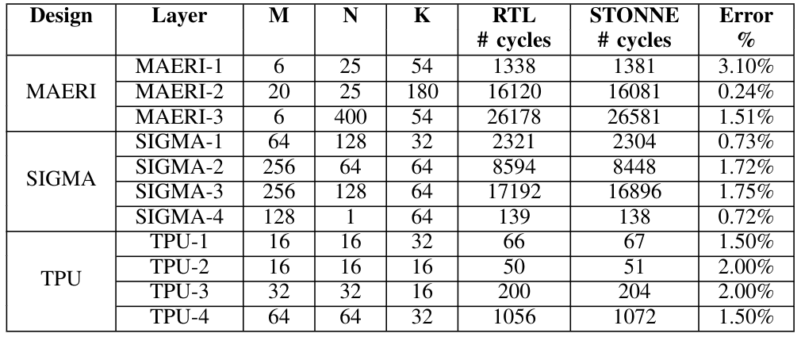
Validation
We have validated three state-of-the-art accelerators (i.e., MAERI, SIGMA and TPU) modeled with STONNE against their RTL implementations.
Max 3.10% of difference in terms of number of cycles (1.5% on average)

Slide 33
Outline
Motivation
STONNE Framework
Validation
Uses Cases of STONNE
Conclusions
F. Muñoz-Martínez, J. L. Abellán, M. E. Acacio and T. Krishna, "STONNE: Enabling Cycle-Level Microarchitectural Simulation for DNN Inference Accelerators”. Proc. of IISWC 2021.

Slide 34
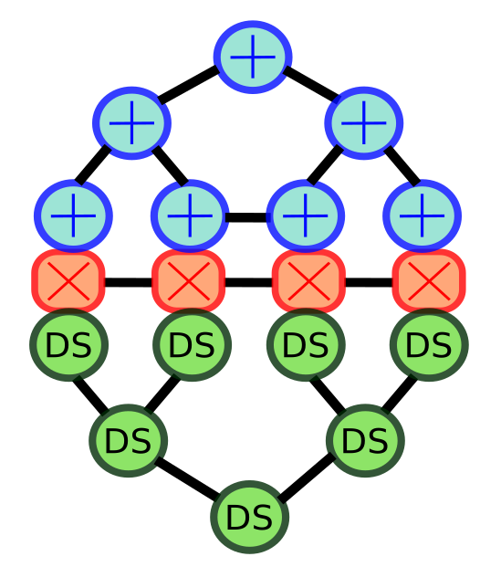
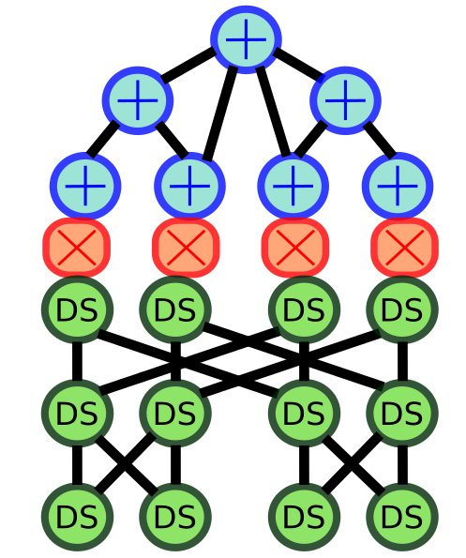
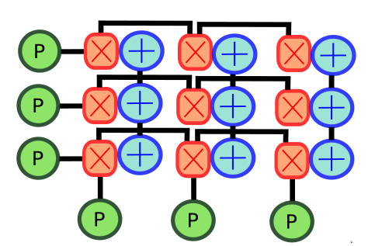
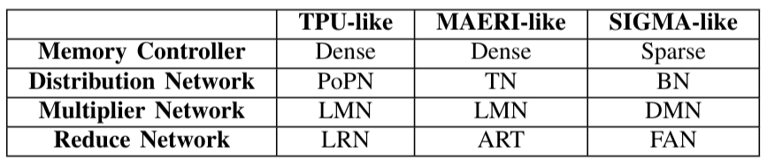
UC#1: DNN inference in TPU, MAERI and SIGMA
Aim: Demonstrate how STONNE can be used to conduct comprehensive evaluations of several DNN accelerators running complete DNN models
Simulated Accelerators: TPU, MAERI, SIGMA with 256 MSs and 128 elem/cycle BW
TPU-like
MAERI-like
SIGMA-like

Slide 35
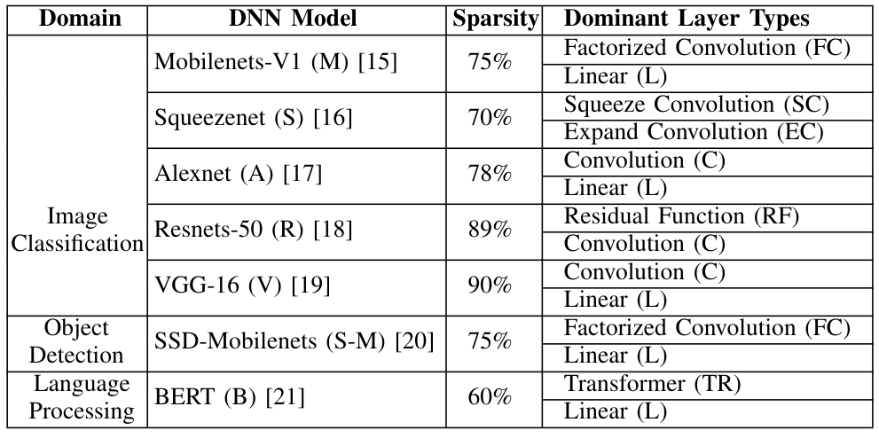
UC#1: DNN inference in TPU, MAERI and SIGMA
Benchmarks:

Slide 36
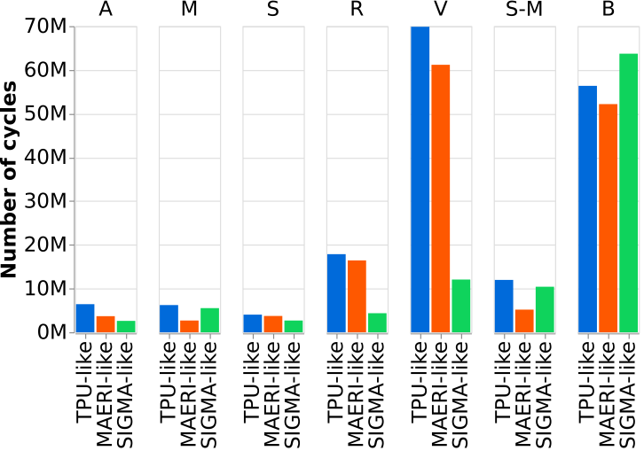
UC#1: DNN inference in TPU, MAERI and SIGMA
Results: Number of cycles

Slide 37
UC#1: DNN inference in TPU, MAERI and SIGMA
Results: Number of cycles
MAERI-like architecture 20% faster than the TPU-like architecture

Slide 38
UC#1: DNN inference in TPU, MAERI and SIGMA
Results: Number of cycles
MAERI-like architecture 20% faster than the TPU-like architecture
SIGMA-like architecture is 91% faster than a MAERI-like one

Slide 39
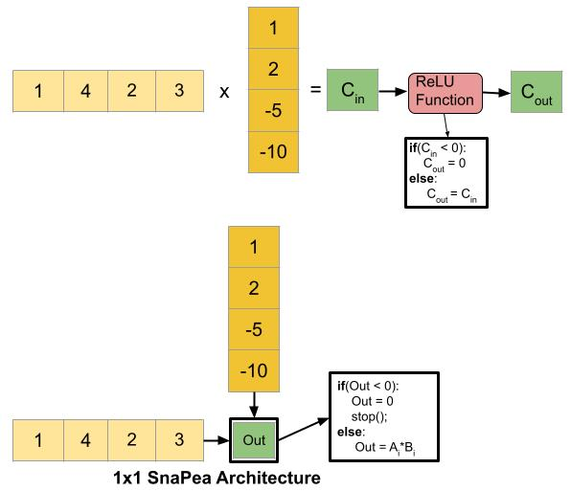
UC#2: Data-Dependent HW Optimizations
Aim: Prove how the back-end of STONNE can be easily extended to model data-dependent accelerators
Simulated Accelerator: SnaPea

Slide 40
UC#2: Data-Dependent HW Optimizations
Implementation:
TPU-like

Slide 41
UC#2: Data-Dependent HW Optimizations
Implementation:
Negative detection Logic
if(current_output < 0):
result = 0;
else:
continue();

Slide 42
UC#2: Data-Dependent HW Optimizations
Implementation:
Negative detection Logic
Order weights
if(current_output < 0):
result = 0;
else:
continue();
order_weights(weights)
off_load_simulation();

Slide 43
UC#2: Data-Dependent HW Optimizations
Parameters: 64 MSs and ASs, and 64 elements/cycle GB read/write BW
Benchmarks: Pure CNN models

Slide 44
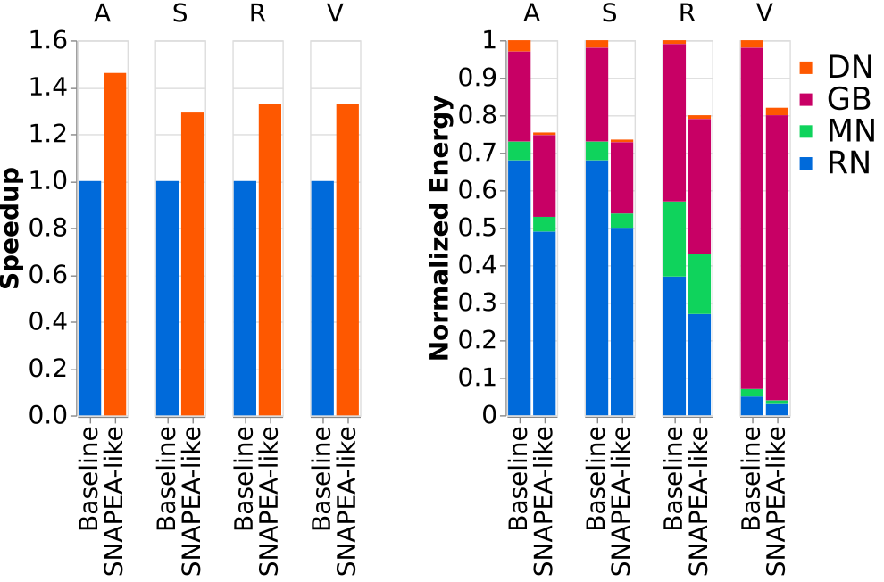
UC#2: Data-Dependent HW Optimizations
Results:

Slide 45
UC#2: Data-Dependent HW Optimizations
Results:
Average SpeedUp of 35%
Average Energy Savings of 21%

Slide 46
Outline
Motivation
STONNE Framework
Validation
Uses Cases of STONNE
Conclusions

Slide 47
Conclusions
As the complexity of the microarchitecture of DNN accelerators grows, the analytical models are not able to capture many important subtleties that simulation at cycle level does.
STONNE is an accurate cycle-level simulator for next-generation DNN accelerator architectures.
STONNE can model rigid, flexible and data-dependent accelerators performing actual computation.
https://github.com/stonne-simulator/stonne
F. Muñoz-Martínez, J. L. Abellán, M. E. Acacio and T. Krishna, "STONNE: Enabling Cycle-Level Microarchitectural Simulation for DNN Inference Accelerators”. Proc. of IISWC 2021.

Slide 48



Acknowledgements
Co-Design Center for Artificial Intelligence-Focused Architectures and Algorithms Funded By

Slide 49


A Simulation TOol for Neural Network Engines
José L. Abellán, PhD
jlabellan@ucam.edu
Universidad Católica de Murcia (UCAM)

Slide 50
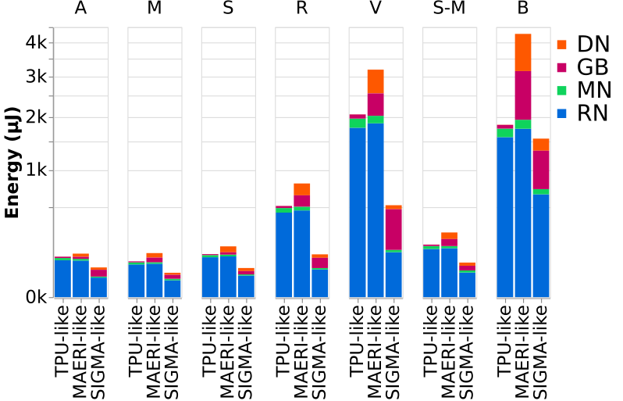
UC#1: DNN inference in TPU, MAERI and SIGMA
Results: Energy
SIGMA-like architecture is 70% and 54% more energy efficient than the MAERI-like and TPU-like architectures

Slide 51
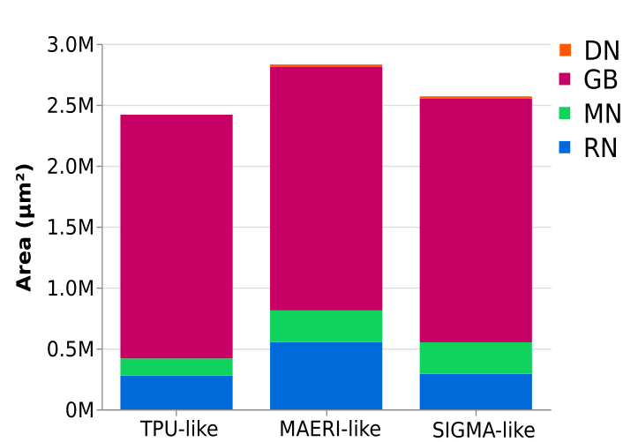
UC#1: DNN inference in TPU, MAERI and SIGMA
Results: Area
The differences in area are not as noticeable as those in the energy and runtime metrics.
Area dominated by the SRAM (i.e., GB): 70%, 77% and 82% of the total area of the MAERI-like, SIGMA-like and TPU-like architectures.

Slide 52
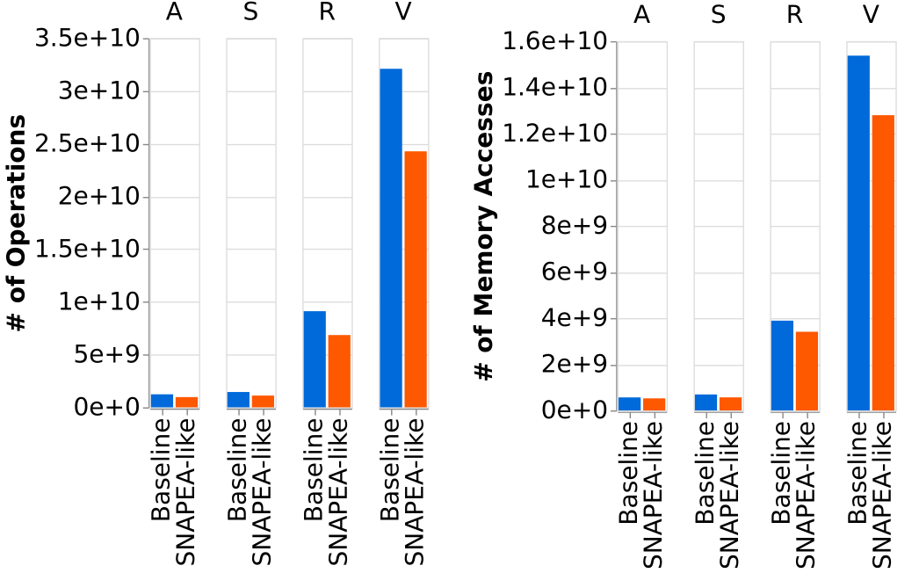
UC#2: Data-Dependent HW Optimizations
Results:

Slide 53
UC#2: Data-Dependent HW Optimizations
Results:
30% reduction of # of operations
16 % reduction of # of Memory Accesses

Slide 54
UC#3: Filter Scheduling in Sparse Accelerators
Aim: Demonstrate that precise, full-model evaluation is required to expose the particular values used during inference
Motivation and Idea: The way in which the filters of a sparse DNN model are scheduled onto a DNN inference accelerator might have significant impact on performance

Slide 55
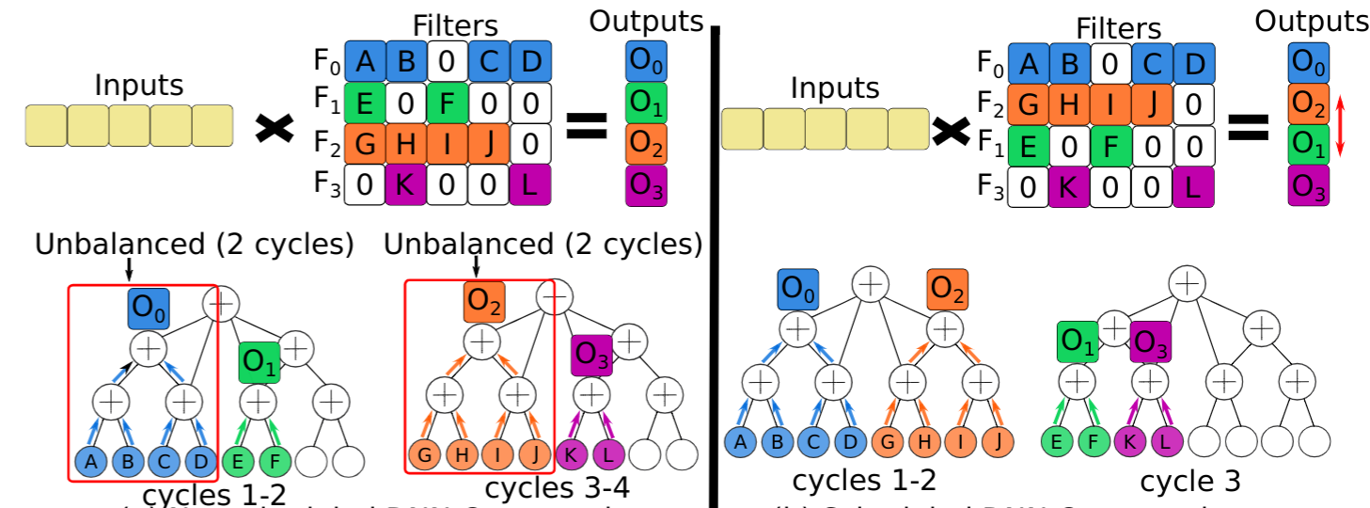
UC#3: Filter Scheduling in Sparse Accelerators
Aim: Demonstrate that precise, full-model evaluation is required to expose the particular values used during inference
Motivation and Idea: The way in which the filters of a sparse DNN model are scheduled onto a DNN inference accelerator might have significant impact on performance

Slide 56
UC#3: Filter Scheduling in Sparse Accelerators
Aim: Demonstrate that precise, full-model evaluation is required to expose the particular values used during inference
Motivation and Idea: The way in which the filters of a sparse DNN model are scheduled onto a DNN inference accelerator might have significant impact on performance

Slide 57
UC#3: Filter Scheduling in Sparse Accelerators
Aim: Demonstrate that precise, full-model evaluation is required to expose the particular values used during inference
Motivation and Idea: The way in which the filters of a sparse DNN model are scheduled onto a DNN inference accelerator might have significant impact on performance

Slide 58
UC#3: Filter Scheduling in Sparse Accelerators
Aim: Demonstrate that precise, full-model evaluation is required to expose the particular values used during inference
Motivation and Idea: The way in which the filters of a sparse DNN model are scheduled onto a DNN inference accelerator might have significant impact on performance

Slide 59
UC#3: Filter Scheduling in Sparse Accelerators
Aim: Demonstrate that precise, full-model evaluation is required to expose the particular values used during inference
Motivation and Idea: The way in which the filters of a sparse DNN model are scheduled onto a DNN inference accelerator might have significant impact on performance

Slide 60
UC#3: Filter Scheduling in Sparse Accelerators
Aim: Demonstrate that precise, full-model evaluation is required to expose the particular values used during inference
Motivation and Idea: The way in which the filters of a sparse DNN model are scheduled onto a DNN inference accelerator might have significant impact on performance

Slide 61
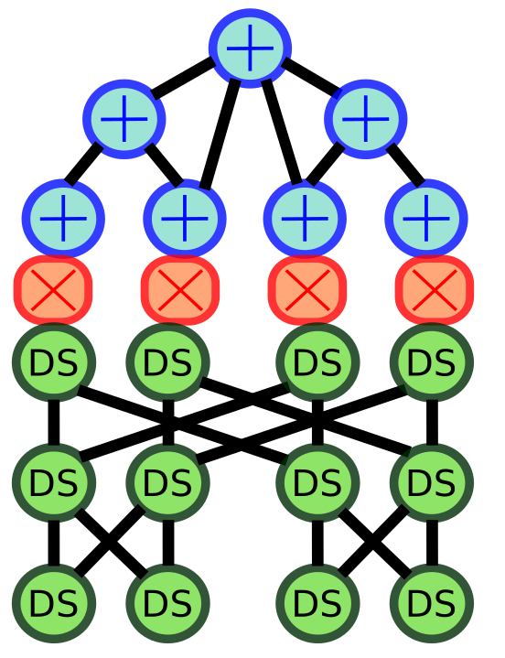
UC#3: Filter Scheduling in Sparse Accelerators
Implementation:
SIGMA-like

Slide 62
UC#3: Filter Scheduling in Sparse Accelerators
Implementation:
We do not require
modifications in the accelerator
SIGMA-like

Slide 63
UC#3: Filter Scheduling in Sparse Accelerators
Implementation:
We do not require
modifications in the accelerator
SIGMA-like

Slide 64
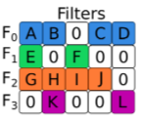
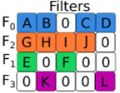
UC#3: Filter Scheduling in Sparse Accelerators
Implementation:
We do not require
modifications in the accelerator
Pre-simulation function to order the filters based on a certain heuristic
SIGMA-like

Slide 65
UC#3: Filter Scheduling in Sparse Accelerators
Implementation: We implement two heuristic algorithms:
Largest Filter First (LFF): The filters are reordered so that the sparse controller always selects the largest available filter.
Random (RDM): The filters are reordered randomly.
No Schedule (NS): The filters are selected as they are in the model.

Slide 66
UC#3: Filter Scheduling in Sparse Accelerators
Simulated Parameters: SIGMA-like architecture with 256 multipliers and adders and 128 elements/cycle Global Buffer(GB) read/write bandwidth.
Benchmarks:

Slide 67
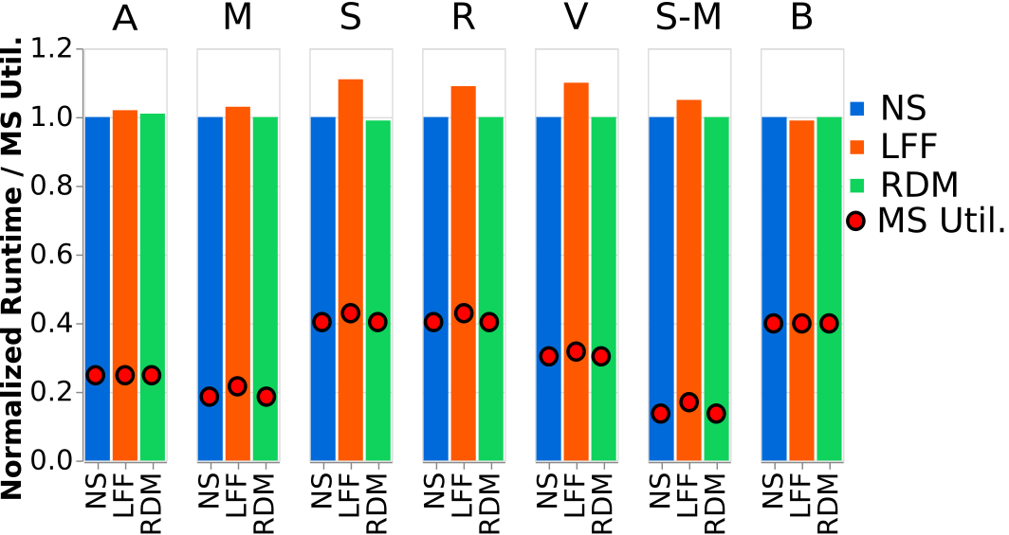
UC#3: Filter Scheduling in Sparse Accelerators
Results:

Slide 68
UC#3: Filter Scheduling in Sparse Accelerators
Results:
LFF obtains performance benefits
of up to 11% (7% on average).

Slide 69
UC#3: Filter Scheduling in Sparse Accelerators
Results:
LFF obtains performance benefits
of up to 11% (7% on average).
RDM does not translate into better performance.

Slide 70
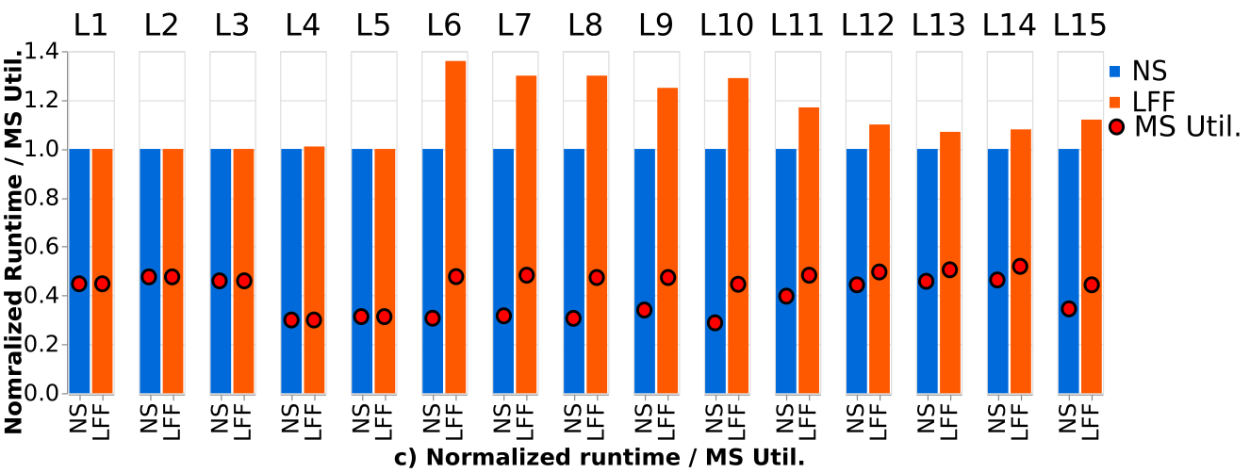
UC#3: Filter Scheduling in Sparse Accelerators
Results:

Slide 71
UC#3: Filter Scheduling in Sparse Accelerators
Results:
Low-Sensitive layers: Do not represent performance benefit at all

Slide 72
UC#3: Filter Scheduling in Sparse Accelerators
Results:
High-Sensitive layers: Up to 36% performance gain

Slide 73
UC#3: Filter Scheduling in Sparse Accelerators
Results:
Medium-Sensitive layers: Up to 17% performance gain

