Slide 1





Understanding the Design Space of Sparse/Dense Multiphase Dataflows for Mapping Graph Neural Networks on Spatial Accelerators
Raveesh Garg¹, Eric Qin¹, Francisco Muñoz-Martínez², Robert Guirado³, Akshay Jain⁴, Sergi Abadal³, José L. Abellán², Manuel E. Acacio², Eduard Alarcón³, Sivasankaran Rajamanickam⁶, Tushar Krishna¹
¹Georgia Tech, ²Universidad de Murcia, ³Universitat Politecnica de Catalunya,
⁴Neutroon, ⁶Sandia National Laboratories
*This work is accepted for publication to IPDPS 2022. Preprint- https://arxiv.org/abs/2103.07977
Notes:
Intro, title, collaboration b/w 6 unis
Transition: Deep Learning and graph representation

Slide 2
Agenda
Time (PT) | Topic | Presenter
1:40 – 2:00 | Flexible Accelerators | José L. Abellán
2:00 – 2:20 | Cycle accurate simulation and Overview of STONNE | José L. Abellán
2:20 – 3:20 | (Hands-on) STONNE | Francisco Muñoz-Martínez
3:20 – 3:40 | Coffee Break
3:40 – 4:10 | (Hands-on) SST-STONNE | Francisco Muñoz-Martínez
4:10 – 4:40 | (Hands-on) OMEGA | Raveesh Garg
4:40 – 5:00 | Roadmap and Concluding Remarks | Tushar Krishna
https://stonne-simulator.github.io/ASPLOSTUT.html

Slide 3
Outline
Graph Neural Networks (GNNs)
GNN Dataflows – Taxonomy and modeling
Hands-on exercises

Slide 4
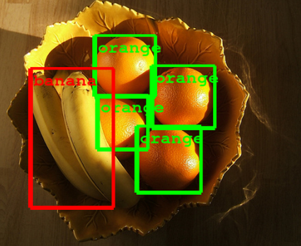

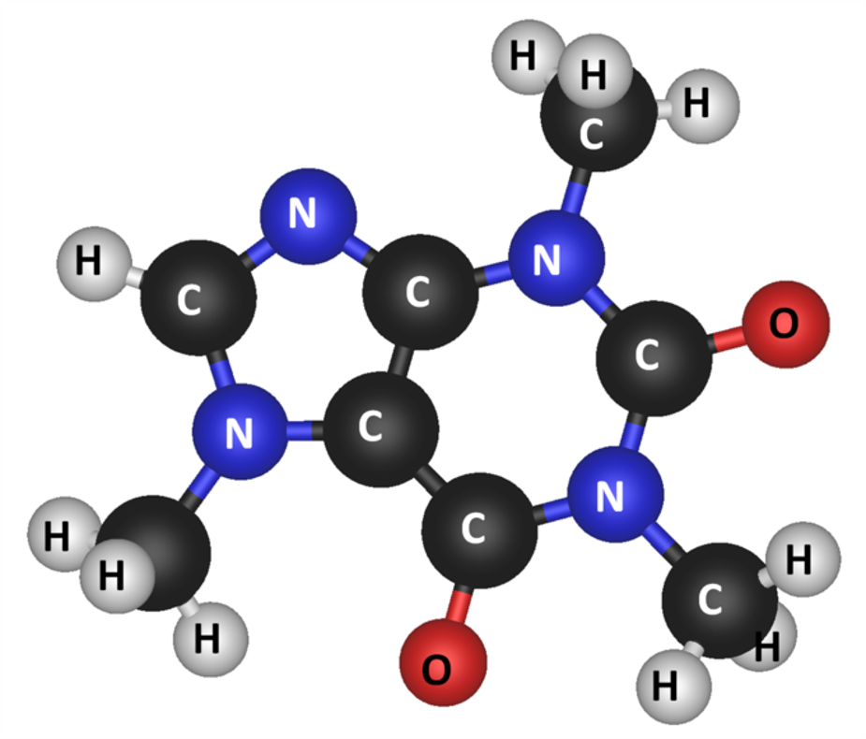
Learning on Irregular Data
Regular Data
Irregular Data
Biochemistry
Social Networks
Notes:
Deep Learning -> success in Computer vision → regular. → every pixel has the same set of neighbours and the same filter can slide uniformly
Real world data →irregular and unstructured → captured by graphs

Slide 5
Graph Neural Networks
Aggregation phase
Combination phase
Graph
1
2
1
2
1
2
3
5
3
3
5
5
4
6
6
4
6
4
Aggregation of neighboring feature vectors, for example, v4=v3+v6
This is a feature transformation phase feature vector of each vertex is transformed using trained weights similar to NN.
Notes:
GNN success→irregular data
Aggregation and Combination mainly

Slide 6
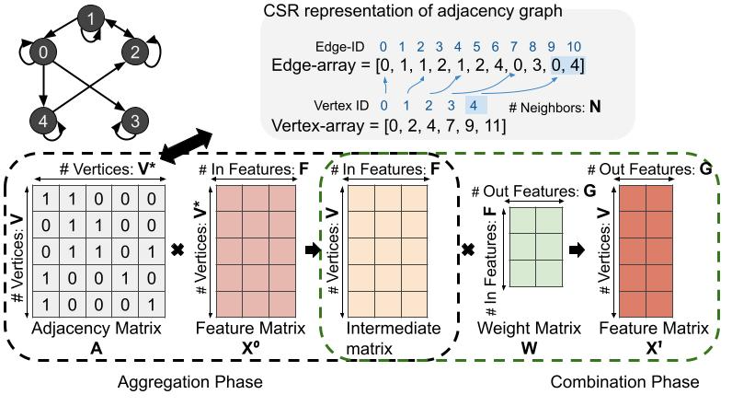
GNN Computations
Graphs can also be represented as adjacency matrix with non-zeros representing the connection as shown.
Thus, Aggregation phase becomes an SpMM problem and Combination involves DenseGEMMs
V: Vertices; N: Neighbors; F: Input Features, G: Output Features
Notes:
(on slides where used)

Slide 7
Key characteristics of GNNs
Aggregation and Combination phases
Interplay of sparse and dense computations.
Reuse opportunities between the two phases.
Squares the design-space.
Complicates it further due to dependency between the phases.
GNNs offer reuse opportunities between two phases which makes the design-space of dataflows and mappings more complex.

Slide 8
Outline
Graph Neural Networks (GNNs)
GNN Dataflows – Taxonomy and modeling
Hands-on Exercises

Slide 9
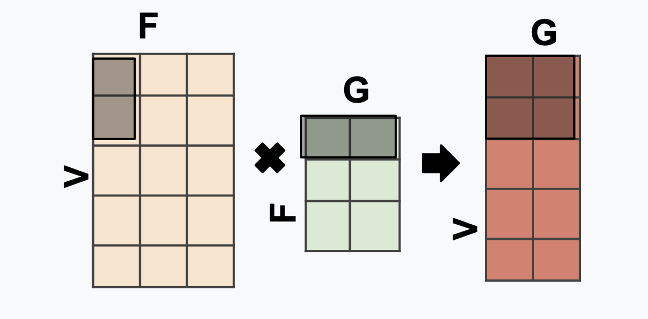
Intra-phase dataflows
V: Vertices; N: Neighbors; F: Input Features, G: Output Features
Example: V_{s}G_{s}F_{t}
for(int v=0;v<V;v+=T_V)
for(int g=0;g<G;g+=T_G)
for(int f=0;f<F;f+=T_F)
parfor(int v1=0;v1<T_V;v1++) //parallel
parfor(int g1=0;g1<T_G;g1++) //parallel
parfor(int f1=0;f1<T_F;f1++) //parallel
X1[v+v1][g+g1]+=I[v+v1][f+f1]*W[f+f1][g+g1];
Tile
Loop order - VGF (V→ G→ F )
Tile size determines spatial or temporal.
s⇒ Spatial⇒ T_Dim>1 and
t⇒ Temporal⇒ T_Dim=1
Example: T_V=2, T_G=2, T_F=1
V and G have spatial parallelism (s) and F is temporal (t)
F
W
Intermediate matrix
X¹
Intra-phase dataflows represent dataflows within a phase
As discussed before, individual dataflows consist of loop orders (VGF) and parallelization strategies (V and G parallel)
Notes:
After first bullet. This figure shows some of the loop transformations that can be done in a matrix dataflow.
****animation****

Slide 10
Inter-phase Dataflows
Inter-phase dataflows describe the data reuse strategies between the two phases. We classify them into 3 categories
Sequential (SEQ)
Sequential Pipeline (SP)
Parallel Pipeline (PP)

Slide 11
Execution of SEQ dataflows
Accelerator
PE running Aggregation
PE running Combination

Slide 12
Execution of SEQ dataflows
V: Vertices; N: Neighbors; F: Input Features, G: Output Features
Accelerator
PE running Aggregation
PE running Combination
Matrix multiplications

Slide 13
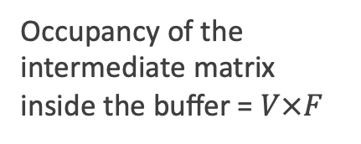
Execution of SEQ dataflows
V: Vertices; N: Neighbors; F: Input Features, G: Output Features
Inside the global buffer/memory hierarchy
Accelerator
PE running Aggregation
WR
PE running Combination
Occupancy of the intermediate matrix inside the buffer = $V×F$
Matrix multiplications

Slide 14
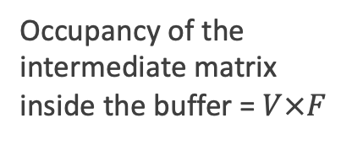
Execution of SEQ dataflow
V: Vertices; N: Neighbors; F: Input Features, G: Output Features
Inside the global buffer/memory hierarchy
Accelerator
PE running Aggregation
RD
PE running Combination
Matrix multiplications
Occupancy of the intermediate matrix inside the buffer = $V×F$

Slide 15
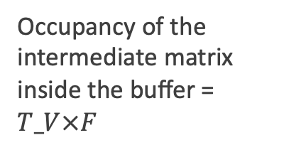
Execution example of SP dataflow
V: Vertices; N: Neighbors; F: Input Features, G: Output Features
Assuming that the computations are staged row-wise.
Inside the global buffer
Accelerator
WR
Occupancy of the intermediate matrix inside the buffer = $T_V×F$
Matrix multiplications
Here, step refers to the duration in which producer writes a part of the intermediate matrix and consumer reads a part of the intermediate matrix

Slide 16
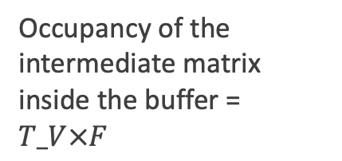
Execution example of SP dataflow
V: Vertices; N: Neighbors; F: Input Features, G: Output Features
Inside the global buffer
Accelerator
RD
Matrix multiplications
Occupancy of the intermediate matrix inside the buffer = $T_V×F$

Slide 17
Execution example of SP dataflow
V: Vertices; N: Neighbors; F: Input Features, G: Output Features
Inside the global buffer
Accelerator
WR
Matrix multiplications
Occupancy of the intermediate matrix inside the buffer = $T_V×F$

Slide 18
Execution example of SP dataflow
V: Vertices; N: Neighbors; F: Input Features, G: Output Features
Inside the global buffer
Accelerator
RD
Matrix multiplications
Occupancy of the intermediate matrix inside the buffer = $T_V×F$

Slide 19

Execution example of PP dataflow
V: Vertices; N: Neighbors; F: Input Features, G: Output Features
Assuming that the computations are staged row-wise.
Inside the global buffer
Accelerator
WR
Matrix multiplications
Occupancy of the intermediate matrix inside the buffer = $T_V×F$
Here, step refers to the duration in which producer writes a part of the intermediate matrix and consumer reads a part of the intermediate matrix
Notes:
Animate With and without matrix

Slide 20
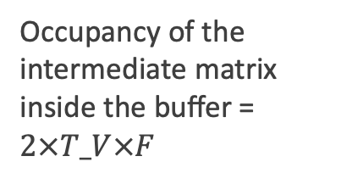
Execution example of PP dataflow
V: Vertices; N: Neighbors; F: Input Features, G: Output Features
Inside the global buffer
Accelerator
RD
WR
Matrix multiplications
Occupancy of the intermediate matrix inside the buffer = $2×T_V×F$
Here, step refers to the duration in which producer writes a part of the intermediate matrix and consumer reads a part of the intermediate matrix

Slide 21
Execution example of PP dataflow
V: Vertices; N: Neighbors; F: Input Features, G: Output Features
Inside the global buffer
Accelerator
RD
WR
Matrix multiplications
Occupancy of the intermediate matrix inside the buffer = $2×T_V×F$
Here, step refers to the duration in which producer writes a part of the intermediate matrix and consumer reads a part of the intermediate matrix

Slide 22
Data movement in Inter-phase Dataflows
Inter-phase dataflows describe the data reuse strategies between the two phases.
SP and PP dataflow reduce the data movement of the intermediate matrix by consuming right after producing
SEQ dataflow writes the complete intermediate matrix to the memory in Aggregation and then reads it in the Combination phase.
SP and PP dataflows reuse the data between the two phases, thus avoiding writing the entire intermediate matrix to the DRAM and reading it.

Slide 23
Interdependence between dataflows
PP
SP
SP and PP dataflows are interdependent.
Here, the production and consumption of data are in the row-major order. Therefore, the outermost loop is V in both the cases and inner loops can be re-ordered.
AGG
for v=1:V
for f=1:F
for n=1:N
CMB
for v=1:V
for g=1:G
for f=1:F
For more details on dependencies between the loop orders and the tile sizes, and for other ways to stage the computations please refer to the pre-print of the paper https://arxiv.org/pdf/2103.07977.pdf

Slide 24
GNN Dataflow Taxonomy
V: Vertices; N: Neighbors; F: Input Features, G: Output Features
<Inter Phase>_{<Phase order>}(<Intra Phase Agg>, <Intra Phase Cmb>)
Inter-Phase dataflows - Seq, SP, PP
Phase Order - AC, CA
Intra-Phase dataflow (Examples - V_{s}G_{s}F_{t} for Combination).
Notes:
So now that we have looked at the inter-phase and intra-phase dataflows, the compete dataflow description is as follows:

Slide 25
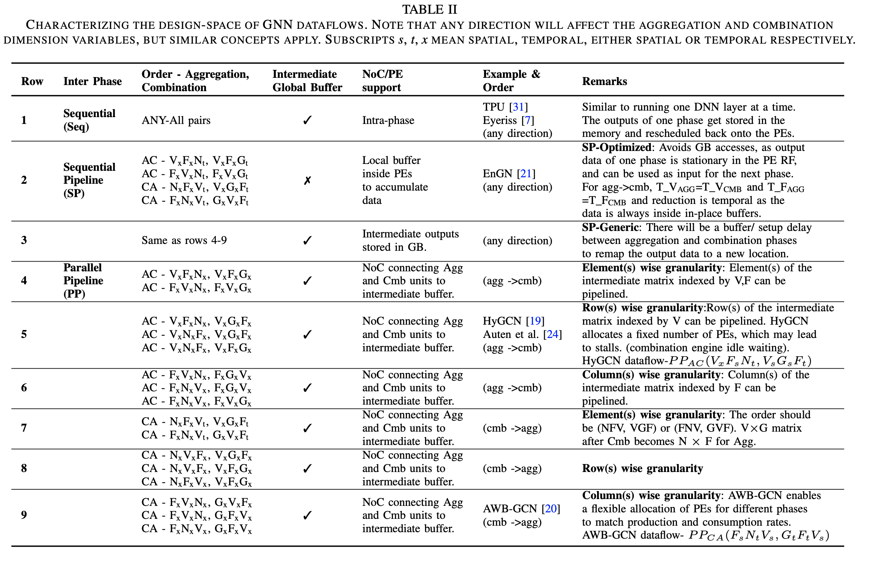
GNN dataflow DSE
Our taxonomy can capture the dataflows used by the state-of-the-art GNN accelerators. For more details, please refer to the paper.

Slide 26
Qualitative observations in Inter-phase dataflows
SEQ – Any intra-phase dataflow ; SP and PP constrained.
Within SP, for intermediate matrix to stay in the register file, T_V should be equal for both phases and so does T_F. T_N=1. So, higher data movement reduction puts more constraints on the dataflow choices. We call this SP-Optimized and we refer to other SP datafloes as SP-Generic.
PP requires balancing Aggregation and Combination.
These dataflows have numerous tradeoffs, thus detailed quantitative modeling of these phases is required.

Slide 27
OMEGA Cost Model
To this end, OMEGA encodes the analytical model of the inter-phase dataflows
OMEGA builds upon STONNE (Munoz-Martinez et al., IISWC 2021), which accurately models the hardware for MAERI which is a flexible accelerator.
We also add support for indexing logic and memory controllers for SpMM which is in addition to MAERI (CONV/GEMM) and SIGMA(SpGEMM) and we use the MAERI accelerator for DenseGEMMs.
OMEGA
SpMM
-Timestamps
-Runtime
-Buffering
INPUT
STONNE()
Dimensions
①
STONNE SpMM parameter translation
SpMM Accelerator
Dataflows+Tile sizes
STATS
STONNE GEMM parameter translation
GEMM Accelerator (MAERI)
GEMM
-Timestamps
-Runtime
-Buffering
Hardware Parameters
②
Runtime
Energy
Buffer
Graph (CSR)
③
INTER-PHASE COST MODEL

Slide 28
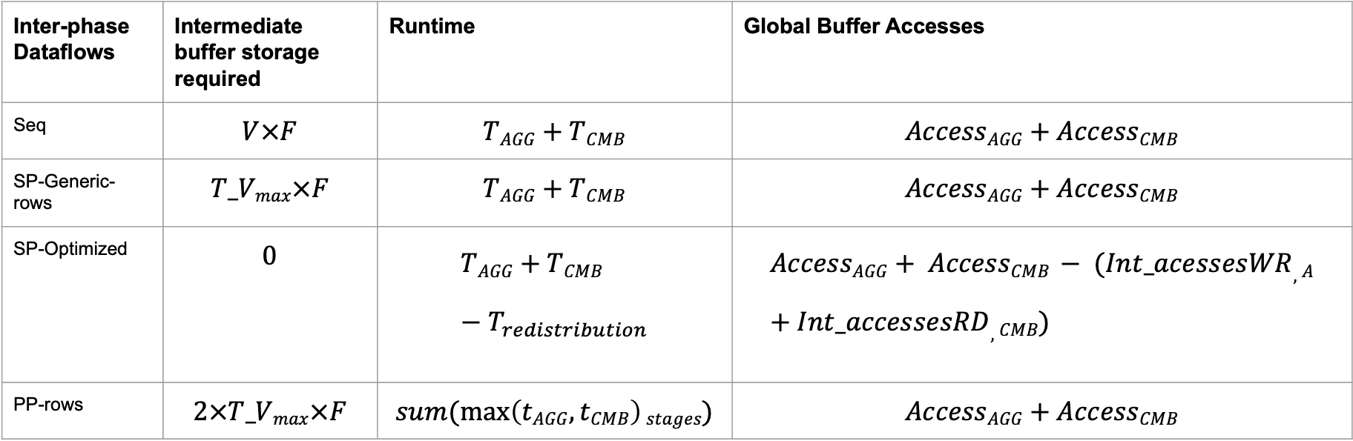
Some key Analytical Equations
For more detailed explanation, please refer to the pre-print of the paper section 4
Inter-phase Dataflows | Intermediate buffer storage required | Runtime | Global Buffer Accesses
Seq | $$V×F$$ | $$TAGG+TCMB$$ | $$AccessAGG+AccessCMB$$
SP-Generic-rows | $$T_Vmax×F$$ | $$TAGG+TCMB$$ | $$AccessAGG+AccessCMB$$
SP-Optimized | $$0$$ | $$TAGG+TCMB−T_{redistribution}$$ | $$AccessAGG+ AccessCMB − (Int_acessesWR,A+Int_accessesRD,CMB)$$
PP-rows | $$2×T_Vmax×F$$ | $$sum(\max\left(tAGG, tCMB\right)stages)$$ | $$AccessAGG+AccessCMB$$

Slide 29
Opening up OMEGA on docker
cd /OMEGA/omega-code

Slide 30
Building OMEGA
make omega

Slide 31
Using git
git clone https://github.com/stonne-simulator/omega.git

Slide 32
Inputs: OMEGA command line interface
vim example_simulation.sh
Dimensions
-V, -F, -G, -E (Edges, required for parsing)
Tile sizes for both phases
-T_Va, -T_N, -T_Fa, -T_Vc, -T_G, -T_Fc
Hardware Parameters
-Pe_agg, -Pe_cmb, -dn_bw_agg, -dn_bw_cmb, -rn_bw_agg, -rn_bw,cmb
Path to Input files for the adjacency matrix (CSR representation)
-vertex_path, edge_path
./omega -V=1168 -F=28 -G=2 -E=2590 -T_Va=18 -T_N=1 -T_Fa=28 -T_Vc=18 -T_G=1 -T_Fc=28 -pe_agg=512 -pe_cmb=512 -dn_bw_agg=512 -rn_bw_agg=512 -dn_bw_cmb=512 -rn_bw_cmb=512 -vertex_path="sample_graphs/vertex_mutag_batch64.txt" -edge_path="sample_graphs/edge_mutag_batch64.txt" cd sample_graphs vim edge_mutag_batch64.txt
vim vertex_mutag_batch64.txt

Slide 33
Parameter translation to STONNE
V_{AGG, GNN}→ M_{SpMM}
F_{AGG, GNN}→ N_{SpMM}
N_{GNN}→ K_non-zero_{SpMM}
V_{CMB, GNN}→ M_{GEMM}
F_{CMB, GNN}→ K_{GEMM}
G_{GNN}→ N_{GEMM}

Slide 34
OMEGA wrapper
vim stonne/src/omega.cpp
The OMEGA wrapper is omega.cpp and consists of the following parts-
Parsing the command line parameters
Reading the matrices
Instantiating and running STONNE for SpMM
Repeating 2. and 3. for GEMM.
Inter-phase analytical equations. Please note that currently there are additional equations to enable T_V_{AGG}=1.

Slide 35
Running example simulation
source example_simulation.sh

Slide 36
Output: Printed Results
SpMM RF statistics
SpMM Global Buffer (GB) statistics
GEMM RF statistics
GEMM Global Buffer Accesses
Aggregation and Combination runtimes
PP cycles (nPEs=AGG+CMB)
SP cycles (These make sense only if PE_agg=PEcmb and then nPEs=PE_AGG)
Intermediate GB occupancies
GB accesses

Slide 37
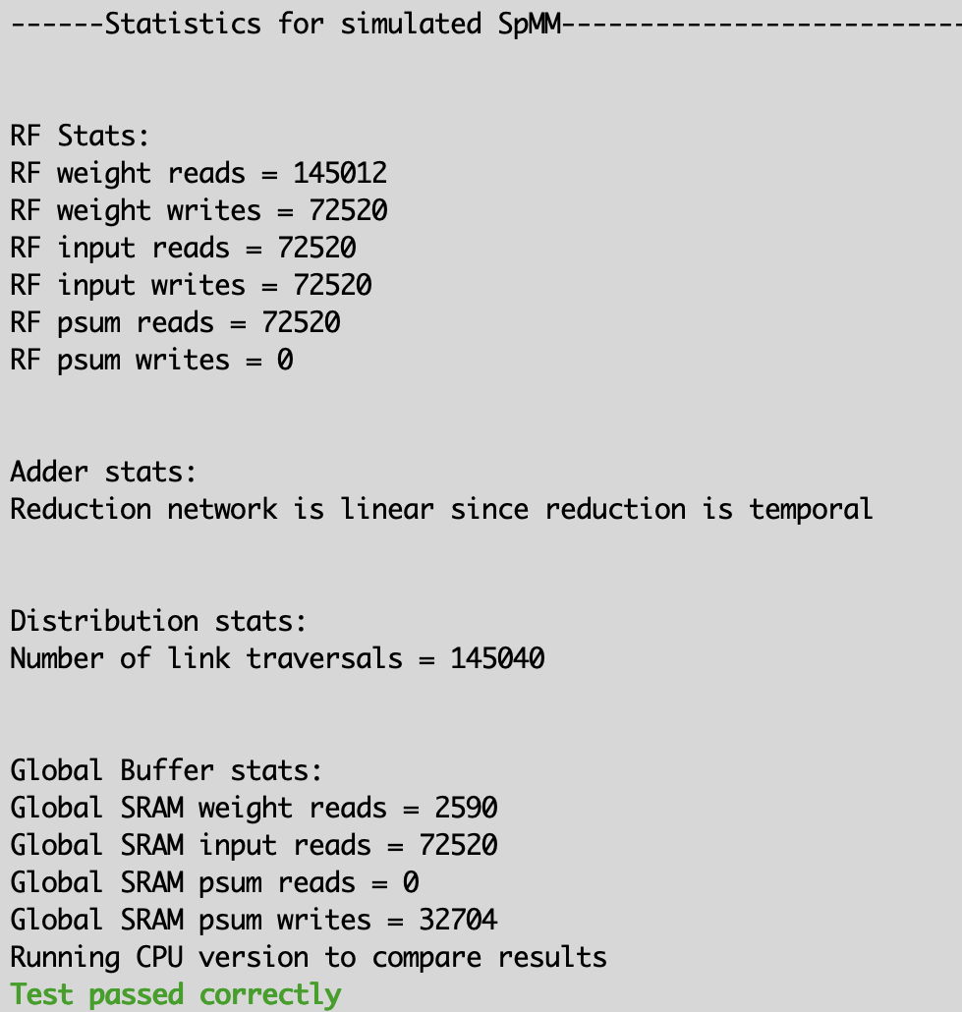
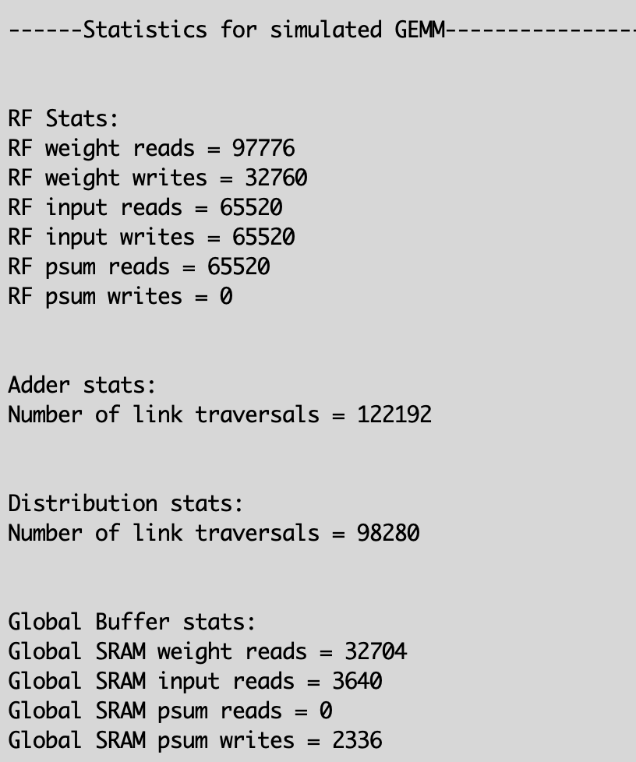
Intra-phase stats

Slide 38
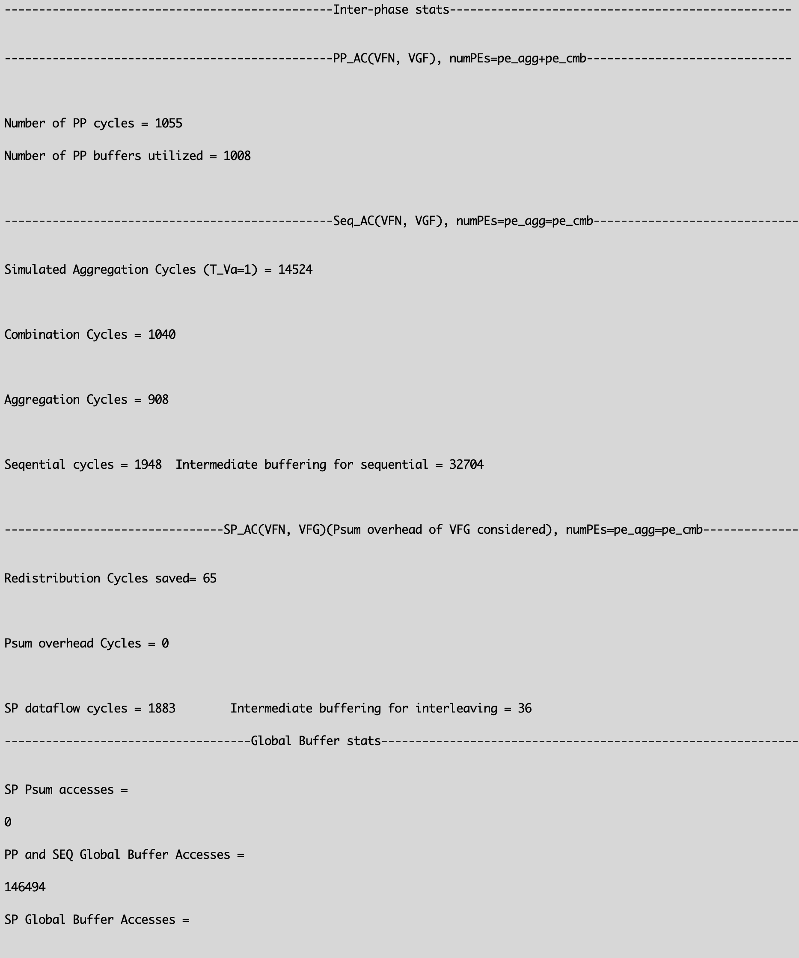
Inter-phase stats

Slide 39
Changing the tile sizes
cp example_simulation.sh example2_simulation.sh
vim example2_simulation.sh
./omega -V=1168 -F=28 -G=2 -E=2590 -T_Va=170 -T_N=1 -T_Fa=3 -T_Vc=170 -T_G=1 -T_Fc=3 -pe_agg=512 -pe_cmb=512 -dn_bw_agg=512 -rn_bw_agg=512 -dn_bw_cmb=512 -rn_bw_cmb=512 -vertex_path="sample_graphs/vertex_mutag_batch64.txt" -edge_path="sample_graphs/edge_mutag_batch64.txt"
source example2_simulation.sh
We observe that performance improves with these tile sizes

Slide 40
Changing the bandwidth
cp example_simulation.sh example3_simulation.sh
vim example3_simulation.sh
./omega -V=1168 -F=28 -G=2 -E=2590 -T_Va=18 -T_N=1 -T_Fa=28 -T_Vc=18 -T_G=1 -T_Fc=28 -pe_agg=512 -pe_cmb=512 -dn_bw_agg=128 -rn_bw_agg=128 -dn_bw_cmb=128 -rn_bw_cmb=128 -vertex_path="sample_graphs/vertex_mutag_batch64.txt" -edge_path="sample_graphs/edge_mutag_batch64.txt"
source example3_simulation.sh
As expected, performance deteriorates with decrease in BW
For details on other experiments, please look at the preprint section 5

Slide 41
Summary
Several important workloads across ML and HPC have multiphase matrix computations and the dataflows that can exploit reuse between the phases are crucial.
We capture the design-space of these dataflows using a succinct taxonomy. We contrast these dataflow choices and highlight the trade-offs in these dataflows.
We propose an analytical framework for cost-modelling dataflows.

Slide 42



Acknowledgements
Co-Design Center for Artificial Intelligence-Focused Architectures and Algorithms Funded By

