Slide 1



Connecting a framework operation with STONNE.
Notes:
Thank you...
Si me presentó: I am going to present a work that has been carried out by
José González, José García, José Duato and myself.
Si no:My name is Manuel Acacio, I’m from the University of Murcia (in Spain)
and I am going to present the work titled “Reducing the Latency
of L2 Misses in Shared-Memory Multiprocessors through On-Chip
Directory Integration. This work has been carried out by
José González, José García, José Duato and myself.

Slide 2
1. Understand how to run the operation with the framework
  The first step is to understand how to run the operation using our framework.
  As an example, in this tutorial we will use the Linear operation (FC layer) and the framework Pytorch.
Notes:
In order to ensure cache coherence in shared memory multiprocessors, two kinds of coherence
protocols are usually considered: snoopy-based and directory-based protocols.
When the number of processors is small, snoopy-based protocols are usually employed.
Snoopy-based protocols solve the cache coherence problem using a network with a
completely ordered message delivery (usually a bus) to broadcast coherence transactions to
all processors and memory. Thus, this is not a scalable solution for two main reasons:
First, the broadcast medium becomes a bottleneck.
And, second, cache controllers could saturate due to an excessive number of unnecessary
coherence messages.
On the other hand, for large-scale multiprocessors, directory-based protocols are the
preferred solution. Now, each memory line is assigned to a home
directory, which is in charge of storing the state and the sharing information for the line.
This way, on a L2 miss, this miss is sent to the corresponding home directory, which,
depending on the state of the line satisfies the miss, either by directly providing the memory
line or by sending coherence messages to the node or nodes holding a copy
of the line (of course, after reading the sharing information).
Unfortunately, this kind of solutions increases the latency of L2 misses (compared with
the previous ones), due to the indirection that directories introduce. But they are the preferred
solution for scalability.

Slide 3
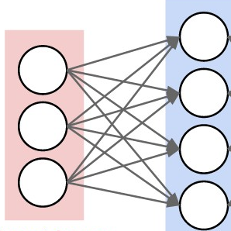
Linear operation
  The linear operation is one of the simplest operations we can think of when it comes to deep learning.
  It is also well-known as a fully-connected layer (FC) composed of a set of output neurons and a set of input neurons. Every output neuron is calculated as a weighted sum of the input neurons.
Notes:
In order to ensure cache coherence in shared memory multiprocessors, two kinds of coherence
protocols are usually considered: snoopy-based and directory-based protocols.
When the number of processors is small, snoopy-based protocols are usually employed.
Snoopy-based protocols solve the cache coherence problem using a network with a
completely ordered message delivery (usually a bus) to broadcast coherence transactions to
all processors and memory. Thus, this is not a scalable solution for two main reasons:
First, the broadcast medium becomes a bottleneck.
And, second, cache controllers could saturate due to an excessive number of unnecessary
coherence messages.
On the other hand, for large-scale multiprocessors, directory-based protocols are the
preferred solution. Now, each memory line is assigned to a home
directory, which is in charge of storing the state and the sharing information for the line.
This way, on a L2 miss, this miss is sent to the corresponding home directory, which,
depending on the state of the line satisfies the miss, either by directly providing the memory
line or by sending coherence messages to the node or nodes holding a copy
of the line (of course, after reading the sharing information).
Unfortunately, this kind of solutions increases the latency of L2 misses (compared with
the previous ones), due to the indirection that directories introduce. But they are the preferred
solution for scalability.

Slide 4
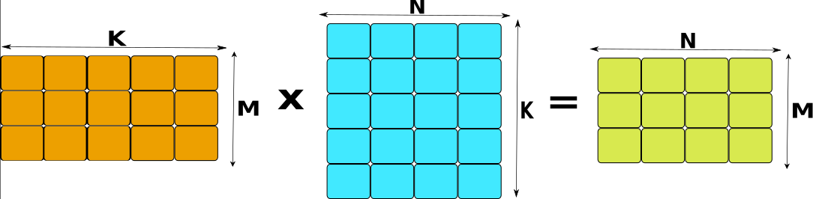
Linear operation
  From a mathematical point of view, this operation can be seen as a matrix multiplication of two matrices MK and KN, where M is the number of output neurons, K is the number of the input neurons, and N is the batch size.
Notes:
In order to ensure cache coherence in shared memory multiprocessors, two kinds of coherence
protocols are usually considered: snoopy-based and directory-based protocols.
When the number of processors is small, snoopy-based protocols are usually employed.
Snoopy-based protocols solve the cache coherence problem using a network with a
completely ordered message delivery (usually a bus) to broadcast coherence transactions to
all processors and memory. Thus, this is not a scalable solution for two main reasons:
First, the broadcast medium becomes a bottleneck.
And, second, cache controllers could saturate due to an excessive number of unnecessary
coherence messages.
On the other hand, for large-scale multiprocessors, directory-based protocols are the
preferred solution. Now, each memory line is assigned to a home
directory, which is in charge of storing the state and the sharing information for the line.
This way, on a L2 miss, this miss is sent to the corresponding home directory, which,
depending on the state of the line satisfies the miss, either by directly providing the memory
line or by sending coherence messages to the node or nodes holding a copy
of the line (of course, after reading the sharing information).
Unfortunately, this kind of solutions increases the latency of L2 misses (compared with
the previous ones), due to the indirection that directories introduce. But they are the preferred
solution for scalability.

Slide 5

Pytorch Framework
  Pytorch is an open source machine learning framework that accelerates the path from research prototyping to production deployment.
  Link to source code: https://github.com/pytorch/pytorch
Notes:
In order to ensure cache coherence in shared memory multiprocessors, two kinds of coherence
protocols are usually considered: snoopy-based and directory-based protocols.
When the number of processors is small, snoopy-based protocols are usually employed.
Snoopy-based protocols solve the cache coherence problem using a network with a
completely ordered message delivery (usually a bus) to broadcast coherence transactions to
all processors and memory. Thus, this is not a scalable solution for two main reasons:
First, the broadcast medium becomes a bottleneck.
And, second, cache controllers could saturate due to an excessive number of unnecessary
coherence messages.
On the other hand, for large-scale multiprocessors, directory-based protocols are the
preferred solution. Now, each memory line is assigned to a home
directory, which is in charge of storing the state and the sharing information for the line.
This way, on a L2 miss, this miss is sent to the corresponding home directory, which,
depending on the state of the line satisfies the miss, either by directly providing the memory
line or by sending coherence messages to the node or nodes holding a copy
of the line (of course, after reading the sharing information).
Unfortunately, this kind of solutions increases the latency of L2 misses (compared with
the previous ones), due to the indirection that directories introduce. But they are the preferred
solution for scalability.

Slide 6
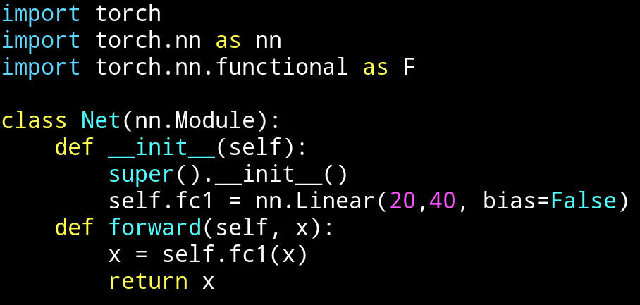
Pytorch Framework
  The main idea to define a DNN in pytorch is to create a NN class (inherits from nn.Module) that defines all the DNN layers (operations).
  Next we define an example that defines a NN composed of a fully connected layer (fc1) of 20 input neurons and 40 output neurons.
Notes:
In order to ensure cache coherence in shared memory multiprocessors, two kinds of coherence
protocols are usually considered: snoopy-based and directory-based protocols.
When the number of processors is small, snoopy-based protocols are usually employed.
Snoopy-based protocols solve the cache coherence problem using a network with a
completely ordered message delivery (usually a bus) to broadcast coherence transactions to
all processors and memory. Thus, this is not a scalable solution for two main reasons:
First, the broadcast medium becomes a bottleneck.
And, second, cache controllers could saturate due to an excessive number of unnecessary
coherence messages.
On the other hand, for large-scale multiprocessors, directory-based protocols are the
preferred solution. Now, each memory line is assigned to a home
directory, which is in charge of storing the state and the sharing information for the line.
This way, on a L2 miss, this miss is sent to the corresponding home directory, which,
depending on the state of the line satisfies the miss, either by directly providing the memory
line or by sending coherence messages to the node or nodes holding a copy
of the line (of course, after reading the sharing information).
Unfortunately, this kind of solutions increases the latency of L2 misses (compared with
the previous ones), due to the indirection that directories introduce. But they are the preferred
solution for scalability.

Slide 7
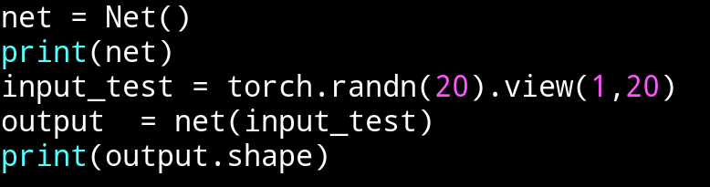
Pytorch Framework
  Once we define the operations, the forward method implements the order and the conditions of the operations to be executed.
  Finally, using the NN is just calling the forward method of that class with the appropiate input (i.e., the shape of the first layer).
  Next, we see the code to run our tiny DNN. As we can see, we use as input a tensor of size 1x20, where 1 is the batch size, and 20 the number of input neurons of the first layer (fc1).
Notes:
In order to ensure cache coherence in shared memory multiprocessors, two kinds of coherence
protocols are usually considered: snoopy-based and directory-based protocols.
When the number of processors is small, snoopy-based protocols are usually employed.
Snoopy-based protocols solve the cache coherence problem using a network with a
completely ordered message delivery (usually a bus) to broadcast coherence transactions to
all processors and memory. Thus, this is not a scalable solution for two main reasons:
First, the broadcast medium becomes a bottleneck.
And, second, cache controllers could saturate due to an excessive number of unnecessary
coherence messages.
On the other hand, for large-scale multiprocessors, directory-based protocols are the
preferred solution. Now, each memory line is assigned to a home
directory, which is in charge of storing the state and the sharing information for the line.
This way, on a L2 miss, this miss is sent to the corresponding home directory, which,
depending on the state of the line satisfies the miss, either by directly providing the memory
line or by sending coherence messages to the node or nodes holding a copy
of the line (of course, after reading the sharing information).
Unfortunately, this kind of solutions increases the latency of L2 misses (compared with
the previous ones), due to the indirection that directories introduce. But they are the preferred
solution for scalability.

Slide 8
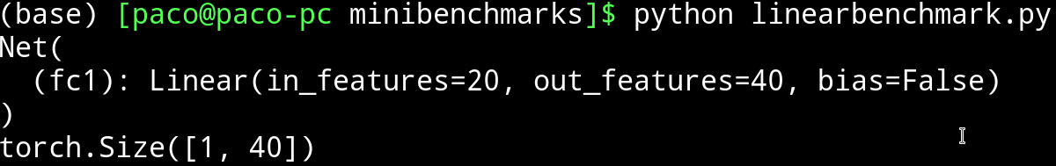
Pytorch Framework
  Here is an example of execution:
  The DNN returns the result of the FC1 layer, which is a tensor of size 1x40 where 1 is the batch size, and 40 the number of output neurons of the layer.
  At this point, the linear operation is executed on the CPU (or GPU if we configure pytorch to do so). Our goal, is to run this operation (i.e., a matrix multiplication) in our simulator STONNE.
Notes:
In order to ensure cache coherence in shared memory multiprocessors, two kinds of coherence
protocols are usually considered: snoopy-based and directory-based protocols.
When the number of processors is small, snoopy-based protocols are usually employed.
Snoopy-based protocols solve the cache coherence problem using a network with a
completely ordered message delivery (usually a bus) to broadcast coherence transactions to
all processors and memory. Thus, this is not a scalable solution for two main reasons:
First, the broadcast medium becomes a bottleneck.
And, second, cache controllers could saturate due to an excessive number of unnecessary
coherence messages.
On the other hand, for large-scale multiprocessors, directory-based protocols are the
preferred solution. Now, each memory line is assigned to a home
directory, which is in charge of storing the state and the sharing information for the line.
This way, on a L2 miss, this miss is sent to the corresponding home directory, which,
depending on the state of the line satisfies the miss, either by directly providing the memory
line or by sending coherence messages to the node or nodes holding a copy
of the line (of course, after reading the sharing information).
Unfortunately, this kind of solutions increases the latency of L2 misses (compared with
the previous ones), due to the indirection that directories introduce. But they are the preferred
solution for scalability.

Slide 9
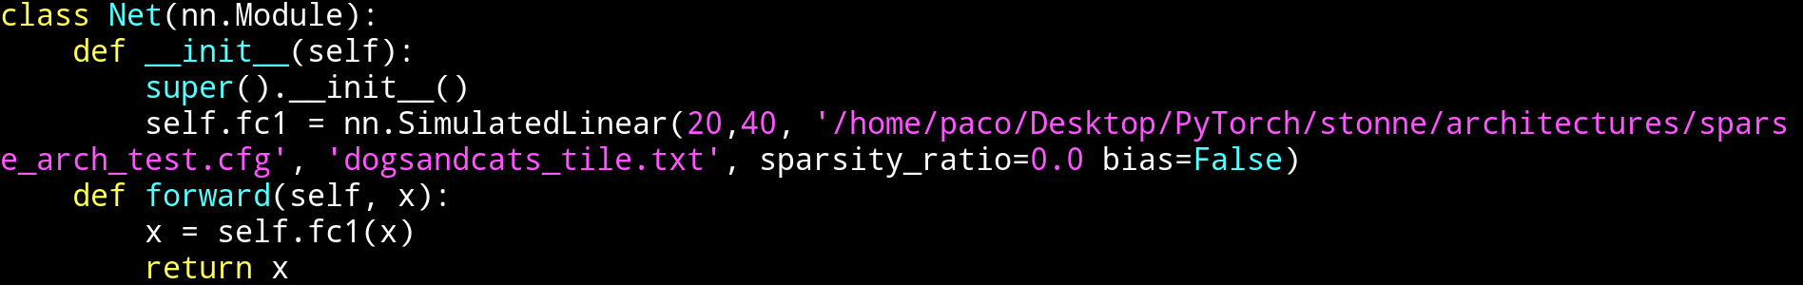
Pytorch Framework + STONNE
  To do so, the idea is to breafly modify the DNN operations to indicate that a certain operation has to be simulated in STONNE and specify the parameters to simulate:
  As we can see, our aim is to use the word ‘Simulated’ to indicate that the fc1 operation (layer) has to be simulated, and indicate as a parameters the architecture file (the file with the hardware parameters to simulate), the tile file to use (layer partition obtained with mRNA), and the sparsity ratio to use in the case that the Sparse controller is enabled in the architecture file.
  With this modifications, the 20x40 linear operation should run into STONNE.
Notes:
In order to ensure cache coherence in shared memory multiprocessors, two kinds of coherence
protocols are usually considered: snoopy-based and directory-based protocols.
When the number of processors is small, snoopy-based protocols are usually employed.
Snoopy-based protocols solve the cache coherence problem using a network with a
completely ordered message delivery (usually a bus) to broadcast coherence transactions to
all processors and memory. Thus, this is not a scalable solution for two main reasons:
First, the broadcast medium becomes a bottleneck.
And, second, cache controllers could saturate due to an excessive number of unnecessary
coherence messages.
On the other hand, for large-scale multiprocessors, directory-based protocols are the
preferred solution. Now, each memory line is assigned to a home
directory, which is in charge of storing the state and the sharing information for the line.
This way, on a L2 miss, this miss is sent to the corresponding home directory, which,
depending on the state of the line satisfies the miss, either by directly providing the memory
line or by sending coherence messages to the node or nodes holding a copy
of the line (of course, after reading the sharing information).
Unfortunately, this kind of solutions increases the latency of L2 misses (compared with
the previous ones), due to the indirection that directories introduce. But they are the preferred
solution for scalability.

Slide 10
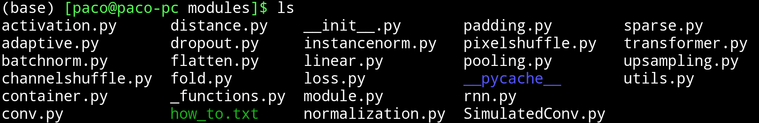
Pytorch modifications
  The first step to achieve our aim, is to create a new operation called SimulatedLinear. This operation will be similar to the Linear operation, but the final backend to run the matrix multiplication will be STONNE.
  The operations in pytorch are organized in modules. All the DNN operations are located in torch/nn/modules.
  As we can appreciate, the module that contains the linear functionality is on linear.py file.
Notes:
In order to ensure cache coherence in shared memory multiprocessors, two kinds of coherence
protocols are usually considered: snoopy-based and directory-based protocols.
When the number of processors is small, snoopy-based protocols are usually employed.
Snoopy-based protocols solve the cache coherence problem using a network with a
completely ordered message delivery (usually a bus) to broadcast coherence transactions to
all processors and memory. Thus, this is not a scalable solution for two main reasons:
First, the broadcast medium becomes a bottleneck.
And, second, cache controllers could saturate due to an excessive number of unnecessary
coherence messages.
On the other hand, for large-scale multiprocessors, directory-based protocols are the
preferred solution. Now, each memory line is assigned to a home
directory, which is in charge of storing the state and the sharing information for the line.
This way, on a L2 miss, this miss is sent to the corresponding home directory, which,
depending on the state of the line satisfies the miss, either by directly providing the memory
line or by sending coherence messages to the node or nodes holding a copy
of the line (of course, after reading the sharing information).
Unfortunately, this kind of solutions increases the latency of L2 misses (compared with
the previous ones), due to the indirection that directories introduce. But they are the preferred
solution for scalability.

Slide 11
Pytorch modifications
  The first step to achieve our aim, is to create a new operation called SimulatedLinear. This operation will be similar to the Linear operation, but the final backend to run the matrix multiplication will be STONNE.
  The operations in pytorch are organized in modules. All the DNN operations are located in torch/nn/modules.
  As we can appreciate, the module that contains the linear functionality is on linear.py file.
Notes:
In order to ensure cache coherence in shared memory multiprocessors, two kinds of coherence
protocols are usually considered: snoopy-based and directory-based protocols.
When the number of processors is small, snoopy-based protocols are usually employed.
Snoopy-based protocols solve the cache coherence problem using a network with a
completely ordered message delivery (usually a bus) to broadcast coherence transactions to
all processors and memory. Thus, this is not a scalable solution for two main reasons:
First, the broadcast medium becomes a bottleneck.
And, second, cache controllers could saturate due to an excessive number of unnecessary
coherence messages.
On the other hand, for large-scale multiprocessors, directory-based protocols are the
preferred solution. Now, each memory line is assigned to a home
directory, which is in charge of storing the state and the sharing information for the line.
This way, on a L2 miss, this miss is sent to the corresponding home directory, which,
depending on the state of the line satisfies the miss, either by directly providing the memory
line or by sending coherence messages to the node or nodes holding a copy
of the line (of course, after reading the sharing information).
Unfortunately, this kind of solutions increases the latency of L2 misses (compared with
the previous ones), due to the indirection that directories introduce. But they are the preferred
solution for scalability.

Slide 12
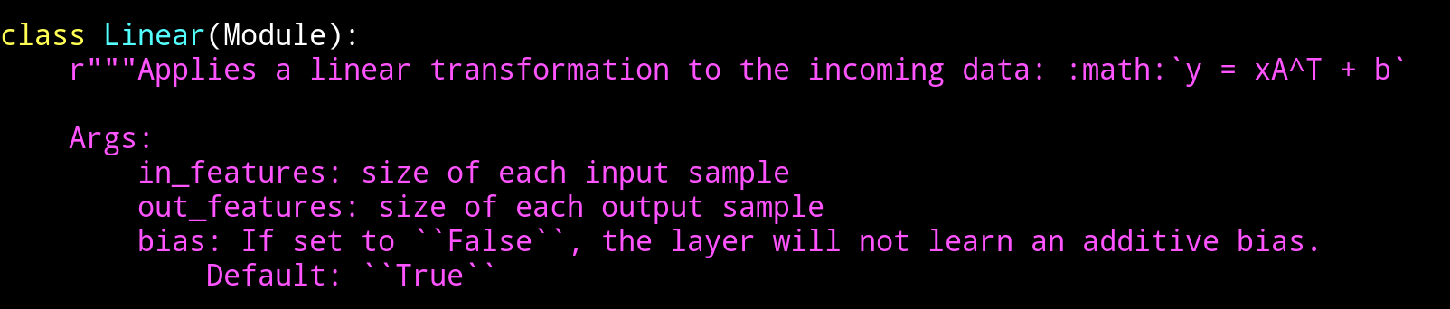
Pytorch modifications
  The linear.py file contains, among others a class called Linear, which represents the linear operation itself.
  This class implements a method called forward, which is the one that computes the result
Notes:
In order to ensure cache coherence in shared memory multiprocessors, two kinds of coherence
protocols are usually considered: snoopy-based and directory-based protocols.
When the number of processors is small, snoopy-based protocols are usually employed.
Snoopy-based protocols solve the cache coherence problem using a network with a
completely ordered message delivery (usually a bus) to broadcast coherence transactions to
all processors and memory. Thus, this is not a scalable solution for two main reasons:
First, the broadcast medium becomes a bottleneck.
And, second, cache controllers could saturate due to an excessive number of unnecessary
coherence messages.
On the other hand, for large-scale multiprocessors, directory-based protocols are the
preferred solution. Now, each memory line is assigned to a home
directory, which is in charge of storing the state and the sharing information for the line.
This way, on a L2 miss, this miss is sent to the corresponding home directory, which,
depending on the state of the line satisfies the miss, either by directly providing the memory
line or by sending coherence messages to the node or nodes holding a copy
of the line (of course, after reading the sharing information).
Unfortunately, this kind of solutions increases the latency of L2 misses (compared with
the previous ones), due to the indirection that directories introduce. But they are the preferred
solution for scalability.

Slide 13
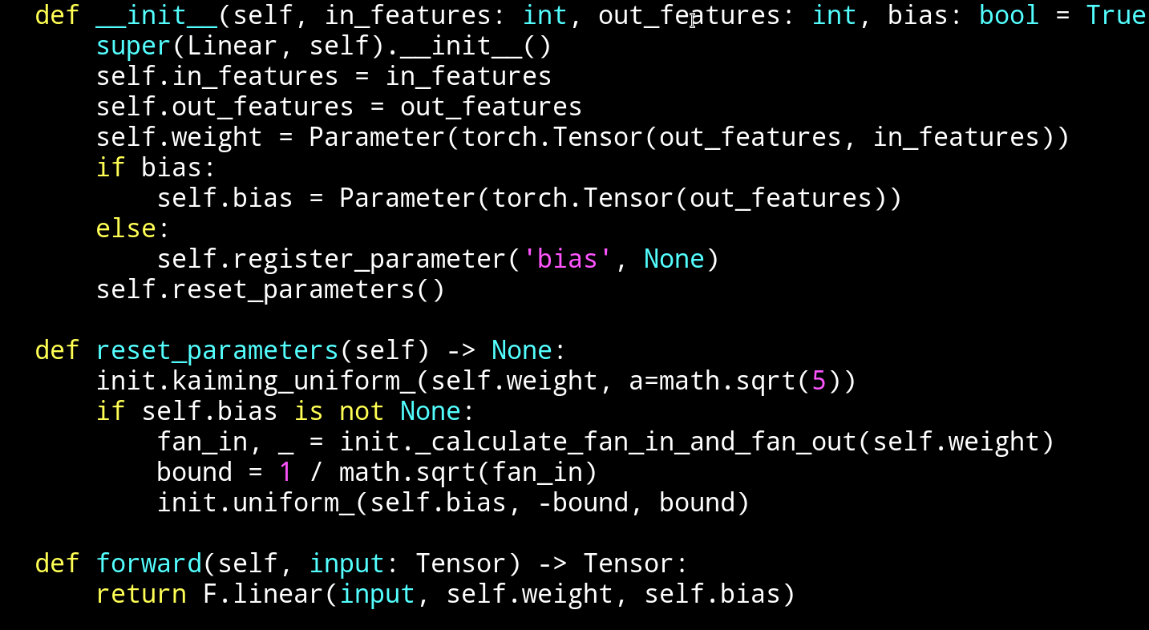
Pytorch modifications
  This class implements a method called forward, which is the one that computes the result
  This forward method uses the package functional to run the final output. Our idea, is to implement a class similar to this one, but replacing this last method by the call to our simulator.
Notes:
In order to ensure cache coherence in shared memory multiprocessors, two kinds of coherence
protocols are usually considered: snoopy-based and directory-based protocols.
When the number of processors is small, snoopy-based protocols are usually employed.
Snoopy-based protocols solve the cache coherence problem using a network with a
completely ordered message delivery (usually a bus) to broadcast coherence transactions to
all processors and memory. Thus, this is not a scalable solution for two main reasons:
First, the broadcast medium becomes a bottleneck.
And, second, cache controllers could saturate due to an excessive number of unnecessary
coherence messages.
On the other hand, for large-scale multiprocessors, directory-based protocols are the
preferred solution. Now, each memory line is assigned to a home
directory, which is in charge of storing the state and the sharing information for the line.
This way, on a L2 miss, this miss is sent to the corresponding home directory, which,
depending on the state of the line satisfies the miss, either by directly providing the memory
line or by sending coherence messages to the node or nodes holding a copy
of the line (of course, after reading the sharing information).
Unfortunately, this kind of solutions increases the latency of L2 misses (compared with
the previous ones), due to the indirection that directories introduce. But they are the preferred
solution for scalability.

Slide 14
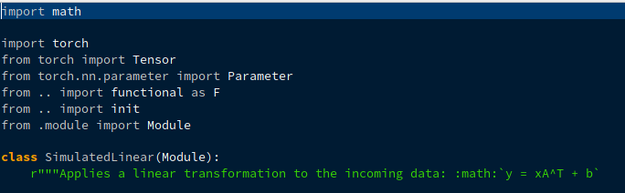
Pytorch modifications
  The first step is to create a new file in torch/nn/modules called simulatedLinear.py. This file contains an exact copy of the class Linear (previously seen), but in this case we call it SimulatedLinear (note that we have to change the name in the whole class):
Notes:
In order to ensure cache coherence in shared memory multiprocessors, two kinds of coherence
protocols are usually considered: snoopy-based and directory-based protocols.
When the number of processors is small, snoopy-based protocols are usually employed.
Snoopy-based protocols solve the cache coherence problem using a network with a
completely ordered message delivery (usually a bus) to broadcast coherence transactions to
all processors and memory. Thus, this is not a scalable solution for two main reasons:
First, the broadcast medium becomes a bottleneck.
And, second, cache controllers could saturate due to an excessive number of unnecessary
coherence messages.
On the other hand, for large-scale multiprocessors, directory-based protocols are the
preferred solution. Now, each memory line is assigned to a home
directory, which is in charge of storing the state and the sharing information for the line.
This way, on a L2 miss, this miss is sent to the corresponding home directory, which,
depending on the state of the line satisfies the miss, either by directly providing the memory
line or by sending coherence messages to the node or nodes holding a copy
of the line (of course, after reading the sharing information).
Unfortunately, this kind of solutions increases the latency of L2 misses (compared with
the previous ones), due to the indirection that directories introduce. But they are the preferred
solution for scalability.

Slide 15
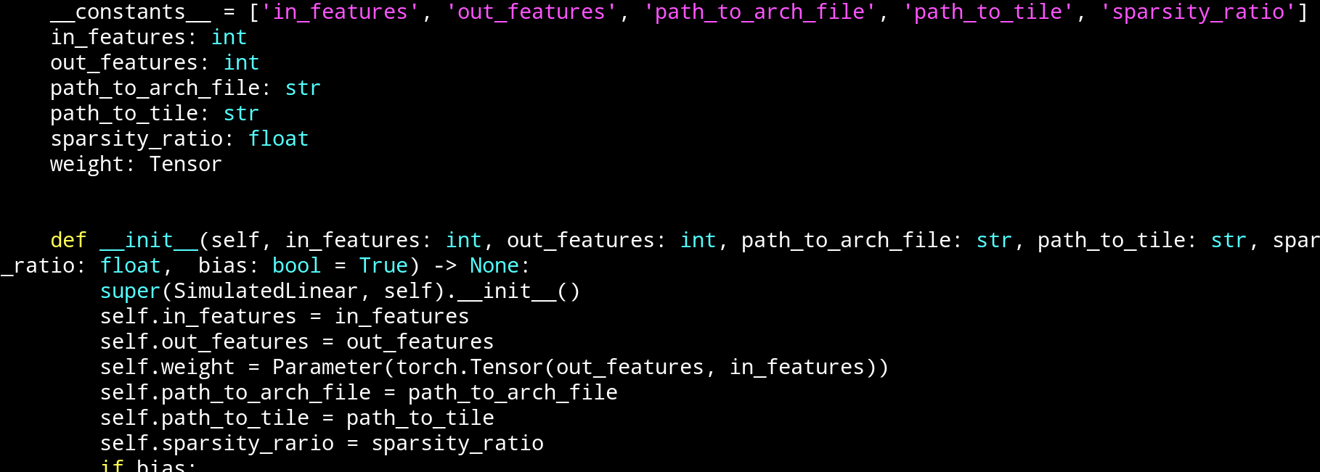
Pytorch modifications
  Next, we have to include the new parameters that will be used to call the simulator. These are three:
    1. The architecture file
    2. The tile file (if dense)
    3. The sparsity ratio (if sparse)
Notes:
In order to ensure cache coherence in shared memory multiprocessors, two kinds of coherence
protocols are usually considered: snoopy-based and directory-based protocols.
When the number of processors is small, snoopy-based protocols are usually employed.
Snoopy-based protocols solve the cache coherence problem using a network with a
completely ordered message delivery (usually a bus) to broadcast coherence transactions to
all processors and memory. Thus, this is not a scalable solution for two main reasons:
First, the broadcast medium becomes a bottleneck.
And, second, cache controllers could saturate due to an excessive number of unnecessary
coherence messages.
On the other hand, for large-scale multiprocessors, directory-based protocols are the
preferred solution. Now, each memory line is assigned to a home
directory, which is in charge of storing the state and the sharing information for the line.
This way, on a L2 miss, this miss is sent to the corresponding home directory, which,
depending on the state of the line satisfies the miss, either by directly providing the memory
line or by sending coherence messages to the node or nodes holding a copy
of the line (of course, after reading the sharing information).
Unfortunately, this kind of solutions increases the latency of L2 misses (compared with
the previous ones), due to the indirection that directories introduce. But they are the preferred
solution for scalability.

Slide 16
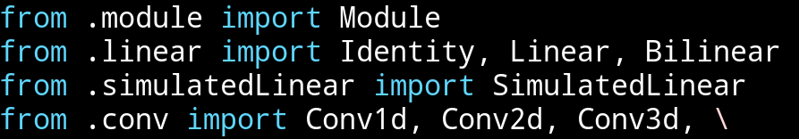
Pytorch modifications
  In order pytorch to recognize our new module/operation we have to import the module in file torch/nn/modules/__init__.py
Notes:
In order to ensure cache coherence in shared memory multiprocessors, two kinds of coherence
protocols are usually considered: snoopy-based and directory-based protocols.
When the number of processors is small, snoopy-based protocols are usually employed.
Snoopy-based protocols solve the cache coherence problem using a network with a
completely ordered message delivery (usually a bus) to broadcast coherence transactions to
all processors and memory. Thus, this is not a scalable solution for two main reasons:
First, the broadcast medium becomes a bottleneck.
And, second, cache controllers could saturate due to an excessive number of unnecessary
coherence messages.
On the other hand, for large-scale multiprocessors, directory-based protocols are the
preferred solution. Now, each memory line is assigned to a home
directory, which is in charge of storing the state and the sharing information for the line.
This way, on a L2 miss, this miss is sent to the corresponding home directory, which,
depending on the state of the line satisfies the miss, either by directly providing the memory
line or by sending coherence messages to the node or nodes holding a copy
of the line (of course, after reading the sharing information).
Unfortunately, this kind of solutions increases the latency of L2 misses (compared with
the previous ones), due to the indirection that directories introduce. But they are the preferred
solution for scalability.

Slide 17
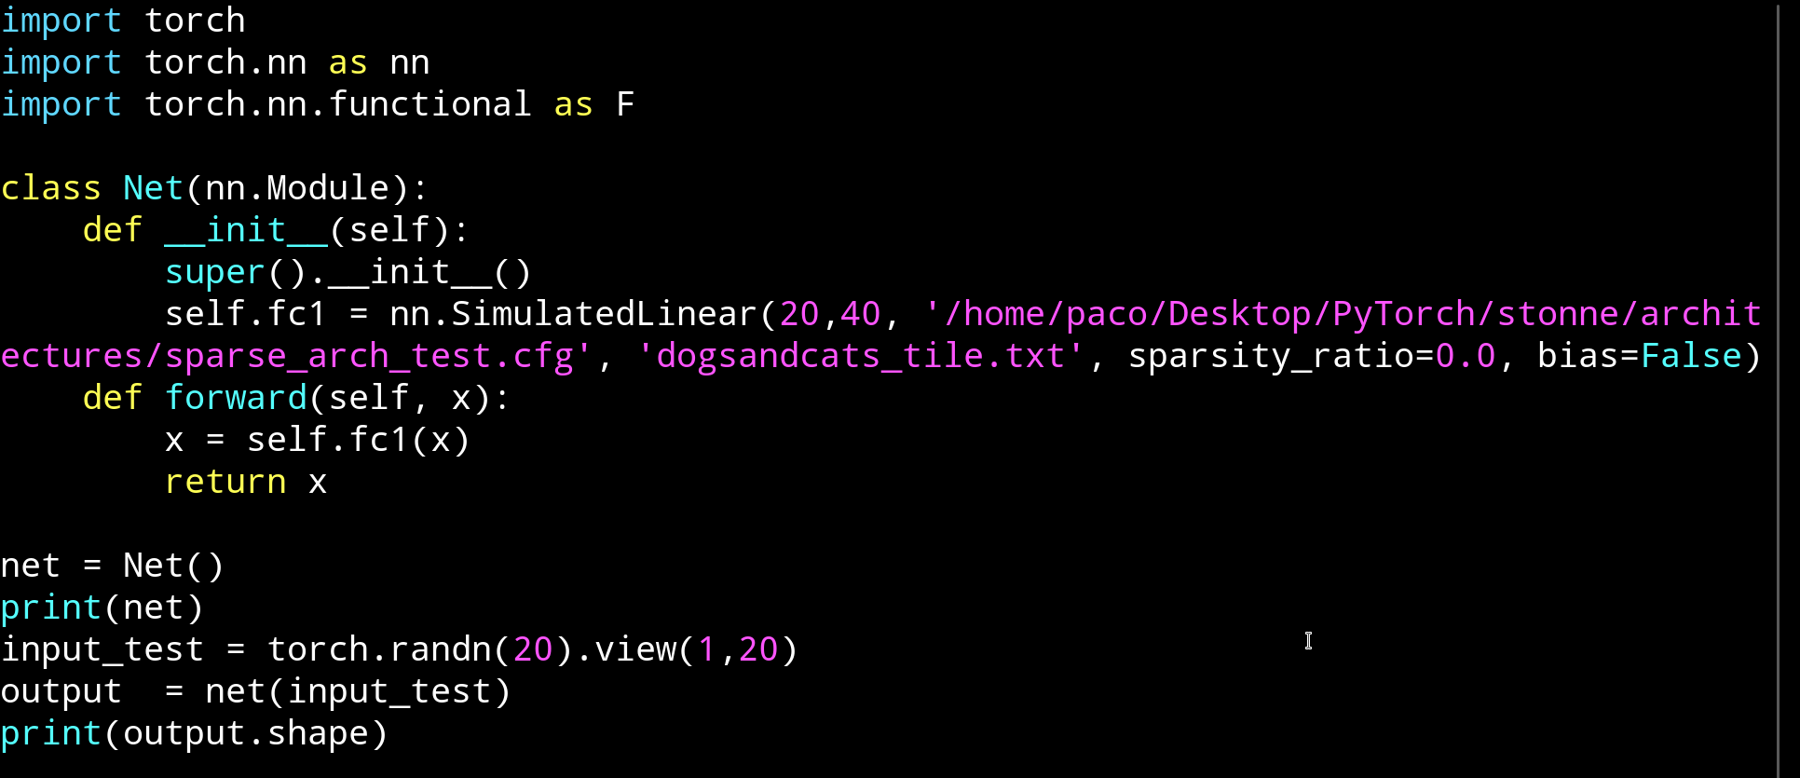
Pytorch modifications
  Now, if we recompile pytorch, we should be able to use the operation SimulatedLinear and Linear indistinctly.
  Pytorch can be re-compiled just running the command python setup install.py in the main directory.
  Once compiled, if we run the previous code using the SimulatedLinear operation, we should get the same result as when using the Linear operation:
Notes:
In order to ensure cache coherence in shared memory multiprocessors, two kinds of coherence
protocols are usually considered: snoopy-based and directory-based protocols.
When the number of processors is small, snoopy-based protocols are usually employed.
Snoopy-based protocols solve the cache coherence problem using a network with a
completely ordered message delivery (usually a bus) to broadcast coherence transactions to
all processors and memory. Thus, this is not a scalable solution for two main reasons:
First, the broadcast medium becomes a bottleneck.
And, second, cache controllers could saturate due to an excessive number of unnecessary
coherence messages.
On the other hand, for large-scale multiprocessors, directory-based protocols are the
preferred solution. Now, each memory line is assigned to a home
directory, which is in charge of storing the state and the sharing information for the line.
This way, on a L2 miss, this miss is sent to the corresponding home directory, which,
depending on the state of the line satisfies the miss, either by directly providing the memory
line or by sending coherence messages to the node or nodes holding a copy
of the line (of course, after reading the sharing information).
Unfortunately, this kind of solutions increases the latency of L2 misses (compared with
the previous ones), due to the indirection that directories introduce. But they are the preferred
solution for scalability.

Slide 18
Pytorch modifications
  Obviously this happens because we have not yet modified the module torch/nn/modules/simulatedLinear.py to use STONNE as a back-end.
Notes:
In order to ensure cache coherence in shared memory multiprocessors, two kinds of coherence
protocols are usually considered: snoopy-based and directory-based protocols.
When the number of processors is small, snoopy-based protocols are usually employed.
Snoopy-based protocols solve the cache coherence problem using a network with a
completely ordered message delivery (usually a bus) to broadcast coherence transactions to
all processors and memory. Thus, this is not a scalable solution for two main reasons:
First, the broadcast medium becomes a bottleneck.
And, second, cache controllers could saturate due to an excessive number of unnecessary
coherence messages.
On the other hand, for large-scale multiprocessors, directory-based protocols are the
preferred solution. Now, each memory line is assigned to a home
directory, which is in charge of storing the state and the sharing information for the line.
This way, on a L2 miss, this miss is sent to the corresponding home directory, which,
depending on the state of the line satisfies the miss, either by directly providing the memory
line or by sending coherence messages to the node or nodes holding a copy
of the line (of course, after reading the sharing information).
Unfortunately, this kind of solutions increases the latency of L2 misses (compared with
the previous ones), due to the indirection that directories introduce. But they are the preferred
solution for scalability.

Slide 19
Pytorch modifications
  Obviously this occurs because we have not yet modified the module torch/nn/modules/simulatedLinear.py to use STONNE as a back-end.
Notes:
In order to ensure cache coherence in shared memory multiprocessors, two kinds of coherence
protocols are usually considered: snoopy-based and directory-based protocols.
When the number of processors is small, snoopy-based protocols are usually employed.
Snoopy-based protocols solve the cache coherence problem using a network with a
completely ordered message delivery (usually a bus) to broadcast coherence transactions to
all processors and memory. Thus, this is not a scalable solution for two main reasons:
First, the broadcast medium becomes a bottleneck.
And, second, cache controllers could saturate due to an excessive number of unnecessary
coherence messages.
On the other hand, for large-scale multiprocessors, directory-based protocols are the
preferred solution. Now, each memory line is assigned to a home
directory, which is in charge of storing the state and the sharing information for the line.
This way, on a L2 miss, this miss is sent to the corresponding home directory, which,
depending on the state of the line satisfies the miss, either by directly providing the memory
line or by sending coherence messages to the node or nodes holding a copy
of the line (of course, after reading the sharing information).
Unfortunately, this kind of solutions increases the latency of L2 misses (compared with
the previous ones), due to the indirection that directories introduce. But they are the preferred
solution for scalability.

Slide 20
Pytorch modifications
  Since STONNE is written in C++, the idea here is to create a torch operation in C++ that calls the simulator
Call torch_stonne.simulated_linear_forward(input, self.weight, self.bias)
Notes:
In order to ensure cache coherence in shared memory multiprocessors, two kinds of coherence
protocols are usually considered: snoopy-based and directory-based protocols.
When the number of processors is small, snoopy-based protocols are usually employed.
Snoopy-based protocols solve the cache coherence problem using a network with a
completely ordered message delivery (usually a bus) to broadcast coherence transactions to
all processors and memory. Thus, this is not a scalable solution for two main reasons:
First, the broadcast medium becomes a bottleneck.
And, second, cache controllers could saturate due to an excessive number of unnecessary
coherence messages.
On the other hand, for large-scale multiprocessors, directory-based protocols are the
preferred solution. Now, each memory line is assigned to a home
directory, which is in charge of storing the state and the sharing information for the line.
This way, on a L2 miss, this miss is sent to the corresponding home directory, which,
depending on the state of the line satisfies the miss, either by directly providing the memory
line or by sending coherence messages to the node or nodes holding a copy
of the line (of course, after reading the sharing information).
Unfortunately, this kind of solutions increases the latency of L2 misses (compared with
the previous ones), due to the indirection that directories introduce. But they are the preferred
solution for scalability.

Slide 21
Pytorch modifications
  The way to create C++ torch operations is exaplained on the next URL: https://pytorch.org/tutorials/advanced/cpp_extension.html
  In this tutorial we will build the C++ extension using the model “ahead of time” (see link).
  Here, we build our C++ extension by writing a setup.py script that uses pybind11 to bind our C++ code.
Notes:
In order to ensure cache coherence in shared memory multiprocessors, two kinds of coherence
protocols are usually considered: snoopy-based and directory-based protocols.
When the number of processors is small, snoopy-based protocols are usually employed.
Snoopy-based protocols solve the cache coherence problem using a network with a
completely ordered message delivery (usually a bus) to broadcast coherence transactions to
all processors and memory. Thus, this is not a scalable solution for two main reasons:
First, the broadcast medium becomes a bottleneck.
And, second, cache controllers could saturate due to an excessive number of unnecessary
coherence messages.
On the other hand, for large-scale multiprocessors, directory-based protocols are the
preferred solution. Now, each memory line is assigned to a home
directory, which is in charge of storing the state and the sharing information for the line.
This way, on a L2 miss, this miss is sent to the corresponding home directory, which,
depending on the state of the line satisfies the miss, either by directly providing the memory
line or by sending coherence messages to the node or nodes holding a copy
of the line (of course, after reading the sharing information).
Unfortunately, this kind of solutions increases the latency of L2 misses (compared with
the previous ones), due to the indirection that directories introduce. But they are the preferred
solution for scalability.

Slide 22
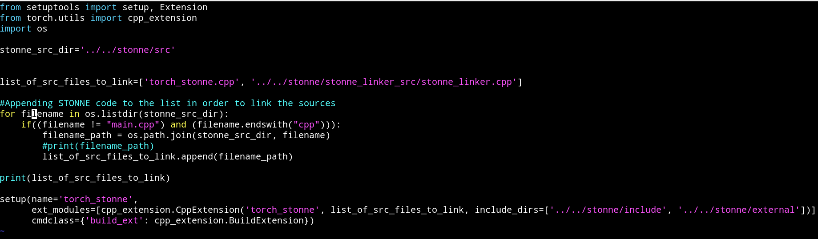
Pytorch modifications
  First, as it is explained in the pytorch tutorial we should create a setup.py file in pytorch-stonne/stonne_connection to instantiate the wrapper that connects our python code with our operation written in c++
  This code creates a python package called torch_stonne that binds the files included in list_of_src_files_to_link. Note that we include the file torch_stonne.cpp that is the one that contains the cpp operations that are going to be run to call the simulator. We also include the simulator paths, in order to be compiled and bind.
Notes:
In order to ensure cache coherence in shared memory multiprocessors, two kinds of coherence
protocols are usually considered: snoopy-based and directory-based protocols.
When the number of processors is small, snoopy-based protocols are usually employed.
Snoopy-based protocols solve the cache coherence problem using a network with a
completely ordered message delivery (usually a bus) to broadcast coherence transactions to
all processors and memory. Thus, this is not a scalable solution for two main reasons:
First, the broadcast medium becomes a bottleneck.
And, second, cache controllers could saturate due to an excessive number of unnecessary
coherence messages.
On the other hand, for large-scale multiprocessors, directory-based protocols are the
preferred solution. Now, each memory line is assigned to a home
directory, which is in charge of storing the state and the sharing information for the line.
This way, on a L2 miss, this miss is sent to the corresponding home directory, which,
depending on the state of the line satisfies the miss, either by directly providing the memory
line or by sending coherence messages to the node or nodes holding a copy
of the line (of course, after reading the sharing information).
Unfortunately, this kind of solutions increases the latency of L2 misses (compared with
the previous ones), due to the indirection that directories introduce. But they are the preferred
solution for scalability.

Slide 23
Pytorch modifications
  Next, we create a C++ torch operation using the C++ torch API. To do so, we create a function in the file torch_stonne.cpp located in the path pytorch-stonne/stonne_connection. Note that this is the file indicated in the setup.py file
  This function will be called directly from python on simulatedLinear.py and receive the layer name, the tensors, and the path to the architecture file, the tile and the sparsity ratio:
  SimulatedLinear.py file modified to include the call to our C++ extension
Notes:
In order to ensure cache coherence in shared memory multiprocessors, two kinds of coherence
protocols are usually considered: snoopy-based and directory-based protocols.
When the number of processors is small, snoopy-based protocols are usually employed.
Snoopy-based protocols solve the cache coherence problem using a network with a
completely ordered message delivery (usually a bus) to broadcast coherence transactions to
all processors and memory. Thus, this is not a scalable solution for two main reasons:
First, the broadcast medium becomes a bottleneck.
And, second, cache controllers could saturate due to an excessive number of unnecessary
coherence messages.
On the other hand, for large-scale multiprocessors, directory-based protocols are the
preferred solution. Now, each memory line is assigned to a home
directory, which is in charge of storing the state and the sharing information for the line.
This way, on a L2 miss, this miss is sent to the corresponding home directory, which,
depending on the state of the line satisfies the miss, either by directly providing the memory
line or by sending coherence messages to the node or nodes holding a copy
of the line (of course, after reading the sharing information).
Unfortunately, this kind of solutions increases the latency of L2 misses (compared with
the previous ones), due to the indirection that directories introduce. But they are the preferred
solution for scalability.

Slide 24
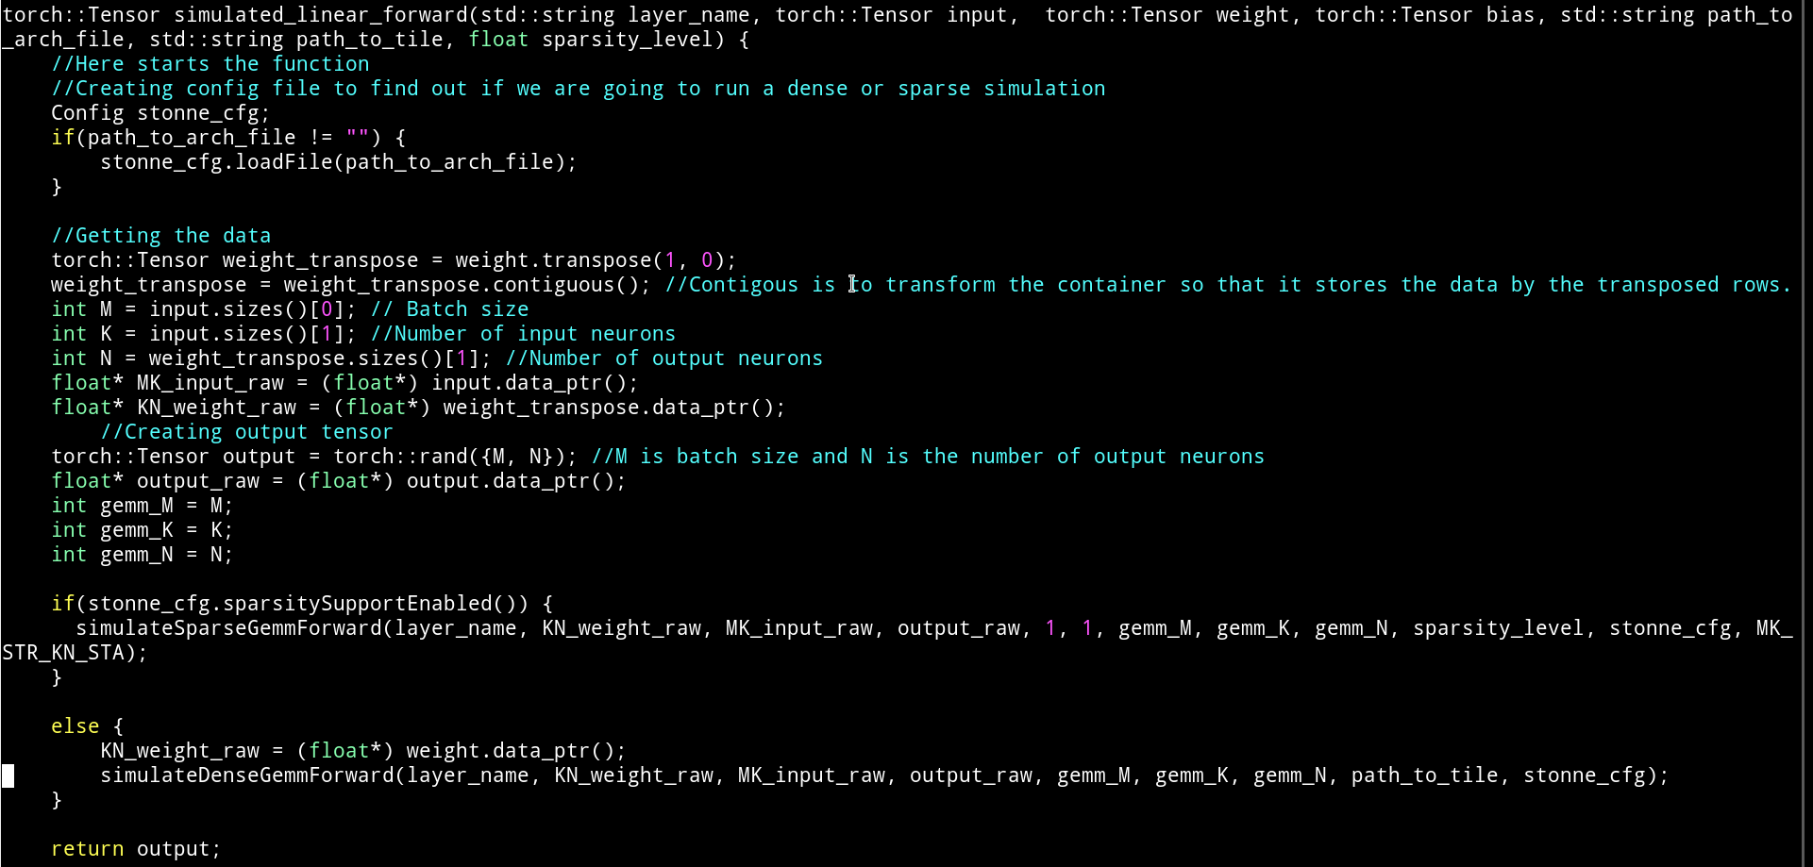
Pytorch modifications
  The aim of this C++ function is to prepare the inputs, weights, and matrices sizes, and call an abstract layer located in stonne/stonne_linker_src/stonne_linker_src.cpp.
The code utilizes the pytorch tensor API to get the matrix sizes (M, K, N) and the raw data (the inputs and weights). Note this is necessary since the calls to the simulator are regardless any framework.
Once we have the data. We check whether the sparsity controller is enabled in the hardware configuration file. If so, we call the operation sparse. Otherwise, we use the dense operation. Note that we have to be aware that the dense operation assumes the weights are stored by rows, while in sparse, these are stored by columns. This is a matter of how the memory controller works.
Notes:
In order to ensure cache coherence in shared memory multiprocessors, two kinds of coherence
protocols are usually considered: snoopy-based and directory-based protocols.
When the number of processors is small, snoopy-based protocols are usually employed.
Snoopy-based protocols solve the cache coherence problem using a network with a
completely ordered message delivery (usually a bus) to broadcast coherence transactions to
all processors and memory. Thus, this is not a scalable solution for two main reasons:
First, the broadcast medium becomes a bottleneck.
And, second, cache controllers could saturate due to an excessive number of unnecessary
coherence messages.
On the other hand, for large-scale multiprocessors, directory-based protocols are the
preferred solution. Now, each memory line is assigned to a home
directory, which is in charge of storing the state and the sharing information for the line.
This way, on a L2 miss, this miss is sent to the corresponding home directory, which,
depending on the state of the line satisfies the miss, either by directly providing the memory
line or by sending coherence messages to the node or nodes holding a copy
of the line (of course, after reading the sharing information).
Unfortunately, this kind of solutions increases the latency of L2 misses (compared with
the previous ones), due to the indirection that directories introduce. But they are the preferred
solution for scalability.

Slide 25
Stonne linker interface
  The stonne linker interface located in stonne/stonne_linker_src/stonne_linker_src.cpp uses the operation parameters and data to actually call the simulator.
  By using this abstraction we separate the pytorch-dependent C++ code with the STONNE API interface.
  This way, to connect a new framework, the user just will have to obtain the raw data and parameters and call the appropiate operation in this interface.
Notes:
In order to ensure cache coherence in shared memory multiprocessors, two kinds of coherence
protocols are usually considered: snoopy-based and directory-based protocols.
When the number of processors is small, snoopy-based protocols are usually employed.
Snoopy-based protocols solve the cache coherence problem using a network with a
completely ordered message delivery (usually a bus) to broadcast coherence transactions to
all processors and memory. Thus, this is not a scalable solution for two main reasons:
First, the broadcast medium becomes a bottleneck.
And, second, cache controllers could saturate due to an excessive number of unnecessary
coherence messages.
On the other hand, for large-scale multiprocessors, directory-based protocols are the
preferred solution. Now, each memory line is assigned to a home
directory, which is in charge of storing the state and the sharing information for the line.
This way, on a L2 miss, this miss is sent to the corresponding home directory, which,
depending on the state of the line satisfies the miss, either by directly providing the memory
line or by sending coherence messages to the node or nodes holding a copy
of the line (of course, after reading the sharing information).
Unfortunately, this kind of solutions increases the latency of L2 misses (compared with
the previous ones), due to the indirection that directories introduce. But they are the preferred
solution for scalability.

Slide 26
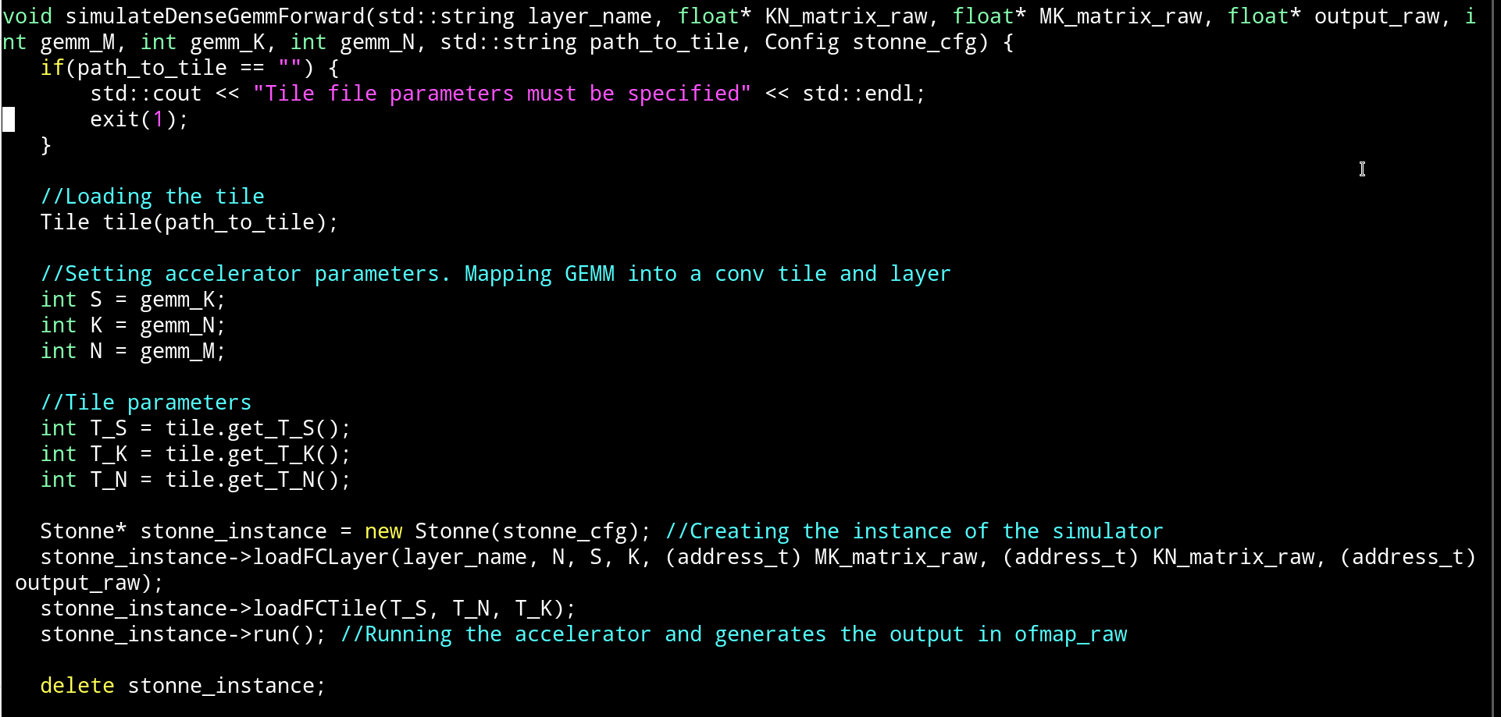
Stonne linker interface
  DenseGemm operation is the one used to run a dense GEMM in STONNE. Next, the code is presented:
Notes:
In order to ensure cache coherence in shared memory multiprocessors, two kinds of coherence
protocols are usually considered: snoopy-based and directory-based protocols.
When the number of processors is small, snoopy-based protocols are usually employed.
Snoopy-based protocols solve the cache coherence problem using a network with a
completely ordered message delivery (usually a bus) to broadcast coherence transactions to
all processors and memory. Thus, this is not a scalable solution for two main reasons:
First, the broadcast medium becomes a bottleneck.
And, second, cache controllers could saturate due to an excessive number of unnecessary
coherence messages.
On the other hand, for large-scale multiprocessors, directory-based protocols are the
preferred solution. Now, each memory line is assigned to a home
directory, which is in charge of storing the state and the sharing information for the line.
This way, on a L2 miss, this miss is sent to the corresponding home directory, which,
depending on the state of the line satisfies the miss, either by directly providing the memory
line or by sending coherence messages to the node or nodes holding a copy
of the line (of course, after reading the sharing information).
Unfortunately, this kind of solutions increases the latency of L2 misses (compared with
the previous ones), due to the indirection that directories introduce. But they are the preferred
solution for scalability.

Slide 27
Stonne linker interface
  From the previous code, some steps may be pointed out:
    1. Get the layer and tile parameters
    2. Create a stonne object with the configuration object.
    3. Load the layer (gemm). In this case, we use the API function loadFCLayer which loads the data and the parameters of the GEMM operation. Note that sending the data to the simulator might take time and this function could be divided into several movement of data functions to account for that movement. We leave this CPU-accelerator connection for further versions.
    4. Load the Tile. Since this operation is dense, we use the tile idea proposed in mRNA.
    5. Run the simulator. This will generates the statistics and energy and area files.
    6. Delete the object.
Notes:
In order to ensure cache coherence in shared memory multiprocessors, two kinds of coherence
protocols are usually considered: snoopy-based and directory-based protocols.
When the number of processors is small, snoopy-based protocols are usually employed.
Snoopy-based protocols solve the cache coherence problem using a network with a
completely ordered message delivery (usually a bus) to broadcast coherence transactions to
all processors and memory. Thus, this is not a scalable solution for two main reasons:
First, the broadcast medium becomes a bottleneck.
And, second, cache controllers could saturate due to an excessive number of unnecessary
coherence messages.
On the other hand, for large-scale multiprocessors, directory-based protocols are the
preferred solution. Now, each memory line is assigned to a home
directory, which is in charge of storing the state and the sharing information for the line.
This way, on a L2 miss, this miss is sent to the corresponding home directory, which,
depending on the state of the line satisfies the miss, either by directly providing the memory
line or by sending coherence messages to the node or nodes holding a copy
of the line (of course, after reading the sharing information).
Unfortunately, this kind of solutions increases the latency of L2 misses (compared with
the previous ones), due to the indirection that directories introduce. But they are the preferred
solution for scalability.

