Slide 1
Character contact
re-positioning under large environment deformation
Steve Tonneau¹, Rami Ali Al-Ashqar², Julien Pettré³,
Taku Komura², Nicolas Mansard¹
¹CNRS-LAAS
²University of Edinburgh
³Inria Rennes

Slide 2
Motion capture does not consider contact interactions

Slide 3
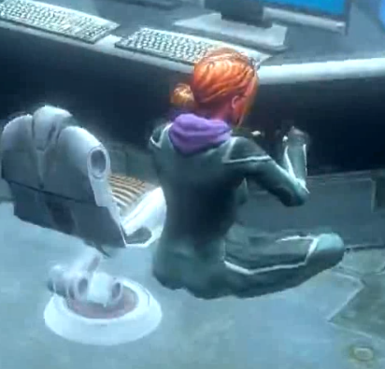
Motion capture does not consider contact interactions
Virtual characters are very good mimes
  Geometry does not matter...
  … except for the user !
<numéro>

Slide 4
Motion capture does not consider contact interactions
Virtual characters are very good mimes
  Geometry does not matter...
  … except for the user !
How to adapt the motion to
position errors / deformed geometries?
A very rich list of contributions on motion editing
[Watkin et al. 95,Kovar et al. 02, Pettré et al. 03, Choi et al. 03,Kim et al. '09...]
<numéro>

Slide 5
Relationship descriptors
[Al Ashqar et al. 2013]
Joint positions described by:
  a configuration q

Slide 6
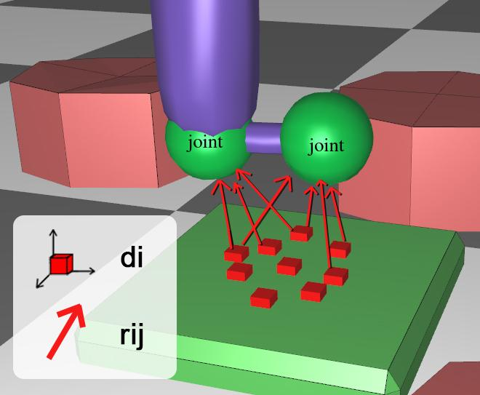
Relationship descriptors
[Al Ashqar et al. 2013]
Joint positions described by:
  a configuration q
  relative positions to elements of geometry
  Geometry deformed =>
  update joint position to preserve relationship

Slide 7
Relationship descriptors
[Al Ashqar et al. 2013]

Slide 8
Motion editing fails when deformation is too important

Slide 9
Solution: use contact repositioning

Slide 10
Paper contribution
We propose a framework to automatically:
  Detect contact failure upon geometry deformation
  Automatically compute replacement contact
  Adapt reference motion to new contact:
    With fidelity w.r.t. original motion
    Preserving motion continuity

Slide 11
Contact generation through procedural techniques
Contact Invariant Optimization
[Mordatch et al. '12]
Monte Carlo approaches
[Hämäläinen et al. '15]
Sampling based, discrete contact planning [Bretl et al. 05, Escande et al. '08]
[Tonneau et al. '15-16, Carpentier et al. '15]

Slide 12
Contact generation through procedural techniques
Sampling based, discrete contact planning [Tonneau et al. '15-16, Carpentier et al. '15]

Slide 13
Generating a contact for one limb

Slide 14
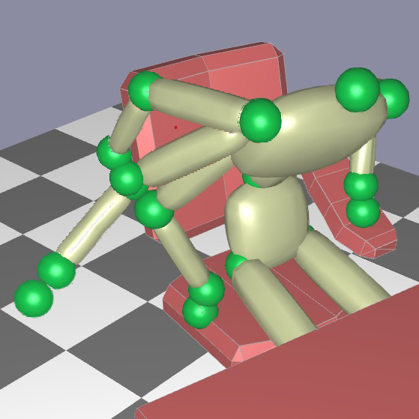
Generating a contact for one limb
Sampling limb
candidates

Slide 15
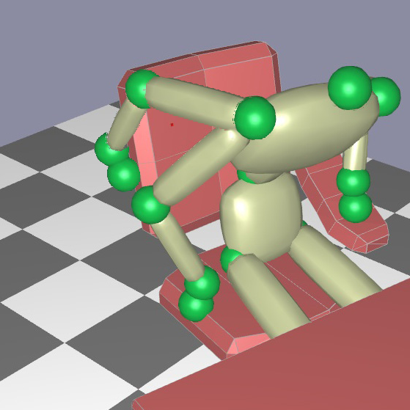
Generating a contact for one limb
Sampling limb Proximity query
candidates

Slide 16
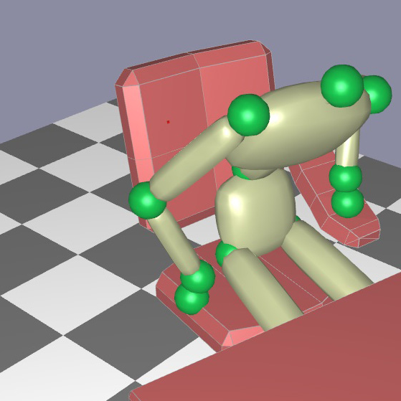
Generating a contact for one limb
Sampling limb Proximity query Keep best
candidates candidate

Slide 17
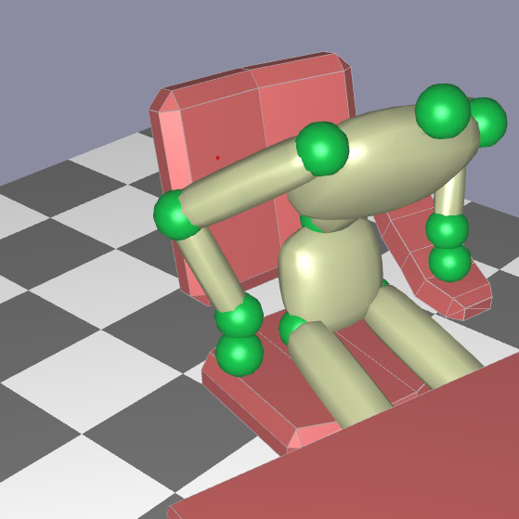
Generating a contact for one limb
Sampling limb Proximity query Keep best Projection
candidates candidate

Slide 18
Generating a contact for one limb
Sampling limb Proximity query Keep best Projection
candidates candidate
What is the “best” candidate ?

Slide 19
Characterize a contact with the force actuation profile
Purpose of contact: force exertion

Slide 20

Characterize a contact with the force actuation profile
Purpose of contact: force exertion
Identify kinematically actuation capabilities?
The limb jacobian gives us the force ellipsoid

Slide 21
Characterize a contact with the force actuation profile
Purpose of contact: force exertion
Identify kinematically actuation capabilities?
The limb jacobian gives us the force ellipsoid

Slide 22
Characterize a contact with the force actuation profile
Purpose of contact: force exertion
Identify kinematically actuation capabilities?
The limb jacobian gives us the force ellipsoid

Slide 23
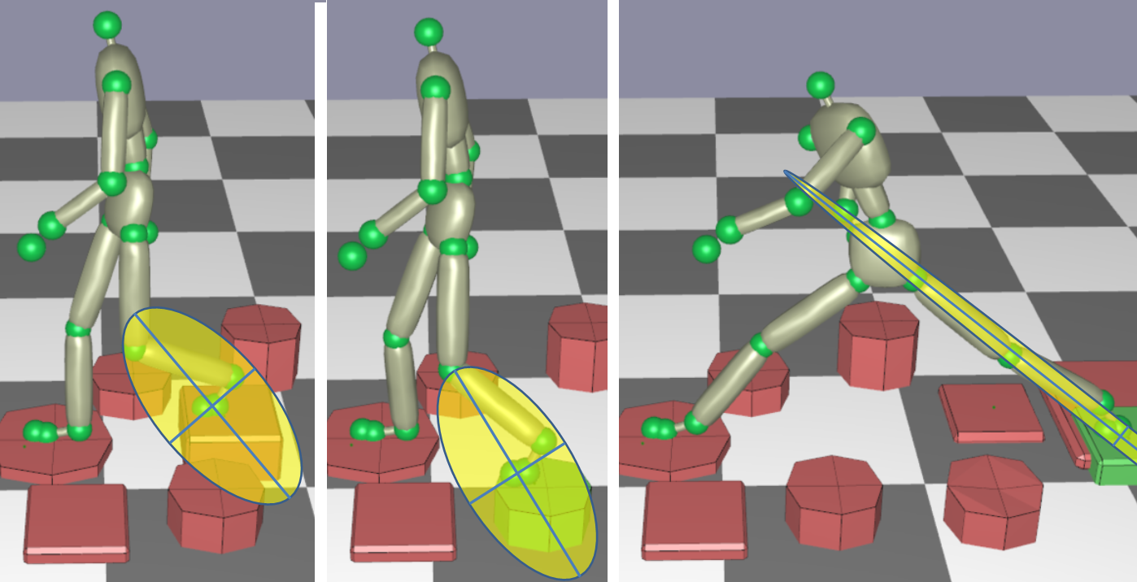
Characterize a contact with the force actuation profile
Purpose of contact: force exertion
Identify kinematically actuation capabilities?
The limb jacobian gives us the force ellipsoid

Slide 24
Characterize a contact with the force actuation profile
Purpose of contact: force exertion
Identify kinematically actuation capabilities?
The limb jacobian gives us the force ellipsoid
We also consider ''dynamic'' equilibrium
Can be verified with an efficient LP

Slide 25
Motion adaptation scheme
Upon deformation: relationship descriptors

Slide 26
Motion adaptation scheme
Upon deformation: relationship descriptors

Slide 27
Motion adaptation scheme
Upon deformation: relationship descriptors
Detect contact failure (joint limits / collision)

Slide 28
Motion adaptation scheme
Upon deformation: relationship descriptors
Detect contact failure (joint limits / collision)
Re-position contact ( Force Actuation Profile)

Slide 29
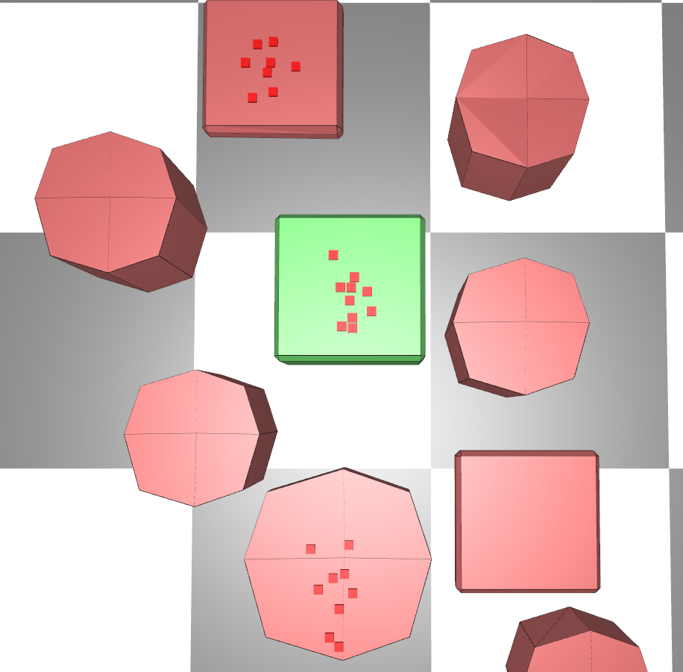
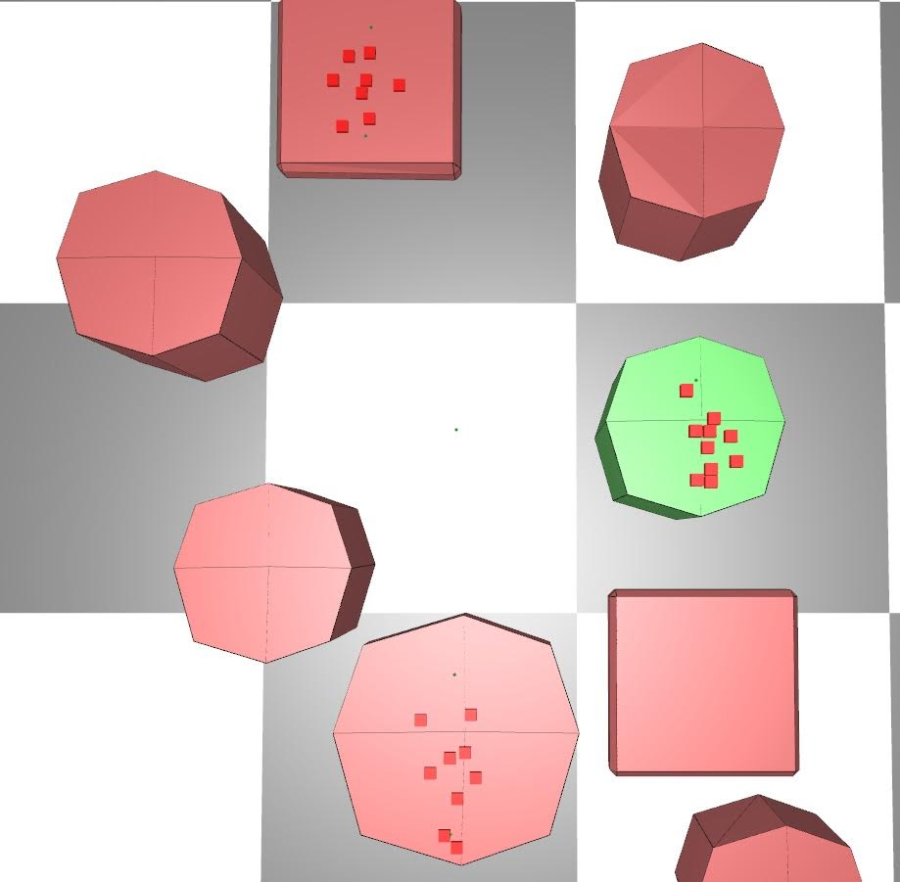
Preserving motion continuity by updating descriptors
Solve a non linear optimization problem:
  adjust di such that weighted sum of
  vectors point to new joint position
  rij invariant
Edited motion can in turn
be edited

Slide 30
Additional results: car ingress

Slide 31
Car ingress: removing the car top, continuity preserved

Slide 32
Table example

Slide 33
Still, failures can occur

Slide 34
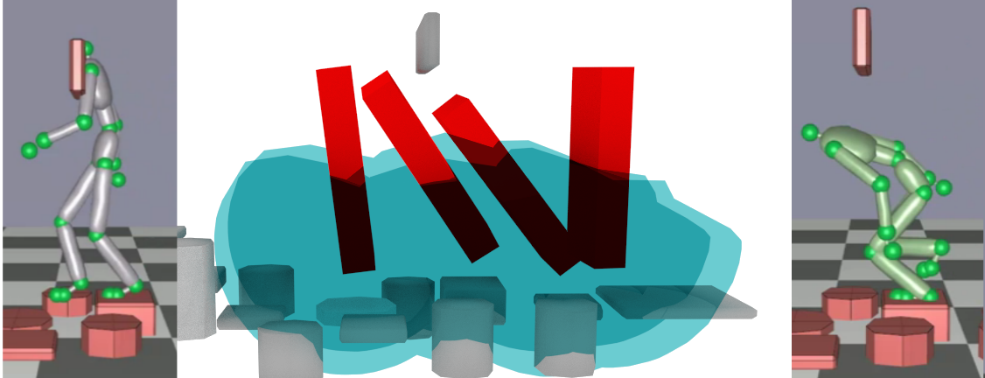
Still, failures can occur
Local replanning of root trajectory:
  Sampling based RRT biased to preserve valid contacts
  Planning in low dimensional space considering:
    Reachable workspace (blue)
    Trunk bounding box (red)

Slide 35
Root trajectory adaptaion

Slide 36
Conclusions on a contact re-positioning framework
Interactive motion editing handling large geometry deformation
Sequential adaptation for minimum deformation
Immediate application for 3D authoring tools
Video games: how to adapt to sudden changes?

Slide 37
Our code is partially open source
Library for:
  Motion planning
  Contact generation
  Equilibrium
part of the humanoid path planner project:
  https://github.com/humanoid-path-planner/hpp-rbprm

Slide 38
Acknowledgements
Thanks to the anonymous reviewers
  who greatly helped improving the paper
FP7 projects:
  Euroc
  TOMSY
ANR project Entracte

Slide 39
Thanks!
Open source code partially available on github:
  Motion planning, contact generation, equilibrium library:
  github.com/humanoid-path-planner/ (http://cpc.cx/fxS)
References on stevetonneau.fr

