Slide 1
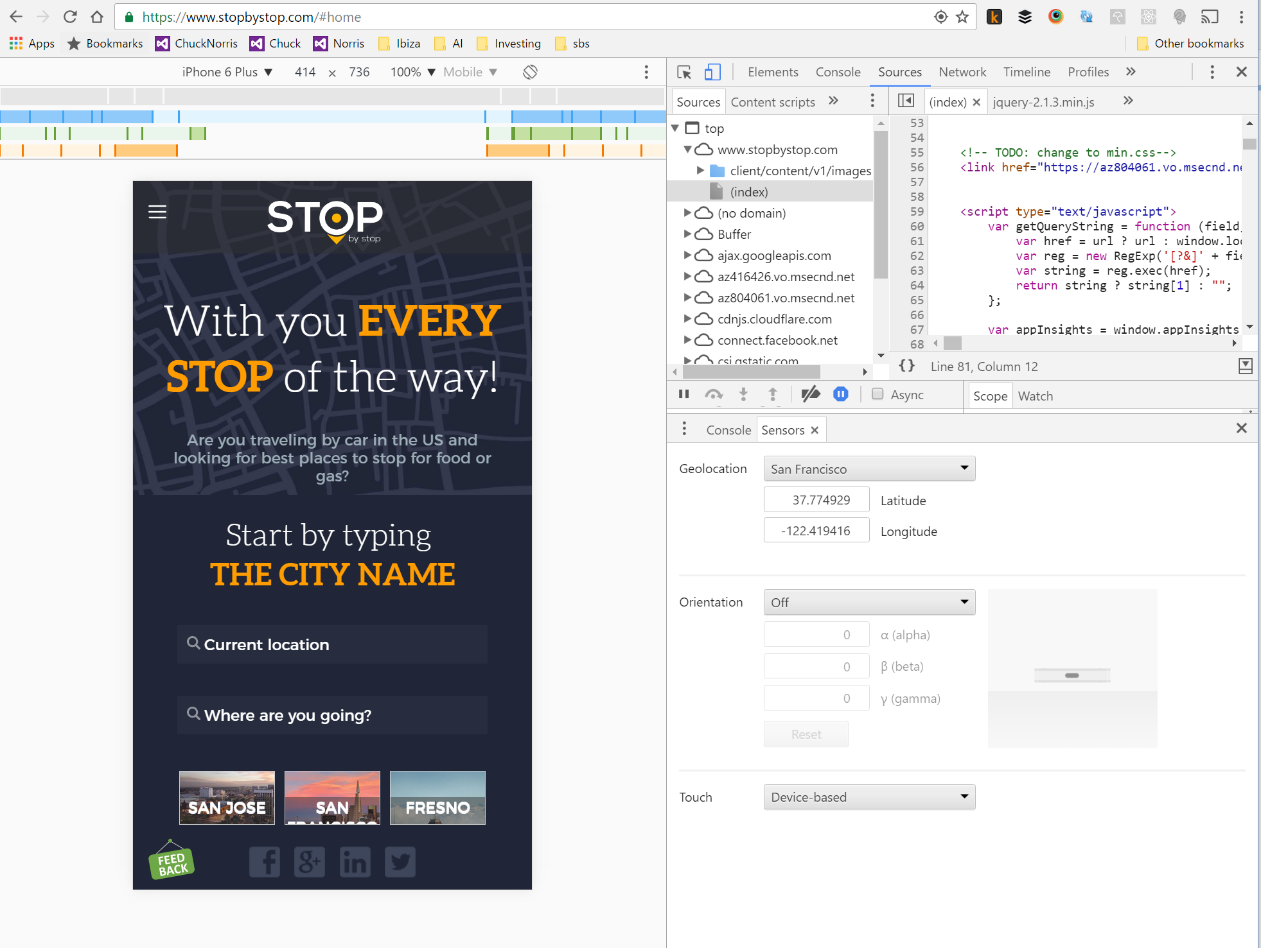
Open chrome developer tools
Pick the device
Open Sensors to emulate location

