Slide 1
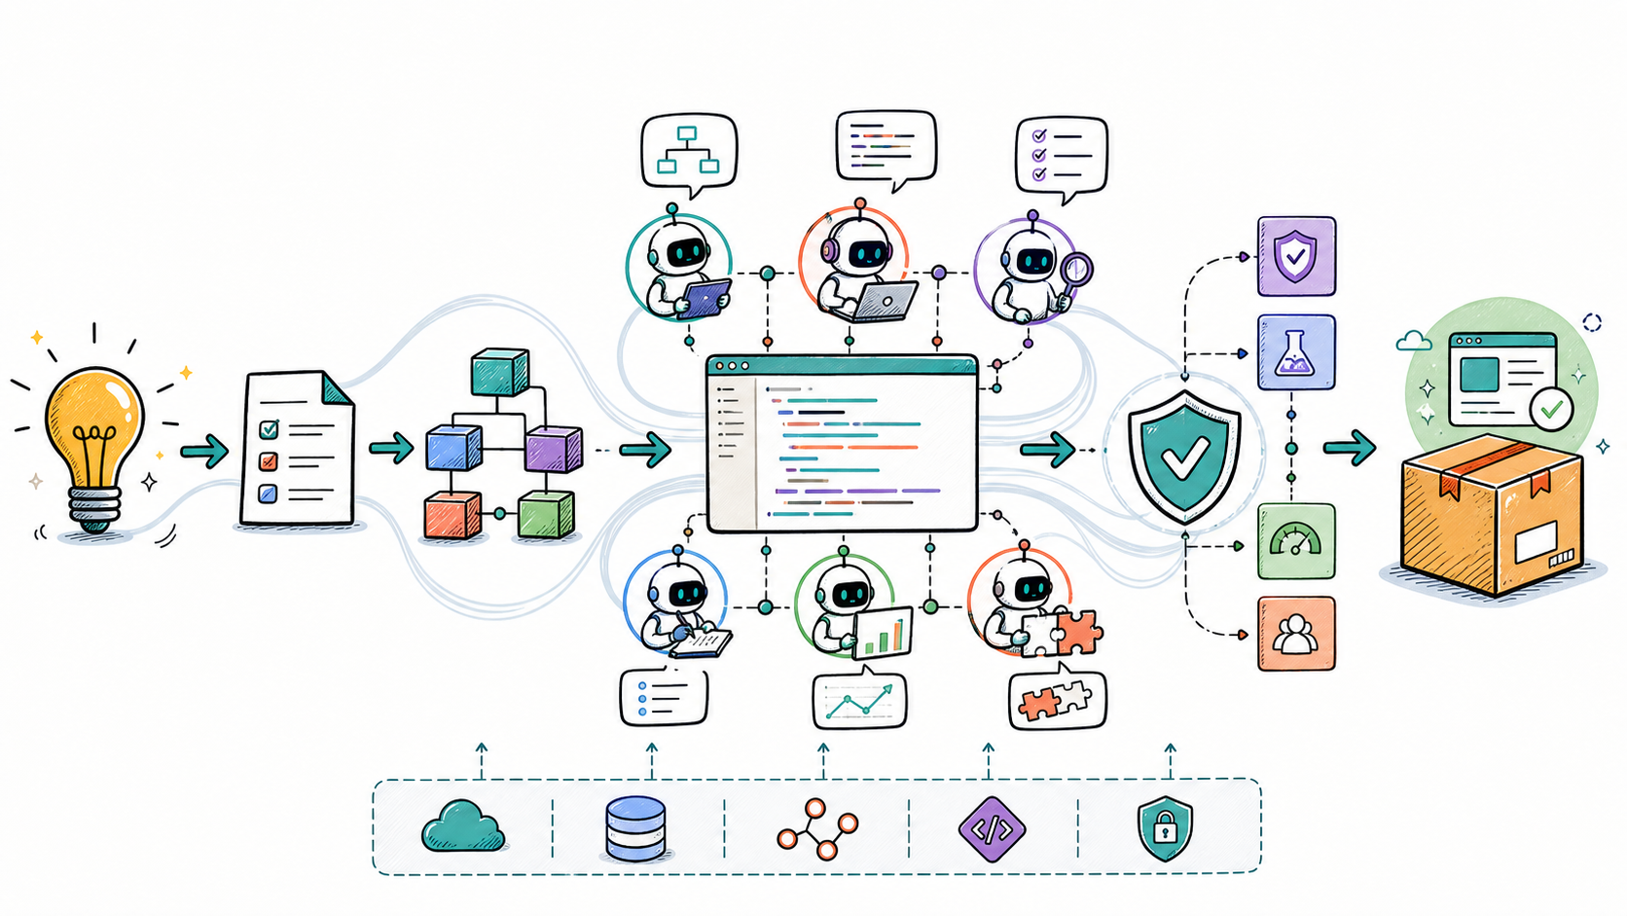
SDLC
AI-assisted software delivery control plane
Brainstorm deck · operating model, evidence, gates, and next bets
DISCOVER
BUILD
VERIFY
DELIVER
SDLC / Brainstorm
01

Slide 2
PROBLEM FRAMING
Why SDLC exists
Speed without evidence
Specialists without control
Automation without trust
Agents can generate quickly, but a fast answer is not automatically a usable delivery.
Parallel roles increase throughput only when ownership, tools, and handoffs are explicit.
A workflow needs deterministic gates, runtime proof, provenance, and a fail-closed release decision.
The product thesis
Turn an ambiguous goal into an observable, reviewable, locally runnable artifact — with every decision and gate recorded.
LOCAL-FIRST
FAIL-CLOSED
EVIDENCE-LINKED
REUSABLE
OBSERVABLE
SDLC / Brainstorm
02

Slide 3
OPERATING MODEL
One goal, a governed delivery system
Discovery
Planning
Build
Verify
Review
Package
Bound the goal and acceptance
Architecture + ownership plan
Specialists write isolated areas
Runtime tests + security review
Cross-role trust verdict
Score + reusable tool contract
Every stage emits events, agent outputs, token/tool telemetry, and a durable session artifact.
SQLite session state
session.yaml
OpenTelemetry
local preview
SDLC / Brainstorm
03

Slide 4
ENGINEERING SYSTEM
Practices encoded as product behavior
Explicit FSM
Bounded agency
Parallel where safe
No hidden phase changes; terminal states are durable and inspectable.
Each role has an allowlisted toolset and workspace write boundary.
Build and verification concurrency without overlapping ownership.
Runtime evidence
Defensive review
Reusable delivery
Test commands and outputs are first-class gate inputs, not prose decoration.
Security and final review are read-only and cannot patch around findings.
Approved work is scored, versioned, and exposed through a strict contract.
SDLC / Brainstorm
04

Slide 5
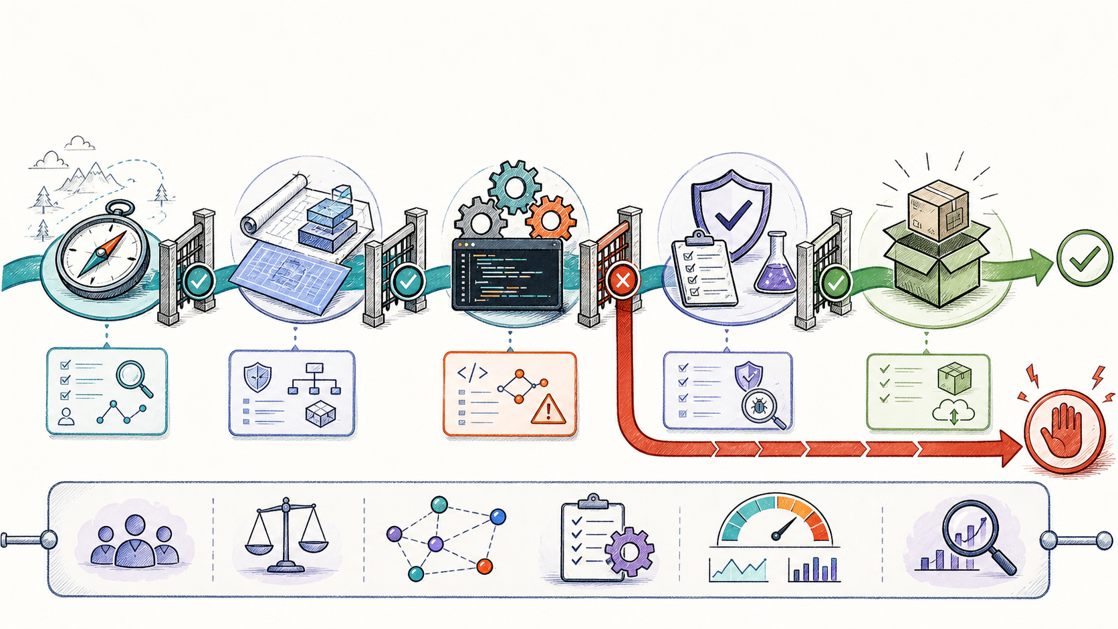
TRUST MODEL
Quality gates must fail closed
BLOCKED means stop here — never “passed with caveats.”
SDLC / Brainstorm
05

Slide 6
INCIDENT REVIEW · 19 AUG 2026
What happened in the latest run
23:08
23:10
23:11
23:11
23:12
Session started
Implementation
QA blocked
False pass
Final rejection
React login UI requested
Static requirements satisfied
vitest: not found · exit 127
Verification marked passed
Runtime evidence missing
Primary cause
Control failure
Now fixed
Dependency setup happened after QA, during Preview. QA therefore could not run the generated frontend suite.
The Verification gate accepted narrative output and did not interpret QA BLOCKED as terminal.
QA prepares a lockfile-based environment; machine-readable verdicts stop the workflow before review.
SDLC / Brainstorm
06

Slide 7
CONTROL DESIGN
The fix: deterministic tests + explicit verdicts
1 · Dependency policy
2 · Reproducible execution
3 · Gate contract
Reject `latest`. Generate and preserve package-lock.json when absent.
Install with npm ci --ignore-scripts, run the suite, then remove node_modules.
Require QA PASSED and SECURITY PASSED as the first non-empty line.
QA BLOCKED
Verification raises
Session → FAILED
Reviewer not invoked
Regression test: blocked QA cannot emit stage-completed and cannot start final review.
SDLC / Brainstorm
07

Slide 8
CURRENT PLATFORM
System architecture
Factory UI + API
Orchestrator
Session workspace
Delivery
FastAPI control plane Session and event APIs Local preview routing
FSM + stage pipeline Agent gateway Deterministic gates
Role-owned files Tests + deployment Session artifact
Exportable project Reusable tool Verified preview
OpenAI Responses
SQLite
File wiki
OTel Collector
Jaeger
Prometheus
Grafana
Local Docker Compose keeps the delivery loop inspectable: code, traces, metrics, events, and artifacts share one operational boundary.
SDLC / Brainstorm
08

Slide 9
PRODUCT + ENGINEERING METRICS
What we should measure
Flow
Quality
Trust
Economics
Lead time per stage Queue and agent duration Parallelism efficiency
First-pass acceptance Gate failure reasons Escaped defects
Runtime evidence coverage Critical findings Human override rate
Tokens per accepted delivery Tool reuse savings Cost by workflow
North-star candidate
Verified, locally runnable deliveries per unit of time and cost
Guardrail: the metric counts only deliveries that passed runtime QA, security, final review, packaging, and preview.
SDLC / Brainstorm
09

Slide 10
WORKSHOP PROMPTS
Brainstorm: decisions worth making tomorrow
01
02
Which workflows deserve hard deterministic gates versus human review?
What is the minimum runtime evidence for frontend, API, data, and infrastructure work?
03
04
Should agents repair a blocked delivery automatically, or open a bounded remediation loop?
How do trusted reusable tools earn, retain, and lose trust over time?
05
06
Where should policy live: prompts, code, signed manifests, or all three?
Which telemetry is useful without turning agent work into vanity dashboards?
SDLC / Brainstorm
10

Slide 11
ROADMAP HYPOTHESIS
A pragmatic 30 / 60 / 90-day path
30 days · Make it reliable
60 days · Make it adaptive
90 days · Make it learn
Structured verdict schema Dependency + browser test harness Failure taxonomy Golden workflow fixtures
Bounded remediation loops Policy profiles by project type Artifact provenance + SBOM Reusable tool lifecycle
Outcome-linked scoring Cross-run pattern analysis Human feedback calibration Portfolio-level controls
Constraint throughout: local-first, auditable, reversible, and fail-closed.
SDLC / Brainstorm
11

Slide 12
CLOSE
Tomorrow’s desired outcome
Agree on the control plane we want — not just the agents we can run.
1 · Scope
2 · Evidence
3 · Learning loop
Pick one or two delivery archetypes for the next iteration.
Define the runtime proof that makes each archetype trustworthy.
Decide how failures become policy, tests, and reusable assets.
SDLC
Software delivery with evidence at every handoff
SDLC / Brainstorm
12

