Slide 1

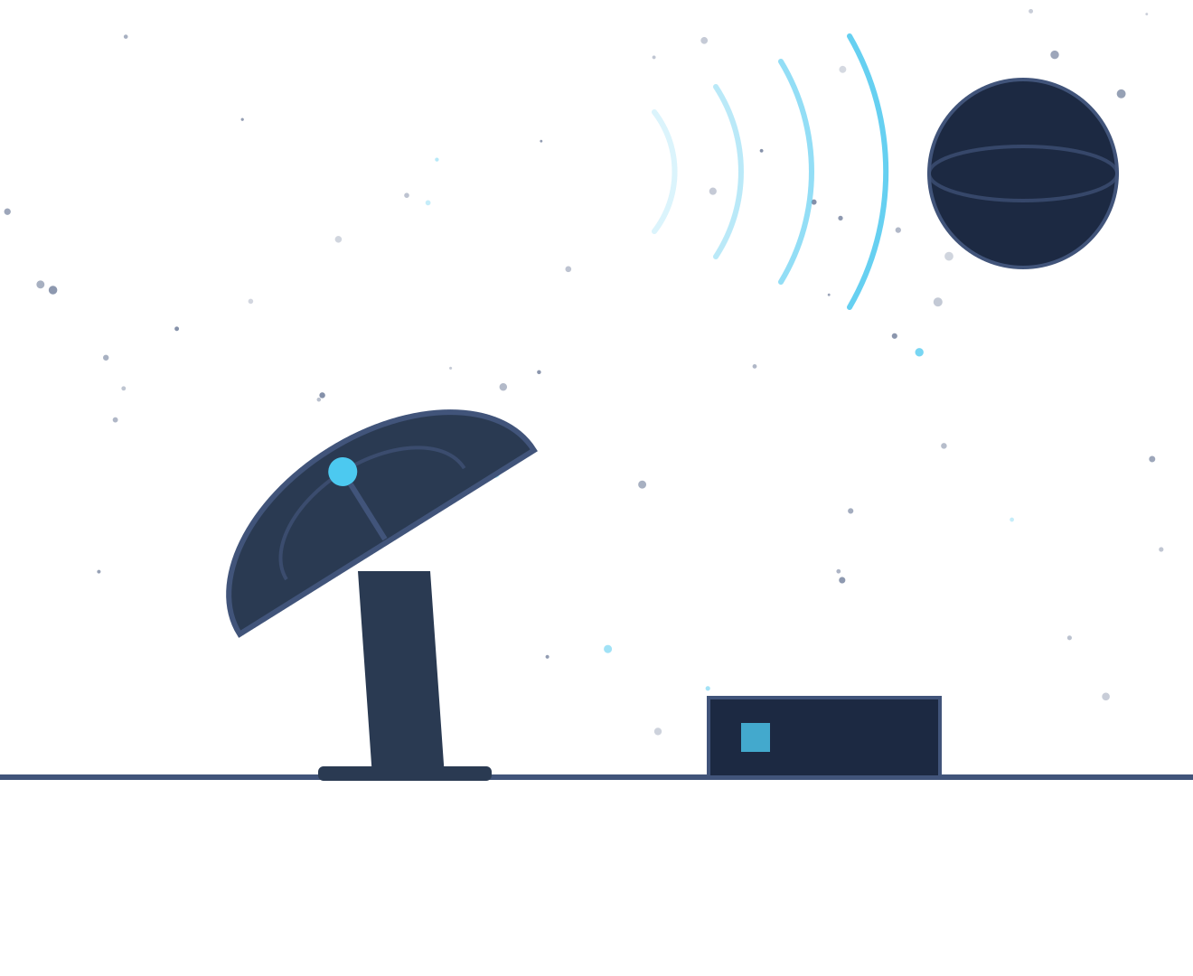
KRYPTON
Signal from the Dark
Seven levels of classical cryptography, played as one long night shift on a deep-space listening post.
A deep-space listening post catches a faint transmission no one can place. Over one long night shift the operator peels back layer after layer, watching the signal grow stranger — less like noise, more like something reaching back — until the last layer reveals a pattern that never quite repeats.
CEI LABS CTF — GUIDE 02 / 04
01
Notes:
Krypton is the shortest track and the most self-contained: seven levels that walk the entire history of classical cryptography, from an encoding that isn't really a cipher at all up to a stream cipher. It is a good second track — it needs far less Linux than Bandit, so it rewards people who found Bandit heavy going.
1

Slide 2




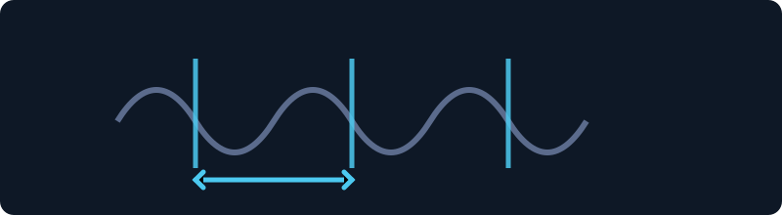

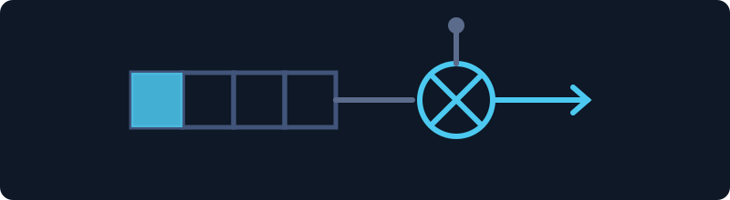
THE MAP
Seven levels, one night shift
Each level is a single named technique. Nothing here needs deep Linux — if Bandit felt heavy, start with this track.
Points run 200 up to 500 across the seven levels — 2,450 in total. Theory section below: about ten minutes of reading.
00
01
02
03
Base64
ROT13
Caesar Shift
Frequency
Not a cipher at all — an encoding. No key, no secret.
A fixed rotation. Apply it twice and you are back.
Same idea, but nobody tells you the number.
Letters aren't evenly used. That imbalance is a crowbar.
04
05
06
Vigenère
Kasiski Test
Stream Cipher
A shift that changes per position — period given.
The period isn't given. Repeats give it away.
A keystream that never quite repeats.
Levels 0–6 share one box. Krypton has no environment of its own beyond that.
CEI LABS CTF — GUIDE 02 / 04
02
Notes:
Each level is a single named technique. Nothing here needs deep Linux — if Bandit felt heavy, start with this track.
2

Slide 3
THE IDEAS
Six ideas every cipher rests on
The vocabulary the levels are written in. Each one is a technique this track will ask you to recognise, explained here without being applied to anything you have to solve.
01
Encoding is not encryption
04
Polyalphabetic ciphers
02
Substitution and the shift
05
Finding the key length
03
Frequency analysis
06
Stream ciphers and XOR
CEI LABS CTF — GUIDE 02 / 04
03
Notes:
A deliberate pause. Say what is coming and roughly how long it will take, then work through the topics. None of them is a level and none is a method — it is the shared vocabulary the track assumes. If you are running short, this list is also the menu: cut topics from it rather than rushing all of them.
3

Slide 4
THEORY 01 / 06
Encoding is not encryption
Base64 changes how bytes look. It keeps no secret at all.
WHAT IT IS
base64, both directions
plain HELLO
encoded SEVMTE8=
how to recognise it
- alphabet is A-Z a-z 0-9 + /
- length is a multiple of 4
- padded at the end with = or ==
- roughly a third longer than the input
there is no key,
so there is nothing to break
Encoding converts data into a different alphabet so that it survives transport — text using only safe characters, for instance. The transformation is fixed and public. There is no key, so anyone can undo it. Base64 turns every three bytes into four printable characters, which is why encoded text runs about a third longer and often ends in an equals sign.
WHY IT MATTERS HERE
Encoded data looks scrambled, so it is often mistaken for encrypted data. Telling them apart saves you from attacking something that was never locked.
No key means no secret. It is a costume, not a lock.
CEI LABS CTF — GUIDE 02 / 04
04
Notes:
Encoding is not encryption. Base64 changes how bytes look. It keeps no secret at all.
The left column is the explanation; the right is a worked example you can talk through line by line. The example is a generic illustration of the concept — it is not a payload, path or command for any actual level, so it can be shown in full without spoiling anything.
Land this: No key means no secret. It is a costume, not a lock.
4

Slide 5
THEORY 02 / 06
Substitution and the shift
Replace every letter with another by a fixed rule. The rule is the key.
WHAT IT IS
PLAIN
The oldest family of ciphers replaces each symbol with a different one. In a shift cipher the rule is simply "move along the alphabet by a fixed number", wrapping round at the end. Encrypting and decrypting are the same operation in opposite directions, and the entire secret is that one number.
A
B
C
D
E
F
G
H
I
J
K
L
M
N
O
P
Q
R
S
T
U
V
W
X
Y
Z
SHIFTED BY 3
D
E
F
G
H
I
J
K
L
M
N
O
P
Q
R
S
T
U
V
W
X
Y
Z
A
B
C
CIPHERTEXT
WKH VLJQDO LV IDLQW
WHY IT MATTERS HERE
Everything else on this track builds on this idea or reacts against it. A rotation of 13 is the same mechanism with the number fixed and published; the interesting case is when nobody tells you the number.
SHIFTED BACK
THE SIGNAL IS FAINT
Encrypting and decrypting are the same move, in opposite directions.
Twenty-five possible numbers is not a secret, it is a short wait.
CEI LABS CTF — GUIDE 02 / 04
05
Notes:
Substitution and the shift. Replace every letter with another by a fixed rule. The rule is the key.
The left column is the explanation; the right is a worked example you can talk through line by line. The example is a generic illustration of the concept — it is not a payload, path or command for any actual level, so it can be shown in full without spoiling anything.
Land this: Twenty-five possible numbers is not a secret, it is a short wait.
5

Slide 6
THEORY 03 / 06
Frequency analysis
Real language is lopsided, and substitution preserves the lopsidedness.
WHAT IT IS
English letter frequency, roughly
E ############ 12.7%
T ######### 9.1%
A ######## 8.2%
O ####### 7.5%
I ####### 7.0%
...
Z # 0.1%
a substitution changes the NAMES
but not the SHAPE of the counts
so the tallest bar is probably E
In English some letters appear far more often than others: E and T at the top, Q and Z at the bottom. A substitution cipher renames the letters but does nothing to how often each one occurs. Count the symbols in the ciphertext: the commonest one is probably E.
WHY IT MATTERS HERE
This one idea ended simple substitution as a serious method. It also explains why a short message is safer than a long one: counts need volume before they mean anything.
You are not reading the letters. You are counting them.
CEI LABS CTF — GUIDE 02 / 04
06
Notes:
Frequency analysis. Real language is lopsided, and substitution preserves the lopsidedness.
The left column is the explanation; the right is a worked example you can talk through line by line. The example is a generic illustration of the concept — it is not a payload, path or command for any actual level, so it can be shown in full without spoiling anything.
Land this: You are not reading the letters. You are counting them.
6

Slide 7
THEORY 04 / 06
Polyalphabetic ciphers
Use several shifts in rotation, and the frequency counts flatten out.
WHAT IT IS
plaintext THESIGNALISFAINT
key KEYKEYKEYKEYKEYK
ciphertext DLCCMEXEJSWDKMLD
each position uses its own shift
T + K -> D
H + E -> L
E + Y -> C
note the two Es and the three Is
do not become the same letter
so counting no longer gives one answer
A Vigenere cipher takes a keyword and uses each of its letters as a shift in turn, repeating the keyword across the message. The same plaintext letter therefore encrypts differently depending on where it happens to sit, so counting letters no longer produces one clear answer.
WHY IT MATTERS HERE
It defeats the previous idea head-on, and for centuries it looked unbreakable. The new weakness is repetition: the keyword restarts at a fixed interval.
One key letter per position. The key is short; the message is not.
CEI LABS CTF — GUIDE 02 / 04
07
Notes:
Polyalphabetic ciphers. Use several shifts in rotation, and the frequency counts flatten out.
The left column is the explanation; the right is a worked example you can talk through line by line. The example is a generic illustration of the concept — it is not a payload, path or command for any actual level, so it can be shown in full without spoiling anything.
Land this: One key letter per position. The key is short; the message is not.
7

Slide 8
THEORY 05 / 06
Finding the key length
If the key repeats, the ciphertext repeats — and the gaps betray the period.
WHAT IT IS
the same fragment, appearing twice
....WXZ..........WXZ.......
^ ^
position 4 position 20
distance = 16
another pair, distance 24
common factors of 16 and 24: 2, 4, 8
so the key is probably 4 or 8 long
then split into that many columns
each column is one simple shift
When the same plaintext fragment lines up with the same part of the keyword, it encrypts to the same ciphertext fragment. Measure the distance between two such repeats and the key length must divide that distance. Do it for several repeats and the common factor stands out.
WHY IT MATTERS HERE
Once the length is known the message splits into that many independent columns, and each column is an ordinary single shift — solvable by counting letters. That turns an unbreakable-looking cipher back into one you already know how to attack.
Two techniques, in order: find the period, then count the letters.
CEI LABS CTF — GUIDE 02 / 04
08
Notes:
Finding the key length. If the key repeats, the ciphertext repeats — and the gaps betray the period.
The left column is the explanation; the right is a worked example you can talk through line by line. The example is a generic illustration of the concept — it is not a payload, path or command for any actual level, so it can be shown in full without spoiling anything.
Land this: Two techniques, in order: find the period, then count the letters.
8

Slide 9
THEORY 06 / 06
Stream ciphers and XOR
Generate a long key rather than writing one down, and combine bit by bit.
WHAT IT IS
XOR applied twice returns the original
message 1 0 1 1 0 0 1 0
keystream 1 1 0 1 0 1 1 0
----------------
cipher 0 1 1 0 0 1 0 0
keystream 1 1 0 1 0 1 1 0
----------------
message 1 0 1 1 0 0 1 0 <- back again
the rule is simply:
same bits -> 0 , different bits -> 1
A stream cipher produces a keystream from a small seed and combines it with the message using XOR, an operation that is its own inverse — so the identical process both encrypts and decrypts. The generator is deterministic: the same seed always produces the same keystream.
WHY IT MATTERS HERE
This is where the classical era ends and the modern one starts. Security no longer rests on keeping a rule hidden. It rests on the keystream being long, non-repeating, and impossible to predict from any piece of it you see.
Encrypting and decrypting stop being opposites. They become the same act.
CEI LABS CTF — GUIDE 02 / 04
09
Notes:
Stream ciphers and XOR. Generate a long key rather than writing one down, and combine bit by bit.
The left column is the explanation; the right is a worked example you can talk through line by line. The example is a generic illustration of the concept — it is not a payload, path or command for any actual level, so it can be shown in full without spoiling anything.
Land this: Encrypting and decrypting stop being opposites. They become the same act.
9

Slide 10





GETTING IN
You connect with SSH
Same as Bandit: a host, a port, and your own terminal. If you've already played Bandit, you already know this part.
STEP BY STEP
THE LAUNCH PANEL
1
Launch Environment
Launch Environment
On any Krypton challenge. Wait for the host and port.
Starts your box, or reconnects you to one already running.
2
SSH in
Reboot Host
Same idea: the previous level's password is this login.
Restarts it in place. Same connection details afterward.
3
Break the cipher
Relaunch Environment
Everything you need is in the level's own directory.
Rebuilds from scratch. Anything you changed inside is lost.
4
Submit the flag
+5 more minutes
The recovered password is both the flag and your next login.
Appears only once the track is solved and a shutdown has started.
The command-line tools you need are already installed — run krypton-tools --help on the box.
Want a coach while you play? The AI Copilot track (Guide 04) is the event's one sanctioned AI helper — set it up early.
CEI LABS CTF — GUIDE 02 / 04
10
Notes:
Identical mechanics to Bandit, so if the room has already seen that deck you can move quickly here. The one addition worth naming is krypton-tools --help: the tools they need are already on the box, and people waste time installing their own.
10

Slide 11
YOUR FIRST FLAG
Start Here, step by step
Ten points to confirm you can reach the box and read a file, before any cipher is involved.
1
2
3
4
Click Launch
Log in
Read welcome.txt
Submit it
On the "Krypton: Start Here" challenge in CTFd.
→
Connect as krypton0 with password krypton0 — the fixed public entry account.
→
In the home directory.
→
Then begin Krypton 0 → 1: Base64 Decoding.
Krypton 0 is deliberately gentle — it's an encoding, not a cipher.
CEI LABS CTF — GUIDE 02 / 04
11
Notes:
Ten points to confirm you can reach the box and read a file, before any cipher is involved.
11

Slide 12

Ready to play.
Krypton is short, self-contained, and needs far less Linux than Bandit.
1
Log in to CTFd and open the Cryptography category
2
Solve "Krypton: Start Here" to check your connection
3
Launch the environment — levels 0 to 6 share it
4
Run krypton-tools --help on the box before you start guessing
5
Stuck? Find a staff member. Hints cost a share of the challenge's points — the cost is shown before you open one.
Good luck.
CEI LABS CTF — GUIDE 02 / 04
12
Notes:
Closing slide — leave it up while people get started.
12

