Slide 1


NATAS
Into the Mirror
15 levels of server-side web security, played as a descent through an inverted underworld.
A researcher logs into a web application built like an inverted underworld — every layer of ordinary web logic mirrored, twisted, or hidden just beneath the surface. Each floor down leads further from what a browser is supposed to show you, toward the raw records at the bottom.
CEI LABS CTF — GUIDE 03 / 04
01
Notes:
Natas is the web track and the one that works differently from the other two: launching gives you an attacker workstation, not a direct line to the target. Every target is reachable only from inside that workstation. There is no SSH requirement — one click gives a full Kali desktop in the browser over noVNC. 'Natas' is 'Satan' spelled backwards, which is where the mirrored-underworld theme comes from.
1

Slide 2







THE MAP
Fifteen levels, one long descent
The first few are things you can do with nothing but a browser. The last few reach the server itself.
Points run 200 up to 900 across the fifteen levels — 8,250 in total. Theory section below: about ten minutes of reading.
00–01
02–03
04–05
06–07
Source & Blockers
Unlisted Paths
Forged Claims
Hidden Includes
What the page is made of, and a barrier that only looks like one.
Corridors never meant to be found; a sign that only asks.
Referer and cookies — arriving from somewhere you never were.
A trapdoor under something ordinary; a door that opens too far.
08–09
10–11
12–14
Mirror & Injection
Guards & Overlap
Uploads & Records
A lock that shows its own key; one extra instruction slipped in.
The same trick with a guard on it; where two things overlap.
Your own thing through the slot — then the records themselves.
All 15 levels share one target box, distinguished by port.
CEI LABS CTF — GUIDE 03 / 04
02
Notes:
The first few are things you can do with nothing but a browser. The last few reach the server itself.
2

Slide 3
THE IDEAS
Seven ideas the web is built on
Enough of how HTTP actually behaves to make the levels legible. No payloads and no walkthroughs — just the model each level is bending.
01
Request and response
05
Input that becomes instruction
02
The client is not a boundary
06
Reversible is not secret
03
Paths and traversal
07
The data layer
04
Cookies, headers and sessions
CEI LABS CTF — GUIDE 03 / 04
03
Notes:
A deliberate pause. Say what is coming and roughly how long it will take, then work through the topics. None of them is a level and none is a method — it is the shared vocabulary the track assumes. If you are running short, this list is also the menu: cut topics from it rather than rushing all of them.
3

Slide 4
THEORY 01 / 07
Request and response
HTTP is one request, one reply, and no memory of either afterwards.
WHAT IT IS
GET /index.php HTTP/1.1 <- method, path
Host: target <- headers
Cookie: session=abc123
Referer: http://example/
User-Agent: Mozilla/5.0
<- blank line
HTTP/1.1 200 OK <- status
Content-Type: text/html <- headers
<html>...</html> <- body
A browser sends a request: a method, a path, a set of headers and sometimes a body. The server replies with a status, its own headers and some content. Then it forgets you entirely. Anything the server needs to know next time has to be carried along in the next request.
WHY IT MATTERS HERE
Every input on this track arrives inside one of those parts. Being able to say exactly where a value lives — in the path, a header, a cookie or the body — is most of the work on most levels.
Name the part a value lives in, and you have named where to change it.
CEI LABS CTF — GUIDE 03 / 04
04
Notes:
Request and response. HTTP is one request, one reply, and no memory of either afterwards.
The left column is the explanation; the right is a worked example you can talk through line by line. The example is a generic illustration of the concept — it is not a payload, path or command for any actual level, so it can be shown in full without spoiling anything.
Land this: Name the part a value lives in, and you have named where to change it.
4

Slide 5
THEORY 02 / 07
The client is not a boundary
Everything the browser does happens on your machine, under your control.
WHAT IT IS
what the server sent to you
<input type=hidden name=price value=10>
<button disabled>Submit</button>
<script>if (!valid()) return;</script>
what you may do about it
- read all of the source, not the page
- change any value before sending it
- ignore the script completely
- send the request without a browser
none of the above is an exploit.
it is just using your own computer.
The page source, the scripts, the hidden fields, the disabled buttons and the validation messages are all delivered to you and run by you. You can read every byte of it, and you can decline to run any of it. A request does not even have to come from a browser.
WHY IT MATTERS HERE
A lot of web software confuses "the interface won't let you" with "it cannot happen". Only a check that runs on the server is a check at all. This one idea unlocks the whole track.
The page is a suggestion. The request is what counts.
CEI LABS CTF — GUIDE 03 / 04
05
Notes:
The client is not a boundary. Everything the browser does happens on your machine, under your control.
The left column is the explanation; the right is a worked example you can talk through line by line. The example is a generic illustration of the concept — it is not a payload, path or command for any actual level, so it can be shown in full without spoiling anything.
Land this: The page is a suggestion. The request is what counts.
5

Slide 6
THEORY 03 / 07
Paths and traversal
A path is a string the server turns into a location on disk.
WHAT IT IS
what the developer pictured
/var/www/files/ + report.txt
= /var/www/files/report.txt
what the same syntax also permits
/var/www/files/ + ../../etc/hostname
= /etc/hostname
'..' means 'up one directory'
the server resolved it exactly as asked
and never checked the destination
When a value taken from the request is used to build a filename, the server is trusting that value to stay where it was meant to. Path syntax includes a component meaning "go up one level", so a value meant to name a file can instead point somewhere outside the intended directory.
WHY IT MATTERS HERE
The flaw is not the syntax — the syntax is doing exactly what it says. The flaw is building a filesystem path out of user input and never checking where it ends up.
The server did nothing wrong. It did exactly what it was told.
CEI LABS CTF — GUIDE 03 / 04
06
Notes:
Paths and traversal. A path is a string the server turns into a location on disk.
The left column is the explanation; the right is a worked example you can talk through line by line. The example is a generic illustration of the concept — it is not a payload, path or command for any actual level, so it can be shown in full without spoiling anything.
Land this: The server did nothing wrong. It did exactly what it was told.
6

Slide 7
THEORY 04 / 07
Cookies, headers and sessions
A forgetful protocol remembers you by handing you something to give back.
WHAT IT IS
the server hands you something
Set-Cookie: role=guest; loggedin=0
your browser gives it back, every time
Cookie: role=guest; loggedin=0
but it is your file, on your disk
Cookie: role=admin; loggedin=1
other headers make claims too
Referer says where you came from
User-Agent says what you are
neither of them is proof of anything
The server sets a cookie; your browser returns it on every later request. Other headers carry similar claims — where you came from, what browser you are, what you will accept. All of them are just text, stored on your machine, and sent by your machine.
WHY IT MATTERS HERE
Anything travelling with the request can be inspected and altered. A value is trustworthy only if the server can verify it independently, not just because the server received it.
Received is not the same as verified.
CEI LABS CTF — GUIDE 03 / 04
07
Notes:
Cookies, headers and sessions. A forgetful protocol remembers you by handing you something to give back.
The left column is the explanation; the right is a worked example you can talk through line by line. The example is a generic illustration of the concept — it is not a payload, path or command for any actual level, so it can be shown in full without spoiling anything.
Land this: Received is not the same as verified.
7

Slide 8
THEORY 05 / 07
Input that becomes instruction
The bug appears when a value supplied as data gets executed as a command.
WHAT IT IS
the developer's mental model
run("ping " + userInput)
command a hostname
what usually runs
ping 127.0.0.1
what a shell also understands
ping 127.0.0.1 ; whoami
^ no longer a hostname
same shape, different interpreter
SELECT * FROM t WHERE n = 'value'
A program builds a command or a query by pasting a value into the middle of a string. To the program it is one piece of text. To whatever reads that text afterwards, part of it is a value and part is syntax — so if the supplied value contains syntax, it stops being data.
WHY IT MATTERS HERE
This single shape explains command injection, SQL injection and most of the second half of this track. Filtering particular characters is a patch on the symptom; not building instructions out of input at all is the actual fix.
Ask on every level: where does my text stop being text?
CEI LABS CTF — GUIDE 03 / 04
08
Notes:
Input that becomes instruction. The bug appears when a value supplied as data gets executed as a command.
The left column is the explanation; the right is a worked example you can talk through line by line. The example is a generic illustration of the concept — it is not a payload, path or command for any actual level, so it can be shown in full without spoiling anything.
Land this: Ask on every level: where does my text stop being text?
8

Slide 9
THEORY 06 / 07
Reversible is not secret
If it can be undone with what you already hold, it protects nothing.
WHAT IT IS
XOR is its own inverse
data XOR key = scrambled
scrambled XOR key = data
and given any matching pair
data XOR scrambled = key
^ the key itself
signs there is no real secret
- output length equals input length
- the same input always gives the same
- the transformation is in the source
Encoding, compression and XOR against a fixed value all transform data without keeping a secret. XOR is its own inverse, so if you can obtain a single matching pair of before and after, the key falls straight out.
WHY IT MATTERS HERE
Home-made "encryption" in web applications is nearly always one of these. If you can spot a reversible transformation, you won't treat it as a wall and burn an hour on it.
Scrambled and secret are not the same property.
CEI LABS CTF — GUIDE 03 / 04
09
Notes:
Reversible is not secret. If it can be undone with what you already hold, it protects nothing.
The left column is the explanation; the right is a worked example you can talk through line by line. The example is a generic illustration of the concept — it is not a payload, path or command for any actual level, so it can be shown in full without spoiling anything.
Land this: Scrambled and secret are not the same property.
9

Slide 10
THEORY 07 / 07
The data layer
Behind most of the web sits a database, answering questions written as text.
WHAT IT IS
the shape of a query
SELECT column the fields you want
FROM table where they live
WHERE name = 'value' the condition
built by joining strings together
"... WHERE name = '" + input + "'"
the quote character ends the value.
anything after it is read as more
query, not as more data.
A query is a sentence: which columns, from which table, matching which condition. Applications build these sentences while running, often by joining fragments and user input into one string. The database cannot tell which part the developer wrote and which part arrived from outside.
WHY IT MATTERS HERE
It is the deepest floor of this track for a reason: the records are the point of the whole building. Every level above it is a route towards here.
The database is not fooled. It was never told there was a difference.
CEI LABS CTF — GUIDE 03 / 04
10
Notes:
The data layer. Behind most of the web sits a database, answering questions written as text.
The left column is the explanation; the right is a worked example you can talk through line by line. The example is a generic illustration of the concept — it is not a payload, path or command for any actual level, so it can be shown in full without spoiling anything.
Land this: The database is not fooled. It was never told there was a difference.
10

Slide 11





GETTING IN
No SSH required
Natas is the one track that needs nothing installed. One click gives you a full Linux desktop inside your browser.
STEP BY STEP
THE LAUNCH PANEL
1
Launch Environment
Launch Environment
You get an attacker workstation plus this track's shared target.
Starts your box, or reconnects you to one already running.
2
Open noVNC
Reboot Host
A full desktop in a browser tab. SSH is offered too.
Restarts it in place. Same connection details afterward.
3
Work from inside
Relaunch Environment
Browse to the target from the workstation, not from your own laptop.
Rebuilds from scratch. Anything you changed inside is lost.
4
Submit the flag
+5 more minutes
Each level's password is the login for the next level's page.
Appears only once the track is solved and a shutdown has started.
This is the track to pick if you're on a locked-down laptop with no terminal.
Want a coach while you play? The AI Copilot track (Guide 04) is the event's one sanctioned AI helper — set it up early.
CEI LABS CTF — GUIDE 03 / 04
11
Notes:
This is the slide people get wrong. The launch gives them an attacker workstation, and the targets are reachable ONLY from inside it — not from their own laptop. Say that twice. The noVNC desktop needs nothing installed, which makes this the right track for anyone on a locked-down machine.
11

Slide 12
YOUR FIRST FLAG
Start Here, step by step
Ten points, and it proves the part people actually get stuck on: that targets live behind the workstation.
1
2
3
4
Click Launch
Open the workstation
Browse from inside it
Submit it
On the "Natas: Start Here" challenge in CTFd.
→
noVNC in your browser, or SSH — your choice.
→
Open the target host on port 8000 and read welcome.txt.
→
Then begin Natas 0: View Source.
If the target won't load, check you're browsing from the workstation and not your own machine.
CEI LABS CTF — GUIDE 03 / 04
12
Notes:
Ten points, and it proves the part people actually get stuck on: that targets live behind the workstation.
12

Slide 13
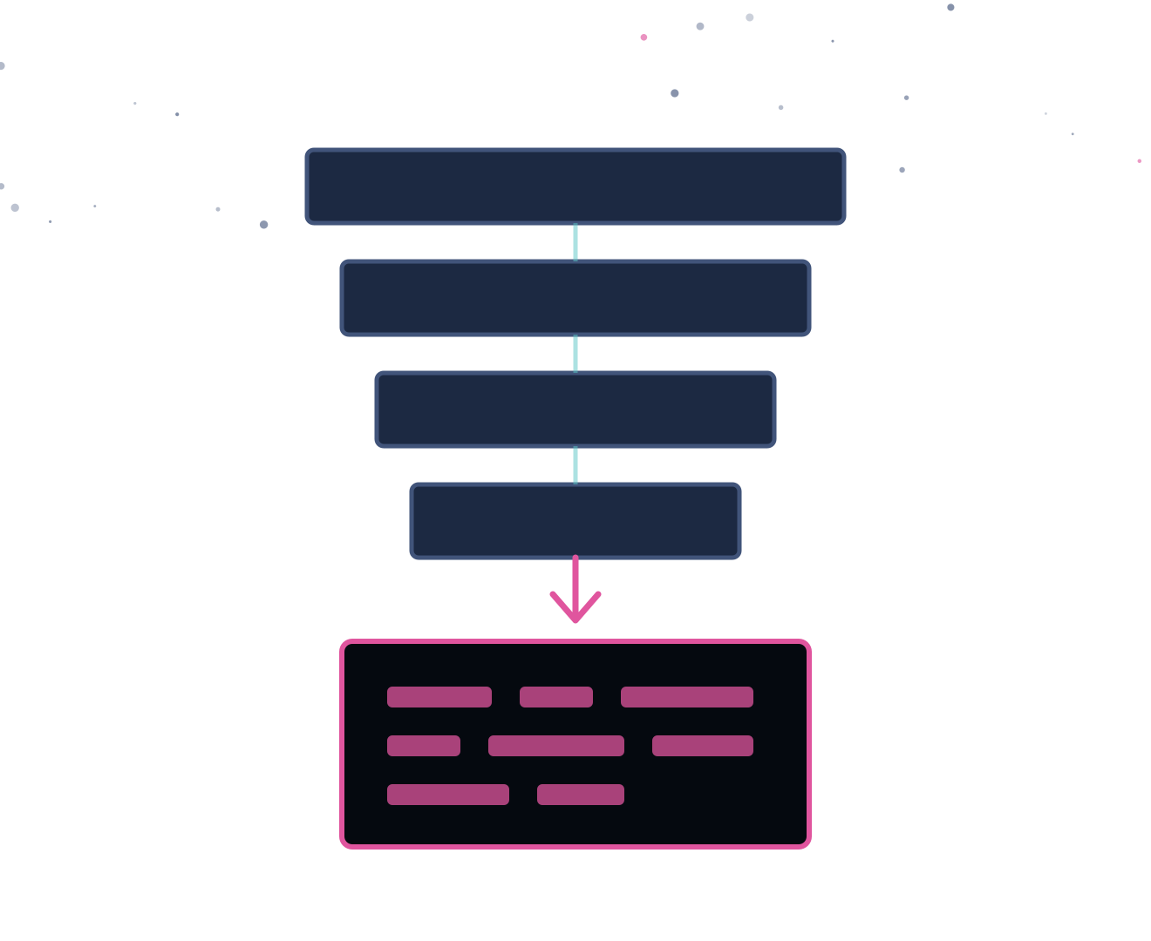
Ready to play.
Natas needs nothing installed — just a browser.
1
Log in to CTFd and open the Web Security category
2
Solve "Natas: Start Here" to reach the workstation
3
Open noVNC and browse to the target from inside it
4
Work level 0 downward; view source before anything else
5
Stuck? Find a staff member. Hints cost a share of the challenge's points — the cost is shown before you open one.
Good luck.
CEI LABS CTF — GUIDE 03 / 04
13
Notes:
Closing slide — leave it up while people get started.
13

