Slide 1

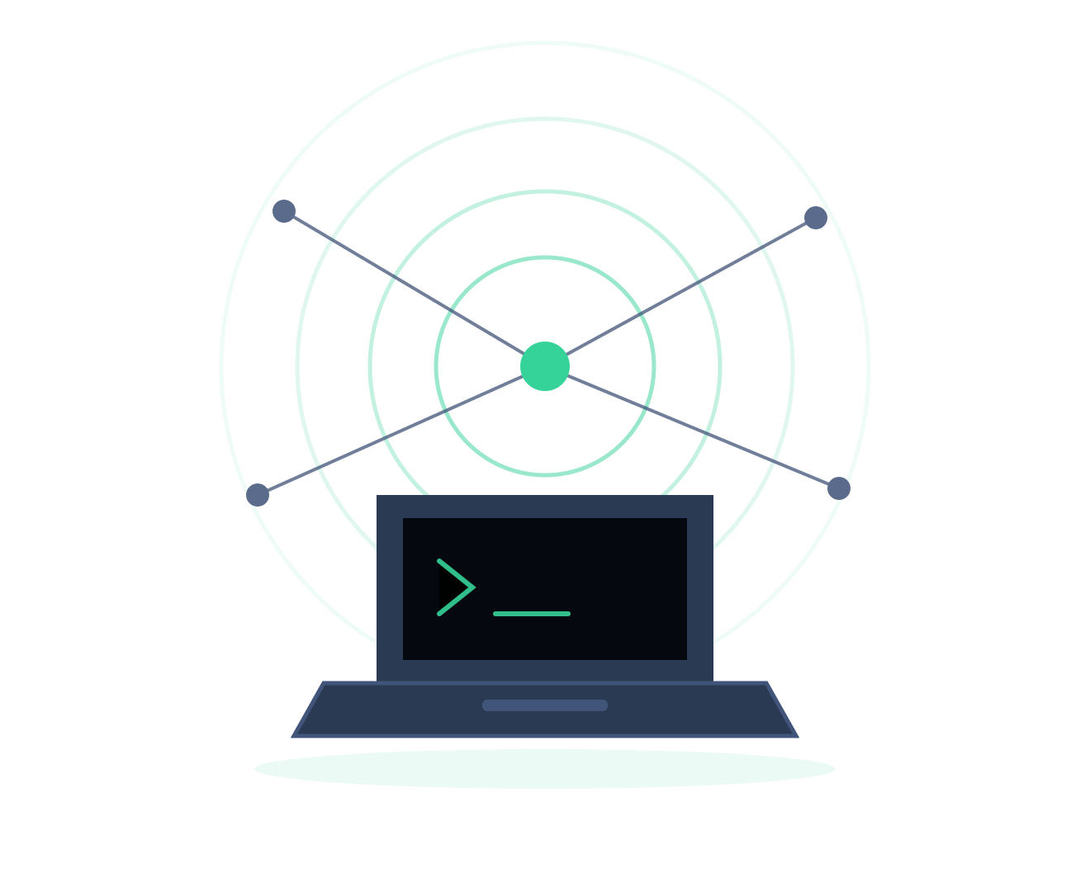
AI COPILOT SETUP
The one that isn't a story
Six challenges that put a free, local AI coach on your own laptop — the event's one sanctioned AI exception.
The other three tracks each carry a story. This one deliberately doesn't. There is no compound to break into and no signal to decode — the target is your own laptop, and the reward is a coach that sits beside you for the rest of the event.
CEI LABS CTF — GUIDE 04 / 04
01
Notes:
This track is deliberately unlike the other three. There is no compound, no signal, no underworld, and no Docker instance to launch — the target is the player's own laptop. It is not part of the staged wave rollout and ships hidden by default; the organizer releases it manually. The single most important slide is the rules one: this is the ONLY sanctioned AI exception, and it does not generalise to the other three tracks.
1

Slide 2






THE MAP
Six challenges, 610 points
Each one is verified by ctf-agent-verify, a tool shipped with the agent. It checks a real milestone and prints the flag only when that milestone is genuinely true on your machine.
Theory section below: about ten minutes of reading — worth it even if you never finish this track.
SH · 10 PTS
01 · 100 PTS
02 · 100 PTS
03 · 100 PTS
Start Here
Local Brain
Pull a Model
Install the Agent
Read the AI-use exception and confirm you understand it.
Ollama installed and answering. Nothing works until this does.
A runtime with no model can't think yet. Size it to your memory.
ctf-agent and ctf-agent-verify properly on your PATH.
04 · 150 PTS
05 · 150 PTS
Point It At a Box
Ask For Help
A real SSH connection to a live Bandit, Krypton or Natas instance.
Launch one of those tracks first.
Name a track and a level. Show the shape of a useful prompt.
Nothing here is guessable without actually doing the step.
CEI LABS CTF — GUIDE 04 / 04
02
Notes:
Each one is verified by ctf-agent-verify, a tool shipped with the agent. It checks a real milestone and prints the flag only when that milestone is genuinely true on your machine.
2

Slide 3
THE IDEAS
Six ideas about how this thing works
What a language model is actually doing, so you can judge when to trust it. Useful whether or not you ever finish this track.
01
What a language model does
04
Prompting
02
Tokens and context
05
Tools: how it acts
03
Running a model locally
06
Being wrong convincingly
CEI LABS CTF — GUIDE 04 / 04
03
Notes:
A deliberate pause. Say what is coming and roughly how long it will take, then work through the topics. None of them is a level and none is a method — it is the shared vocabulary the track assumes. If you are running short, this list is also the menu: cut topics from it rather than rushing all of them.
3

Slide 4
THEORY 01 / 06
What a language model does
It predicts the next piece of text, over and over, very quickly.
WHAT IT IS
generation, one token at a time
"The capital of France is" -> " Paris"
"The capital of France is Paris" -> "."
it is choosing likely, not true
"The flag for this level is" -> ???
it will produce something
that LOOKS exactly like a flag,
with no way of knowing whether
it is the real one
A model is trained on a great deal of text and learns which continuations are likely. Given everything so far it produces one small chunk, a token, appends it, and repeats. There is no lookup, no stored table of facts, and no step at which it checks whether the result is true.
WHY IT MATTERS HERE
Most of what it does follows from that. It is fluent because fluency is what it was optimised for — and confidently wrong for the same reason.
Likely and true are different targets. It is aiming at the first.
CEI LABS CTF — GUIDE 04 / 04
04
Notes:
What a language model does. It predicts the next piece of text, over and over, very quickly.
The left column is the explanation; the right is a worked example you can talk through line by line. The example is a generic illustration of the concept — it is not a payload, path or command for any actual level, so it can be shown in full without spoiling anything.
Land this: Likely and true are different targets. It is aiming at the first.
4

Slide 5
THEORY 02 / 06
Tokens and context
The model sees a fixed-size window of text, and absolutely nothing else.
WHAT IT IS
roughly how text becomes tokens
"unbreakable" -> un | break | able
"ssh" -> ssh
what has to fit in the window
[ instructions ][ conversation ][ reply ]
|<--------- fixed total size --------->|
when it fills, the oldest drops out
practical consequence:
start a fresh chat for each level
Text is split into tokens, roughly word-sized pieces. Everything the model can use has to fit inside its context window: the standing instructions, the conversation so far, and the reply it is producing. Once the window is full, the earliest material stops being visible to it.
WHY IT MATTERS HERE
It cannot see your screen, your files, or a session from yesterday. What you paste in is all it has — and a long conversation can push the important part back out.
It has no memory between chats. Only what is in front of it.
CEI LABS CTF — GUIDE 04 / 04
05
Notes:
Tokens and context. The model sees a fixed-size window of text, and absolutely nothing else.
The left column is the explanation; the right is a worked example you can talk through line by line. The example is a generic illustration of the concept — it is not a payload, path or command for any actual level, so it can be shown in full without spoiling anything.
Land this: It has no memory between chats. Only what is in front of it.
5

Slide 6
THEORY 03 / 06
Running a model locally
Size, memory and speed are one trade-off, made three times over.
WHAT IT IS
what the numbers mean
parameters how big the model is
quantization how precisely it is stored
smaller file, some quality lost
context how much text it can hold
the practical trade
more memory -> bigger model -> better
CPU only -> slower to answer
and the thing you gain in return:
nothing you type leaves the machine
A model's size is counted in parameters, and its weights are stored at a chosen precision. Reducing that precision — quantization — shrinks the file so it fits in ordinary memory, at some cost to quality. The whole thing loads before it can answer, and on a CPU it thinks at roughly reading speed rather than instantly.
WHY IT MATTERS HERE
This is why the bootstrap picks a model to match your laptop, why the first run downloads several gigabytes, and why answers arrive a word at a time.
Slower, smaller, and entirely yours.
CEI LABS CTF — GUIDE 04 / 04
06
Notes:
Running a model locally. Size, memory and speed are one trade-off, made three times over.
The left column is the explanation; the right is a worked example you can talk through line by line. The example is a generic illustration of the concept — it is not a payload, path or command for any actual level, so it can be shown in full without spoiling anything.
Land this: Slower, smaller, and entirely yours.
6

Slide 7
THEORY 04 / 06
Prompting
The prompt is the whole briefing. Specific beats polite, every time.
WHAT IT IS
tells it almost nothing
"help"
"this isn't working"
tells it what it actually needs
"Help me with Bandit level 12.
I can see the file but it isn't text.
Explain what I should look at.
Don't give me the answer."
task + subject + what you tried
+ what you want back
Because the output depends only on what is in the window, the levers that work are concrete ones: state the task, name the subject, say what you have already tried, and say what sort of answer you want back. Courtesy words change nothing. Asking for reasoning before a conclusion generally produces a better conclusion.
WHY IT MATTERS HERE
"It didn't help" usually means "it wasn't told enough". Naming a track and a level number is the smallest change with the largest effect — there's a whole challenge for exactly that.
Please and thank you cost you nothing, and buy you nothing.
CEI LABS CTF — GUIDE 04 / 04
07
Notes:
Prompting. The prompt is the whole briefing. Specific beats polite, every time.
The left column is the explanation; the right is a worked example you can talk through line by line. The example is a generic illustration of the concept — it is not a payload, path or command for any actual level, so it can be shown in full without spoiling anything.
Land this: Please and thank you cost you nothing, and buy you nothing.
7

Slide 8
THEORY 05 / 06
Tools: how it acts
On its own it only writes. A tool is what lets it actually do something.
WHAT IT IS
the agent loop
you ask
-> model decides on an action
-> the program really runs it
-> the output goes back in
-> model reads the output
-> model answers you
the difference this makes
without tools it guesses the output
with tools it reads the output
A plain chat model produces text and stops. An agent adds a loop: the model asks for an action, the surrounding program really performs it, and the result is fed back into the context. The model then works from real output from your machine instead of its own guesses.
WHY IT MATTERS HERE
That's why the agent connects to a challenge box, and why step 4 of this track verifies a real connection instead of accepting a description of one.
Reading real output beats predicting plausible output.
CEI LABS CTF — GUIDE 04 / 04
08
Notes:
Tools: how it acts. On its own it only writes. A tool is what lets it actually do something.
The left column is the explanation; the right is a worked example you can talk through line by line. The example is a generic illustration of the concept — it is not a payload, path or command for any actual level, so it can be shown in full without spoiling anything.
Land this: Reading real output beats predicting plausible output.
8

Slide 9
THEORY 06 / 06
Being wrong convincingly
A confident answer and a correct answer look exactly the same.
WHAT IT IS
worth checking before you trust it
- does that command actually exist?
- did it really print that, or is it
describing what it expects to see?
- is that a path you have seen before?
what the verify tool does instead
ctf-agent-verify
-> performs the real step
-> prints the flag ONLY if the step
genuinely passed on your machine
never a claim. always a check.
When the likely continuation is not the true one, the model gives you the likely one anyway — in the same tone and at the same fluency, sometimes with invented specifics. There is no internal signal separating the two cases, so there is no warning.
WHY IT MATTERS HERE
Here that costs you twice: an invented command wastes your time, and an invented flag wastes a submission. It's why every step in this track is verified on your real machine rather than taken on trust.
Use it as a fast colleague who is sometimes wrong, never as an oracle.
CEI LABS CTF — GUIDE 04 / 04
09
Notes:
Being wrong convincingly. A confident answer and a correct answer look exactly the same.
The left column is the explanation; the right is a worked example you can talk through line by line. The example is a generic illustration of the concept — it is not a payload, path or command for any actual level, so it can be shown in full without spoiling anything.
Land this: Use it as a fast colleague who is sometimes wrong, never as an oracle.
9

Slide 10
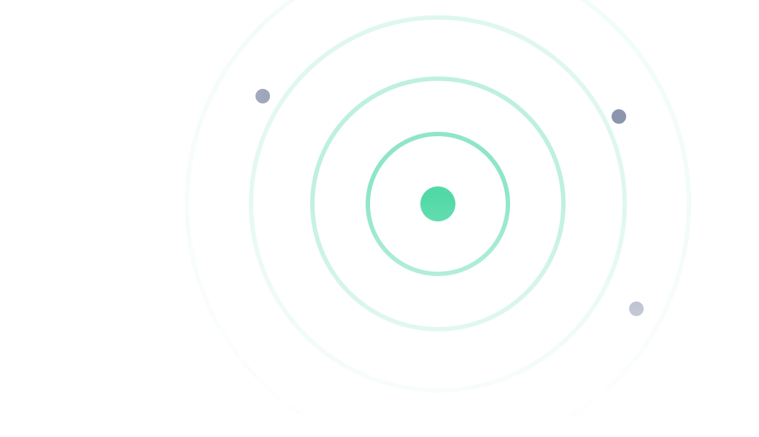



GETTING IN
One command installs everything
The bootstrap script installs Ollama, the agent and its dependencies, then opens the app in your browser.
STEP BY STEP
WHAT THE INSTALLER PUTS DOWN
1
Download the script
Ollama
bootstrap.sh for macOS and Linux, bootstrap.ps1 for Windows.
The local runtime that loads and runs the model.
2
Run it
A model
One line in Terminal or PowerShell. First run pulls a model.
Chosen to fit your laptop's memory. Downloaded once.
3
The app opens
ctf-agent
A chat window in your browser, with a model and box picker.
The app itself — a chat window in your browser.
4
Verify
ctf-agent-verify
Run ctf-agent-verify. It reports the milestones you passed.
Checks each milestone and prints its flag when it truly passes.
Venue Wi-Fi unreliable? An offline copy of the whole project site is attached to Start Here.
CEI LABS CTF — GUIDE 04 / 04
10
Notes:
There is no launch panel on this track at all — the target is their own laptop, which is why the right column lists what the installer sets up instead. Warn them about the first-run model download: it is several gigabytes and it only happens once, but on venue wi-fi it is not quick.
10

Slide 11
YOUR FIRST FLAG
Start Here, step by step
This one has no command to run. It exists so nobody can claim they didn't know the rule.
1
2
3
4
Open Start Here
Read the exception
Grab the attachments
Submit the sentence
"AI Copilot Setup: Start Here" in CTFd.
→
One paragraph explaining exactly what this track does and does not permit.
→
Bootstrap scripts, README, troubleshooting guide, offline site copy.
→
Copy it word for word. That confirmation is the flag.
Read it properly. The rest of this deck assumes you have.
CEI LABS CTF — GUIDE 04 / 04
11
Notes:
This one has no command to run. It exists so nobody can claim they didn't know the rule.
11

Slide 12
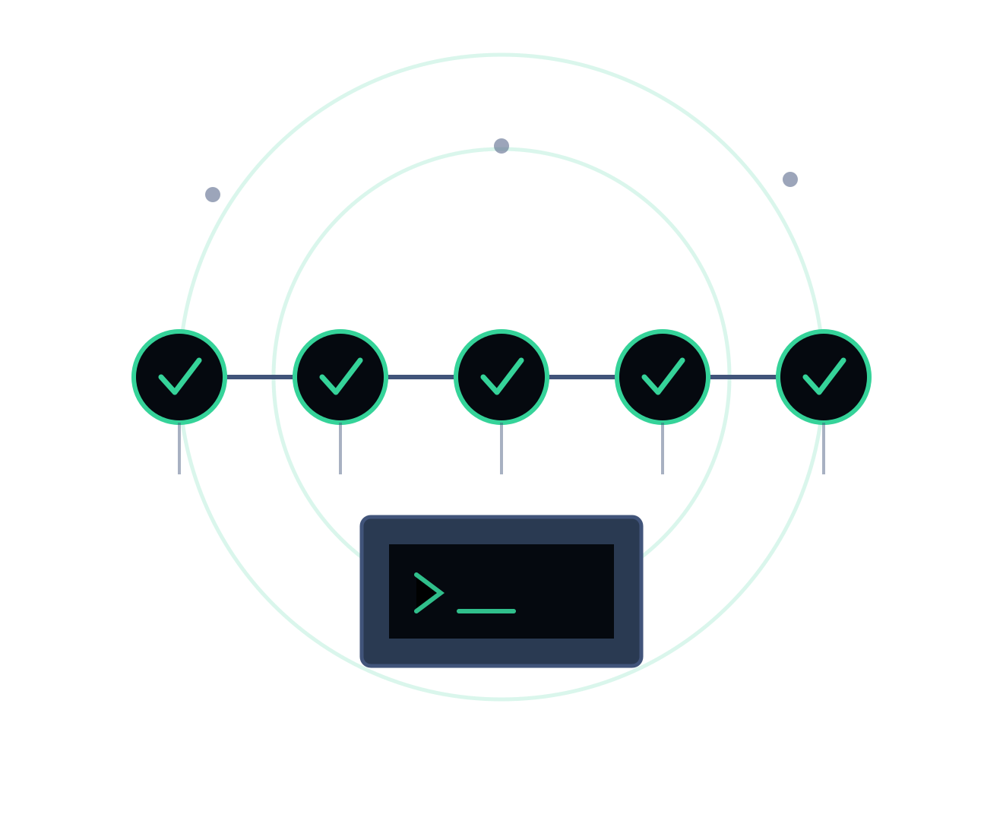
Ready to play.
Do this one early. It pays for itself across the other three tracks.
1
Open "AI Copilot Setup: Start Here" and read the AI-use exception
2
Download and run the bootstrap script for your operating system
3
Wait out the first model download — it only happens once
4
Run ctf-agent-verify and collect the flags it reports
5
Stuck? Find a staff member. Hints cost a share of the challenge's points — the cost is shown before you open one.
Good luck.
CEI LABS CTF — GUIDE 04 / 04
12
Notes:
Closing slide — leave it up while people get started.
12

