Slide 1

You Want Snakes? Because That’s How You Get Snakes.
Terraform antipatterns in the wild
Jason Brown – jasbro@jasbro.io
Notes:
OK, so this talk is not an exhaustive list of terraform antipatterms or best practices – it is a little discussion and rant on some of the most common antipatterns I’ve een seeing of late. I’ve been in the business over 20 years now, doing ”DevOps” for about the last ten. I’ve been at a bunch of organisations using Terraform, and I don’t think a single one of them is doing it right – even the ones I’ve architected.
One last note before we get into it: there’s no blame here. If you’re doing on of these things, I’m sure you have your reasons. But I hope by the end you’ll at least consider maybe looking at your Terraform and start picking away at the bad things Right. So why is this talk called what it’s called? To explain that, let’s go to Antipattern #1

Slide 2
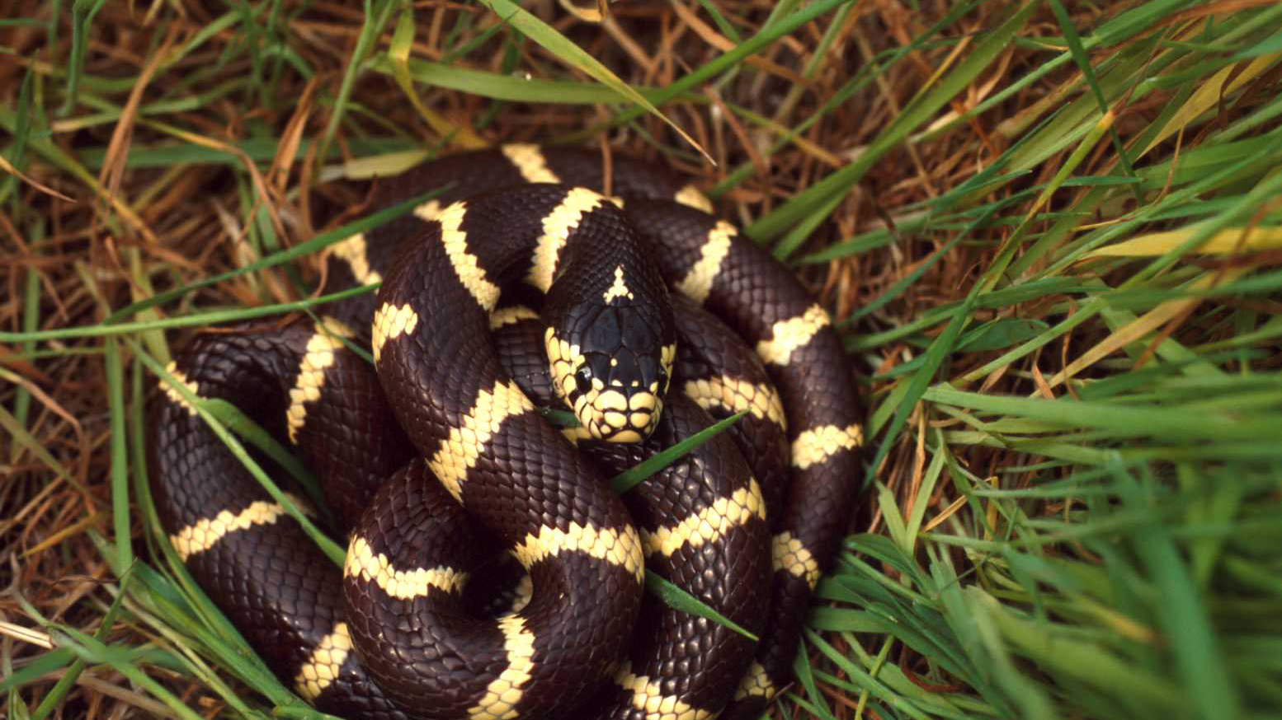
ANTIPATTERN #1: FIRE AND FORGET
Notes:
FIRE and FORGET. That is, folks who write up a bunch of terraform, or maybe copy and paste it from a website, run it once to set up the infrastructure…. Then do nothing else with it. The biggest strength of Terraform is in Drift detection and Correction – if you’re not running it over and over, you don’t get that strength. And what does this have to do with snakes? I lived in the country for a few years, up in NE Victoria. I had a big old lawn front and back, and I was fairly lazy in mowing it. In fact, I don’t think I mowed it at all for the first few months. After a while, a mate at the pub asked me why I hadn’t mowed my lawn lately. I attempted to explain that I wasn’t really bothered, it was nice to leave it a bit natural and besides, I’m lazy. He replied “So… you want snakes? Because that’s how you get snakes”. Which was a surprise. I – city kid – hadn’t thought about that at all.
If you don’t mow your lawn regularly when you’re out in the country, you’re creating a lovely environment in which small critters can roam around unseen, and where there are small critters, there are predators. Snakes will arrive. And it’s the same with terraform. You need to run it regularly to check and correct your infrastructure, otherwise small changes will creep in, and where small changes multiply, eventually bigger and worse ones will arrive. Sure enough, one morning a few weeks after that conversation, I stepped out my front door to find a 3ft red-belly sunning on my driveway. Shortly after, I bought a lawnmower. No more snakes. So that’s Antipattern #1, and I hope nobody here is doing that.

Slide 3

ANTIPATTERN #2: RUNNING TERRAFORM
ON YOUR LAPTOP
Notes:
RUNNING TERRAFORM ON YOUR LAPTOP
OK, this one is gonna be way more common than the last one. Show of hands, how many people run terraform apply from their local workstation instead of in a CI pipeline? WHY?? There’s only one reason you would e doing this, and that’s if you’re the only engineer in your entire company. And even then, I’d say you probably don’t want to, and I’ll explain why in a second Now, let’s try and explain this. There are lots of reasons not to do this 1. dependencies. You probably need credentials, env variables, a bunch of different secrets and things. Terraform credentials, by their nature, are god mode. DO you really want these on your local laptop 2. Branch control How do you guarantee what you’re running locally is the right VERSION of your terraform? We have good solutions for this, using git, we can have a “main” branch, which is our known canonical state. How do you guarantee that nobody accidentally runs “develop” instead though, even by accident? 3. Contention
Yes, state locks exist, but how can you be sure you and your colleague aren’t trying to run the same terraform config against AWS?
4. Visibility
How do you know what’s been applied where and when? There’s no records or logs. 5. State Lock Hell Every time I’ve had to go an manually unlock a state file, it’s been because someone triggered it from their laptop, realized they’d screwed something up and cancelled The answer? You put your terraform in a CI pipeline. That way, your devs don’t necessarily need secrets on their local laptop. There’s no contention

Slide 4
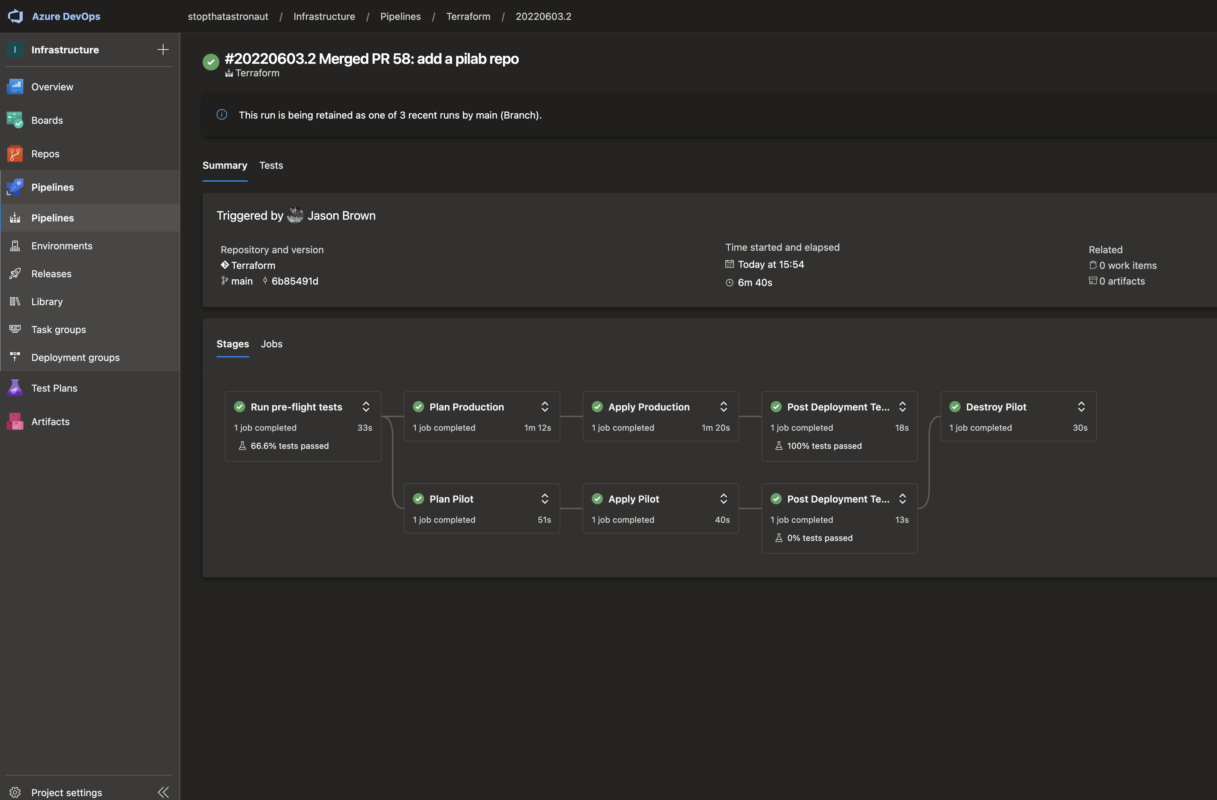
Notes:
Here’s my side-hussle pipeline, in Azure devops. I’m the ONLY engineer in this company. My workflow here is pretty simple. I start a branch in git, I make my changes, I push the branch and I open a pull request The CI pipeline runs PLAN I check it’s working as I expect. I can run plan locally again if I want to tighten up the feedback loop a bit. Once I’m happy, I merge, the pipeline runs apply across everything
You can see I have two accounts there, Production and Pilot, they map to two Azure accounts I own, but this also controls an AWS account, a github organization, My circleCI account, my gitlab account and my StatusCake endpoint monitoring. If I want to make a change, I just pop open VS Code and I change it, then merge the PR. I can demo this live later if you like, but I’ve built similar pipelines in CircleCI, TravisCI and Github actions.
There are lots of cool things you can do in here, FWIW. At work, we run infracost in the pipeline, so our pull requests always include a cost estimate. We also run Pytest against a generated JSON plan, just to check that things are the way we expect them to be, and we also run live tests afterwards to make sure our infra is up and running as expected. All the boring bits are automated so I don’t have to think about them.

Slide 5

ANTIPATTERN #3: MODULES THAT
AREN’T REUSABLE
Notes:
I HAVE SOME EXAMPLES OF THIS

Slide 6
ANTIPATTERN #4: RELIANCE ON TFVARS
Notes:
FIRE and FORGET. That is, folks who write up a bunch of terraform, or maybe copy and paste it from a website, run it once to set up the infrastructure…. Then do nothing else with it. The biggest strength of Terraform is in Drift detection and Correction – if you’re not running it over and over, you don’t get that strength. And what does this have to do with snakes? I lived in the country for a few years, up in NE Victoria. I had a big old lawn front and back, and I was fairly lazy in mowing it. In fact, I don’t think I mowed it at all for the first few months. After a while, a mate at the pub asked me why I hadn’t mowed my lawn lately. I attempted to explain that I wasn’t really bothered, it was nice to leave it a bit natural and besides, I’m lazy. He replied “So… you want snakes? Because that’s how you get snakes”. Which was a surprise. I – city kid – hadn’t thought about that at all.
If you don’t mow your lawn regularly when you’re out in the country, you’re creating a lovely environment in which small critters can roam around unseen, and where there are small critters, there are predators. Snakes will arrive. And it’s the same with terraform. You need to run it regularly to check and correct your infrastructure, otherwise small changes will creep in, and where small changes multiply, eventually bigger and worse ones will arrive. Sure enough, one morning a few weeks after that conversation, I stepped out my front door to find a 3ft red-belly sunning on my driveway. Shortly after, I bought a lawnmower. No more snakes. So that’s Antipattern #1, and I hope nobody here is doing that.

Slide 7

ANTIPATTERN #5
terraform apply -target="s3_bucket.my_pet_resource"
Notes:
Remember the bit about not mowing your lawn? Well this is the equivalent of mowing a tiny patch of lawn just outside your back door and leaving the rest looking like the nethers of a 1970s porn star why do this?? I was at a nameless company a while back who only ever did this. They’d let drift get so far out of control that they only ever applied one or two resources at a time. And these guys were a PCI-compliant fintech startup with a LOT of responsibilities around data security. And yet they’d lost control of their IaC to the extent they were laboriously applying single resources at a time. If you ever have cause to use this switch, question your life choices – there are very rare times you might want to use it, for example if recovering or migrating a horribly broken state, but in general, it would have been much better if you’d put your terraform in a CI pipeline in the first place and had the entire thing run every time you change some code.

Slide 8

ANTIPATTERN #6: Y U NO VERSION YOUR MODULES??

Slide 9

DISCUSSION TIME: WHAT HAVE YOU SEEN
THAT DRIVES YOU MAD?

