Slide 1
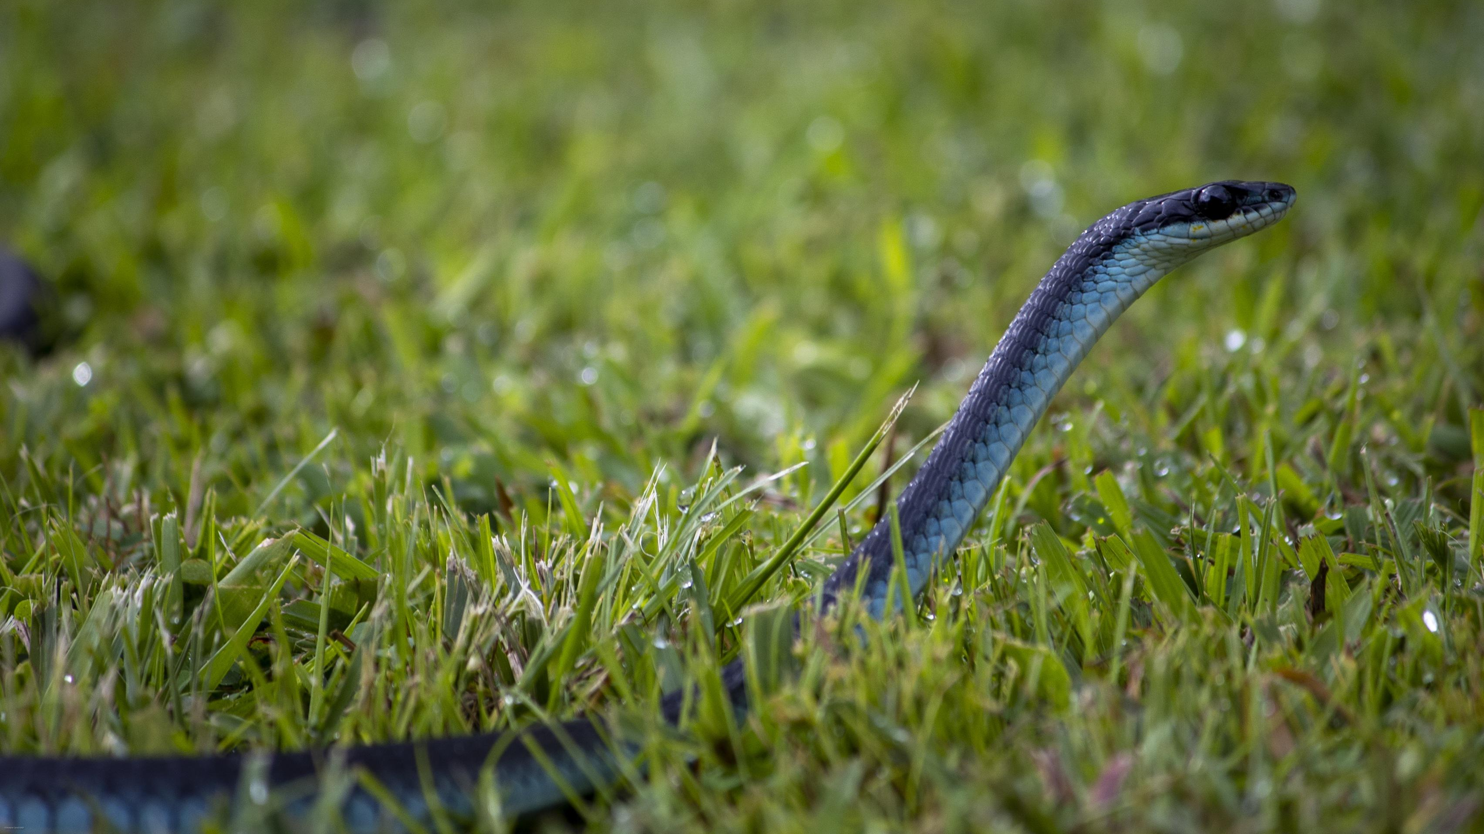
You Want Snakes? Because That’s How You Get Snakes.
Terraform antipatterns in the wild
Jason Brown – jasbro@jasbro.io

Slide 2
