Slide 1
WP5 – Economic Model
T5.2. – DSF Interoperability with 3rd party and DSO system
Matteo Ferraris
LINKS – Innovation Development Senior Business Analyst
Skive | 27-29 May 2019

Slide 2
WP5 – ECONOMIC MODEL DESIGN
A preliminary draft of Economic Model has been provided in D2.4 linked to the HLUC-3 and it will be implemented and described better in DSF-SE (WP5)
The steps for identifying the Economic Model have been:
Stakeholders identification
Scenarios selection
Identification of the are of reference (Fur/Skive)
Selection of the main variables where each variable has been described as:
Definition of the functional form (TCO)
Implementation of the model and results
Interaction with Professional GUI (Input/Output) and DSF-EE (DSF-Economic Engine)
Example of implementation of the model
Tools for the computation (e.g., Excel, MatLab, Stata, other?)

Slide 3
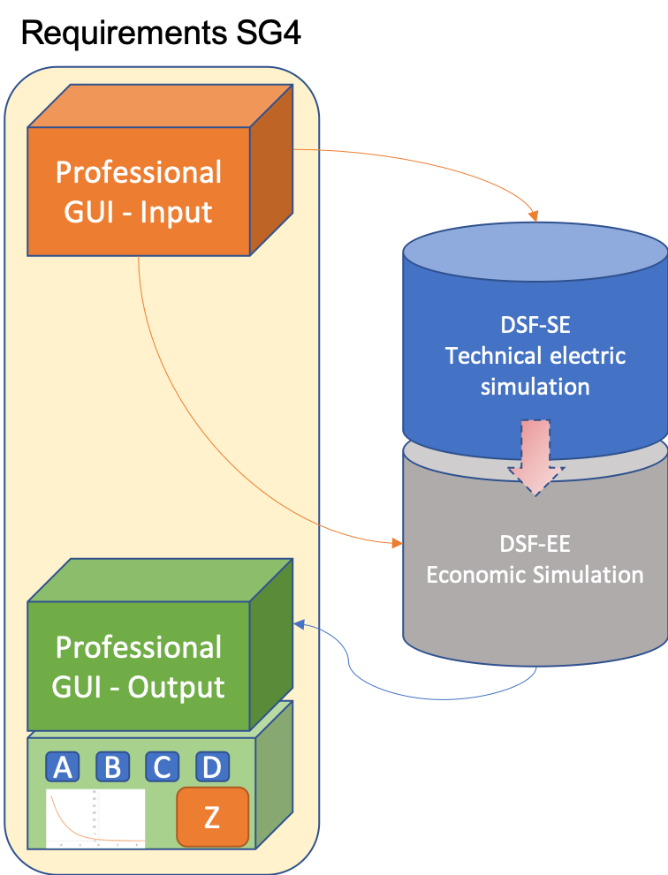
WP5 – ECONOMIC MODEL DESIGN

Slide 4
WP5 – ECONOMIC MODEL DESIGN
Stakeholder Identification:
DSO will be the main Professional User for which we are going to implement the DSF-SE economic modelling
Social Planner (i.e., decision maker) will be the actor that can get output useful from welfare point of view
Prosumers perspective is a NICE TO HAVE but not at this stage of the project and not for this low TRL tool

Slide 5
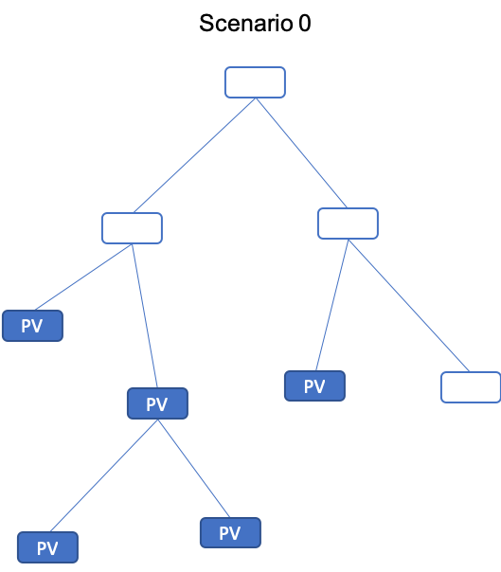
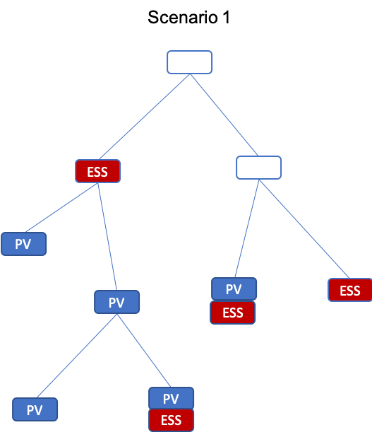
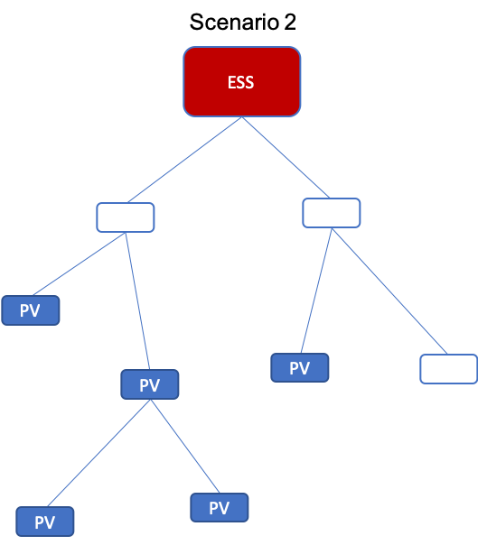
WP5 – ECONOMIC MODEL DESIGN
Scenario selection:
(Baseline) Scenario 0 with grid strengthening (HLUC-3-PUC-1-BM-1)
Scenario 1 with ESS at residential level (HLUC-3-PUC-2)
Scenario 2 with ESS at sub-station level (HLUC-3-PUC-3)
Scenario 3 both with ESS at sub-station and residential level (HLUC-3-PUC-4)
Wok in Progress

Slide 6
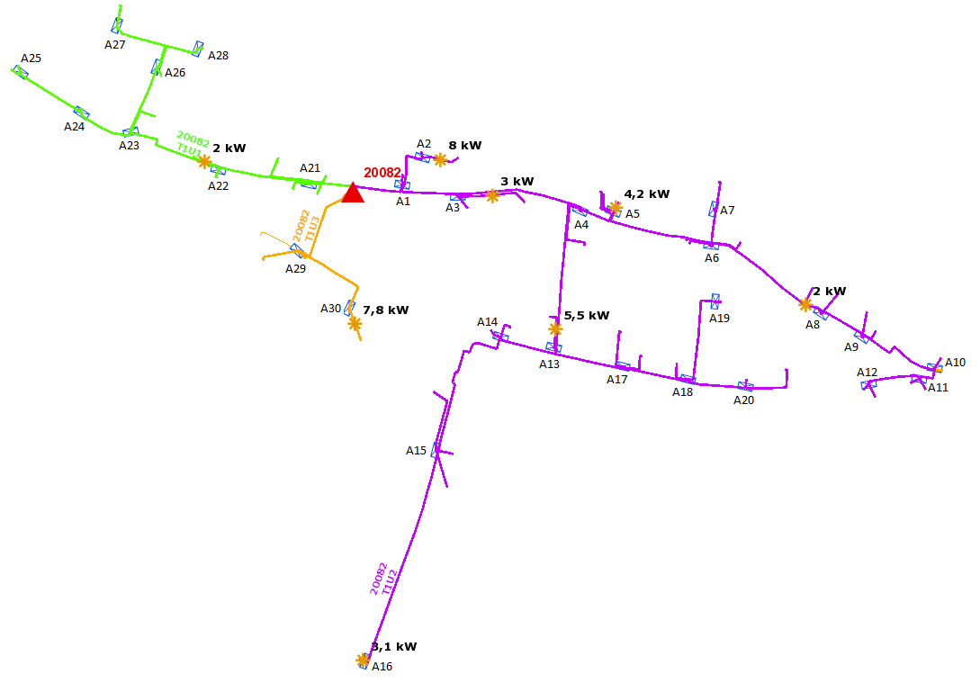
WP5 – ECONOMIC MODEL DESIGN
Identification of the Area where to simulate the DSF-EE:
Fur/Skive
Bolzano for EV penetration scenario (?) → Open issue!

Slide 7
WP5 – ECONOMIC MODEL DESIGN
Variable selection
Selection of the main variables for the model that could be easily integrated with the technical DSF-SE (electric simulator engine)
For each selected variable we provide the following inputs:
Description and functional form
Acronym
Interaction with the Professional GUI
The current (initial) list of main variables to be considered for the Economic Model is shown in the next slides

Slide 8
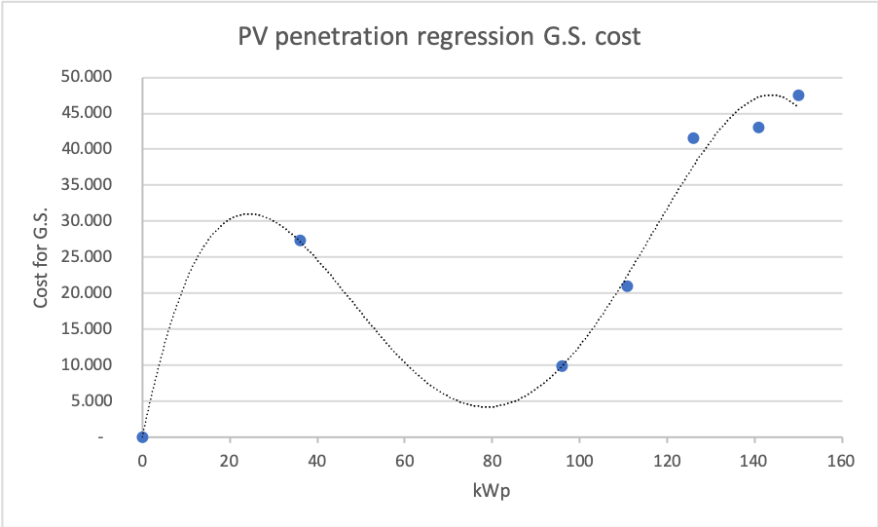
WP5 – ECONOMIC MODEL DESIGN
PV penetration regression model
kWp
CapEx
PV penetration | kWp | Grid strengthening cost CapEx (Euro)
0 | 0 | 0
… | … | …
24% flicker | 36 | 27,300
… | … | …
40% | 60 | 15,930
64% | 96 | 9,850
74% | 111 | 21,000
… | … | …
100% | 150 | 47,500

Slide 9
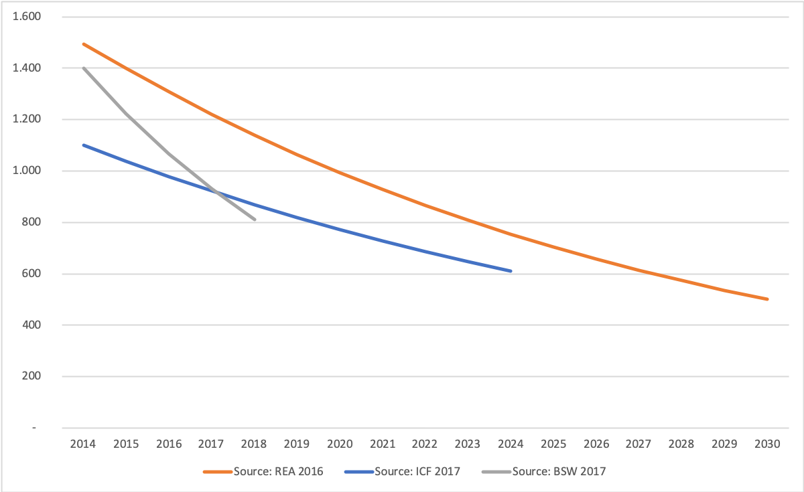
WP5 – ECONOMIC MODEL DESIGN
PV penetration regression model
kWp
CapEx
OpEx
Battery price trend
PV penetration | kWp | Grid strengthening cost CapEx (Euro) | Grid strengthening cost OpEx (% of CapEx)
0 | 0 | 0
… | … | …
24% flicker | 36 | 27,300
… | … | …
40% | 60 | 15,930
64% | 96 | 9,850
74% | 111 | 21,000
… | … | …
100% | 150 | 47,500
Average rate of battery decreasing price -7.16%

Slide 10
WP5 – ECONOMIC MODEL DESIGN
List of variables of the Model
Variable Name | Variable acronym | Professional GUI | Unit of measure | Task Owner (TO) and description of the source of the variable (DES)
Time frame | T_{Inv} | Input | Years | TO: Users/DSF-SE DES: DSO should decide appropriate time horizon for an investment in grid strengthening and in battery exploitation (e.g., 10, 15, 20 years?) The timeline should be inserted by the User or, alternatively, automatically by the DSF-SE (t=20 years) if the User does not choose a time frame
PV penetration | PV_{pen} | Input from Technical DSF-SE | Percentage (%) and kWp | TO: User/DSF-SE DES: The correspondence between percentage and kWp is provided by Table 10 of D2.4
Equivalent PV penetration | PV_{pen} | Input | Percentage (%) and kWp | TO: LINKS and ALL DES: The correspondence between percentage and kWp is provided by Table 10 of D2.4
Capital Expenditure for grid strengthening (scenario 0) | CapEx_{grid} | S4G assumption | Euro | TO: ENIIG, EDYNA, LINKS DES: The main figures are provided internally by S4G partners. For the other values, LINKS built a polynomial regression model to associate for each PV penetration a correspondent figure of cost (Table 10 of D2.4)
Operational Expenditure for grid strengthening (scenario 0) | OpEx_{grid} | Input | Euro | TO: ENIIG, EDYNA (?) DES: S4G Partners should provide a value of OpEx in terms of percentage of CapEx. As a consequence, we can compute OpEx for every value of PV penetration
Capital Expenditure for grid strengthening (scenario 1, 2) | CapEx_{grid} | S4G assumption | Euro | TO: ENIIG, EDYNA, LINKS DES: Table 10 of D2.4
Operational Expenditure for grid strengthening (scenario 1, 2) | OpEx_{grid} | Input | Euro | TO: LINKS DES: It will be computed automatically based on the new

Slide 11
WP5 – ECONOMIC MODEL DESIGN
List of variables of the Model (cont’d)
Variable Name | Variable acronym | Professional GUI | Unit of measure | Task Owner (TO) and description of the source of the variable (DES)
Power Losses (scenario 0) | PwLoss_{t} | Input from Technical DSF-SE | kWh per year | TO: DSF-SE DES: It will be computed automatically based on the DSF-SE electric engine
Power Losses Costs (scenario 0) | PwLoss_{t} (SC₀) | Input from Technical DSF-SE | Euro per year | TO: LINKS DES: Current price of energy (Euro per kWh)
Power Losses (scenario 1, 2) | PwLoss_{t} (SC_{1,2}) | Input from Technical DSF-SE | kWh per year | TO: DSF-SE DES: It will be computed automatically based on the DSF-SE electric engine based on the new information after introduction of ESS
Battery info:
Operational Mode | ES_{Expl} | Input from Technical DSF-SE | Text | TO: DSO, User DES: This is an information the User insert in the Professional GUI through a drop-down menu
Type and Size | Type_{ESS} | Input from Technical DSF-SE | kWh | TO: DSO, User DES: This is an information the User insert in the Professional GUI for the technical DSF-SE through a drop-down menu where she can select two or more types of battery (e.g., 12kWh, 70 kWh, etc.)
Number (storage penetration) | ESS_{pen} | Input from Technical DSF-SE | # | TO: DSF-SE DES: This is an information the User inserts in the Professional GUI for the technical DSF-SE. Through a manual selection in the DSF-SE she can select how many and where to install the storage.
Lifetime of battery | ES_{time} | Input from Technical DSF-SE | # of Years | TO: DSF-SE DES: This is information technical DSF-SE will compute
Price of batteries | C(ESS)_{type} | S4G assumption | Euro per kWh | TO: LiBAL, LINKS DES: This information can come from LiBAL inputs or from literature

Slide 12
WP5 – ECONOMIC MODEL DESIGN
List of variables of the Model (cont’d)
Variable Name | Variable acronym | Professional GUI | Unit of measure | Task Owner (TO) and description of the source of the variable (DES)
PV Equivalent (Scenario 1, 2) | PV_{eq} | S4G assumption | Percentage (%) and kWp | TO: ALL DES: The simulation DSF-SE engine will provide kWp of the grid after the introduction of a storage system at sub-station or at residential level
Cost of capital | r | S4G assumption | Percentage (%) | TO: LINKS DES: Interest rate
Trend for batteries pricing | C(ESS)_{trend} | S4G assumption | Percentage (%) | TO: LINKS DES: This is based on the literature. LINKS provides an estimation of the future trend for batteries prices in the long run
Total Cost of Ownership | TCO_{i} | Output | Euro | TO: LINKS DES: Functional form
Delta Total Cost of Ownership for different scenarios | ΔTCO_{i} | Output | Euro | TO: LINKS DES: Functional form
Incentives/Subsidies | Sub | Output | Euro | TO: LINKS DES: Functional form

Slide 13
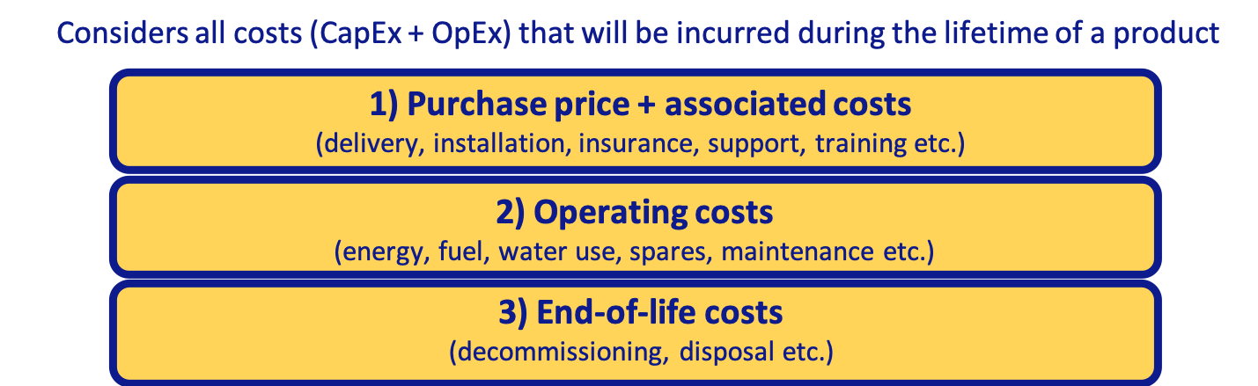
WP5 – ECONOMIC MODEL DESIGN
Functional Form:
Total Cost of Ownership (TCO) for DSO
TCO for the community (DSO + prosumer)

Slide 14
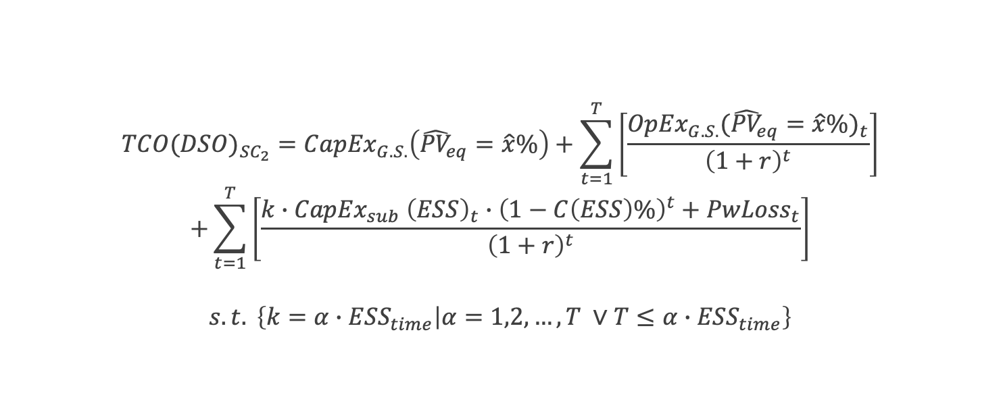
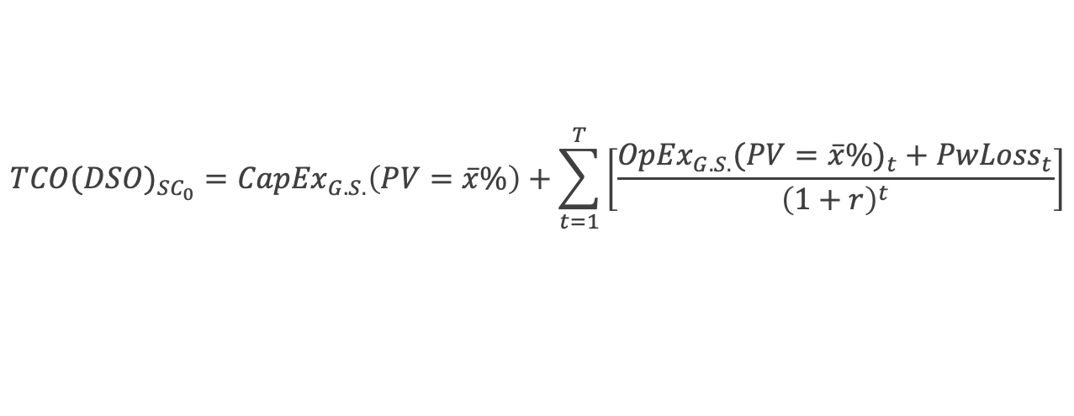
WP5 – ECONOMIC MODEL DESIGN
‘Preliminary’ functional form
$${TCO(DSO)}_{{SC}_{0}}={CapEx}_{G.S.}\left(PV=\overline{x}\%\right)+\sum_{t=1}^{T}{\left[\frac{{{OpEx}_{G.S.}(PV=\overline{x}\%)}_{t}+{PwLoss}_{t}}{{\left(1+r\right)}^{t}}\right]}$$
$${TCO(DSO)}_{{SC}_{2}}={CapEx}_{G.S.}\left({\hat{PV}}_{eq}=\hat{x}\%\right)+\sum_{t=1}^{T}{\left[\frac{{{OpEx}_{G.S.}({\hat{PV}}_{eq}=\hat{x}\%)}_{t}}{{\left(1+r\right)}^{t}}\right]}$$
$$+\sum_{t=1}^{T}{\left[\frac{{{k∙CapEx}_{sub} \left(ESS\right)}_{t}∙{\left(1−C\left(ESS\right)\%\right)}^{t}{+ PwLoss}_{t}}{{\left(1+r\right)}^{t}}\right]}$$
$$s.t. \left\{k=α∙{ESS}_{time} | α=1,2,…,T ∨T≤α∙{ESS}_{time}\right\}$$
TCO

Slide 15
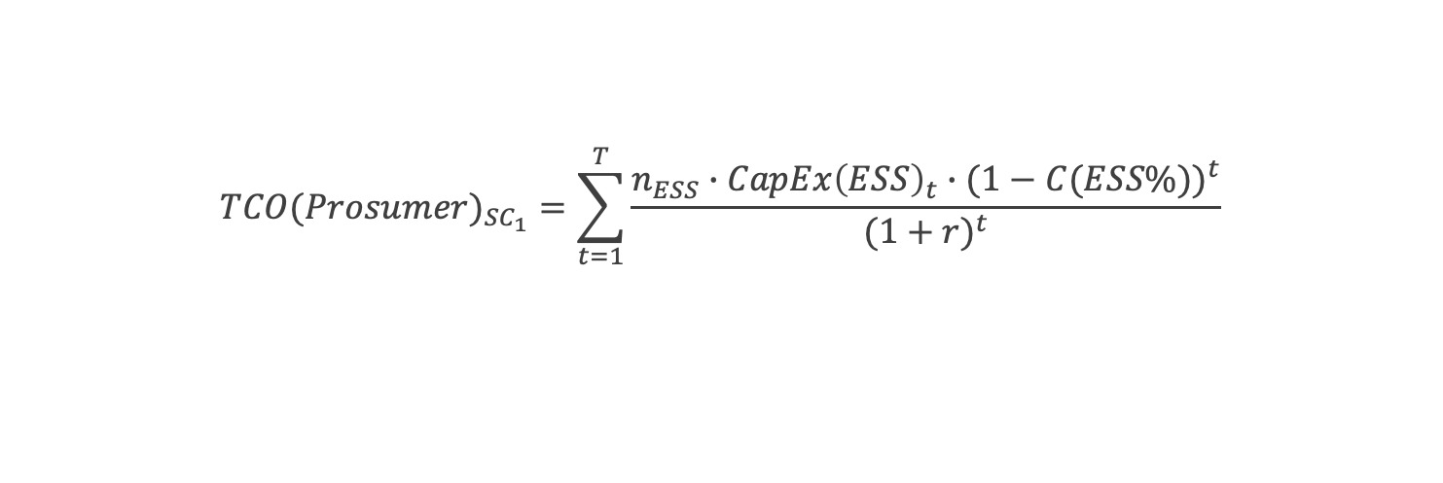
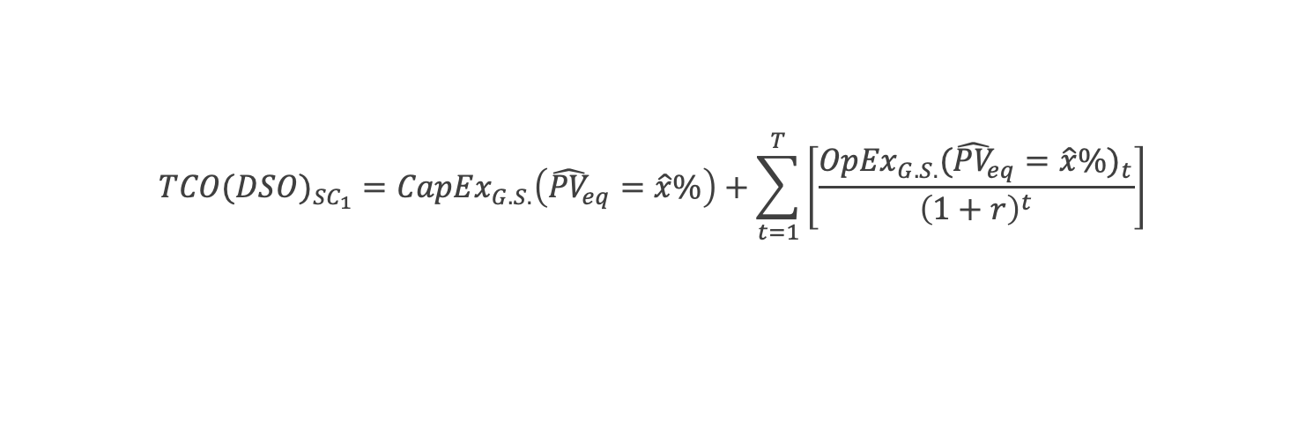
WP5 – ECONOMIC MODEL DESIGN
‘Preliminary’ functional form
$${TCO(DSO)}_{{SC}_{1}}={CapEx}_{G.S.}\left({\hat{PV}}_{eq}=\hat{x}\%\right)+\sum_{t=1}^{T}{\left[\frac{{{OpEx}_{G.S.}({\hat{PV}}_{eq}=\hat{x}\%)}_{t}}{{\left(1+r\right)}^{t}}\right]}$$
$${TCO(Prosumer)}_{{SC}_{1}}=\sum_{t=1}^{T}{\frac{{n_{ESS}∙CapEx\left(ESS\right)}_{t}∙{(1−C(ESS\%))}^{t}}{{(1+r)}^{t}}}$$
TCO
$${{{TCO(DSO+Prosumer)}_{{SC}_{1}}=TCO(DSO)}_{{SC}_{1}}+TCO(Prosumer)}_{{SC}_{1}}$$

Slide 16
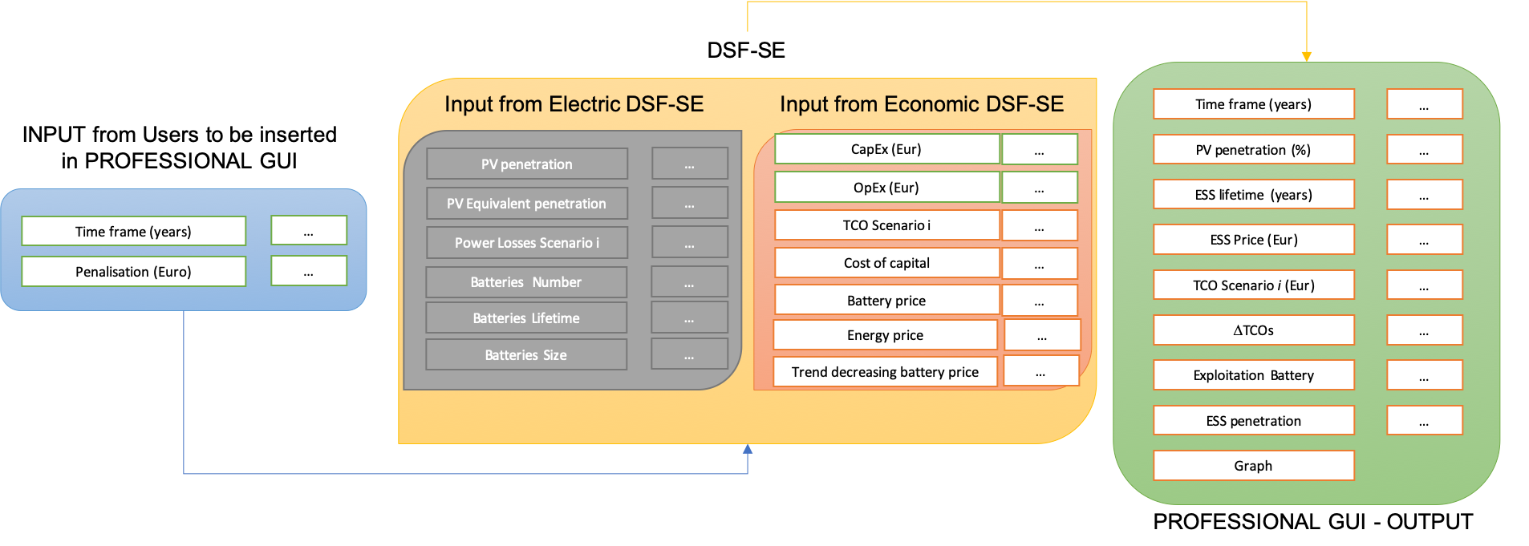
WP5 – ECONOMIC MODEL INTERACTION WITH GUI

Slide 17
WP5 – EXAMPLE of ECONOMIC MODEL IMPLEMENTATION
User inserts her inputs in the GUI (economic interface):
Time = 20
User inserts her inputs in the GUI (technical interface GUI):
PV penetration = 74%
Size of sub-station battery for Scenario 1 (70kWh)
Size of residential battery for Scenario 2 (12 kWh)
Number of Batteries for Scenario 2 (ESS_{pen} = 7)
Location of Batteries in the grid for Scenario 2 (decided by Users)

Slide 18
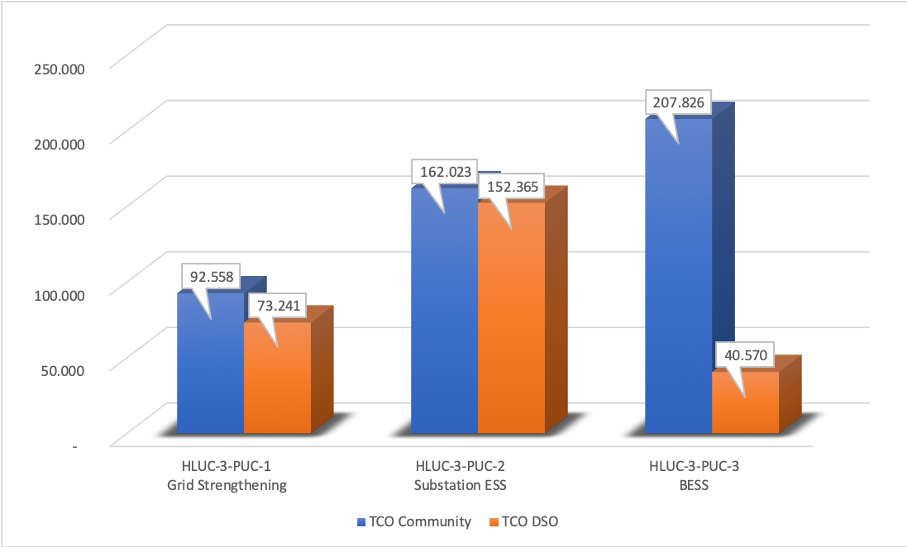
WP5 – EXAMPLE of ECONOMIC MODEL IMPLEMENTATION
(Electrical) DSF-SE automatically will compute:
Power Losses for Scenario 1 (kWh)
Power Losses for Scenario 2 (kWh)
(Economic) DSF-EE will compute:
CapEx for Scenario 0, 1 and 2 (Euro)
OpEx for Scenario 0, 1 and 2 (Euro)
Total price of batteries for Scenario 1 and 2 (Euro)
Cost for power losses in Scenario 1 and 2 (Euro)
TCO for Scenario 0, 1 and 2
Graph comparison

Slide 19
WP5 – EXAMPLE of ECONOMIC MODEL Input/Output
INPUTS/VARIABLE | VALUES | SOURCE
PV penetration (%) | 74% | LINKS assumption (but in the Professional GUI, the professional user will decide her own percentage)
PV penetration (kWp) | 111 | Economic regression model
Battery at substation level Info:
Type size | 70 | LINKS assumption (but in the DSF-SE S4G Partners will provide these information)
Number | 1 | LINKS assumption
Price (Euro) | 74,470 | LINKS assumption computed as price of batteries per kWh (but in the DSF-SE S4G Partners will provide these information)
Lifetime (years) | 8 | LINKS assumption (but in the DSF-SE S4G Partners will provide these information)
Operational mode | Support voltage regulation (sub-station) | LINKS assumption (but in the DSF-SE S4G Partners will provide these information)
Battery at substation level Info:
Type size | 12 | LINKS assumption (but in the DSF-SE S4G Partners will provide these information)
Number | 7 | LINKS assumption
Price (Euro) | 12,766 | LINKS assumption computed as price of batteries per kWh (but in the DSF-SE S4G Partners will provide these information)
Lifetime (years) | 8 | LINKS assumption (but in the DSF-SE S4G Partners will provide these information)
Operational mode | Self-consumption (residential) | LINKS assumption (but in the DSF-SE S4G Partners will provide these information)
INPUTS/VARIABLE | VALUES | SOURCE
OpEx (percentage of CapEx), including grid repairs, etc. | 10% | LINKS assumption
CapEx – Scenario 0 (Euro) | 24,007 | Economic regression model
OpEx – Scenario 0 (Euro per year) | 2,401 | Economic model
Losses – Scenario 0 (kWh per year) | 10,000 | LINKS assumption
Losses – Scenario 0 (Euro per year) | 3,100 | DSF-SE
Equivalent PV penetration | 55 (37%) | Economic regression model
CapEx – Scenario 1 and 2 (Euro) | 13,762 | S4G Partners and Economic Model
OpEx – Scenario 1 and 2 (Euro per year) | 1,376 | S4G Partners
Losses – Scenario 1 and 2 (kWh per year) | 5,000 | LINKS assumption (but DSF-SE will provide this figure)
Losses – Scenario 1 and 2 (Euro per year) | 1,555 | LINKS assumption (but DSF-SE will provide this figure)
Timeline (years) | 20 | LINKS assumption
Cost of capital | 5% | LINKS assumption
Rate of decreasing storage prices/costs | -7.16% | LINKS assumption based on literature
Price of energy (Euro) | 0.31 | LINKS assumption (based on the current price in Denmark)
Number of houses with PV | 20 | LINKS assumption (based on the Denmark grid)

Slide 20
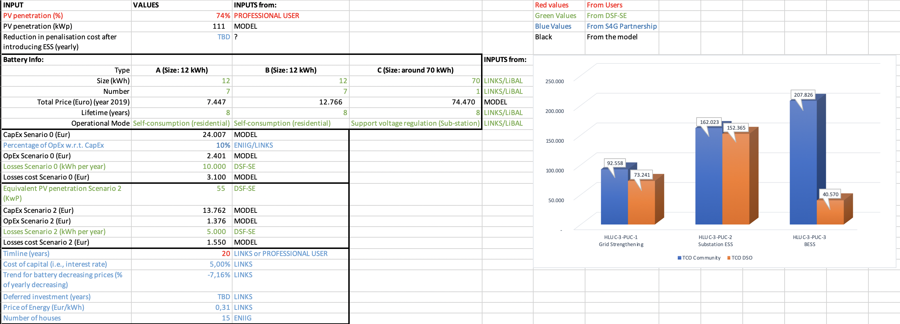
WP5 – EXAMPLE of ECONOMIC MODEL Input/Output

Slide 21
WP5 – Tools for Economic Simulation
How to implement the economic model? The algorythm can be done:
Directly in the DSF-EE
Through an external tool (and imported as an output in the DSF-EE):
Stata
Excel
Matlab
Other?
How to develop the economic model?
The idea is to provide all the computations for all the scenarios in a single output box (or graph)
If the User would simulate different scenarios changing values of variables, how can save the previous ones? (API, etc.)

Slide 22
CONTACTS
MATTEO FERRARIS
Senior Business Analysist Innovation Development Area
LINKS, Via Piercarlo Boggio 61,
10136, Torino, IT
matteo.ferraris@linksfoundation.com ferraris@ismb.it
http://innodev.ismb.it
@ferraris_mat75
Matteo Ferraris

