Slide 1
StoragePrabhu99
Storage Fundamentals
& Architectures
DAY 1 • STUDENT PRESENTATION
From storage media and performance metrics to RAID, DAS/NAS/SAN, modern storage services, and data protection.
8 HOURS
FUNDAMENTALS
ARCHITECTURE
BANKING USE CASES
Reference-led • vendor-aware • scenario based

Slide 2
Learning outcomes
By the end of Day 1, learners should be able to explain storage fundamentals, choose architectures, and relate protection methods to banking workloads.
1
Explain storage
2
Differentiate RAID
3
Choose an architecture
4
Protect data
Data, lifecycle, media and core performance measures.
Understand RAID 0/1/5/6/10, trade-offs and failure behavior.
Compare DAS, NAS, SAN and select by workload.
Position snapshots, backup and replication in recovery design.
→
Learner expectation
Ask “what does the application need?” before choosing a disk, RAID level or architecture.
CONCEPT → EXAMPLE → SCENARIO
WHITEBOARD MOMENTS
CHECKPOINTS
Primary: Introduction to Information Storage; ITC Storage & Backup

Slide 3
Day 1 roadmap
An 8-hour learning journey with short discussions, whiteboard exercises and knowledge checks.
01
Storage foundation
60 min
02
Media + metrics
75 min
03
RAID + architectures
135 min
04
File / block / object
80 min
05
Banking use cases
60 min
06
Snapshots / backup / replication
70 min
Includes ≈ 50 min of interactive checkpoints / discussion / breaks embedded in the flow.
Session plan

Slide 4
1 | Intro to Data Storage
Storage exists because data must remain available, durable, usable and recoverable.
DATA
INFORMATION
BUSINESS PROCESS
BUSINESS OUTCOME
↗
Why storage matters
✓
What storage must provide
∞
Enterprise lens
Digital data growth + fast access + continuity requirements make storage an operational capability, not just a hardware layer.
Capacity • performance • availability • protection • security • manageability.
The same data can move from hot transactional storage to secondary, archive and backup tiers as its value and access pattern change.
Source: Information Storage deck

Slide 5
Structured, unstructured and semi-structured data
Storage design starts with the shape and access pattern of the data.
DB
Structured
FILE
Unstructured
JSON
Semi-structured
Examples: core banking tables, customer master, ledger entries, payment records.
Access: rows / columns, queries, transactions.
Examples: statements, scans, PDFs, images, recordings, emails, CCTV/video.
Access: files / objects / content services.
Examples: JSON/XML events, API payloads, logs and telemetry.
Access: key/value, documents, analytics pipelines.
Teaching prompt: “Would the same storage service suit a transaction ledger and a 4 GB compliance video?”
Source: Information Storage deck

Slide 6
2 | Storage Lifecycle
A practical lifecycle model: create → classify → store → protect → use → retain → retire.
CREATE
CLASSIFY
STORE
PROTECT
USE
RETAIN
RETIRE
Generate data
Value / sensitivity
Place on media
Backup / replicate
Serve application
Archive / comply
Delete / sanitize
1
Hot → warm → cold
2
Retention is not backup
3
Deletion is a control
Access frequency and business value influence placement.
Retention may be driven by legal, regulatory or business policy.
Secure disposal and retention enforcement close the lifecycle.
Source: synthesis from storage fundamentals; external context where noted

Slide 7
Storage lifecycle in a banking workflow
One customer record can touch several storage tiers and protection mechanisms during its life.
TRANSACTION
CORE DB
REPORTING
ARCHIVE
RETENTION
CREDIT / DEBIT
BLOCK
FILE / OBJECT
OBJECT / TAPE
POLICY
₹
Example: payment event
PDF
Example: monthly statement
VID
Example: audit video
Low-latency random I/O, strong consistency, database protection.
Large objects, customer retrieval, retention and immutability may matter.
Very large data, infrequent retrieval, long retention, cost-aware tiering.
Banking scenario: illustrative

Slide 8
3 | Storage Media – HDD, SSD, Tape, Optical
Different media optimize different dimensions: latency, throughput, density, durability, portability and cost.
H
S
T
O
HDD
SSD
Tape
Optical
Mechanical
Flash
Sequential
Removable
Cost / capacity
General purpose, bulk data
Low latency / IOPS
Databases, VMs, hot data
High capacity + offline
Backup / archive
Portable / fixed media
Specialized retention
DAS / SAN / NAS
SAN / cloud block
Libraries / vaults
Archives / exchange
Reference: backup/storage decks; media characteristics generalized

Slide 9
HDD: what is happening mechanically?
The head moves to a track and waits for the platter sector to rotate into position.
SEEK
!
Why random I/O can be expensive
Move head
Every I/O may carry seek + rotation overhead in addition to transfer time.
ROTATIONAL
Wait sector
✓
Where HDDs fit
Bulk capacity, backup repositories, file shares, throughput-heavy workloads where latency is less dominant.
TRANSFER
Read / write
↕
Modern reality
Hybrid systems often combine flash for hot data with HDD for capacity-oriented tiers.
Conceptual; complements reference media material

Slide 10
SSD: flash changes the latency equation
SSDs eliminate mechanical seek and rotation, making low-latency random I/O practical at much higher rates.
L
Low latency
I
High IOPS
No mechanical seek / rotation delay; latency is dominated by flash architecture and controller behavior.
Ideal for transactional workloads with many small random reads/writes.
P
Performance consistency
₹
Cost / capacity trade-off
Controller, queue depth, endurance and workload mix still matter.
Flash tiers typically cost more per usable capacity than capacity-oriented HDD tiers.
Conceptual; verify specific device specifications with vendor documentation

Slide 11
Tape & optical: sequential and removable media
Not every workload needs millisecond latency. Long retention and offline copies change the design objective.
T
Tape
O
Optical
?
Design question
• Sequential access
• High density for long-term retention
• Portable / offline
• Useful for backup and archive workflows
• Restore time depends on tape position, catalog and backup set
• Removable medium
• Stable archival format in specialized environments
• Useful for fixed, exchangeable media use cases
• Lower role in mainstream high-scale primary storage
Do we optimize for: lowest latency, highest capacity, portability, offline isolation, or lowest cost?
The answer determines the tier.
Reference: Backup deck for tape/media coverage

Slide 12
Media comparison: match the access pattern
Think in workload dimensions rather than “SSD good, HDD bad”.
Dimension
HDD
SSD
Tape
Optical
Random I/O
Good
Excellent
Poor
Poor
Sequential throughput
Good
Excellent
Excellent
Moderate
Latency
High
Low
Very high
High
Offline / air-gapped
No
No
Yes
Possible
Bulk retention
Good
Good
Excellent
Moderate
Values are qualitative teaching guidance; vendor media and specific device classes vary.
Conceptual comparison

Slide 13
4 | Key Metrics: IOPS, latency and throughput
Performance is multidimensional. A single number rarely tells the whole storage story.
I
IOPS
L
Latency
T
Throughput
Input/output operations per second. Most useful when I/O size and workload pattern are understood.
Time from request to completion. Lower latency matters for interactive / transactional workloads.
Amount of data transferred per unit time (e.g., MB/s or GB/s). Often dominant for large sequential transfers.
The same array can show high throughput but poor small-block random latency—or excellent IOPS at low queue depth but lower sustained bandwidth.
Conceptual

Slide 14
IOPS: count operations, not bytes
IOPS depends on block size, read/write mix, queue depth, concurrency and device behavior.
↔
Why 100k IOPS does not mean 100 GB/s
At small block sizes, the number of operations and the amount of data per operation are very different measures.
?
Ask for the workload profile
Example workload: 4 KiB random reads
Block size • read/write ratio • sequential/random • concurrency • queue depth.
Conceptual

Slide 15
Latency: where the user feels storage performance
For transactional systems, reducing request time can be more important than maximizing peak bandwidth.
Application
0.4 ms
✓
Teaching point
Host + stack
0.3 ms
Optimize the biggest contributor first.
Fabric / network
0.2 ms
Array + media
0.7 ms
Total
1.6 ms
Conceptual

Slide 16
Throughput: optimize the pipe for big I/O
Throughput is usually expressed as data moved per unit time.
Host bus / HBA
Fabric / network
Array controllers
Media pool
THROUGHPUT BOTTLENECK
The slowest / saturated stage limits end-to-end transfer.
Conceptual

Slide 17
Metrics together: a workload-first mental model
Use the workload profile to interpret storage numbers.
1
Small random DB I/O
2
Large sequential backup
Latency + IOPS dominate
Throughput dominates
3
File sharing
4
Archive retrieval
Mixed; concurrency + throughput
Capacity + durability + cost
Checkpoint: Which metric would you look at first for an online transaction database?
Conceptual

Slide 18
Checkpoint #1
Answer individually, then compare with a partner.
MODULE 5
RAID & data protection
Q
Q1 • A storage platform reports 500,000 IOPS. What three questions do you ask before calling it “fast”?
Think: block size • read/write mix • concurrency / queue depth.
RAID combines disks into a logical set to improve performance, capacity use and/or fault tolerance. We will focus on RAID 0, 1, 5, 6 and 10.
Q
Q2 • A backup job is slow although the disks show low latency. What other bottleneck might exist?
Think: network / fabric / host CPU / source application / media server.
Q
Q3 • When is throughput more important than latency?
Think: large sequential transfers such as backup, ETL, media and analytics.
21
Interactive

Slide 19
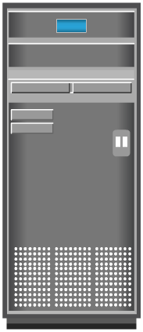
RAID: why combine disks?
Mechanical disks have finite performance and failure characteristics; RAID uses multiple drives as a logical set.
↗
Performance
!
RAID is not backup
Parallel access can increase aggregate I/O capability.
RAID protects against certain media failures inside the array.
It does not protect against accidental deletion, corruption, ransomware, logical errors or site loss by itself.
Backup and replication solve different failure domains.
✓
Protection
Mirroring / parity can preserve access after a disk failure.
↔
Trade-off
Capacity overhead, write penalty and rebuild behavior differ by RAID level.
Source: EMC RAID deck

Slide 20
RAID building blocks
Three techniques appear repeatedly across RAID levels.
S
1 • Striping
M
2 • Mirroring
P
3 • Parity
Split sequential data blocks across multiple disks.
Benefit: parallelism / bandwidth.
Risk: no redundancy by itself.
Store the same logical data on more than one disk.
Benefit: simple redundancy and reads from copies.
Cost: usable capacity overhead.
Store redundant information that can reconstruct missing data after a disk failure.
Benefit: better capacity efficiency than full mirroring.
Trade-off: parity processing and rebuild complexity.
Source: EMC RAID deck

Slide 21
Striping explained
A stripe spreads logical blocks across disks so multiple devices can participate in the I/O.
DISK 1
DISK 2
DISK 3
DISK 4
A1
A2
A3
A4
B2
B3
B4
B5
C3
C4
C5
C1
D4
D5
D1
D2
E5
E1
E2
E3
Stripe width / block size are design parameters that influence performance.
Source: EMC RAID deck

Slide 22
Mirroring explained
Every logical write is stored on at least two copies.
MIRROR 1
MIRROR 2
A
A
HOST WRITE
B
B
A+B+C+D
C
C
D
D
↔
Trade-off
Simple failure protection but usable capacity is approximately half for a two-way mirror.
Source: EMC RAID deck

Slide 23
Parity explained
Parity allows missing data to be reconstructed without storing a full mirror copy for every block.
D1
D2
D3
D4
P
4
6
1
7
18
Parity is commonly calculated with XOR in classic RAID parity schemes.
✓
Drive failure
↻
Rebuild cost
!
Design implication
If one data block is missing, parity + the surviving blocks can reconstruct it.
Large modern disks may require substantial time and I/O to rebuild.
Protection level must match failure-domain and rebuild risk.
Source: EMC RAID deck

Slide 24
RAID 0
Striping without fault tolerance
D1
D2
D3
D4
C
Usable capacity
P
Typical protection
≈ 100%
0 disk redundancy; any disk loss can lose the array
DATA
DATA
DATA
DATA
DATA
DATA
DATA
DATA
DATA
DATA
DATA
DATA
DATA
DATA
DATA
DATA
✓
What to remember
DATA
DATA
DATA
DATA
Striping without fault tolerance
Source: EMC RAID deck + ITC RAID material

Slide 25
RAID 1
Mirroring for simple redundancy
D1
D2
D3
D4
C
Usable capacity
P
Typical protection
≈ 50%
Can tolerate a disk failure when the mirror copy remains available
COPY
COPY
COPY
COPY
COPY
COPY
COPY
COPY
COPY
COPY
COPY
COPY
COPY
COPY
COPY
COPY
✓
What to remember
COPY
COPY
COPY
COPY
Mirroring for simple redundancy
Source: EMC RAID deck + ITC RAID material

Slide 26
RAID 5
Striping + single distributed parity
D1
D2
D3
D4
D5
C
Usable capacity
P
Typical protection
≈ (N−1)/N
One disk failure tolerated; rebuilds are parity-intensive
DATA
DATA
DATA
DATA
Parity
DATA
DATA
DATA
PARITY
DATA
DATA
DATA
PARITY
DATA
DATA
DATA
PARITY
DATA
DATA
DATA
✓
What to remember
PARITY
DATA
DATA
DATA
DATA
Striping + single distributed parity
Source: EMC RAID deck + ITC RAID material

Slide 27
RAID 6
Striping + dual distributed parity
D1
D2
D3
D4
D5
D6
C
Usable capacity
P
Typical protection
≈ (N−2)/N
Two disk failures tolerated within the RAID set
DATA
DATA
DATA
DATA
P
Q
DATA
DATA
DATA
P
Q
DATA
DATA
DATA
P
Q
DATA
DATA
DATA
P
DQ
DATA
DATA
DATA
✓
What to remember
P
Q
DATA
DATA
DATA
DATA
Striping + dual distributed parity
Source: EMC RAID deck + ITC RAID material

Slide 28
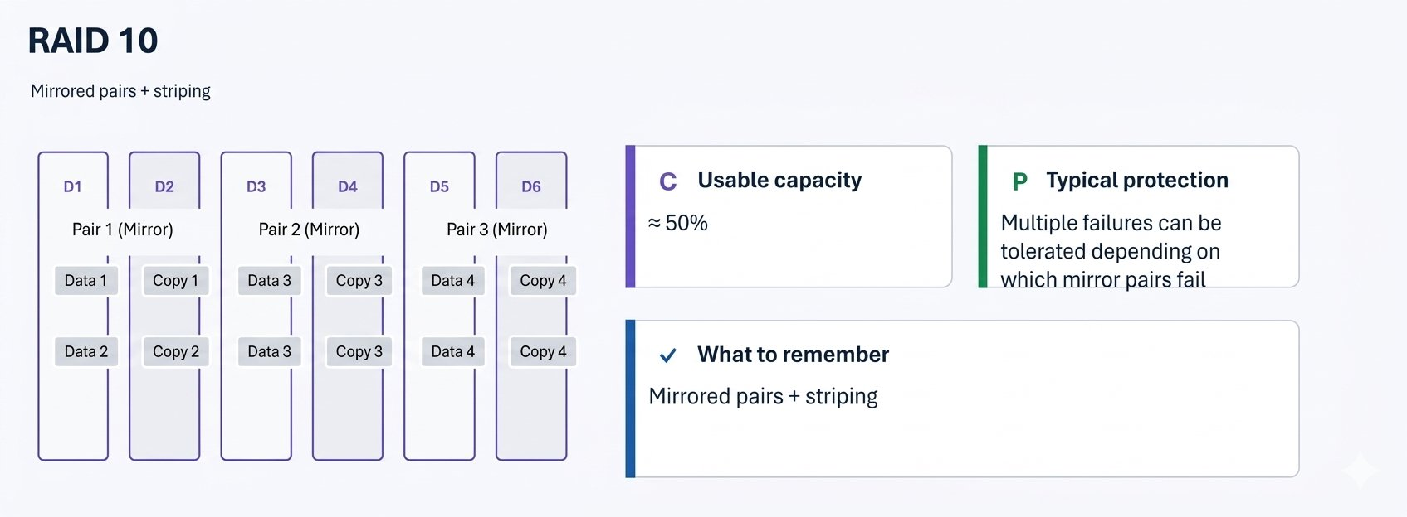

Slide 29
RAID comparison: read this table, then ask “why?”
No RAID level is universally best; the workload and failure model drive the choice.
RAID
Technique
Usable capacity
Read performance
Write behavior
Disk failures tolerated
0
Striping
High
High
High
0
1
Mirroring
50%
High
Low overhead
1 per mirror set
5
Stripe + parity
N-1
Good
Parity overhead
1
6
Stripe + dual parity
N-2
Good
Higher parity overhead
2
10
Mirror + stripe
~50%
High
Good for random write
Depends on mirror placement
Teaching comparison; exact behavior varies by implementation

Slide 30
RAID selection by workload
Use the application profile and the organization’s protection objective together.
MODULE 6
Storage Architectures
0
Temporary / scratch
1
Simple mirror
5
Capacity-oriented
6/10
Higher resilience
High-speed working set where loss is acceptable.
→ RAID 0 can be a teaching example—not a backup strategy.
Small workloads where simple redundancy and predictable behavior matter.
Good usable capacity with protection against a single disk failure.
Dual-parity or mirrored-stripe designs where performance and rebuild risk are important.
Compare DAS, NAS and SAN by where the storage sits, how data is accessed, who manages it, and which applications benefit.
Enterprise storage arrays may use additional protection schemes, distributed sparing and proprietary data-protection algorithms beyond these classic RAID labels.
32
Illustrative guidance

Slide 31

DAS: Direct-Attached Storage
Storage is directly connected to the host or server.
SERVER
DAS
DISKS
Application
Direct link
Local / external
+
Benefits
!
Limitations
↳
Use cases
Low initial investment; simple to deploy; local provisioning.
Limited sharing and scalability; can create storage islands.
Standalone servers, edge, branch or capacity close to a single host.
Source: Storage-Module1

Slide 32
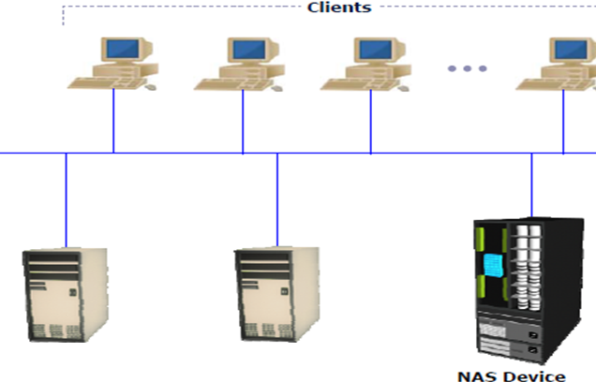
NAS: Network-Attached Storage
NAS provides file-level access over an IP network, typically using SMB or NFS.
CLIENTS
NAS HEAD
STORAGE
Windows / Linux
File services
Pools / disks
F
Protocols
✓
Benefits
₹
Typical banking uses
SMB for Windows-oriented file sharing; NFS for Unix/Linux and many application workloads.
Centralized file sharing, simplified administration, concurrent access.
Shared document repositories, reports, application content, user home/team shares.
Source: NAS deck + Storage-Module1

Slide 33
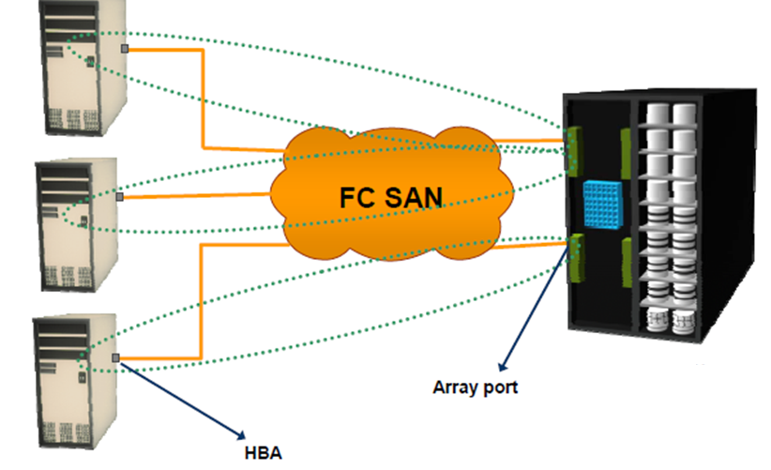
SAN: Storage Area Network
SAN provides block-level access through a dedicated storage network / fabric.
HOSTS
HBA
FABRIC
ARRAY
LUNS
Servers / VMs
Initiators
Switches
Controllers
Block devices
P
Protocol examples
Z
Design features
DB
Workloads
Fibre Channel • iSCSI • FCoE
Multi-pathing • zoning • LUN masking
Databases • VMs • high-I/O enterprise apps
Source: Storage-Module1 + ITC Storage & Backup

Slide 34
DAS vs NAS vs SAN
Same physical storage idea—different access models and operational boundaries.
Architecture
Access
Network
Sharing
Typical use
DAS
Block
Direct
Low
Single-host / edge
NAS
File
Ethernet / IP
High
Shared files / content
SAN
Block
FC / IP
High
DB / VM / enterprise apps
Memory hook: DAS = directly attached • NAS = file over IP • SAN = block over a storage network
Sources: Storage-Module1; NAS deck; ITC Storage & Backup

Slide 35
SAN building blocks
A SAN is a layered system: host → fabric → storage, with redundant paths for availability.
H
Host / initiator layer
F
Fabric layer
A
Storage / target layer
• Server / hypervisor
• HBA / CNA
• Multipath software
• WWN / initiator identity
Goal: reliable, redundant access to storage paths.
• FC switches / directors
• ISL links
• VSAN / fabric separation
• Zoning
Goal: controlled connectivity and path redundancy.
• Front-end ports
• Controllers / cache
• RAID / pools
• LUN masking / mapping
Goal: present the right blocks to the right host.
Source: ITC Storage & Backup; Storage-Module1

Slide 36
SAN path: why multipathing matters
A single path is a hidden dependency. Redundant paths reduce the impact of a cable, HBA, switch-port or controller failure.
HBA 1
SW 1
ARRAY PORT 1
↻
Failure example
Path A
Fabric A
Target
Lose SW 1 → Path A disappears.
With healthy Path B, the host can continue depending on multipath policy.
HOST
Application
HBA 2
SW 2
ARRAY PORT 2
Path B
Fabric B
Target
Source: ITC Storage & Backup

Slide 37
SAN protocols: Fibre Channel vs iSCSI
Both provide block storage access; the transport and operational model differ.
Brocade / FC
Cisco / FC
Broadcom
Dell / storage
Fibre Channel
Fibre Channel
Brocade owner
Example vendor
FC
Fibre Channel SAN
IP
iSCSI SAN
Dedicated storage networking ecosystem; HBAs, FC switches/directors, WWNs, zoning and multipathing are common concepts.
Carries SCSI commands and data over TCP/IP. Often attractive where Ethernet/IP skills and infrastructure are already strong.
Both ultimately expose block devices to hosts; the application sees a disk/LUN abstraction.
Source: ITC Storage & Backup; external protocol concepts

Slide 38
NAS protocols: SMB and NFS
NAS is about file semantics: file paths, permissions, locking and shared access.
MODULE 7
File vs Block vs Object
SMB
SMB
NFS
NFS
Client/server file-sharing protocol widely used in Windows environments. Useful for user shares, application file shares and hybrid Windows workloads.
Common in Unix/Linux environments. Current cloud services such as Amazon EFS and Azure Files support NFS-based file access for applicable workloads.
Three access models. The mental model is more important than memorizing product names.
40
Source: NAS deck; current Azure Files docs
External: Microsoft Learn – Azure Files; AWS EFS documentation

Slide 39
File vs Block vs Object – the three models
Ask: who owns the filesystem, how is data addressed, and what is the application interface?
F
FILE
B
BLOCK
O
OBJECT
Path / directory / filename
Examples: NAS, SMB shares, NFS, Azure Files, Amazon EFS
Best fit: shared files, content repositories, user and application file shares.
Raw blocks presented as a disk / volume
Examples: SAN LUN, Amazon EBS, Azure Managed Disk
Best fit: DBs, VM disks, filesystems controlled by the host.
Object + metadata addressed through an API
Examples: Amazon S3, Azure Blob Storage
Best fit: large-scale unstructured data, archives, media, data lakes.
Synthesis + current cloud documentation

Slide 40
Object storage: change the addressing model
Instead of “disk sectors” or “directory paths”, object storage exposes objects, metadata and APIs.
APPLICATION
OBJECT STORE
OBJECT
DURABILITY
API call
Service
Data + metadata
Policy / tier
✓
Strong fit
↔
Trade-off
A
Architecture clue
Large volumes of unstructured content, data lakes, backups, media.
Not a drop-in replacement for every POSIX filesystem or low-latency block workload.
Design around APIs, metadata, access policy and lifecycle tiering.
External: AWS S3 and Azure Blob documentation

Slide 41
Current cloud mapping: AWS
Cloud services make the file/block/object model explicit.
AWS
Amazon Web Services
B
Amazon EBS • BLOCK
F
Amazon EFS • FILE
O
Amazon S3 • OBJECT
Persistent block volumes for EC2. The host can format and use the volume like a disk. EBS snapshots provide point-in-time copies of volumes.
Managed elastic file storage. Supports NFS and shared access for applicable workloads.
Object storage for large-scale data, data lakes, cloud applications and content.
External: AWS official docs

Slide 42
Current cloud mapping: Azure
Azure exposes the same core storage models through different service names.
Azure
Microsoft Azure
B
Azure Managed Disks • BLOCK
F
Azure Files • FILE
O
Azure Blob Storage • OBJECT
Block-level storage volumes used with Azure VMs. Disk types include SSD and HDD classes.
Managed file shares supporting SMB and NFS for applicable workloads and clients.
Cloud object storage for massive amounts of unstructured data.
External: Microsoft Learn

Slide 43
File / block / object: architecture checklist
Choosing a storage model is an architecture decision, not just a product selection.
MODULE 8
Storage Use Cases in Banking
1
Who needs access?
2
How is data addressed?
One host • many servers • internet-scale clients
Blocks • file paths • object keys
3
What does the app expect?
4
What fails?
Now move from technology to workload: core banking, payments, ATM, digital channels, analytics, statements, regulatory retention and recovery.
Disk • filesystem • API
Disk • node • site • credentials • application logic
5
How is data protected?
6
What is the lifecycle?
RAID • snapshots • backup • replication • immutability
Hot • warm • cold • archive • delete
47
Synthesis

Slide 44
Banking workload map
Different banking functions generate very different I/O, data types, recovery objectives and retention requirements.
1
Core banking
2
Payments
3
Digital banking
Structured / block
Low-latency random I/O
Structured / block
High transaction concurrency
Mixed
Scale + session + content
4
Statements
5
Analytics / AML
6
Archive
File / object
Large sequential / retrieval
Object + analytics
Throughput + scale
Object / tape
Retention + low access
Banking storage design is a portfolio of workload patterns—not one universal storage platform.
Illustrative banking architecture

Slide 45
Use case 1: Core banking / transaction database
The storage path must sustain random I/O, predictable latency, concurrency and recoverability.
CHANNEL
APP TIER
DB
BLOCK
PROTECT
ATM / branch / mobile
Services
Core ledger
SAN / cloud disk
Snapshot / backup
I
Storage priorities
P
Protection priorities
O
Operational priorities
Low latency • high IOPS • multipathing • consistent recovery.
Point-in-time recovery + independent backup copy + site recovery.
Monitoring, capacity, performance baselines, alerting and change control.
Illustrative

Slide 46
Use case 2: ATM and payment processing
The architecture emphasizes availability and predictable transaction response.
ATM / POS
Payment gateway
Transaction service
Database / block
!
What matters
B
Why SAN / block can fit
P
Protection
Availability, latency, transaction integrity and controlled failover.
Database and VM workloads often need disk-like block semantics and predictable I/O.
Synchronous/local copies for near-term recovery plus independent backup for logical recovery.
Illustrative

Slide 47
Use case 3: Statements, scans and digital content
File and object storage become more attractive when data is accessed as documents or large content items.
SOURCE
FILE SHARE
OBJECT
ARCHIVE
PDF / scan / image
NAS / Azure Files / EFS
S3 / Blob
Cold tier / tape
F
File fit
O
Object fit
A
Archive fit
Shared access, folders, permissions, application compatibility.
Massive scale, API-driven access, metadata and lifecycle tiers.
Rare access, long retention, cost and offline copies.
Illustrative

Slide 48
Use case 4: Analytics, fraud and AML
Analytics changes the storage problem: huge datasets, high throughput, diverse formats and often less predictable access.
MODULE 9
Snapshots, Backups & Replication
EVENTS
OBJECT STORE
PROCESSING
ANALYTICS
REPORT
Payments / logs
Data lake
Spark / SQL
Fraud / AML
Output
D
O
P
These are complementary controls. The key learning objective is to understand what failure each one is designed to address.
Data characteristics
Storage characteristics
Protection
Structured + unstructured + semi-structured; high volume and long history.
Object storage / data lake patterns favor scalable capacity and throughput.
Versioning, immutable copies, backups and controlled retention remain important.
52
Illustrative

Slide 49
Snapshot: point-in-time state
A snapshot captures a point-in-time view of data, usually within the same storage platform or service.
PRODUCTION
SNAPSHOT
RECOVERY
NEW WORKLOAD
Volume / dataset
PIT copy
Rollback / clone
Test / restore
S
Strength
!
Limitation
DB
Banking example
Fast point-in-time rollback / clone use cases within the platform.
A snapshot is not automatically an independent copy in a separate failure domain.
Recover a database volume to a recent known state before full restore from backup.
Reference: intelligent storage + AWS EBS snapshot concept

Slide 50
Backup: independent recoverability
Backup creates recoverable copies that can survive failures beyond the primary storage system.
1
Select
2
Read
3
Write
4
Catalog
5
Retain
6
Restore
Policy / scope
Source data
Backup target
Metadata / index
Policy / lock
Required point
P
Backup protects against
R
Policy dimensions
↻
Restore is the real test
Accidental deletion • corruption • ransomware • storage failure • operational error • site loss (when copies are separate).
RPO • retention • backup window • media • encryption • immutability.
A backup that cannot be restored within the business requirement is not an operational success.
Reference: Backup decks

Slide 51
Replication: maintain another copy at another location
Replication moves or maintains data at a secondary site / system to support continuity and recovery.
PRIMARY
REPLICA
DR SITE
FAILOVER
Production
Secondary
Distance
Business
SYNC
Synchronous / near-zero RPO
ASYNC
Asynchronous
DR
Different failure domain
Suitable when the business requires minimal data loss and network/storage conditions permit.
Allows longer distance and decoupled timing, with an RPO reflecting replication lag.
Replication is strongest when the secondary copy is protected from the same outage.
Source: Storage-Module1; replication concepts

Slide 52
Snapshot vs backup vs replication
Use the right tool for the right failure mode.
Control
Primary purpose
Typical location
Fast rollback
Site failure
Logical corruption
Snapshot
Point-in-time copy
Often same platform
Excellent
Usually not by itself
Limited
Backup
Independent recovery copy
Separate target / location
Good
Yes, when separated
Yes, if copy is clean
Replication
Continuity at secondary
Another system / site
Good
Yes
Not necessarily—bad writes can replicate too
Memory hook: SNAPSHOT = fast PIT • BACKUP = independent recoverability • REPLICATION = continuity copy
Synthesis

Slide 53
Banking protection pattern
A resilient design layers controls instead of relying on one mechanism.
PRIMARY
SNAPSHOT
BACKUP
REPLICA
ARCHIVE
DB / file / object
Fast PIT
Independent
Secondary site
Retention
M
Minutes → hours
H
Hours → days
DR
Site outage
Snapshots provide quick rollback / clone paths.
Backup restores address logical / operational failure.
Replication supports continuity at a secondary environment.
Illustrative

Slide 54
Scenario: design storage for a new digital banking platform
Work in small groups. You have 10 minutes to sketch the storage architecture.
CASE
Requirements
1–7
Your choices
DISCUSS
Expected discussion
• Online transactions
• Customer document upload
• Mobile statement generation
• Fraud analytics
• 7-year retention for selected records
• Primary DC + DR site
• Recovery must be testable
1. Block / file / object?
2. RAID level?
3. DAS / NAS / SAN?
4. Snapshot frequency?
5. Backup target?
6. Replication mode?
7. What will you monitor?
There may be more than one viable architecture. Defend each choice against workload, availability, recovery and operational constraints.
Group activity

Slide 55
Checkpoint #2 – rapid-fire
Use the answer key verbally after learners attempt the questions.
1
Need a filesystem shared by many servers?
2
Need a disk-like volume for a database?
NAS / file service
Block / SAN / cloud block
3
Need massive unstructured image archive?
4
Need fast rollback on same storage?
Object storage is a common fit
Snapshot
5
Need independent recovery copy?
6
Need DR copy at another site?
Backup
Replication
Interactive

Slide 56
Key takeaways
The most useful skill from Day 1 is not memorizing acronyms—it is matching storage behavior to application needs.
01
Workload first
02
RAID is inside the array
Latency, IOPS, throughput and access model drive design.
It handles specific media failures; it does not replace backup.
03
Architecture defines access
04
Cloud uses the same models
DAS = direct • NAS = file • SAN = block network.
EBS / Managed Disks = block; EFS / Azure Files = file; S3 / Blob = object.
05
Protection is layered
06
Banking is multi-workload
Snapshots, backup and replication address different recovery goals.
Core transactions, content, analytics and archives can need different tiers.
End-of-day recap

Slide 57
Storage terminology cheat sheet
A one-screen reference for classroom discussion and later Days.
IOPS
Latency
Throughput
Operations / second
Time to complete I/O
Data per second
RAID
LUN
WWN
Multiple disks as logical set
Logical block device presented to host
Fibre Channel identity
SAN
NAS
Snapshot
Block storage network
File storage over network
Point-in-time copy
RPO
RTO
Replication
Maximum acceptable data-loss window
Target recovery time
Maintained secondary copy
Student reference

Slide 58
Reference mapping for this Day
Where the Day 1 content came from and which areas were supplemented.
SRC
Primary uploaded sources
WEB
External/current context added
• 1.Introduction_to_information_Storage.pptx – data, storage evolution, data center, virtualization/cloud
• 2.Intelligent_Storage_System.pptx – storage components, cache, provisioning
• 3.Raid.pptx – RAID techniques, levels, comparisons
• 4.Network_Attached_Storage.pptx – NAS components, protocols, I/O
• Backup.pptx / 5.Backup.pptx – backup concepts, methods and architecture
• Introduction to Storage & Backup_ITC.pptx – SAN components, protocols, zoning, cloud and broader curriculum
• Storage-Module1.pptx – DAS/NAS/SAN, iSCSI, fabric, zoning, RAID, replication
• AWS official documentation – Amazon EBS, EFS and S3 storage models
• Microsoft Learn – Azure Managed Disks, Azure Files and Blob Storage
• Current cloud naming and service positioning used only to modernize examples; the conceptual foundations remain anchored to the uploaded training material.
Reference transparency

Slide 59
External references
Current documentation links used for the modern cloud-storage examples in this student deck.
AWS EBS
https://docs.aws.amazon.com/ebs/latest/userguide/what-is-ebs.html
AWS EFS
https://docs.aws.amazon.com/efs/latest/ug/whatisefs.html
AWS S3
https://docs.aws.amazon.com/s3/
Azure Managed Disks
https://learn.microsoft.com/en-us/azure/virtual-machines/managed-disks-overview
Azure Files
https://learn.microsoft.com/en-us/azure/storage/files/storage-files-introduction
Azure Blob Storage
https://learn.microsoft.com/en-us/azure/storage/blobs/
Azure Storage Architecture
https://learn.microsoft.com/en-us/azure/architecture/storage/storage-get-started
Vendor-specific product references shown in the diagrams are examples, not endorsements.
Verify vendor documentation before production implementation.

Slide 60
DAY 1 COMPLETE
Storage fundamentals → architectures → protection
Next: deeper administration, fabric operations, provisioning and storage management.
AWS
Azure
Brocade
Dell
NetApp
vendor example
vendor example
fabric example
storage example
storage example
Student Presentation • RPS / ICICI

