Slide 1

KALINGA INSTITUTE OF INDUSTRIAL TECHNOLOGY
Object Oriented Programming (IT- 2005)
School Of Computer
Engineering
Dr. Pradeep Kumar Mallick
Associate Professor [II]
School of Computer Engineering,
Kalinga Institute of Industrial Technology (KIIT),
Deemed to be University,Odisha
3 Credit
Lecture Note 01

Slide 2
Chapter Contents
Evolution of programming paradigm
Procedure oriented programming
Object-oriented programming (OOP)

Slide 3
Procedure Oriented Programming
Conventional progrmming , using high level languages sucha as COBOL, FORTAN and C ,is commonly known as Procedure-oriented programming (POP).
In the Procedure-oriented approach , the problem is viewed as a sequence of things to be done sucha s readuing, calculating, and printing.
A number of functiuons are written to accomplish the task.
The primary focus is on function.
The Typical structure of POP is like hierarchical structure

Slide 4
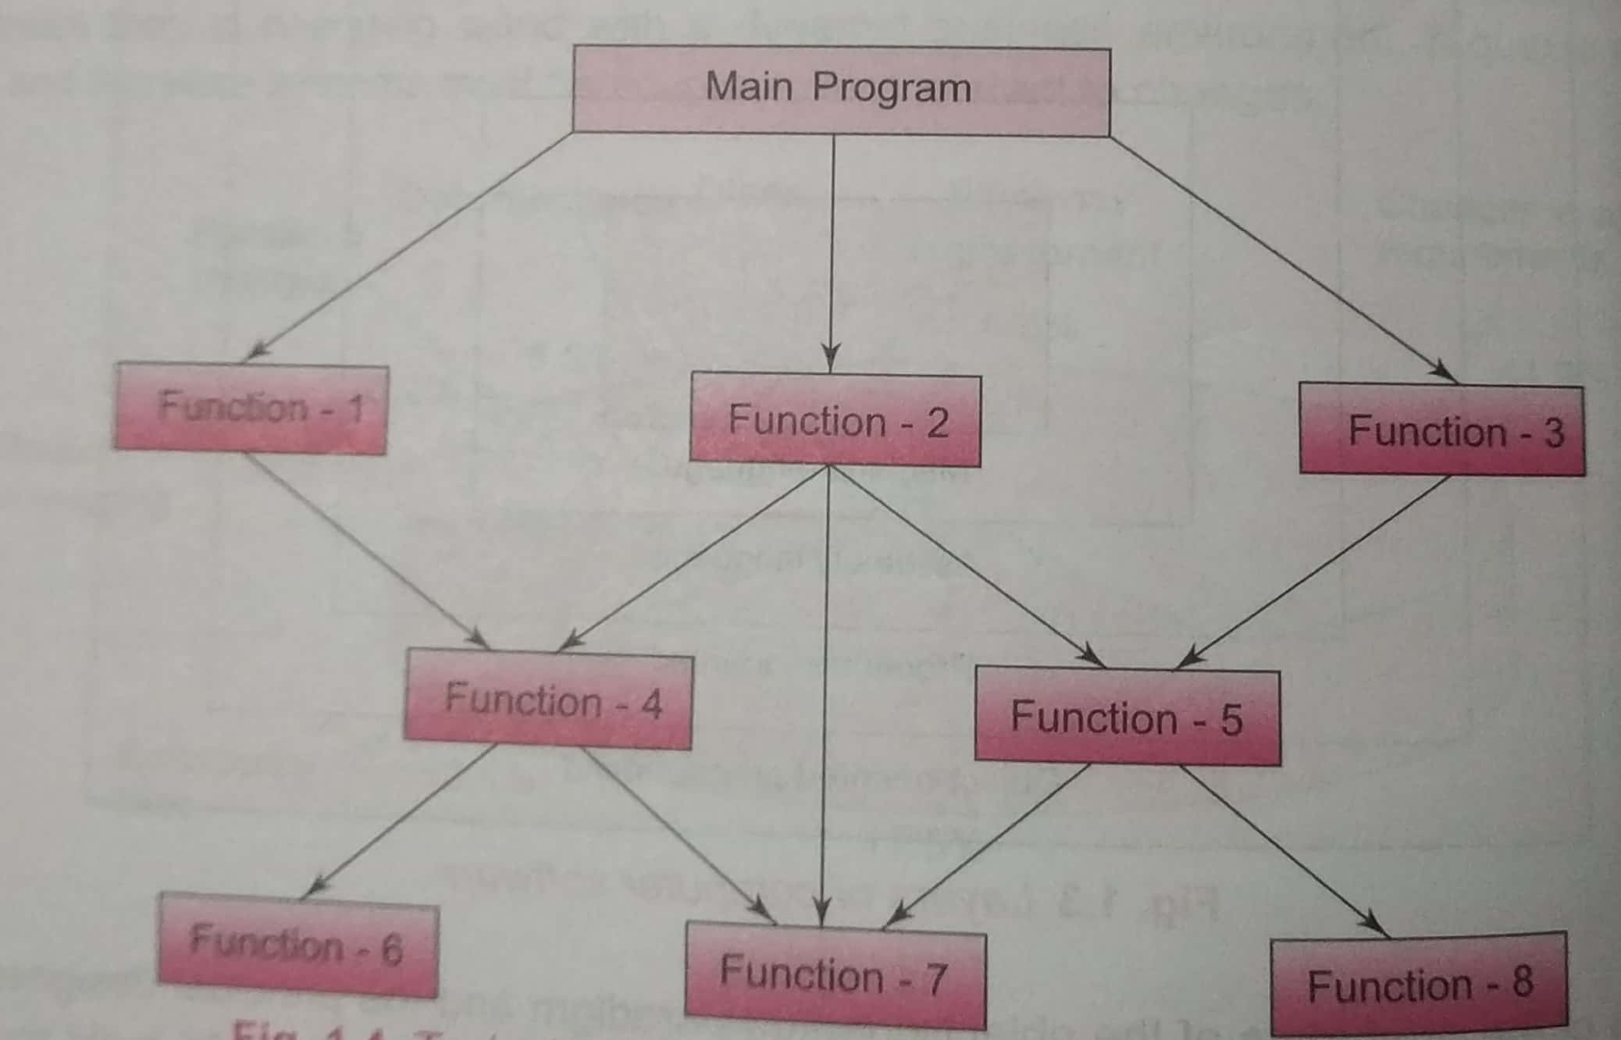
Typical Structure of POP

Slide 5
Characteristics of POP
POP follows a top-down approach.
Functions are more important than data in a program.
Emphasis is on doing things(algorithms)
Large programs are divided in to smaller programs known as functions.
Most of the functions shares global data.
Data moves openly around the system from function to function.
Functions transferm data from one form to another.

Slide 6
Procedure Oriented Programming

Slide 7
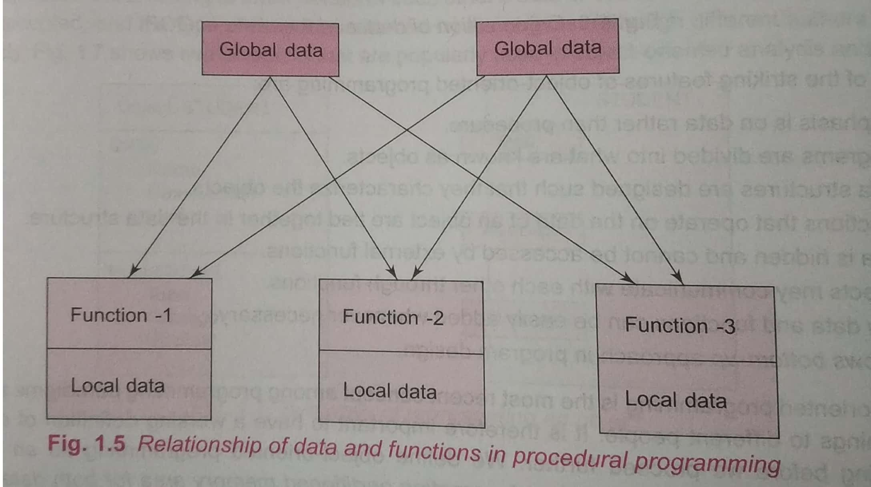
Relationship of Data and Function in POP

Slide 8
Advantages and Drawbacks of POP
Advantages
In a multi-function program,many important data items are placed as global so that they may be accessed by all the functions. Each function may have its local data also..
Follows a systematic approach to solve the problem
Drawbacks of POP
Global data rae more vulnerable to an inadvetent change by a function.
In a large program it is very difficult to identify what data is used by which function.
Another drwaback is that POP is not model real world problem very well.
No easy way for data hiding

Slide 9
Object-Oriented Programming
Object-oriented programming (OOP) refers to a type of computer programming (software design) in which programmers define not only the data type of a data structure, but also the types of operations (functions) that can be applied to the data structure.
The major motovating factor in the invention of Object oriented approach is to remove some of flaws encountered in POP.
OOP treats data as a critical element in the program development and does not allow it to flow freely around the system.
it ties data more closely to the functions that operate on it, and protects it from accidential modification from out side functions.
OOP allows decomposition of a problem into number of entites called objects and then builds data and functions around these objects.

Slide 10
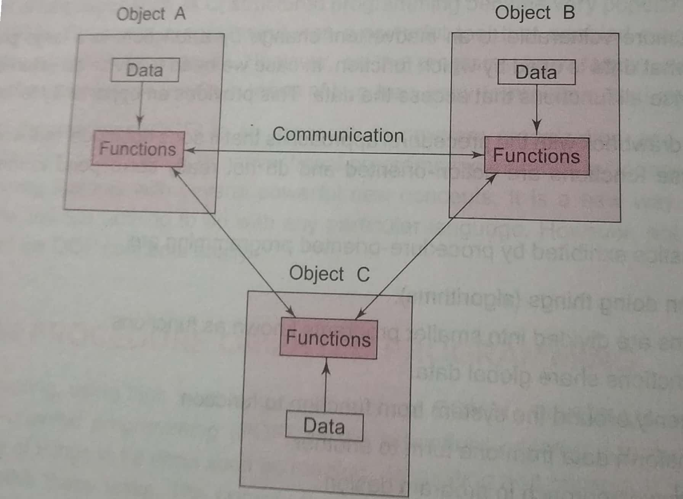
Organization of Data and Functions in OOP

Slide 11
Characteristics of OOP
Emphasis is on data rather than procedure.
Programs are divided into what are known as objects.
Data structures are designed such that they characterize the objects.
Functions that operate on the data of an object are tied together in the data structure.
Data is hidden and cannot be accessed by external functions.
Object may communicate with each other through functions.
New data and functions can be easily added whenever necessary.
Follows Bottom-up approach in program design.

Slide 12


