Slide 1

KALINGA INSTITUTE OF INDUSTRIAL TECHNOLOGY
Dynamic Constructor
School Of Computer Engineering
Dr. Pradeep Kumar Mallick
Associate Professor [II]
School of Computer Engineering,
Kalinga Institute of Industrial Technology (KIIT),
Deemed to be University,Odisha
3 Credit
Lecture Note 11

Slide 2
Chapter Contents
Constructor
  Dynamic Constructor
  Friend Class
  Private Constructor

Slide 3
What is Dynamic constructor?
When allocation of memory is done dynamically using dynamic memory allocator new in a constructor, it is known as dynamic constructor.
By using this, we can dynamically initialize the objects.
or
Dynamic constructor is used to allocate the memory to the objects at the run time.Memory is allocated at run time with the help of 'new' operator.
Explanation: In this below program , we point data member of type char which is allocated memory dynamically by new operator and when we create dynamic memory within the constructor of class this is known as dynamic constructor.

Slide 4
Dynamic constructor
#include <iostream>
using namespace std;
class geeks
{
const char* p;
public:
// default constructor
geeks()
{
// allocating memory at run time
p = new char[6];
p = "geeks";
}
void display()
{
cout << p << endl;
}
};
int main()
{
geeks obj = new geeks();
obj.display();
}

Slide 5
Dynamic constructor
#include <iostream>
using namespace std;
class geeks {
int* p;
public:
geeks()
{
// allocating memory at run time
// and initializing
p = new int[3]={ 1, 2, 3 };
for (int i = 0; i < 3; i++) {
cout << p[i] << " ";
}
cout << endl;
}
};
int main()
{
// five objects will be created
// for each object
// default constructor would be called
// and memory will be allocated
// to array dynamically
geeks* ptr = new geeks[5];
}
O/P
1 2 3
1 2 3
1 2 3
1 2 3
1 2 3

Slide 6
Dynamic constructor
Explanation: In this program we have created array of object dynamically. The first object is ptr[0], second is ptr[1] and so on . For each object creation default constructor is called and for each object memory is allocated to pointer type variable by new operator.

Slide 7
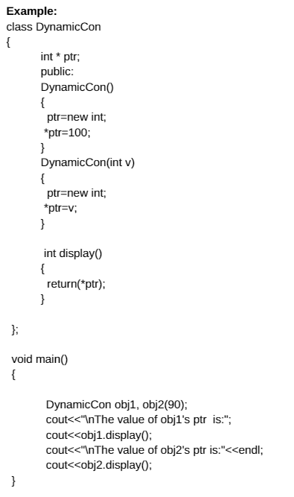
Dynamic constructor

Slide 8
Constructor Overloading
More than one constructor with different signature in a class is called constructor overloading. Signature of constructor includes :
  Number of arguments
  Type of arguments
  Sequence of arguments
When we create an object, the compiler determines the most appropriate constructor to use by comparing the signature of the statement which is creating object with the signature of specific constructor definition.

Slide 9
Constructor Overloading
#include <iostream>
using namespace std;
class ABC
{
private:
int x,y;
public:
ABC () //constructor 1 with no arguments
{
x = y = 0;
}
ABC(int a) //constructor 2 with one argument
{
x = y = a;
}
ABC(int a,int b) //constructor 3 with two argument
{
x = a;
y = b;
}
void display()
{
cout << "x = " << x << " and " << "y = " << y << endl;
}
};
int main()
{
ABC cc1; //constructor 1
ABC cc2(10); //constructor 2
ABC cc3(10,20); //constructor 3
cc1.display();
cc2.display();
cc3.display();
return 0;
} //end of program

Slide 10
Friend Class
A friend class can access private and protected members of other class in which it is declared as friend.
It is sometimes useful to allow a particular class to access private members of other class.
For example a LinkedList class may be allowed to access private members of Node.

Slide 11
Private Constructor
A constructor is a special member function of a class which initializes objects of a class. In C++, constructor is automatically called when object of a class is created.
By default, constructors are defined in public section of class. So, question is can a constructor be defined in private section of class ?
Answer : Yes, Constructor can be defined in private section of class
How to use Constructors in private section?
  Using Friend Class : If we want that class should not be instantiated by anyone else but only by a friend class.
  Using Singleton design pattern: When we want to design a singleton class. This means instead of creating several objects of class, the system is driven by a single object or a very limited number of objects.

Slide 12
Private Constructor
#include <iostream>
using namespace std;
class A{
private:
A(){
cout << "constructor of A\n";
}
friend class B;
};
// class B, friend of class A
class B{
public:
B(){
A a1;
cout << "constructor of B\n";
}
};
int main(){
B b1;
return 0;
}
O/P
constructor of A
constructor of B
Note:
If you comment the line friend class B, you will encounter error.

Slide 13


