Slide 1

KALINGA INSTITUTE OF INDUSTRIAL TECHNOLOGY
Introduction to C++
School Of Computer
Engineering
Dr. Pradeep Kumar Mallick
Associate Professor [II] School of Computer Engineering, Kalinga Institute of Industrial Technology (KIIT),
Deemed to be University,Odisha
3 Credit
Lecture Note 03

Slide 2
Chapter Contents
Evolution of programming paradigm
Procedure oriented programming
Object-oriented programming (OOP)

Slide 3
C++ History
C++ programming language was developed in 1980 by Bjarne Stroustrup at bell laboratories of AT&T (American Telephone & Telegraph), located in U.S.A.
Bjarne Stroustrup is known as the founder of C++ language
C++ runs on a variety of platforms, such as Windows, Mac OS, and the various versions of UNIX.
C++ is a general purpose, case-sensitive, free-form programming language that supports object-oriented, procedural and generic programming.
It was develop for adding a feature of OOP (Object Oriented Programming) in C without significantly changing the C component
C++ is an object-oriented programming language. It is an extension to C programming.
It is combination of Simula67 + C.
C++ programming is "relative" (called a superset) of C, it means any valid C program is also a valid C++ program.

Slide 4
C vs C++
No. | C | C++
1) | C follows the procedural style programming. | C++ is multi-paradigm. It supports both procedural and object oriented.
2) | Data is less secured in C. | In C++, you can use modifiers for class members to make it inaccessible for outside users.
3) | C follows the top-down approach. | C++ follows the bottom-up approach.
4) | C does not support function overloading. | C++ supports function overloading.
5) | In C, you can't use functions in structure. | In C++, you can use functions in structure.
6) | C does not support reference variables. | C++ supports reference variables.
7) | In C, scanf() and printf() are mainly used for input/output. | C++ mainly uses stream cin and cout to perform input and output operations.
8) | Operator overloading is not possible in C. | Operator overloading is possible in C++.
9) | C programs are divided into procedures and modules | C++ programs are divided into functions and classes.
10) | C does not provide the feature of namespace. | C++ supports the feature of namespace.
11) | Exception handling is not easy in C. It has to perform using other functions. | C++ provides exception handling using Try and Catch block.

Slide 5
C++ Features
Simple
Machine Independent or Portable
Mid-level programming language
Structured programming language
Rich Library
Memory Management
Fast Speed
Pointers
Recursion
Extensible
Object Oriented
Compiler based

Slide 6
C++ Features Contd....
1. Simple
C++ is a simple language in the sense that it provides structured approach (to break the problem into parts), rich set of library functions, data types etc.
2. Machine Independent or Portable
Unlike assembly language, c programs can be executed in many machines with little bit or no change. But it is not platform-independent.
3.Mid-level programming language
C++ is also used to do low level programming. It is used to develop system applications such as kernel, driver etc. It also supports the feature of high level language. That is why it is known as mid-level language.
4. Structured programming language
C++ is a structured programming language in the sense that we can break the program into parts using functions. So, it is easy to understand and modify.

Slide 7
C++ Features Contd....
5. Rich Library
C++ provides a lot of inbuilt functions that makes the development fast.
6. Memory Management
It supports the feature of dynamic memory allocation. In C++ language, we can free the allocated memory at any time by calling the free() function.
7. Speed
The compilation and execution time of C++ language is fast.
8. Pointer
C++ provides the feature of pointers. We can directly interact with the memory by using the pointers. We can use pointers for memory, structures, functions, array etc.
9. Recursion
In C++, we can call the function within the function. It provides code reusability for every function.

Slide 8
C++ Features Contd....
10. Extensible
C++ language is extensible because it can easily adopt new features.
11. Object Oriented
C++ is object oriented programming language. OOPs makes development and maintenance easier where as in Procedure-oriented programming language it is not easy to manage if code grows as project size grows.
12. Compiler based
C++ is a compiler based programming language, it means without compilation no C++ program can be executed. First we need to compile our program using compiler and then we can execute our program.

Slide 9
Structure of the C++ Program
Preprocessor directive section
Global Declaration section
Class definition and method definition section
main method
Method definition section

Slide 10

C++ Program Structure
Let us look at a simple code that would print the words Hello World.
#include <iostream>
using namespace std;
// main() is where program
//execution begins.
int main() {
// prints Hello World
cout << "Hello World";
return 0;
}
The C++ language defines several headers, which contain information that is either necessary or useful to the program. For this program, the header <iostream> is needed.
The line using namespace std tells the compiler to use the std namespace. Namespaces are a relatively recent addition to C++
The line int main() is the main function where program execution begins.
cout << " Hello World " causes the message " Hello World " to be displayed on the screen.
Terminates the program

Slide 11
C++ Program Compilation and Execution
Compilation
Run
g++ filename.cpp
E.g. g++ hello.cpp
./a.out
Compilation and Execution Process
Source
Files
Compiler
Object
Files
Intermediate file of the machine code output of the compiler.
Library
Files
Executable
Files
Linker

Slide 12
Files used in C++ Program
Files in C++ Program
Source Files
Header Files
Object Files
Executable Files
Source Files – Contains source code of the program whose extension is .cpp and contains main and other functions.
Header Files – Make the subroutines and store them in header file.
Object Files – Generated by compiler after processing the source code file. It contain a compact binary code of the function definition. The linker uses this object file to produce an executable file by combining the object files together. Generally, it have .obj extension
Binary Executable Files – Generated by Linker. The linker links the various object files to produce a binary file that can be directly executed.

Slide 13
C++ Program
#include <iostream>
#include<conio.h>
using namespace std;
int main()
{
clrscr();
cout << "Welcome to C++ Programming.";
getch();
return 0;
}
#include<iostream.h> includes the standard input output library functions. It provides cin and cout methods for reading from input and writing to output respectively.
#include <conio.h> includes the console input output library functions. The getch() function is defined in conio.h file.
void main() The main() function is the entry point of every program in C++ language. The void keyword specifies that it returns no value.

Slide 14
C++ Program
cout << "Welcome to C++ Programming." is used to print the data "Welcome to C++ Programming." on the console.
The getch() function asks for a single character. Until you press any key, it blocks the screen.

Slide 15
How to compile and run the C++ program
By menu
Now click on the compile menu then compile sub menu to compile the c++ program.
Then click on the run menu then run sub menu to run the c++ program.
By shortcut
Or, press ctrl+f9 keys compile and run the program directly.
You can view the user screen any time by pressing the alt+f5 keys.
Now press Esc to return to the turbo c++ console.

Slide 16
C++ Basic Input/Output
C++ I/O operation is using the stream concept. Stream is the sequence of bytes or flow of data. It makes the performance fast.
If bytes flow from main memory to device like printer, display screen, or a network connection, etc, this is called as output operation.
If bytes flow from device like printer, display screen, or a network connection, etc to main memory, this is called as input operation.
In C++, input and output (I/O) operators are used to take input and display output. The operator used for taking the input is known as the extraction or get from operator (>>), while the operator used for displaying the output is known as the insertion or put to operator (<<).
Standard output stream (cout)
The cout is a predefined object of ostream class. It is connected with the standard output device, which is usually a display screen. The cout is used in conjunction with stream insertion operator (<<) to display the output on a console
Standard input stream (cin)
The cin is a predefined object of istream class. It is connected with the standard input device, which is usually a keyboard. The cin is used in conjunction with stream extraction operator (>>) to read the input from a console.

Slide 17
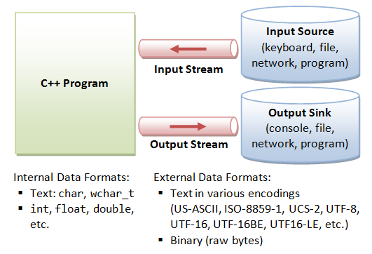
Input/Output Stream
Input Stream: It is the direction of flow of bytes is from the device (e.g., keyboard) to the main memory.
Output Stream: It is the direction of flow of bytes is opposite, i.e. from main memory to device (display screen)

Slide 18
Examples
#include <iostream>
using namespace std;
void main( ) {
int age;
cout << "Enter your age: ";
cin >> age;
cout << "Your age is: " << age << endl;
}
Standard end line (endl)
The endl is a predefined object of ostream class. It is used to insert a new line characters and flushes the stream.
#include <iostream>
void main( ) {
cout << "C++ Tutorial";
cout << " Javatpoint"<<endl;
cout << "End of line"<<endl;
}

Slide 19
Cascading of Input/Output Operators
The cascading of the input and output operators refers to the consecutive occurrence of input or output operators in a single statement. A program with cascading of the input/output operator is as follows
#include<iostream>
using namespace std;
int main ()
{
int a, b;
cin>>a>>b;
cout<<"The value of b is : "<<b;
cout<<“\nThe value of a is : "<<a;
return 0;
}

Slide 20
Comments
Comments are portions of the code ignored by the compiler which allow the user to make simple notes in the relevant areas of the source code. Comments come either in block form or as single lines. C++ supports two types of commenting –
Single-line comments (informally, C++ style), start with // and continue until the end of the line. If the last character in a comment line is a \ the comment will continue in the next line.
Multi-line comments (informally, C style), start with /* and end with */.
Example:
/* This is a single line comment */
/*
This is a multiple line comment
*/

Slide 21
Escape Sequence
An escape sequence is a combination of characters that is translated into another character or sequence of characters that may be difficult or impossible to represent directly. Similar to new line character, other escape sequences supported by C++ is presented below.
Escape Sequence | Purpose
\r | carriage return
\b | backspace
\a | audible bell
\t | horizontal tab
\v | vertical tab
\n | line feed - new line
\? | question mark
\" | double quote
Escape Sequence | Purpose
\' | single quote
\\ | backslash
\f | form feed - new page
\O | Octal constant
\x | Hexadecimal constant

Slide 22
Namespace in C++
// A program to demonstrate need of namespace
int main()
{
int value;
value = 0;
double value; // Error here
value = 0.0;
}
Output :
Compiler Error:
'value' has a previous declaration as 'int value'
In each scope, a name can only represent one entity. So, there cannot be two variables with the same name in the same scope. Using namespaces, we can create two variables or member functions having the same name.

Slide 23
C++ Variable
A variable is a name of memory location. It is used to store data. Its value can be changed and it can be reused many times.
It is a way to represent memory location through symbol so that it can be easily identified.
Syntax to declare a variable:
type variable_list;
Example of declaring variable is given below:
int x; float y; char z;
Here, x, y, z are variables and int, float, char are data types.
Rules for defining variables
A variable can have alphabets, digits and underscore.
A variable name can start with alphabet and underscore only. It can't start with digit.
No white space is allowed within variable name.
A variable name must not be any reserved word or keyword e.g. char, float etc.

Slide 24
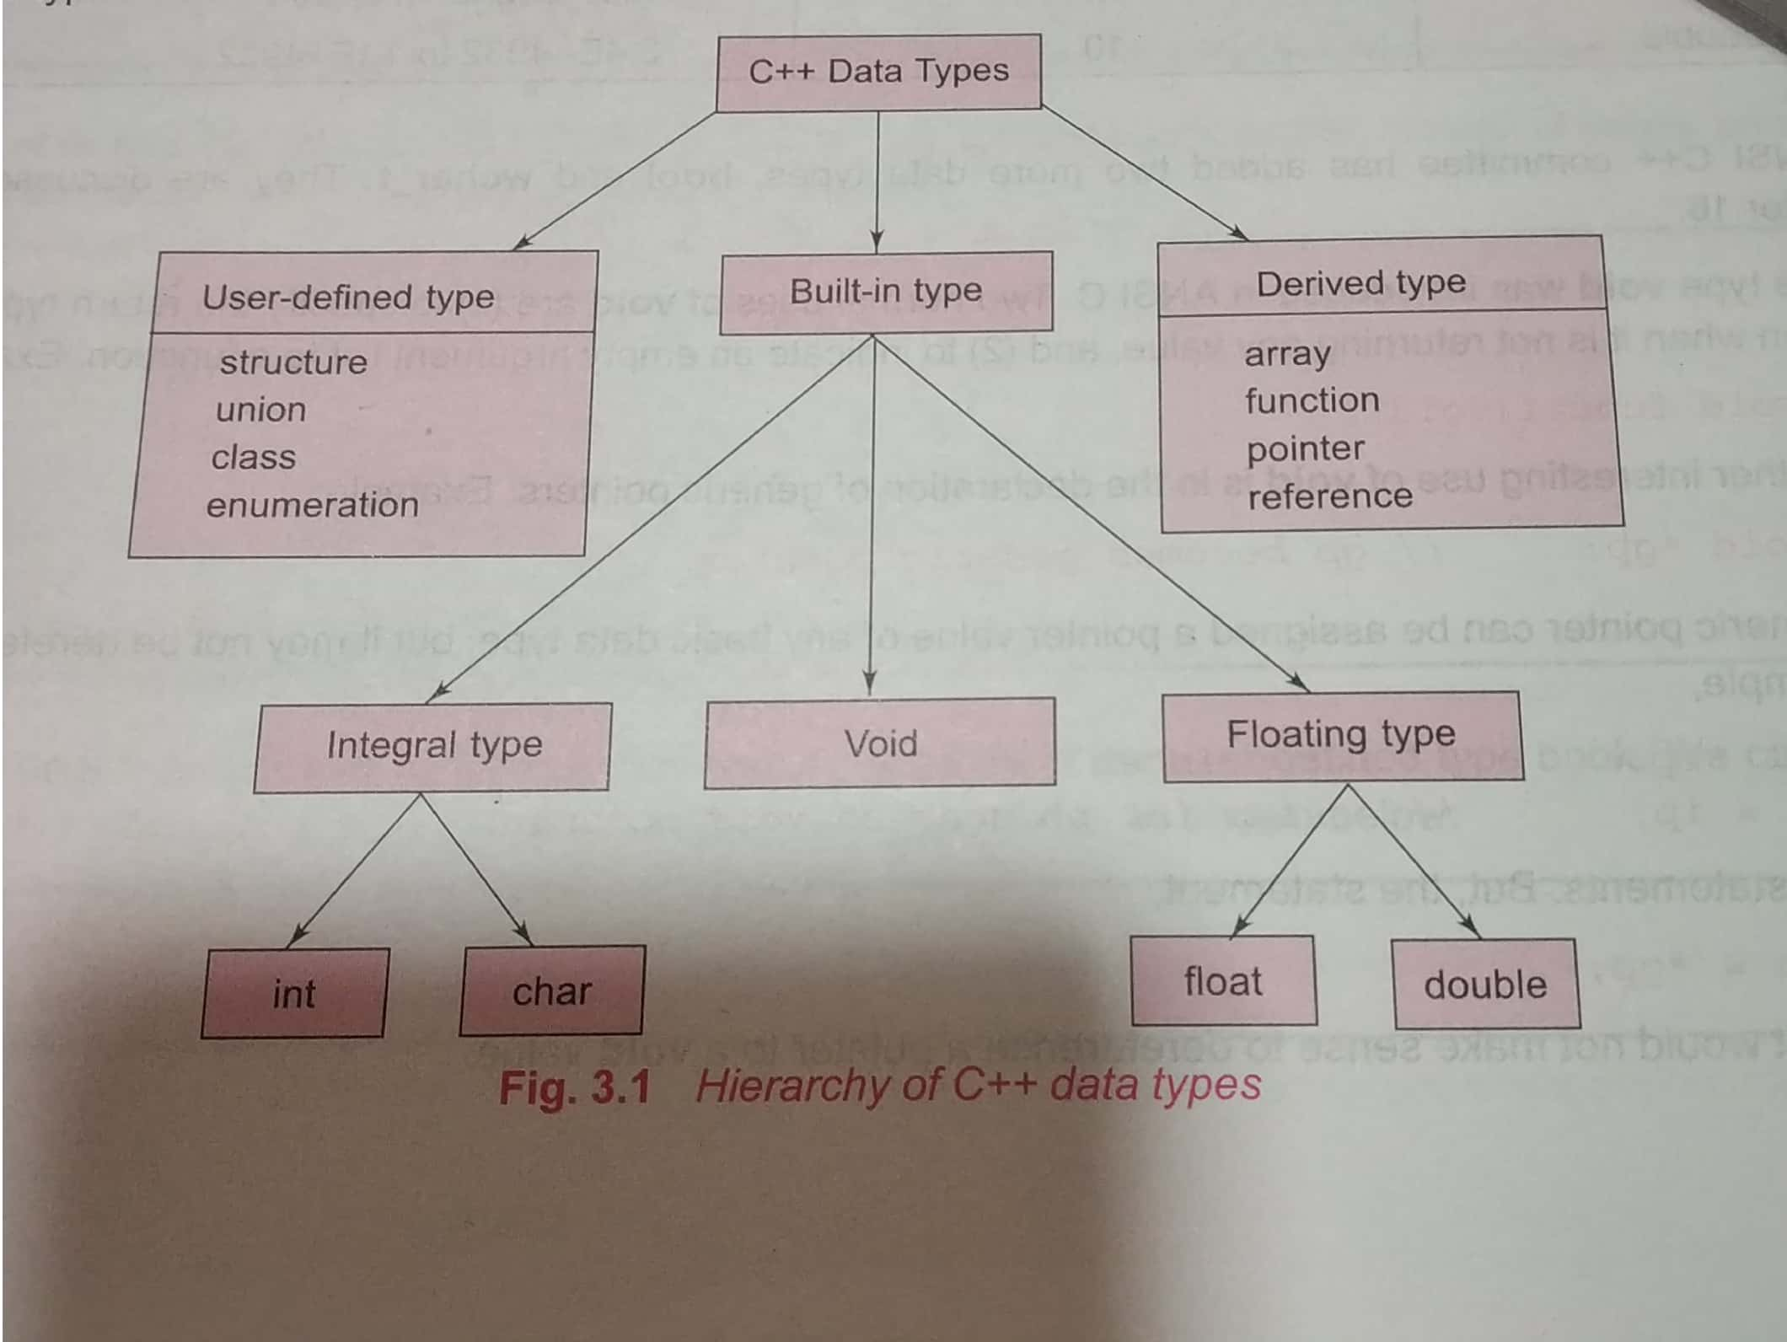
Data Types
There are 4 types of data types in C++ language.
The basic data types are integer-based and floating-point based. C++ language supports both signed and unsigned literals.
The memory size of basic data types may change according to 32 or 64 bit operating system.
Let's see the basic data types. It size is given according to 32 bit OS.

Slide 25
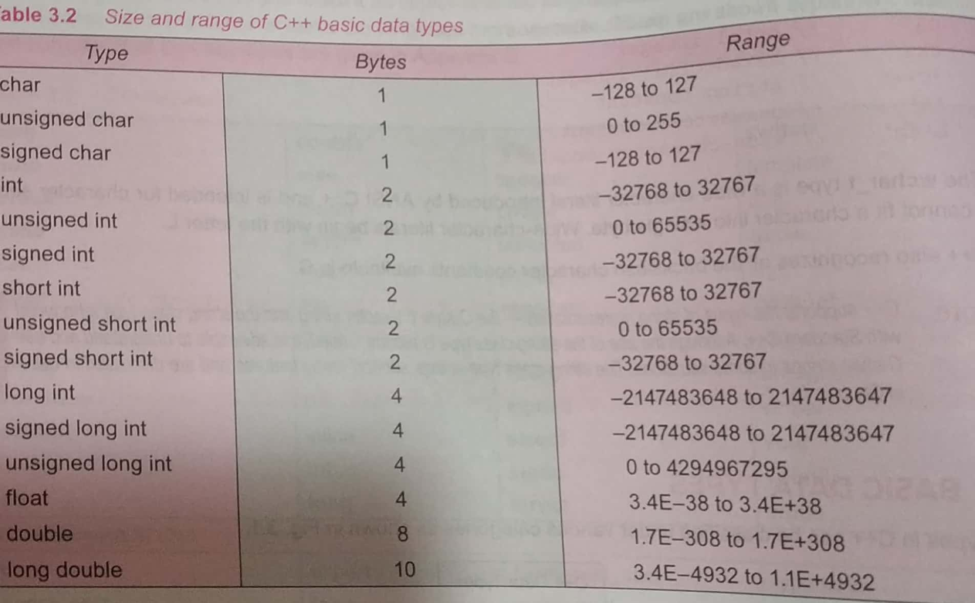
Basic Data Types

Slide 26
C++ Keywords
A keyword is a reserved word. You cannot use it as a variable name, constant name etc
A list of 32 Keywords in C++ Language which are also available in C language are given below.
auto | break | case | char | const | continue | default | do
double | else | enum | extern | float | for | goto | if
int | long | register | return | short | signed | sizeof | static
struct | switch | typedef | union | unsigned | void | volatile | while
A list of 30 Keywords in C++ Language which are not available in C language are given below.
asm | dynamic_cast | namespace | reinterpret_cast | bool
explicit | new | static_cast | false | catch
operator | template | friend | private | class
this | inline | public | throw | const_cast
delete | mutable | protected | true | try
typeid | typename | using | virtual | wchar_t

Slide 27
C++ Operators
An operator is simply a symbol that is used to perform operations. There can be many types of operations like arithmetic, logical, bitwise etc.
There are following types of operators to perform different types of operations in C language.
Basic Operators in C:
Arithmetic Operators ,2. Relational Operators, 3. Logical Operators
4. Bitwise Operators, 5. Assignment Operator, 6.Unary operator
7. Ternary or Conditional Operator, 8.Comma
Operators in C++:
:: Scope Resolution Operator
::* Pointer-to-member declaration
->* Pointer -to-member operator
.* Pointer -to-member operator
delete memory release operator
new memory allocation operator
endle Line feed operator
setw Field width operator

Slide 28
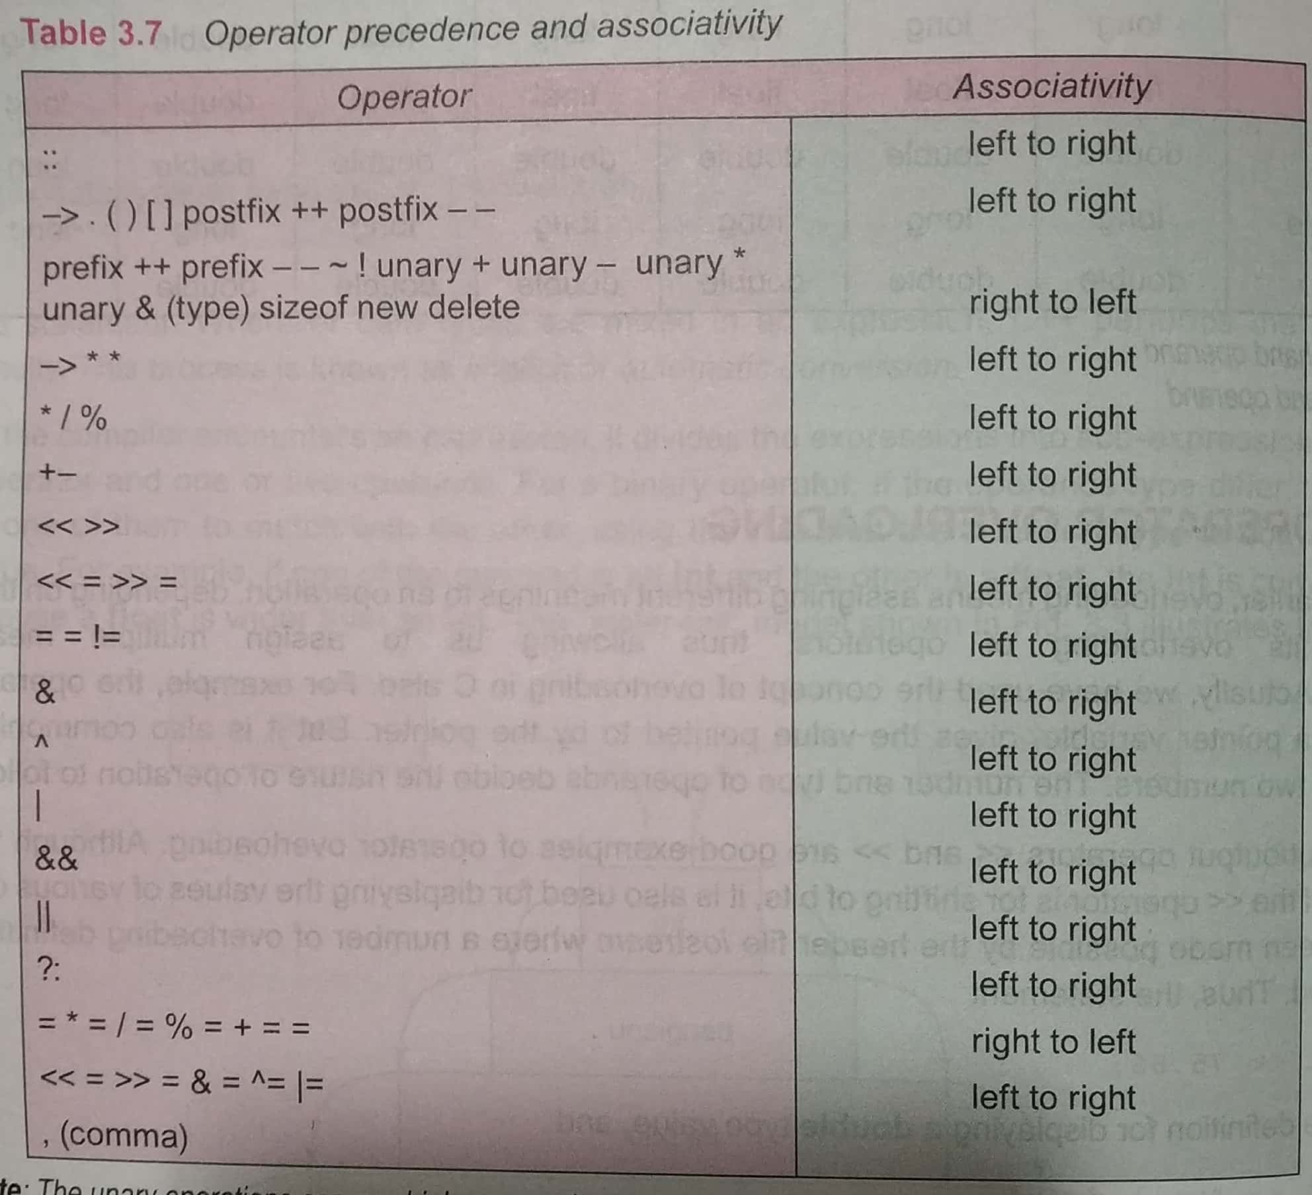
Precedence of Operators in C++
The precedence of operator species that which operator will be evaluated first and next. The associativity specifies the operators direction to be evaluated, it may be left to right or right to left.

Slide 29
Scope Resolution Operator (::)
In C++, scope resolution operator is ::. It is used for following purposes.
1) To access a global variable when there is a local variable with same name:
// C++ program to show that we can access a global variable
// using scope resolution operator :: when there is a local
// variable with same name
#include<iostream>
using namespace std;
int x; // Global x
int main()
{
int x = 10; // Local x
cout << "Value of global x is " << ::x;
cout << "\nValue of local x is " << x;
return 0;
}
O/P: Value of global x is 0 , Value of local x is 10

Slide 30
Scope Resolution operator cont…
2. To define a function outside a class.
#include<iostream>
using namespace std;
class A
{
public:
// Only declaration
void fun();
};
// Definition outside class using ::
void A::fun()
{
cout << "fun() called";
}
int main()
{
A a;
a.fun();
return 0;
}

Slide 31
Scope Resolution operator cont…
3. To access a class’s static variables
class Test
{
static int x;
public:
static int y;
// Local parameter 'a' hides class member
// 'a', but we can access it using ::
void func(int x)
{
// We can access class's static variable
// even if there is a local variable
cout << "Value of static x is " << Test::x;
cout << "\nValue of local x is " << x;
}
};
// In C++, static members must be explicitly defined
// like below
int Test::x = 1;
int Test::y = 2;
int main()
{
Test obj;
int x = 3 ;
obj.func(x);
cout << "\nTest::y = " << Test::y;
return 0;
}

Slide 32
Scope & Lifetime of variables
Life Time – Life time of any variable is the time for which the particular variable outlives in memory during running of the program.
Scope – The scope of any variable is actually a subset of life time. A variable may be in the memory but may not be accessible though. So, the area of our program where we can actually access our entity (variable in this case) is the scope of that variable. The scope of any variable can be broadly categorized into three categories :
Global scope : When variable is defined outside all functions. It is then available to all the functions of the program and all the blocks program contains.
Local scope : When variable is defined inside a function or a block, then it is locally accessible within the block and hence it is a local variable.
Function scope : When variable is passed as formal arguments, it is said to have function scope.

Slide 33
Scope Resolution Operator (::)
::* Pointer-to-member declaration
To declare a pointer to a member of a class
->* Pointer -to-member operator
To access a member using obeject name and a pointer to that member
.* Pointer -to-member operator
To access a member using a pointer to the object and a pointer to that member.

Slide 34
new and delete operators in C++
Dynamic memory allocation in C/C++ refers to performing memory allocation manually by programmer.
Dynamically allocated memory is allocated on Heap and non-static and local variables get memory allocated on Stack (Refer Memory Layout C Programs for details).
new operator
The new operator denotes a request for memory allocation on the Heap. If sufficient memory is available, new operator initializes the memory and returns the address of the newly allocated and initialized memory to the pointer variable.
Syntax to use new operator:
To allocate memory of any data type, the syntax is:
pointer-variable = new data-type;
Here, pointer-variable is the pointer of type data-type. Data-type could be any built-in data type including array or any user defined data types including structure and class.

Slide 35
new Operator
/ Pointer initialized with NULL
// Then request memory for the variable
int *p = NULL;
p = new int;
OR
// Combine declaration of pointer
// and their assignment
int *p = new int;
Initialize memory:
We can also initialize the memory using new operator:
pointer-variable = new data-type(value);
Example:
int *p = new int(25);
float *q = new float(75.25);

Slide 36
delete operator
Since it is programmer’s responsibility to deallocate dynamically allocated memory, programmers are provided delete operator by C++ language.
Syntax:
// Release memory pointed by pointer-variable
delete pointer-variable;
Here, pointer-variable is the pointer that points to the data object created by new.
Examples:
delete p;
delete q;

Slide 37
Example of new and delete
#include <iostream>
using namespace std;
int main () {
int * arr;
int size;
cout<<”Enter the size of the integer array”;
cin>>size;
cout<<”creating an array of size”<<size<<”. .”;
arr= new int[size];
cout<<”Dynamic allocation for array is successful”;
delete arr;
getch();
return 0;
}

Slide 38
Example of new and delete
#include <iostream>
using namespace std;
int main () {
double* pvalue = NULL; // Pointer initialized with null
pvalue = new double; // Request memory for the variable
*pvalue = 29494.99; // Store value at allocated address
cout << "Value of pvalue : " << *pvalue << endl;
delete pvalue; // free up the memory.
return 0;
}
If we compile and run above code, this would produce the following result −
Value of pvalue : 29495

Slide 39
Type cast operator
A cast is a special operator that forces one data type to be converted into another.
The most general cast supported by most of the C++ compilers is as follows −
(type name) expression // C notation
type name( expression) // C++ notation
#include <iostream>
using namespace std;
int main () {
int intvar=25;
float floatvar=35.87;
cout<<”intvar=” <<intvar;
cout<<”floatvar=” <<floatvar;
cout<<” \n float(intvar)=” <<float(intvar);
cout<<”\n int(floatvar)=” <<int(floatvar);
return 0;
}

Slide 40
Type cast operator
#include <iostream>
using namespace std;
main() {
double a = 21.09399;
float b = 10.20;
int c ;
c = (int) a;
cout << "Line 1 - Value of (int)a is :" << c << endl ;
c = (int) b;
cout << "Line 2 - Value of (int)b is :" << c << endl ;
return 0;
}
Line 1 - Value of (int)a is :21
Line 2 - Value of (int)b is :10

Slide 41
Type cast operator
#include <iostream>
using namespace std;
main() {
double a = 21.09399;
float b = 10.20;
int c ;
c = (int) a;
cout << "Line 1 - Value of (int)a is :" << c << endl ;
c = (int) b;
cout << "Line 2 - Value of (int)b is :" << c << endl ;
return 0;
}
Line 1 - Value of (int)a is :21
Line 2 - Value of (int)b is :10

Slide 42
Type cast operator
There are other casting operators supported by C++, they are listed below −
const_cast
dynamic_cast
reinterpret_cast
static_cast

Slide 43


