Slide 1

KALINGA INSTITUTE OF INDUSTRIAL TECHNOLOGY
Introduction to C++
School Of Computer
Engineering
Dr. Pradeep Kumar Mallick
Associate Professor [II] School of Computer Engineering, Kalinga Institute of Industrial Technology (KIIT),
Deemed to be University,Odisha
4 Credit
Lecture Note 03

Slide 2
Chapter Contents
If statements
Looping

Slide 3
C++ if-else
In C++ programming, if statement is used to test the condition. There are various types of if statements in C++.
if statement
if-else statement
nested if statement
if-else-if ladder
C++ IF Statement
The C++ if statement tests the condition. It is executed if condition is true.
Syntax:
if(condition)
{
//code to be executed
}

Slide 4
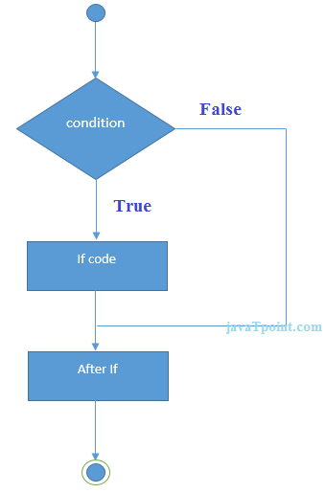
C++ if-else

Slide 5
Example
#include <iostream>
int main ()
{
int num = 10;
if (num % 2 == 0)
{
cout<<"It is even number";
}
return 0;
}
O/P: It is even number

Slide 6
C++ IF-else Statement
The C++ if-else statement also tests the condition. It executes if block if condition is true otherwise else block is executed.
Syntax:
if(condition)
{
//code to be executed if condition is true
}
else
{
//code to be executed if condition is false
}

Slide 7
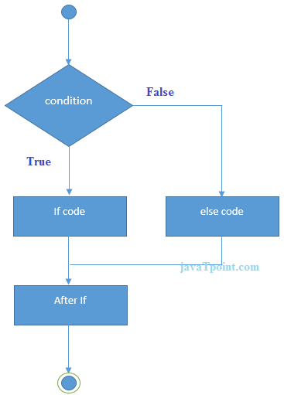
C++ IF-else Statement

Slide 8
Example
#include <iostream>
using namespace std;
int main ()
{
int num ;
cout<<"Enter Value for num"<<endl;
cin>> num;
if (num % 2 == 0)
{
cout<<"It is even number";
}
else
{
cout<<"It is odd number";
}
return 0;
}

Slide 9
Nested if-else Statement
if (Condition1)
{
if(Condition2)
{
Statement1;
}
else
{
Statement2;
}
}
else
{
if(Condition3)
{
Statement3;
}
else
{
Statement4;
}
}

Slide 10
Nested if-else Statement
#include <iostream>
using namespace std;
int main()
{
int a,b,c;
cout<<"Enter value for a, b and c"<< endl;
cin>>a>>b>>c;
if(a>=b)
{
if(a>=c)
{
cout<<"a is agreater" <<a<<endl;
}
else
{
cout<<"c is geater:"<<c<<endl;
}
}
else
{
if (b>=c)
{
cout << "b is greater"<<b;
}
else
{
cout<<"c is greater:" <<c<<endl;
}
}
return 0;
}

Slide 11
C++ IF-else-if ladder Statement
The C++ if-else-if ladder statement executes one condition from multiple statements.
Syntax:
if(condition1){
//code to be executed if condition1 is true
}else if(condition2){
//code to be executed if condition2 is true
}
else if(condition3){
//code to be executed if condition3 is true
}
...
else{
//code to be executed if all the conditions are false
}

Slide 12
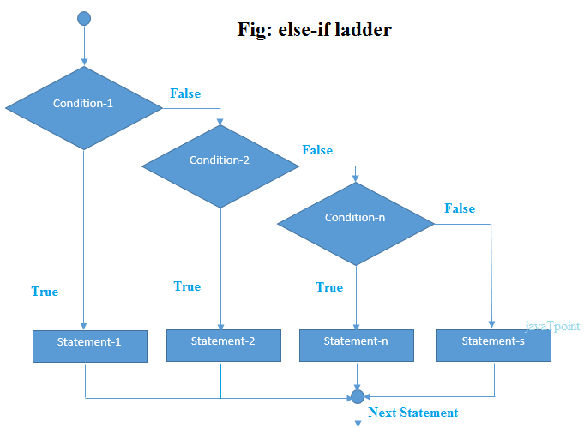
Flow Chart

Slide 13
Example
#include <iostream>
using namespace std;
int main()
{
int a,b,c;
cout<<"Enter value for a, b and c"<< endl;
cin>>a>>b>>c;
if(a>=b&& a>=c)
{
cout<< "a is greater"<<a<<endl;
}
else if(b>=c && b>=a)
{
cout<<"b is greater"<<b<<endl;
}
else
{
cout<<"c is greater<<c"<< endl;
}
return 0;
}

Slide 14
Example
#include <iostream>
int main () {
int num;
cout<<"Enter a number to check grade:";
cin>>num;
if (num <0 || num >100)
{
cout<<"wrong number";
}
else if(num >= 0 && num < 50){
cout<<"Fail";
}
else if (num >= 50 && num < 60)
{
cout<<"D Grade";
}
else if (num >= 60 && num < 70)
{
cout<<"C Grade";
}
else if (num >= 70 && num < 80)
{
cout<<"B Grade";
}
else if (num >= 80 && num < 90)
{
cout<<"A Grade";
}
else if (num >= 90 && num <= 100)
{
cout<<"A+ Grade";
}
}

Slide 15
C++ switch
The C++ switch statement executes one statement from multiple conditions. It is like if-else-if ladder statement in C++.
switch(expression){
case value1:
//code to be executed;
break;
case value2:
//code to be executed;
break;
......
default:
//code to be executed if all cases are not matched;
break;
}

Slide 16
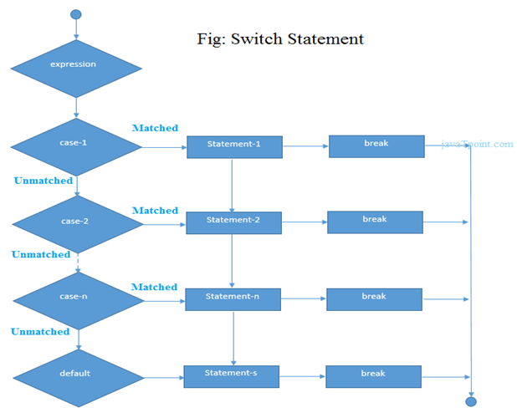
Switch Case...

Slide 17
Examples
#include <iostream>
using namespace std;
int main () {
int num;
cout<<"Enter a number to check grade:";
cin>>num;
switch (num)
{
case 10: cout<<"It is 10"; break;
case 20: cout<<"It is 20"; break;
case 30: cout<<"It is 30"; break;
default: cout<<"Not 10, 20 or 30"; break;
}
}

Slide 18
C++ For Loop
The C++ for loop is used to iterate a part of the program several times. If the number of iteration is fixed, it is recommended to use for loop than while or do-while loops.
The C++ for loop is same as C/C#. We can initialize variable, check condition and increment/decrement value.
Syntax:
for(initialization; condition; incr/decr)
{
//code to be executed
}

Slide 19
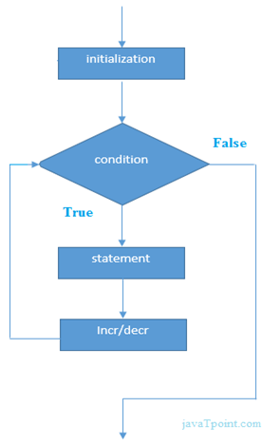
C++ For Loop

Slide 20
Example
#include <iostream>
using namespace std;
int main() {
for(int i=1;i<=10;i++){
cout<<i <<"\n";
}
}

Slide 21
C++ While loop
In C++, while loop is used to iterate a part of the program several times.
If the number of iteration is not fixed, it is recommended to use while loop than for loop.
Syntax:
while(condition)
{
//code to be executed
}

Slide 22
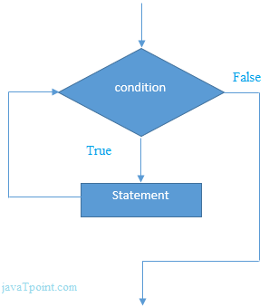
Flow Chart

Slide 23
Example
#include <iostream>
using namespace std;
int main() {
int i=1;
while(i<=10)
{
cout<<i <<"\n";
i++;
}
}

Slide 24
C++ Nested While Loop Example
In C++, we can use while loop inside another while loop, it is known as nested while loop.
The nested while loop is executed fully when outer loop is executed once.
#include <iostream>
using namespace std;
int main () {
int i=1;
while(i<=3)
{
int j = 1;
while (j <= 3)
{
cout<<i<<" "<<j<<"\n";
j++;
}
i++;
}
}

Slide 25
C++ Infinitive While Loop Example:
#include <iostream>
using namespace std;
int main () {
while(true)
{
cout<<"Infinitive While Loop";
}
}

Slide 26
C++ Do-While Loop
The C++ do-while loop is used to iterate a part of the program several times.
If the number of iteration is not fixed and you must have to execute the loop at least once, it is recommended to use do-while loop.
Syntax:
do{
//code to be executed
}while(condition);

Slide 27
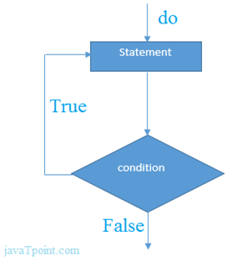
Flow Chart

Slide 28
C++ Do-While Loop Example
#include <iostream>
using namespace std;
int main() {
int i = 1;
do{
cout<<i<<"\n";
i++;
} while (i <= 10) ;
}

Slide 29
C++ Infinitive do-while Loop
Syntax:
do{
//code to be executed
}while(true);
Example:
#include <iostream>
using namespace std;
int main() {
do{
cout<<"Infinitive do-while Loop";
} while(true);
}

Slide 30


