Slide 1

KALINGA INSTITUTE OF INDUSTRIAL TECHNOLOGY
Recursion,Storage Classes,Function overloading in C++
School Of Computer Engineering
Dr. Pradeep Kumar Mallick
Associate Professor [II]
School of Computer Engineering,
Kalinga Institute of Industrial Technology (KIIT),
Deemed to be University,Odisha
3 Credit
Lecture Note 07

Slide 2
Chapter Contents
Recursion
C++ Storage Classes
Function overloading in C++
Rules for Function Overloading

Slide 3
Recursion
When function is called within the same function, it is known as recursion in C++.
The function which calls the same function, is known as recursive function.
A function that calls itself, and doesn't perform any task after function call, is known as tail recursion.
In tail recursion, we generally call the same function with return statement.

Slide 4
Example
#include<iostream>
using namespace std;
int main()
{
int factorial(int);
int fact,value;
cout<<"Enter any number: ";
cin>>value;
fact=factorial(value);
cout<<"Factorial of a number is: "<<fact<<endl;
return 0;
}
int factorial(int n)
{
if(n<0)
return(-1); /*Wrong value*/
if(n==0)
return(1); /*Terminating condition*/
else
{
return(n*factorial(n-1));
}
}

Slide 5
C++ Storage Classes
Storage class is used to define the lifetime and visibility of a variable and/or function within a C++ program.
Lifetime refers to the period during which the variable remains active and visibility refers to the module of a program in which the variable is accessible.
There are four types of storage classes, which can be used in a C++ program
    Automatic
    Register
    Static
    External

Slide 6
Storage Classes
Storage Class | Keyword | Lifetime | Visibility | Initial Value
Automatic | auto | Function Block | Local | Garbage
Register | register | Function Block | Local | Garbage
External | extern | Whole Program | Global | Zero
Static | static | Whole Program | Local | Zero

Slide 7
Function overloading in C++
Function overloading is a C++ programming feature that allows us to have more than one function having same name but different parameter list,
Parameter list means the data type and sequence of the parameters,
Eexample the parameters list of a function myfuncn(int a, float b) is (int, float) which is different from the function myfuncn(float a, int b) parameter list (float, int).
Function overloading is a compile-time polymorphism.
Now that we know what is parameter list lets see the rules of overloading: we can have following functions in the same scope.
Example:
  sum(int num1, int num2)
  sum(int num1, int num2, int num3)
  sum(int num1, double num2)

Slide 8
Examples:
These two have different number of parameters:
    sum(int num1, int num2)
    sum(int num1, int num2, int num3)
These two functions have different parameter type:
    sum(int num1, int num2)
    sum(double num1, double num2)
These two have different sequence of parameters:
    sum(int num1, double num2)
    sum(double num1, int num2)
All of the above three cases are valid case of overloading. We can have any number of functions, just remember that the parameter list should be different. For example:
    int sum(int, int)
    double sum(int, int)
This is not allowed as the parameter list is same. Even though they have different return types, its not valid.

Slide 9
Example
#include <iostream>
using namespace std;
void print(int i) {
cout << " Here is int " << i << endl;
}
void print(double f) {
cout << " Here is float " << f << endl;
}
void print(char const *c) {
cout << " Here is char* " << c << endl;
}
int main() {
print(10);
print(10.10);
print("ten");
return 0;
}
Output:
Here is int 10
Here is float 10.1
Here is char* ten

Slide 10
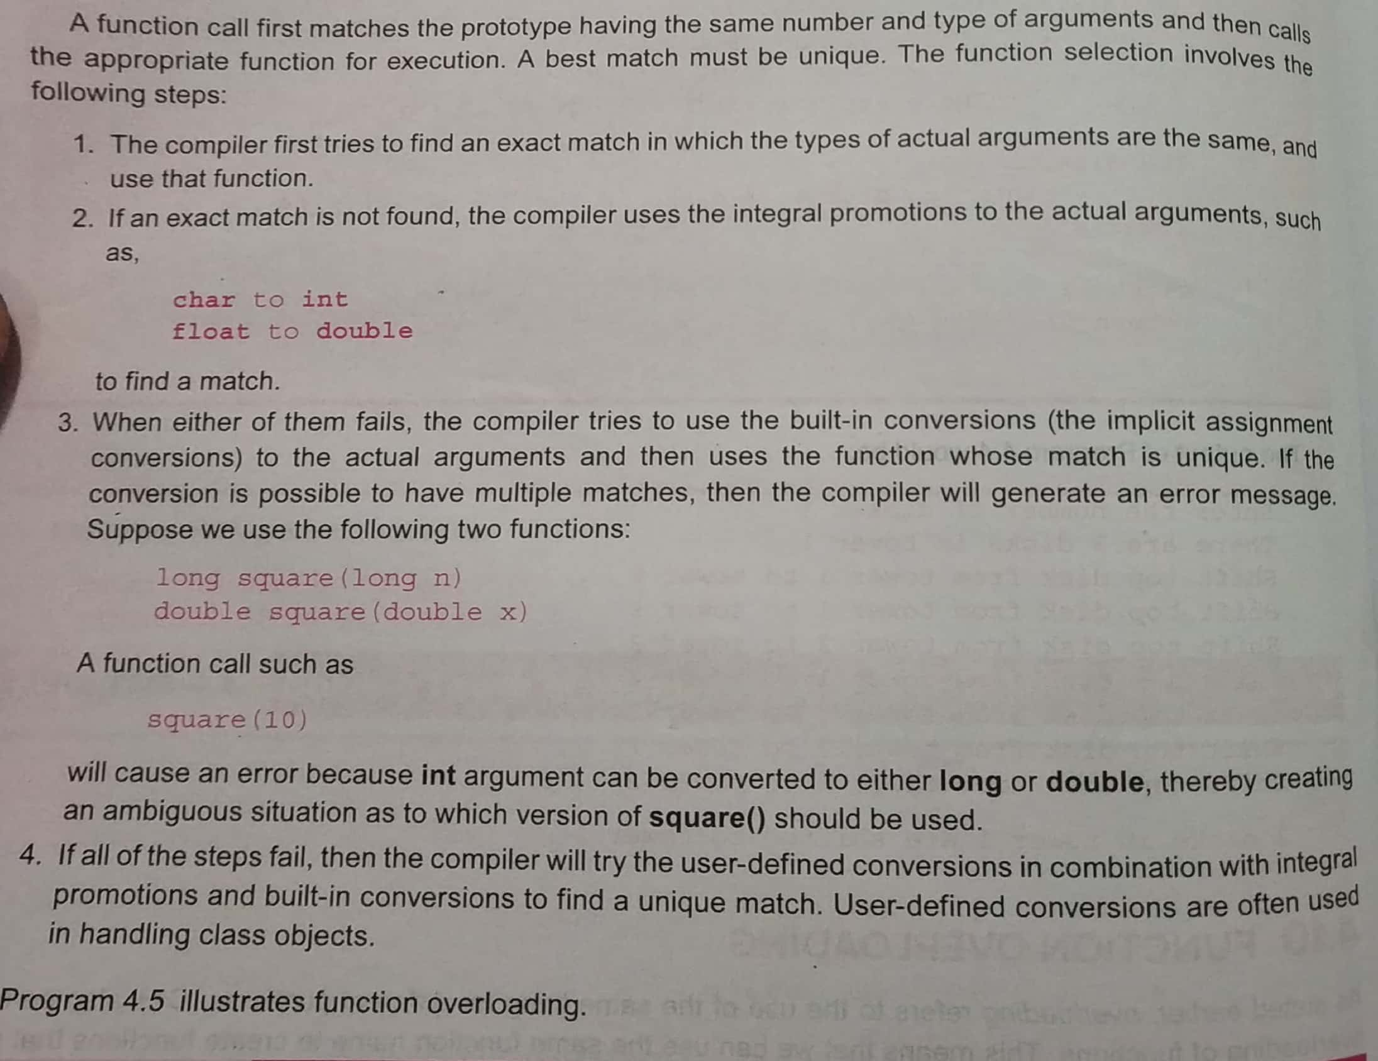
Rules for Function overloading

Slide 11


