Slide 1

KALINGA INSTITUTE OF INDUSTRIAL TECHNOLOGY
Class and Object
School Of Computer Engineering
Dr. Pradeep Kumar Mallick
Associate Professor [II]
School of Computer Engineering,
Kalinga Institute of Industrial Technology (KIIT),
Deemed to be University,Odisha
3 Credit
Lecture Note 08

Slide 2
Chapter Contents
Specifying Class
Creating Objects
Accessing Class Members
Defining Member Functions
  Inside the class defination
  Outside the class defination

Slide 3
Specifying Class
A class is a way to bind the data and its associated functions together.
It allows the data (and functions ) to be hidden , if necessary, from external use.
When declaring a class , we are creating a new abstract data type tat can be treated like any other built-in data types.
It is a user defined data type, which holds its own data members and member functions, which can be accessed and used by creating an instance of that class.
A class is like a blueprint for an object.
A Class specification has two parts:
    Class declaration
    Class function defination
The Class declaration describes the type and scope of its members.
The class function defination describes how the class functions are implemented.

Slide 4
Specifying Class contd...
  class class_name
  {
  private:
  variable declaration;
  function declaration
  public:
  variable declaration;
  function declaration
  };
The keyword class is required to declare a class.
The keyword class specifies , that what follows is an abstract data of class_name.
The body of a class is enclosed within braces and terminated by a semicolon.

Slide 5
Specifying Class contd..
The Class body contains the declaration of variables and functions.
These variables and functionsare collectively called class members .
They are usually grouped into two sections,namely,private and public,to denote which of the members are private and which of them are public.
The keyword private and public are know as visibility level.
private and public keywords are followed by a colon(:).
The class members that have been declared as private can be accessed only from within the class.
In other hand the class members that have been declared as public can be accessed from outside of class.
The use of private keyword is optional because by default a class is private.
If both private and public labels are missing, by default , all the members are private.such class is completely hidden from the outside world and dosenot serve any purpose.
The variables declared inside the class are known as data member and the functions are known as member functions.

Slide 6
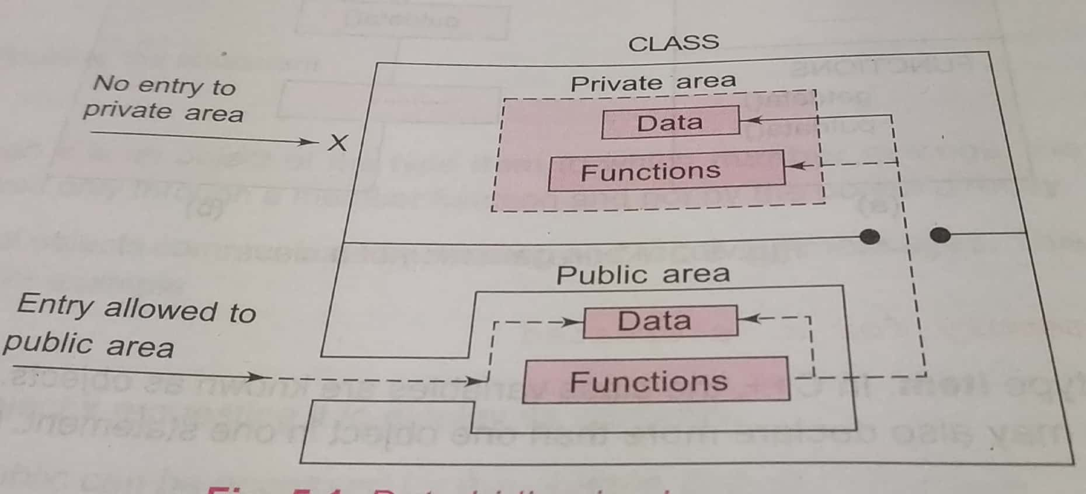
Specifying Class contd..
Only the member functions can have access tothe private data members and private functions.
However the public members (both function and data) can be accessed from outside the class.

Slide 7
Class Examples:
  class item
  {
  private:
  int number;
  float cost;
  public:
  void getdata(int a , int b);
  void putdata();
  }

Slide 8
Private, Public and Protected Access Specifiers
The class members are grouped into sections private, protected and public.
These keywords are called access specifiers which define the accessibility or visibility level of class members.
The class members that have been declared as private can be accessed only from within the class. This facilitates data hiding which is also one of the key features of object-oriented programming.
The class members that has been declared as protected are accessible within the class and also in the derived class.
Public members can be accessed from outside of class as well.

Slide 9
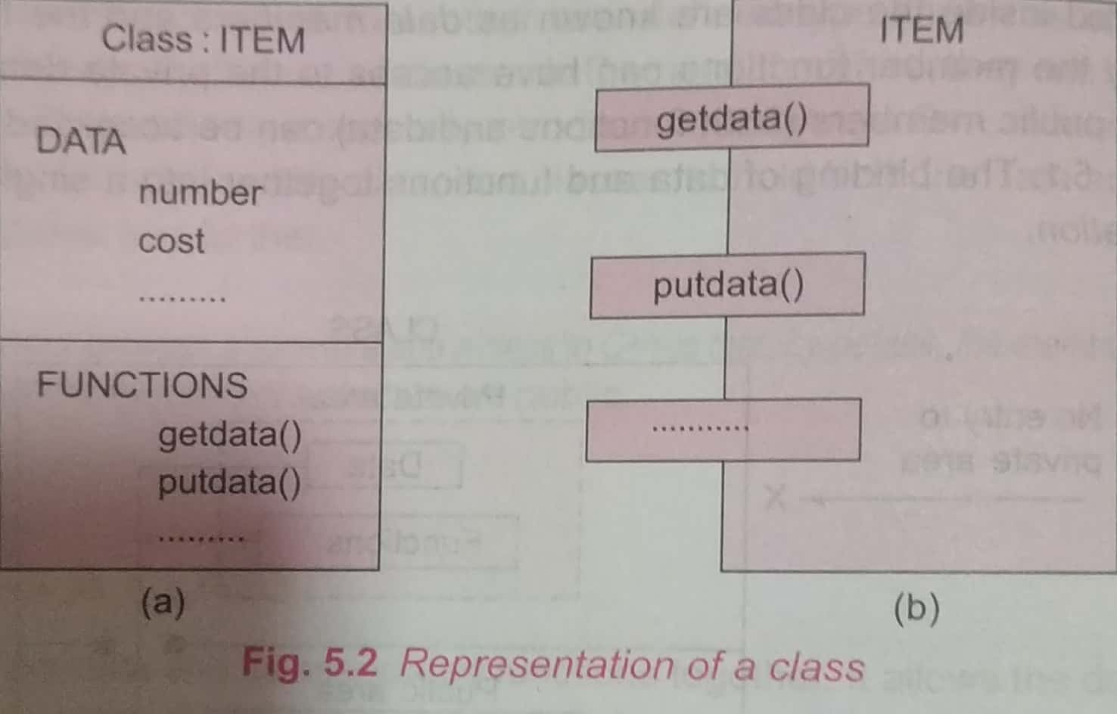
Creating Objects:
When a class is defined, only the specification for the object is defined; no memory or storage is allocated.
To use the data and access functions defined in the class, you need to create objects.
Syntax:
ClassName ObjectName;
Example :
item obj; // obj is the object of class item

Slide 10
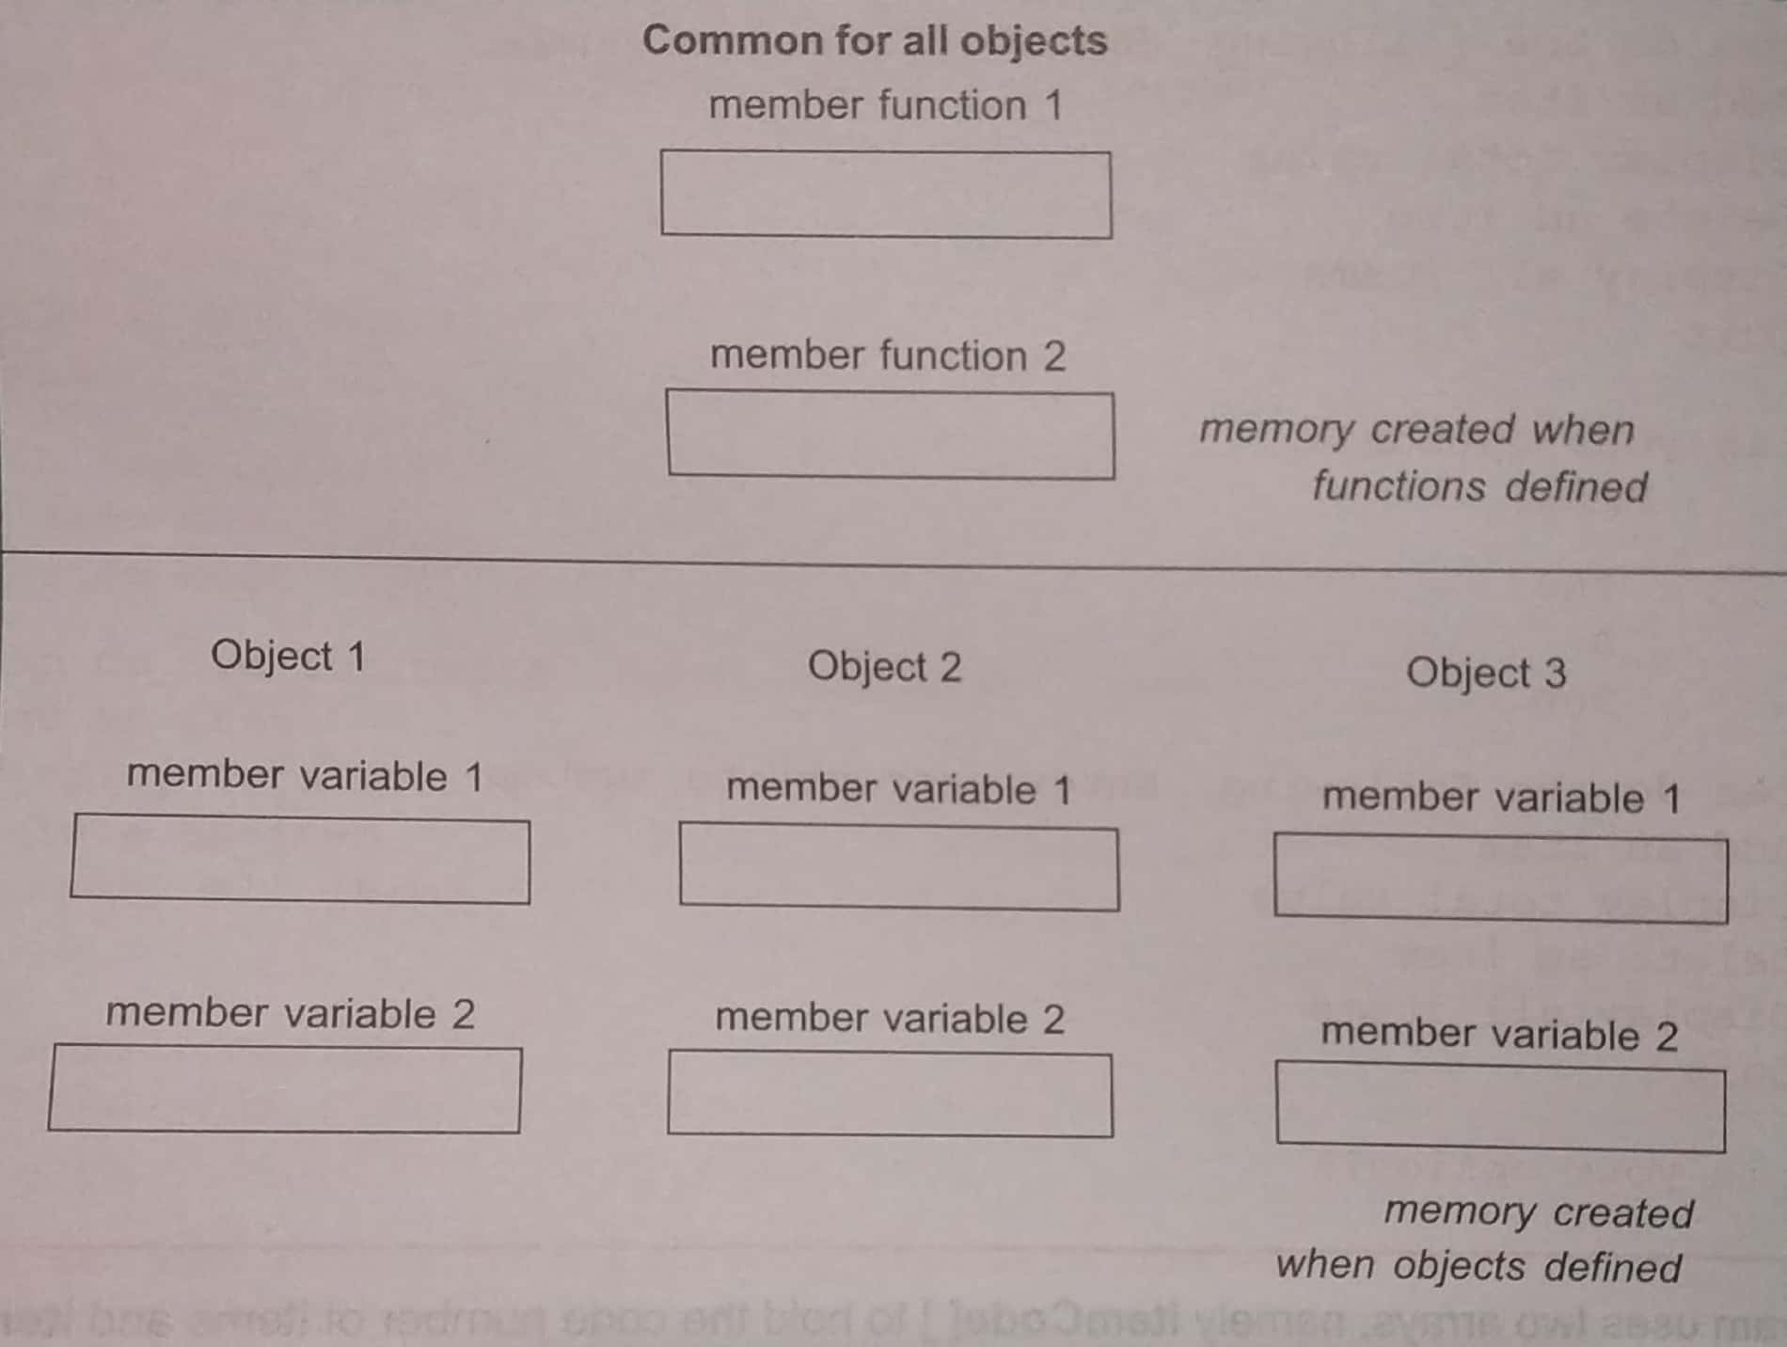
Memory Allocation for Objects

Slide 11
Memory Allocation for Objects
The member functions are created and placed in the memory space only once when they are defined as a part of class specification.
Since all the objects belonging to that class use the same member functions, no separate space is allocated for member functions, when the object are created .
Only space for member variable is allocated separately for each object.
Separate memory locations for the objects are essetial , because the member variable will hold different data values for different objects.

Slide 12
Accessing Class Members
The data members and member functions of class can be accessed using the dot(‘.’) operator with the object.
Syntax:
object-name.function-name()
For example if the name of object is obj and you want to access the member function with the name putdata( ) then you will have to write obj.putdata( ) .
Example-1
  obj.getdata(10,20);
Example-2
obj.number=100; // illegal
Athough obj is an object of class item to which number belongs, the number (declared private ) can be accessed only through a member function and not by the object directly.

Slide 13
Defining Member Functions
Member function can be defined in two ways.
    Outside the class defination
    Inside the class defination

Slide 14
Function Declaration : outside of class
To define a member function outside the class definition we have to use the scope resolution :: operator along with class name and function name.
Syntax :
    return-type class-name :: function-name(list of arguments)
    {
    function body
    }
The membership label class-name:: tells the compiler that the function function-nmae belongs to the class class-name.
The symbol :: is called te scope resolution operator.

Slide 15
Function Declaration : inside class
When a function is defined inside a class , it is treated as an inline function.
Normally , only small functionsa ae defined inside the class defination.
All restrictions and limitaions that apply to an inline function are also applicable here.

Slide 16
Function Declaration : inside class
#include <iostream>
using namespace std;
class car
{
private:
int car_number;
char car_model[10];
public:
void getdata()
{
cout<<"Enter car number: ";
cin>>car_number;
cout<<"\n Enter car model: ";
cin>>car_model;
}
void showdata()
{
cout<<"Car number is "<<car_number;
cout<<"\n Car model is "<<car_model;
}
};
// main function starts
int main()
{
car c1;
c1.getdata();
c1.showdata();
return 0;
}

Slide 17
Function Declaration Inside Class
    #include <iostream>
    using namespace std;
    class Student {
    public:
    int id;//data member (also instance variable)
    string name;//data member(also instance variable)
    };
    int main() {
    Student s1; //creating an object of Student
    s1.id = 201;
    s1.name = "Sonoo Jaiswal";
    cout<<s1.id<<endl;
    cout<<s1.name<<endl;
    return 0;
    }

Slide 18
Initialize and Display data through method
#include <iostream>
using namespace std;
class Student {
public:
int id;//data member (also instance variable)
string name;//data member(also instance variable)
void insert(int i, string n)
{
id = i;
name = n;
}
void display()
{
cout<<id<<" "<<name<<endl;
}
};
    int main(void)
    {
    Student s1; //creating an object of Student
    Student s2; //creating an object of Student
    s1.insert(201, "Sonoo");
    s2.insert(202, "Nakul");
    s1.display();
    s2.display();
    return 0;
    }

Slide 19
Initialize and Display data through method
#include <iostream>
using namespace std;
class Employee {
public:
int id;//data member (also instance variable)
string name;//data member(also instance variable)
float salary;
void insert(int i, string n, float s)
{
id = i;
name = n;
salary = s;
}
void display()
{
cout<<id<<" "<<name<<" "<<salary<<endl;
}
};
int main(void) {
Employee e1; //creating an object of Employee
Employee e2; //creating an object of Employee
e1.insert(201, "Sonoo",990000);
e2.insert(202, "Nakul", 29000);
e1.display();
e2.display();
return 0;
}

Slide 20
Function Declaration : outside class
#include <iostream>
using namespace std;
class car
{
private:
int car_number;
char car_model[10];
public:
void getdata(); //function declaration
void showdata();
};
// function definition
void car::getdata()
{
cout<<"Enter car number: "; cin>>car_number;
cout<<"\n Enter car model: "; cin>>car_model;
}
  void car::showdata()
  {
  cout<<"Car number is "<<car_number;
  cout<<"\n Car model is "<<car_model;
  }
  // main function starts
  int main()
  {
  car c1;
  c1.getdata();
  c1.showdata();
  return 0;
  }

Slide 21


