Slide 1
타이젠 계산기 , OpenGL ES

Slide 2
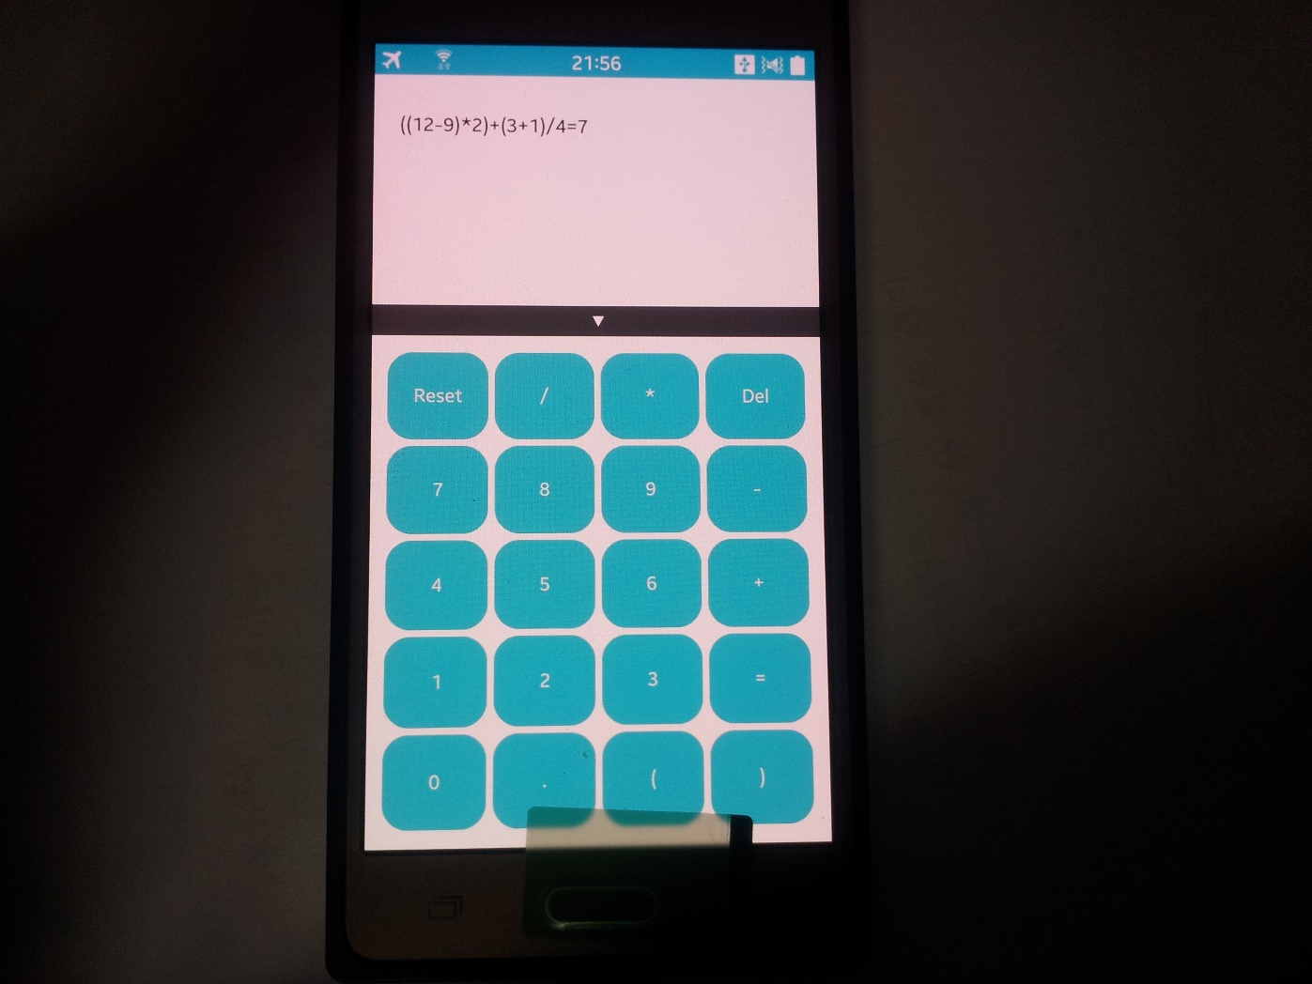

Slide 3
계산기 핵심 요인
연산자 우선순위개념과 스택의 LIFO방식을 이용한 계산기 구현 중 각 기호들의 우선순위 체크 함수
static int check_permission(char target)
{
if (target == '(')
{return 1;}
else if (target == '+' || target == '-')
{return 3;}
else if (target == '*' || target == '/')
{return 2;}
else if (target == ')')
{return 4;}
else
{return 5;}
}

Slide 4
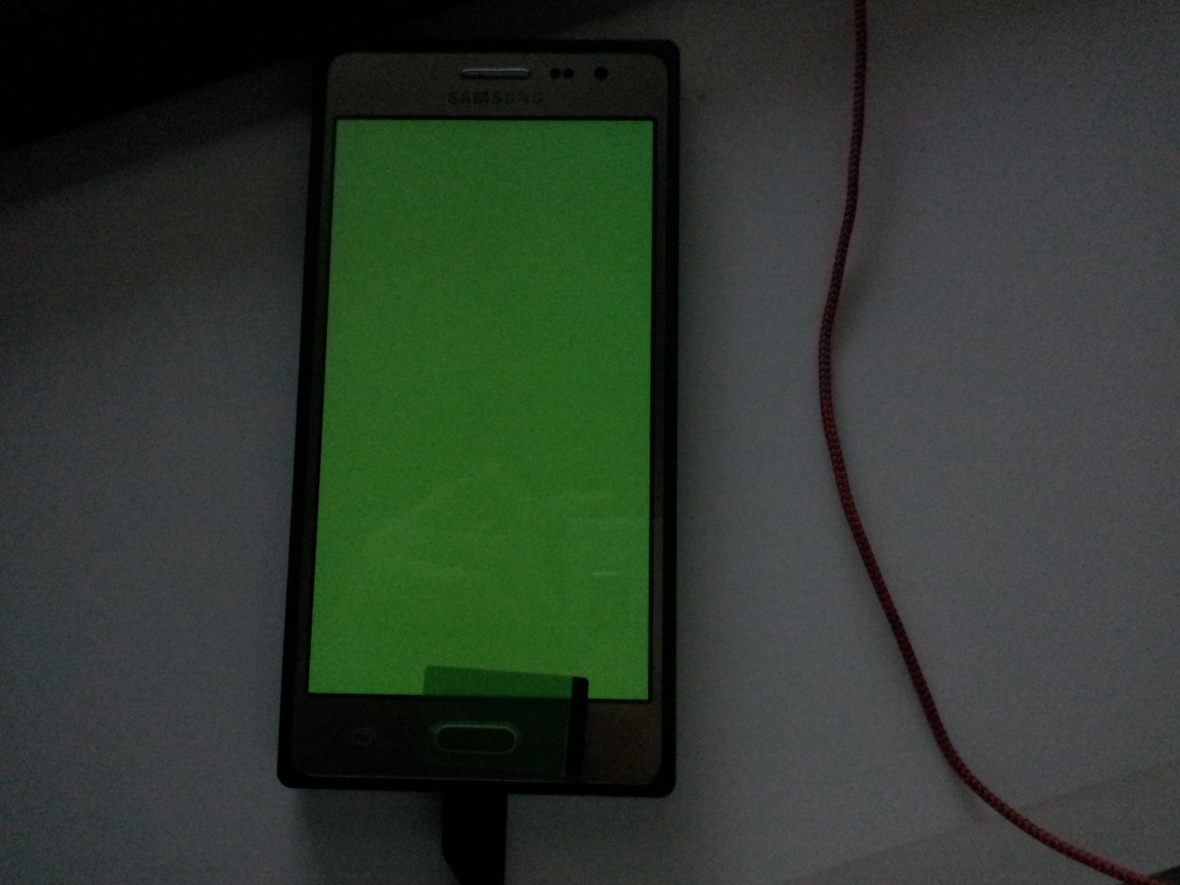

Slide 5
evas_object_show(ad->win);//윈도우 그린 후
gl_view_create(ad->win);//뷰 생성
elm_run();
elm_shutdown();

Slide 6
Evas_Object* gl_view_create(Evas_Object *view)
{
Evas_Object *gl_view;
gl_view = elm_glview_add(view);
elm_win_resize_object_add(view,gl_view);
elm_glview_mode_set(gl_view,ELM_GLVIEW_ALPHA | ELM_GLVIEW_DEPTH | ELM_GLVIEW_STENCIL);
elm_glview_resize_policy_set(gl_view,ELM_GLVIEW_RESIZE_POLICY_RECREATE);
elm_glview_render_policy_set(gl_view,ELM_GLVIEW_RENDER_POLICY_ON_DEMAND);
elm_glview_render_func_set(gl_view,draw_gl); //여기서 렌더링
elm_glview_resize_func_set(gl_view,resize_gl); //여기서
evas_object_size_hint_min_set(gl_view,250,250);
evas_object_show(gl_view);
return gl_view;
}

Slide 7
로그를 보면 렌더링을 2번 한것을 알 수 있음
01-18 04:26:21.815 : INFO / ex18 ( 6123 : 6123 ) : width : 250 height : 250
01-18 04:26:21.815 : INFO / ex18 ( 6123 : 6123 ) : .
01-18 04:26:21.895 : INFO / ex18 ( 6123 : 6123 ) : width : 720 height : 1280
01-18 04:26:21.905 : INFO / ex18 ( 6123 : 6123 ) : .

Slide 8
화면 렌더링
static void draw_gl(Evas_Object *gl)
{
ELEMENTARY_GLVIEW_USE(gl);
glClearColor(0.4,0.7,0.4,1.0);
glClear(GL_COLOR_BUFFER_BIT);
dlog_print(DLOG_INFO,"ex18",".");
}

Slide 9
뷰 사이즈 체크
static void resize_gl(Evas_Object *gl)
{
ELEMENTARY_GLVIEW_USE(gl);
int width,height;
elm_glview_size_get(gl,&width,&height);
glViewport(0,0,width,height);
char buffer[128]={'\0',};
sprintf(buffer,"width : %d height : %d",width,height);
dlog_print(DLOG_INFO,"ex18",buffer);
}

