Slide 1


SMODERP2D SOIL EROSION MODEL ENTERING AN OPEN SOURCE ERA WITH GPU-BASED PARALLELIZATION
Landa, Jeřábek, Pešek, Kavka
Faculty of Civil Engineering
Czech Technical University in Prague
Notes:
Good morning ladies and gentlemens, let me welcome you on the last presentation of this section related to SMODERP2D project. The presentation will be performed by Martin Landa (that’s apparently me;-) and by me colleague Ondrej Pesek. But the real credit must be acknowledged to our colleagues who cannot attend this great event: Jakub Jerabek and Petr Kavka. They are true authors of this project. SMODERP2D is one of erosion models available on the market. I would like also to warn you that neither me or my colleague Ondrej are hydrologist. We are responsible for technical part and implementing GIS functionality. So if you want to have a real fun ask us hydrology-related questions after this presentation. I can promise that you will not get any answer ;-)

Slide 2
What is SMODERP2D?
Runoff-soil erosion physically-based distributed episodic model
Calculation and prediction processes at agricultural areas and small watersheds
Written in Python
Open Source project since 2018
Code on GitHub https://github.com/storm-fsv-cvut/smoderp2d
GNU GPL 3.0 licence
Notes:
First of all, let me introduce in few sentences the SMODERP2D project. SMODERP2D is a physically-based surface runoff erosion model. It’s designed for episodic computation. From erosion perspective the biggest erosion is typically caused by huge rainfall (so called “episode”). This model can be used for designing measures in order to prevent or at least to decrease erosion events in specified area of interest.
The code is written in Python. It’s an open source project available on GitHub since 2018 and licensed under GNU GPL v3.0.
---
K tu bych rekl, ze se jedna o povrchovy odtok (surface runoff) co to pocita. Je je zalozen na fyzice (physically based) a ze je navrzen pro pocitani jednotlivych epizod (episodic - tzn reakce povodi na jednotlivou srazku).
K tomu episodic se da rict, ze je to dobre pri navrchovani nejakych protipovodnovych opatreni (polder, retencni nardz), tzn napriklad urcit kolik maji zadrzet objemu vody z dane srazky. Z hlediska eroze je to zajimave protoze nejvetri odnos pudy je prave zpusoben nejakou vetri srazkou (jak rikame my - epizodou). Kde vznika povrchovy odtok a puda se odnasi z pozemku. Tenhle model ti ma pomoct kdyz chces navrhnout opatreni (measure), ktere ma (a) zabranit tomu aby ten odnos pudy budec zacal, (b) ma ten odnos pudy snizit a nebo (c) to ma zaridit aby se ta odnesena puda aspon udrzena na danem pozemku a nevtekla nekam do rek.
Sezony (tzn ze pocitas treba cely rok) se s tim pocictat nedaj na to jsou jine modely.
V pythonu je to kvuli arcGisu.

Slide 3
History
Long-term project driven by the Department of Landscape Water Conservation at the Czech Technical University in Prague
Originally developed as a surface runoff simulated by profile model (1D)
Later redesigned using spatially distributed method → SMODERP2D
Originally written in Fortran, later in Visual Basic, currently in Python
Major refactoring / functionality improvements started in 2018
Notes:
SMODERP2D is a long-term project …
It was originally developed as …
And later rewritten using … Spatially distributed methods are currently widely used in hydrologic modelling.
Code was originally written …
In this presentation we would like to presently mainly ongoing development which was launched in 2018.
---
Ad bod 1. Ze se katedra zabejva malyma stavebnima zasahama v krajine pro ktere je vodni a erozni rezim na meritku povodi zasadni. Proto na katedre vedle nejake merici infrastruktury vznikl i matematicky model. Puvodne 1d v fortranu, pak ve visual basicu.
Spatial distributed modely jsou dnes rozsirene pac jsme to dnes schopny upocitat diky lepsim pocitacum tzn je to proste trend.

Slide 4
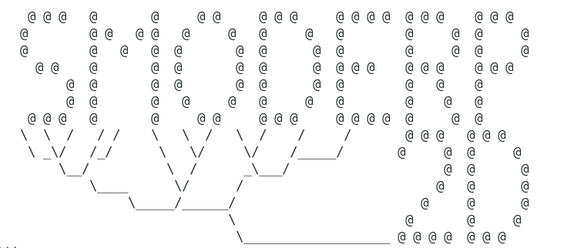
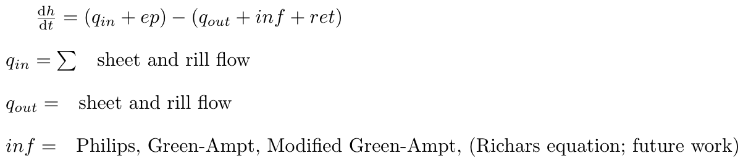
SMODERP2D Model
GIS based model
Cell by cell mass balance information
Kinematic wave approach for sheet flow
Explicit solution of time discretization
Rill development implemented in the model
See related paper for details
Model structure:
Notes:
The model belongs to a family of so-called GIS-based hydrological models utilizing capabilities of GIS software for geospatial data processing. The core of the model is a raster based cell-by-cell mass balance calculation which includes the key hydrological processes, such as effective precipitation, surface runoff and stream network routing. Stream network routing is performed line-by-line in the user predefined polyline layer. Please find the details in related paper.
---
GIS based model - vyuziva features, ktere se uzivaji v gis a k tomu si pridava nejake svoje hydrologicne veci (vypocet infiltrace, povrchoveho odtoku nebo odnosu pudy).
Cell by cell mass balance information - mass balance je zakone zachovani hmoty, ktery predpokladame ze funguje. V tomhle modelu to znamena, ze to co pritece, musi nejak odtect. To jak to odteka ridi prave ten Kinematic wave approach. Kinematic wave approach nevim jak v kratkosti vysvetlit… Je to proste zdednoduseni slozitejcich rovnic, ktere popisuji jak tece voda mimo reky na povrchu zemskem ;).
Explicit solution of time discretization -
Rill development implemented in the model - toto tam pisem, protoze to casto erozni modeli nejak obchazeji. Ten rill development implementation je odnos pudy tim, ze ve bunce DEM, kde nastane eroze, model udela diru velkou podle toho kolik je voda co v te bunce je schopna odnest. To ze tam ta dira vznikne zpetne ovlivnuje, jak tam rychle ta voda tece. To ze se to takhle navzajem ovlivnuje (to jak tece voda ovlivnuje to se odnasi puda a naopak) je jeden z orisku tohohle pocitani.

Slide 5
Workflow
Data preparation (pre-processing)
  DEM→calculate flow direction
  Soil map, land-use map → assign soil properties to each polygon
  Rainfall data → check the data for correctness
  Watercourse network (WN) →check WN connection→ assign order to WN reaches
Model computation
  For each DEM cell and each time step:
    Calculate the current rainfall and infiltration
    Calculate inflow from surrounding and outflow from current cell
    Move to the next time step
Data post-processing
  Store rasters, vectors and text files with results
Notes:
Now we are going to explain how SMODERP2D works in the reality. The workflow contains three major steps. At the beginning data pre-processing is performed. Here GIS functionality plays the major role. There are several tasks which need to be performed. Most importantly to assign soil properties to each polygon defined by area of interest and to order watercourse network reaches. In the second step a model computation is performed. The computation is done in arrays using numpy library. No GIS tools are used here. In the last steps the resultant data is saved in specified output directory. This procedure is done by native tools of used GIS software.

Slide 6
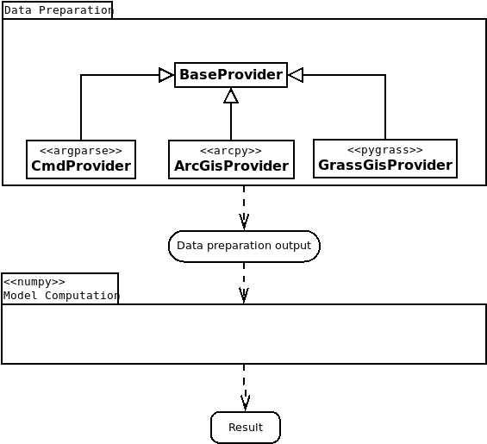
Ongoing development | Major goals
Major refactoring: separate Data Preparation and Model Computation packages
Data preparation provided by various software packages (ArcGIS 10.x/Pro, GRASS GIS, QGIS)
Python 3 support
Model computation parallelization experiments (ongoing, experimental)
Notes:
On this slide you can see major points which will presented here. In 2018 we started to work on a new generation of SMODERP2D project. The main goal was to do major refactoring of a current code base. In the result GIS-based data preparation part was clearly separated from numpy-based model computation. This step was crucial for introducing support for various GIS packages. Originally only Esri ArcGIS proprietary platform was supported. Here we are going to present support for two widely used open source GIS platforms - GRASS GIS and QGIS. At the end of presentation Ondrej will present ongoing experiments related to computation parallelization.

Slide 7
Ongoing development | GIS tools
Options:
Perform data preparation (pre-processing) part only
Run model computation only
Perform full workflow (data preparation + model computation)
Supported platforms:
Esri ArcGIS 10.x (Pro)
GRASS GIS
QGIS
Notes:
All designed GIS tools allow running data preparation and model computation separately or together. As already noted the new generation of SMODERP2D project supports three widely used GIS platforms. Proprietary Esri ArcGIS (both 10 version or Pro) and two open source platforms - GRASS GIS and QGIS.

Slide 8
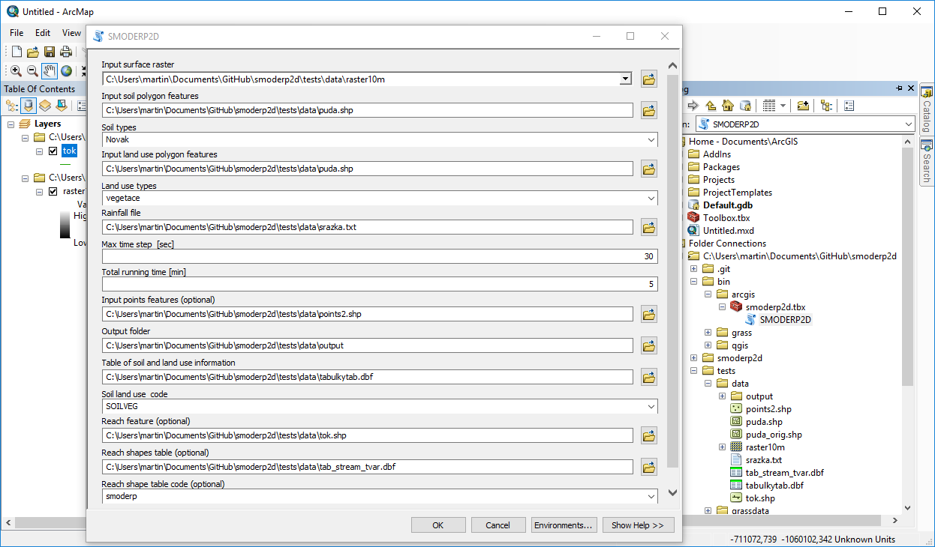
GIS tools | Esri ArcGIS
Toolbox for ArcGIS 10.x / Pro
Notes:
Let’s start with originally supported platform - Esri ArcGIS. The tool is designed as a standard ArcGIS Toolbox for both currently used ArcGIS versions - 10.x and Pro.

Slide 9
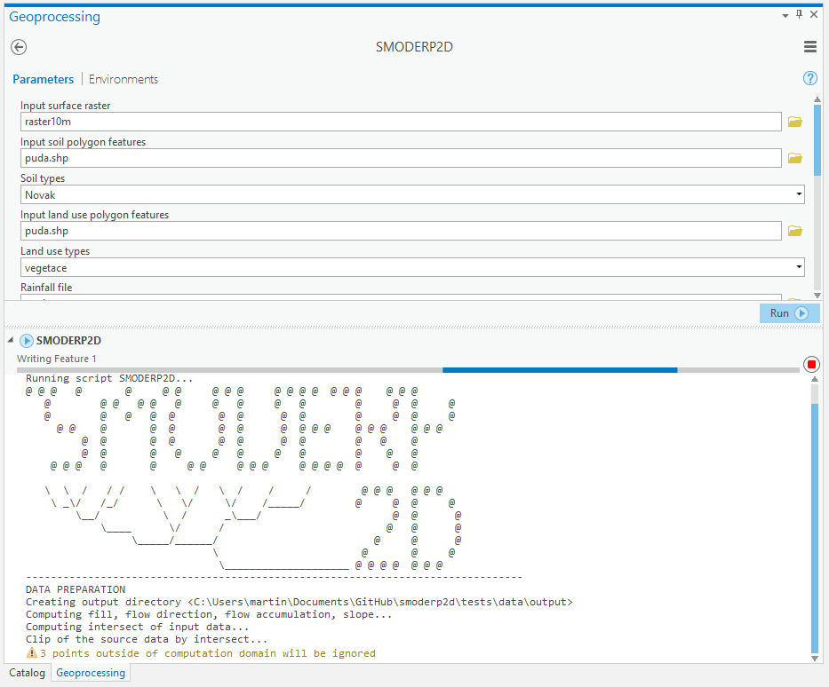
GIS tools | ArcGIS Toolbox
Existing ArcGIS toolbox rewritten
Data preparation done by ArcGIS GIS provider (arcpy)
Added support for ArcGIS Pro (Python3)
Available on GitHub
Notes:
It is important to mention that for data preparation native ArcGIS tools are used. They are called using Python arcpy library. There is major difference between ArcGIS 10 and Pro versions from Python perspective. Version 10 runs on Python 2, Pro is using Python3. This means that SMODERP2D code base has been rewritten to operate on the both Python major versions. ArcGIS Toolbox is available from GitHub repository similarly as other GIS tools which we are going to present.

Slide 10
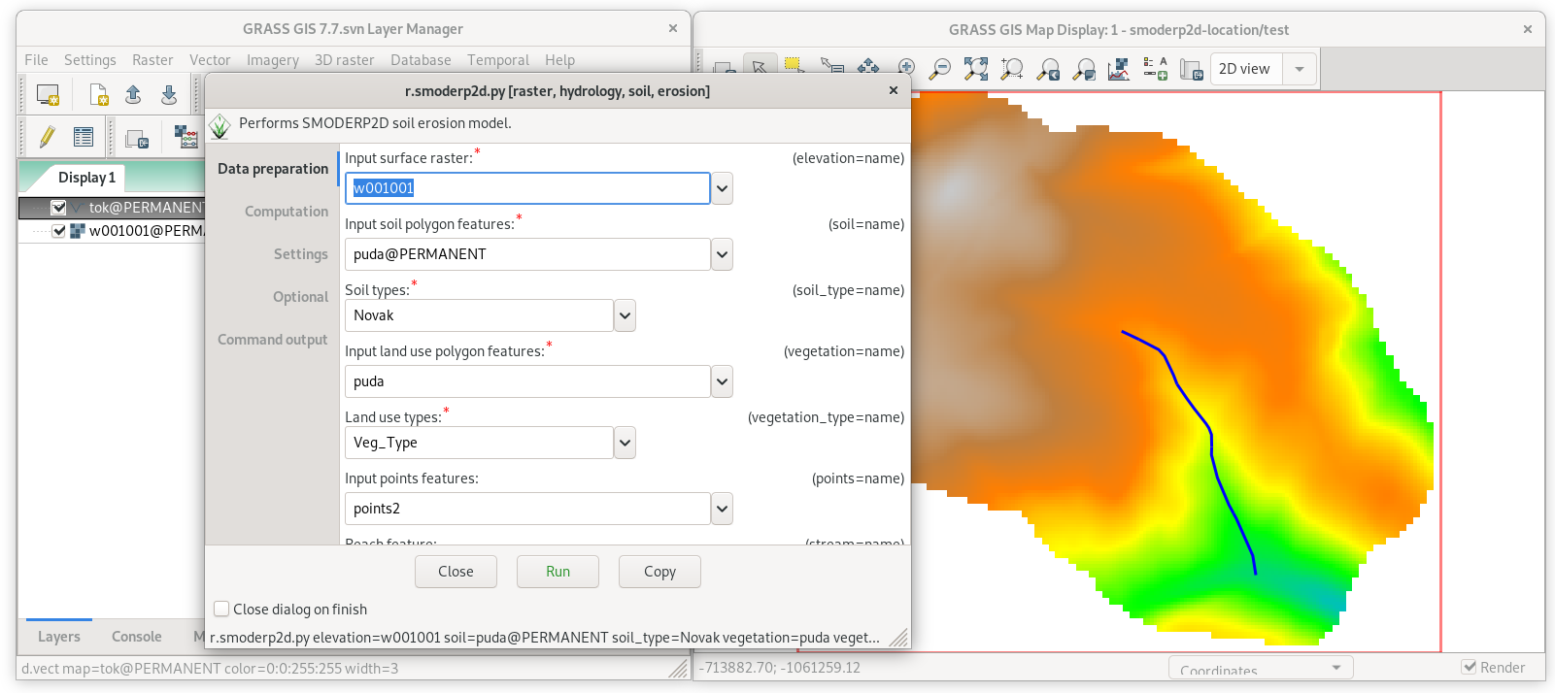
Ongoing development | GIS tools
GRASS GIS 7.8+ Addons
Notes:
Also already mentioned, the new generation of SMODERP2D project also supports open source GRASS GIS platform.

Slide 11
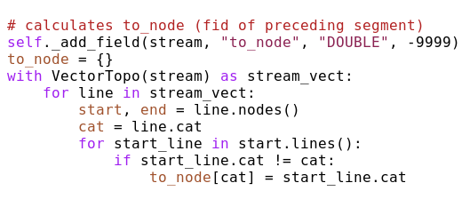
GIS tools | GRASS GIS Addons
New GRASS Addons r.smoderp2d
Available via g.extension
Data preparation done using GRASS GIS provider (pygrass)
GRASS GIS 7.8 (currently RC1) required (Python3)
Notes:
That means that new GRASS module called r.smoderp2d has been designed. It’s possible to install it via g.extension similarly as other GRASS Addons modules. Data preparation is performed by native GRASS tools using Python pygrass library. This library allows beside calling existing GRASS modules also to access GIS functionality from Python API as presented in the example on the right side. There is important requirement, SMODERP2D assumes GRASS version operating in Python3 environment. In other worlds r.smoderp2d can be run in GRASS 7.8 which is first GRASS version coming with Python 3 support. BTW, GRASS 7.8 is really fresh stuff, currently there is first release candidate available for testing.

Slide 12
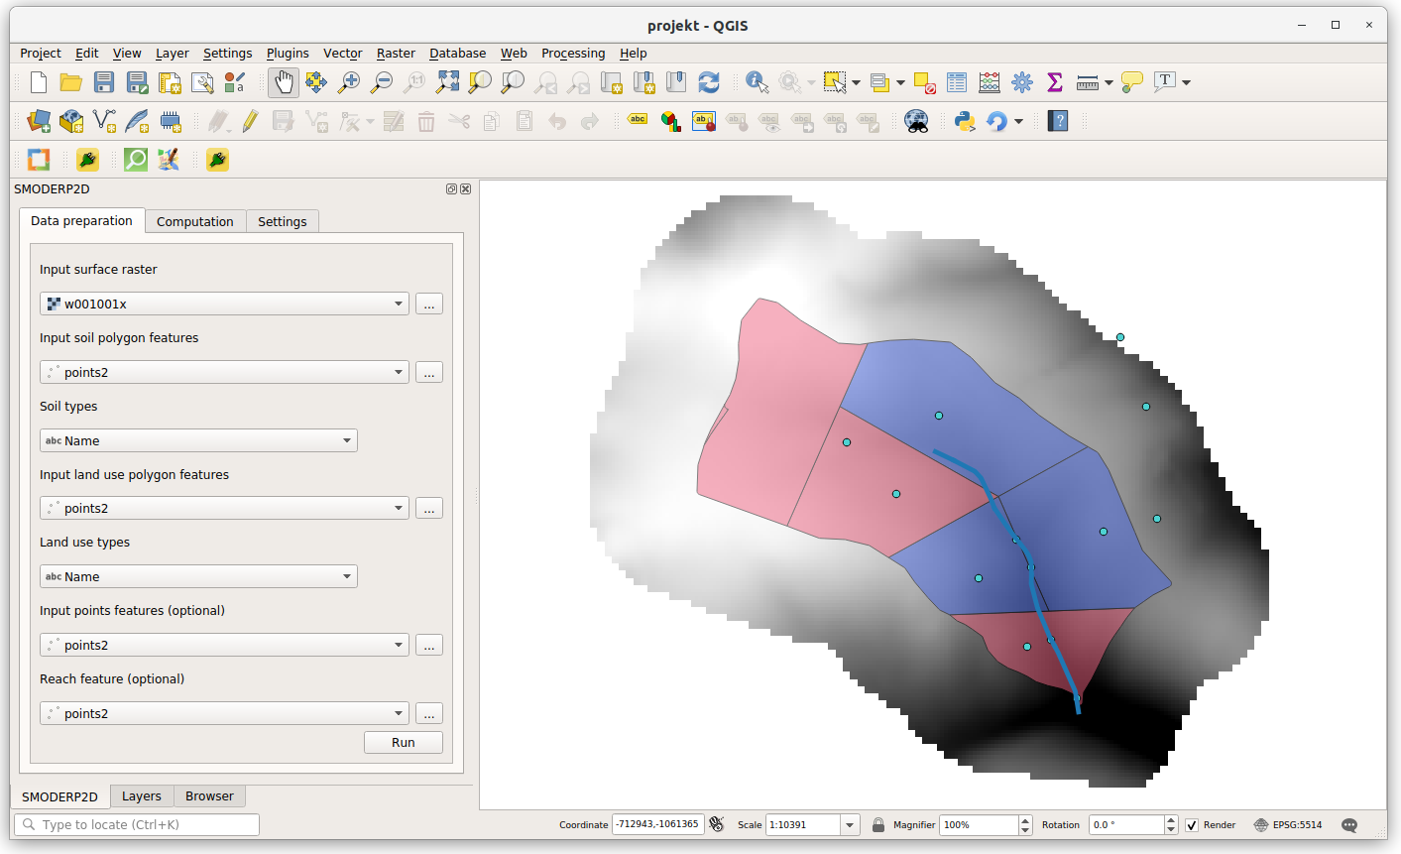
Ongoing development | GIS tools
QGIS 3 Plugin
Notes:
The last supported GIS platform is well-known QGIS.

Slide 13
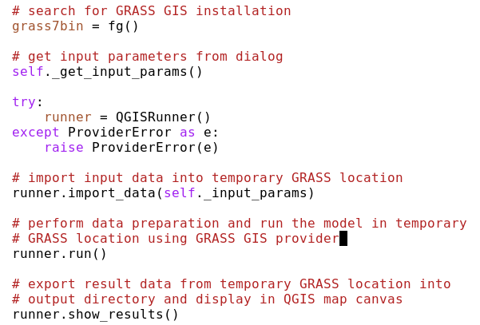
GIS tools | QGIS plugin
New QGIS plugin
QGIS 3.x required
Available from GitHub
Final release planned to uploaded into official QGIS repository
Data preparation done using GRASS GIS provider (pygrass)
GRASS GIS 7.8 required (Python3)
Notes:
There is new QGIS plugin which is currently under development. The plugin requires QGIS 3. Currently it’s available on GitHub. There is plan to include the plugin to official QGIS repository when it will be released. Data preparation is done by GRASS provider. That’s important point. Basically it means that QGIS plugin depends on GRASS GIS software. Since QGIS 3 runs on Python 3 also GRASS environment must operate in the same Python environment. In the example on the right side a basic workflow is presented. QGIS plugin gets input parameters defined by the user, creates temporary GRASS location (something like “project” in other GIS platforms), import input data into the location, perform data preparation using GRASS tools, run model computation and displays exported resultant data in QGIS map canvas.

Slide 14
Ongoing development | Parallelization experiments
Reasons
  To reduce the computation time
  For both CPU and GPU
Approach
  Loop-based computations rewritten to matrix-based ones
  Mathematical operations rewritten to TensorFlow (2.0) or NumPy
    Graph-based computations (independent math operations run in parallel)

Slide 15
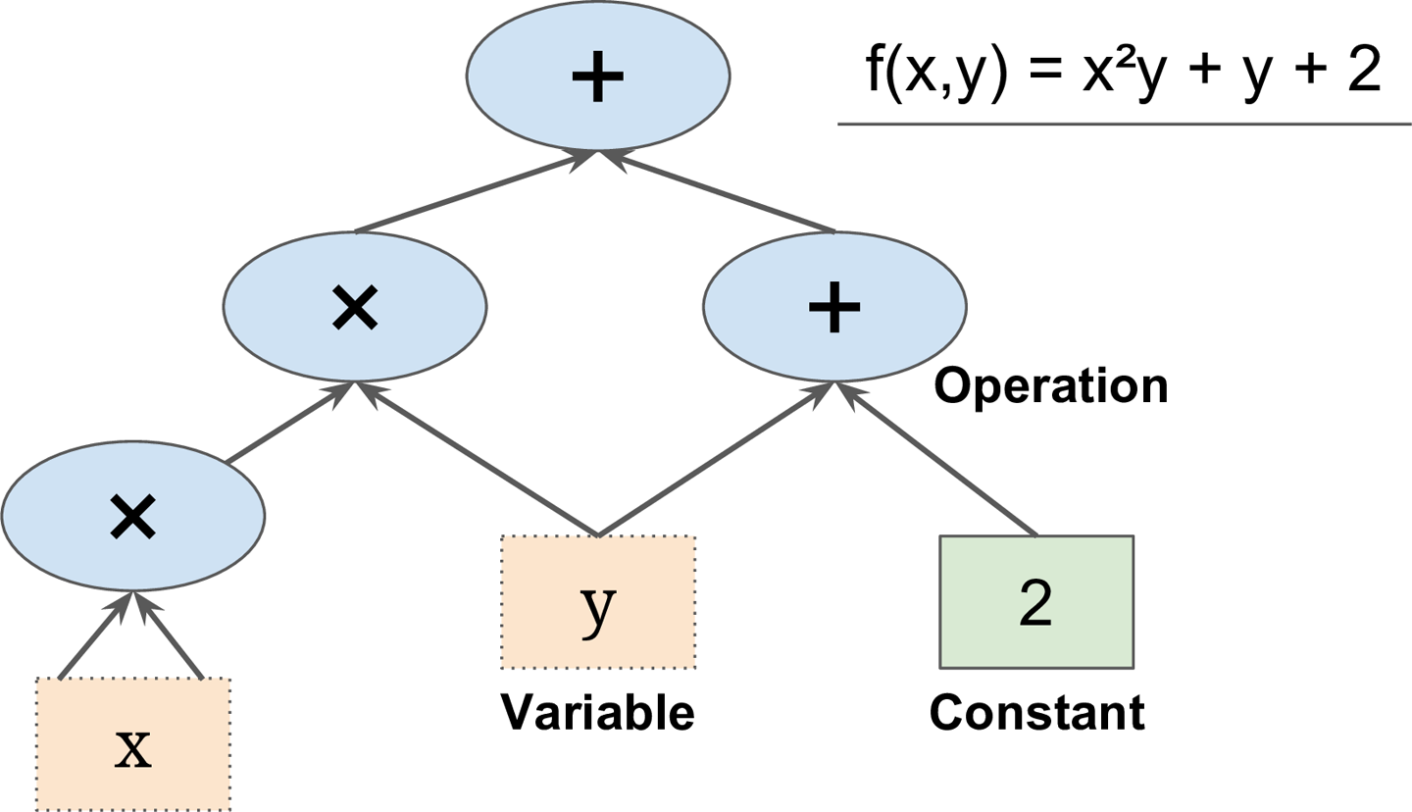
Ongoing development | Parallelization experiments

Slide 16
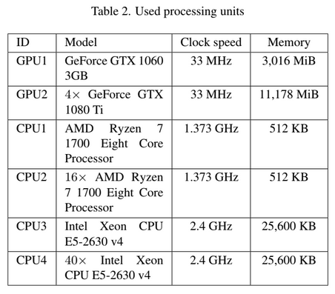
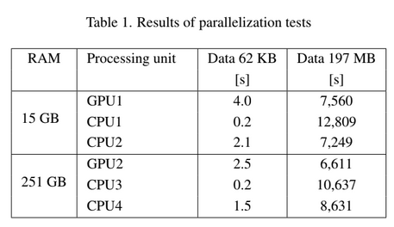
Results of experimental parallelized branch
Results
Notes:
It does not make sense to use GPUs for small data (initialization of the computation takes too much time)
On the school GPU (the worse one) the parallelized version takes cca 60 % of the time needed for the normal one
On the JRC GPUs (the better ones) the parallelized version has almost the same speed as the normal one
Possible reason: The computation is splitted between four GPUs -> four memory shifts (will try to run it just on one today, sorry for not having time for this experiment yesterday)
However, an interesting fact is that the initialization is two times faster on the JRC GPUs than on the school GPU (can be seen on small data)

Slide 17
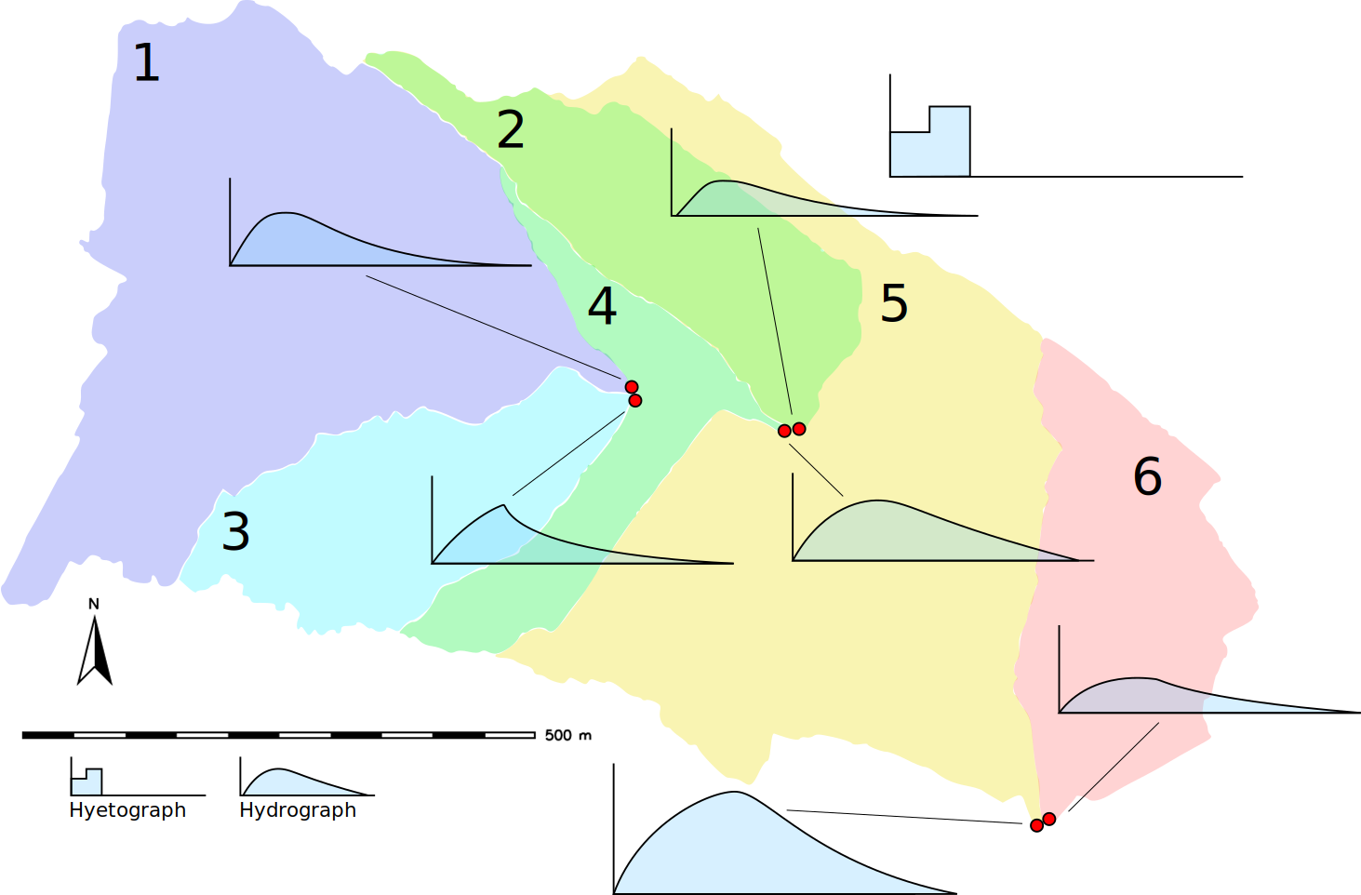
Ongoing development | Parallelization experiments
Sub-catchments based parallelization approach (planned)
Notes:
On this slide is presented another CPU-based parallelization approach. In this case area of interest is split into irregular tiles based on sub-catchments. It is important to note that we are assuming that sub-catchments do not influence each other, so they can be processed in parallel. Resultant runoff is computed as sum of runoffs from individual sub-catchments. Currently we are working on the implementation.
---
Ten obrazek popisuje, jak se da delat parallelizace s vyuzitim hydrologicke skutecnosti. O tom jsme se martine jednou bavili na kafi. Ze uzemi neni rozsekane na pravidelne dlazdice, ale podle toho jak na nem vznikaji sub-povodi (sub-catchments). Jednotlive sub-catchments se navzajem neovlivnuji, takze se daji pocitat parallelne. To co nakonec tece z celeho uzemi je soucet odtoku z jednotlivych subpovodi.

Slide 18
Conclusion
Ongoing development
  Release candidates Q4/2019
  Final release Q1/2020
Join us on GitHub
  Report issues
Thanks for attention!
The research has been supported by the research grants TJ01000270, QK1910029, and internal CTU grant SGS17/173/OHK1/T3/11.
Notes:
You can follow ongoing development on our GitHub repository. We are close to beta release, final release is planned in the beginning of 2020. So please join us on GitHub and enjoy filling bug reports ;-)
So thanks for attention, we are looking forward to hear exciting hydrology-related questions ;-)

