Slide 1
Operating Systems Hardening: How to Guide
Larry Baucum
9/21/2024
CTEC 450

Slide 2
Introduction
Systems hardening is the methods, strategies, and tools used to harden a system against threats (Ninja, 2024). Hardening means that you are decreasing the ways that your system could be attacked by reducing the number of vulnerabilities that your system has (Ninja, 2024). In this guide, we will focus on hardening an operating system. We will go through methods and steps to harden System Configuration, User Management, Access Control, Patch Management, and Network Security to lessen the attack surface of an operating system. After laying out the methods and steps involved, we will apply them to a virtualized Windows 10 environment and analyze the steps applied using a vulnerability scanner to measure the effectiveness of the methods.

Slide 3
Core OS Areas
System Configuration - System configuration involves the settings that determine how your system runs.
User Management - User Management involves managing user accounts and permissions.
Access Control - Access Control involves managing who or what has access to your system.
Patch Management - Patch Management is the process of keeping computers updated to lessen the attack surface (Intel, 2024).
Network Security - Network Security is ensuring that your network is protected against cyber-attacks by using policies, procedures, and people to safeguard your network (Fortinet, 2024).

Slide 4
Procedures
Remove Unnecessary Software – any software that is not used in your system's necessary functions should be removed.
Disable Unnecessary Services – Only allowing services to run that are necessary to the user's organizational function.
Create limited user accounts – Creating user accounts that are only able to access what is necessary for the user's job.
Application Whitelisting – Whitelisting applications only allow applications that are designated as trusted (Perception Point, 2024).
Automate Patch Management – Automating patch management involves using a tool to manage when and what updates are installed.
Configure Firewalls – Configuring firewalls will control who can access your network by setting firewall rules.

Slide 5
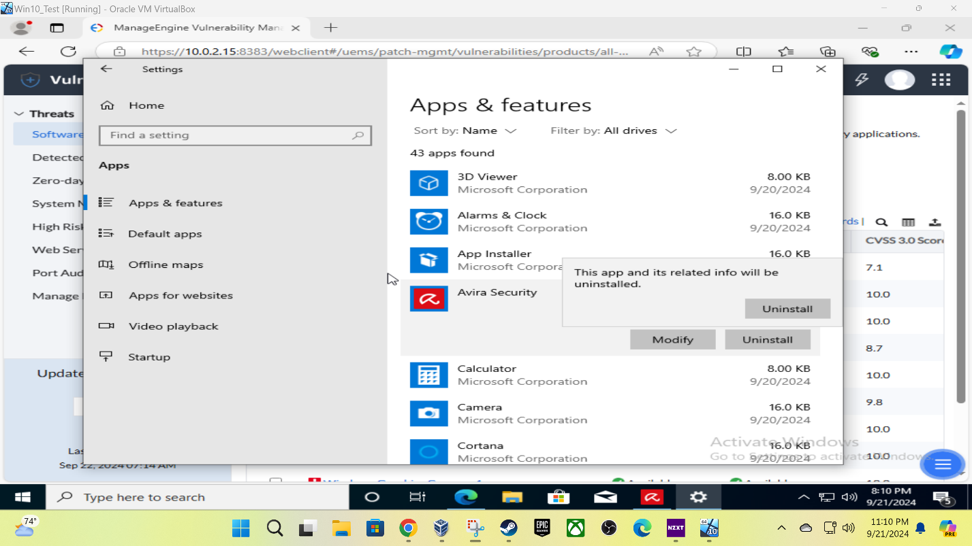
Steps to Success – System Configuration
Remove Unnecessary Software

Slide 6
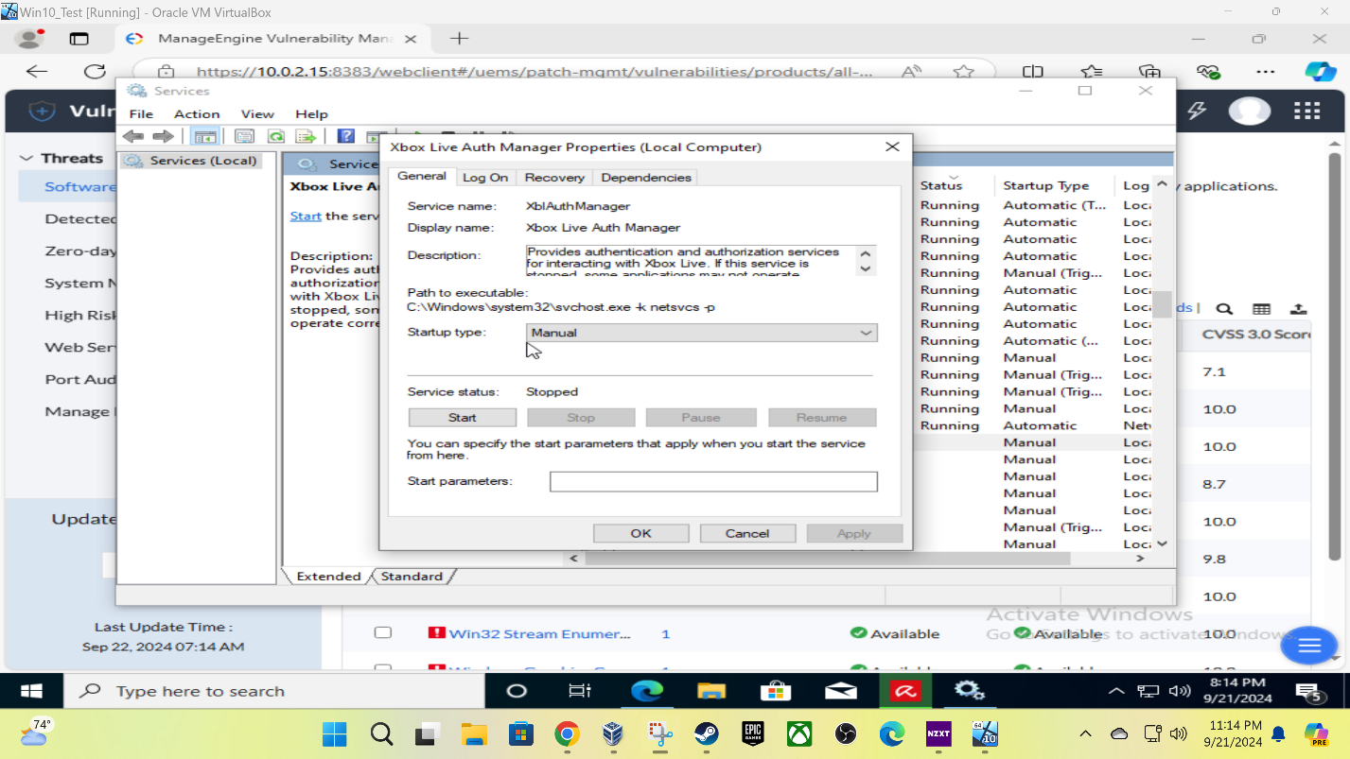
Steps to Success – System Configuration
Disable Unnecessary Services

Slide 7
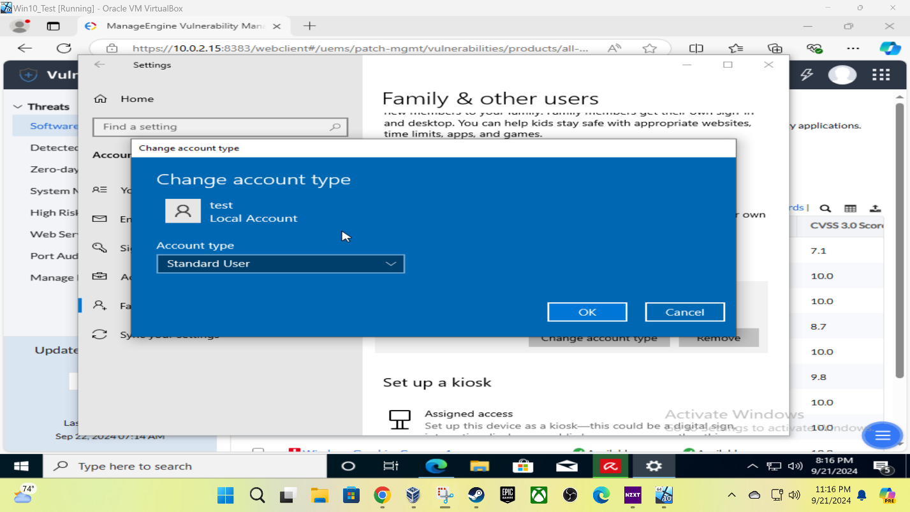
Steps to Success – User Management
Create Limited User Accounts

Slide 8
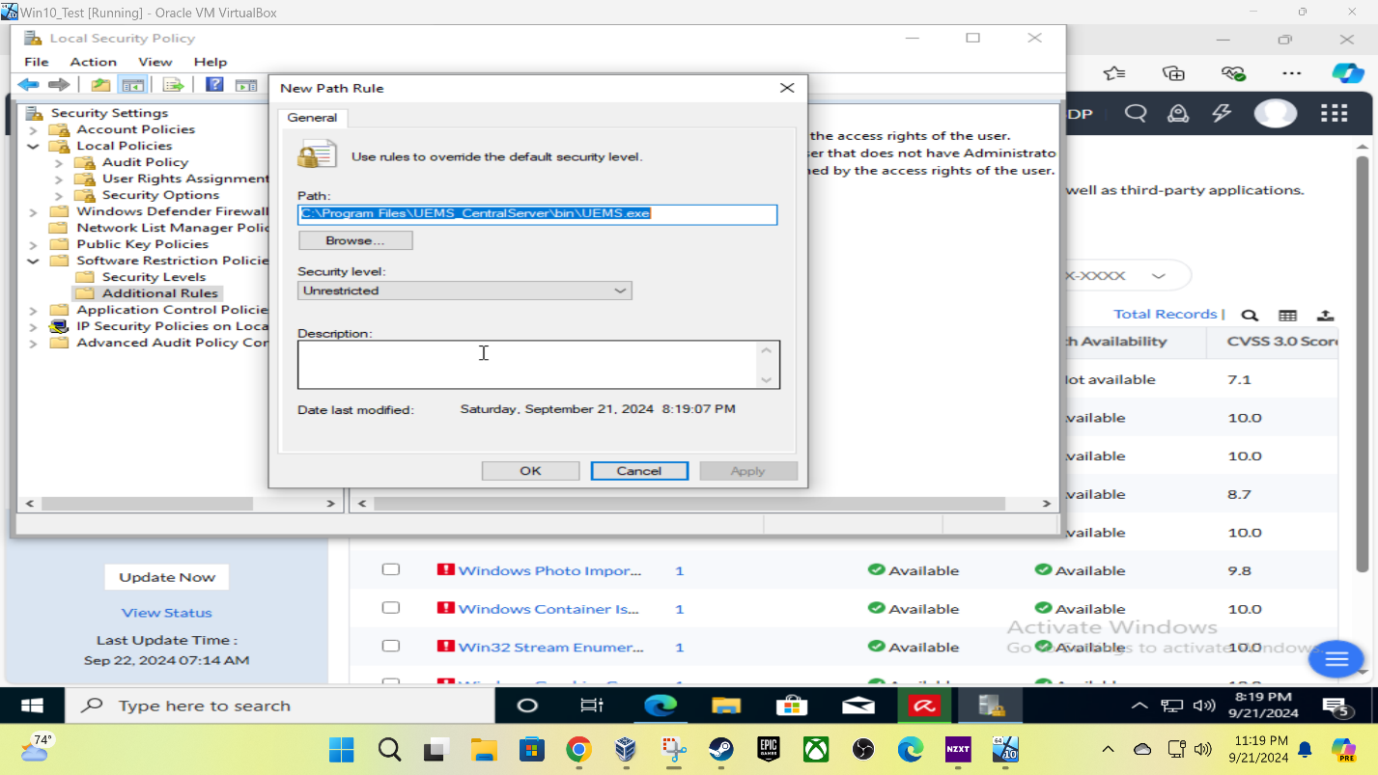
Steps to Success – Access Control
Application Whitelisting

Slide 9
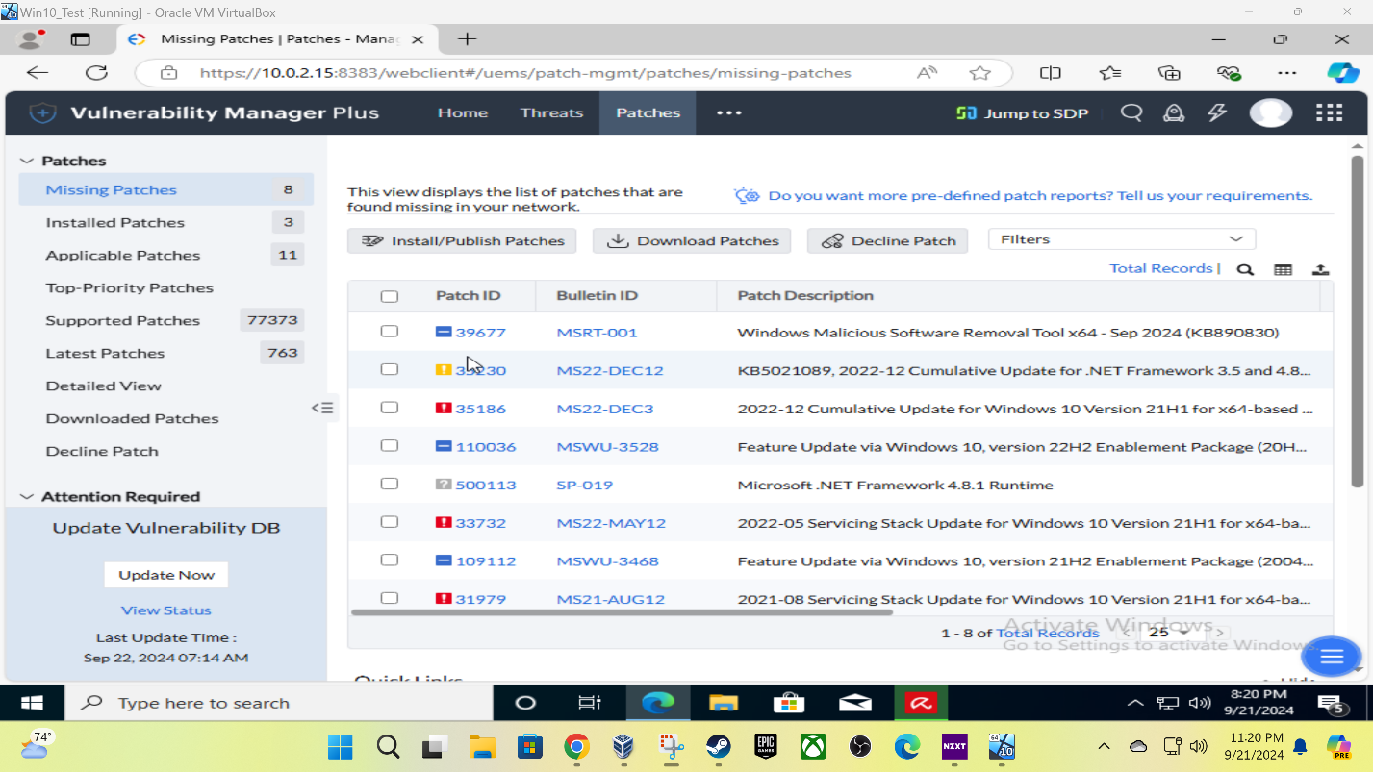
Steps to Success – Patch Management
Automate Patch Management

Slide 10
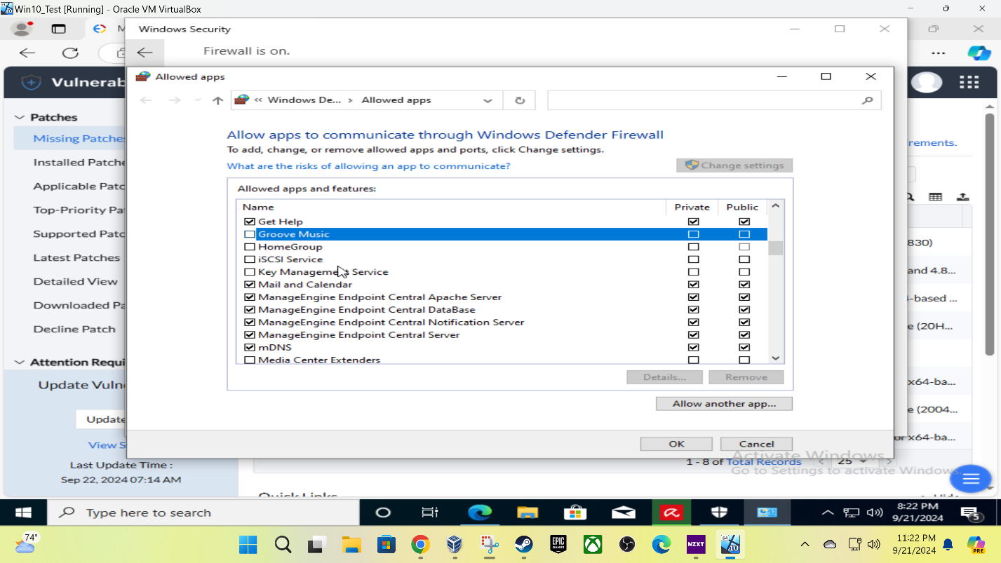
Steps to Success – Network Security
Configure Firewalls

Slide 11
Analysis
I believe that the procedures outlined in my step-by-step guide section are good procedures to harden an operating system. The problem with my procedures is that there should be more of them. I provided the base level of each concept that was discussed, but a true modern security strategy will always involve many layers of defense to ensure that attacks can be mitigated properly and the attack surface is as small as it can be. The evidence of this is in the vulnerability scan I did after implementing my hardening procedures. There are still many vulnerabilities left unaddressed. I should add more layers of procedures to the ideas that are outlined in this document to improve the operating system hardening that was done in this guide.

Slide 12
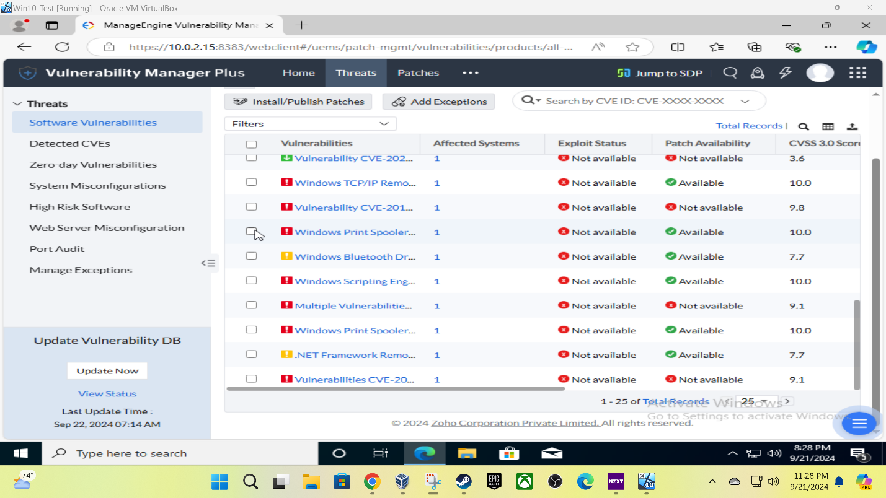
Vulnerability Scan - Software

Slide 13
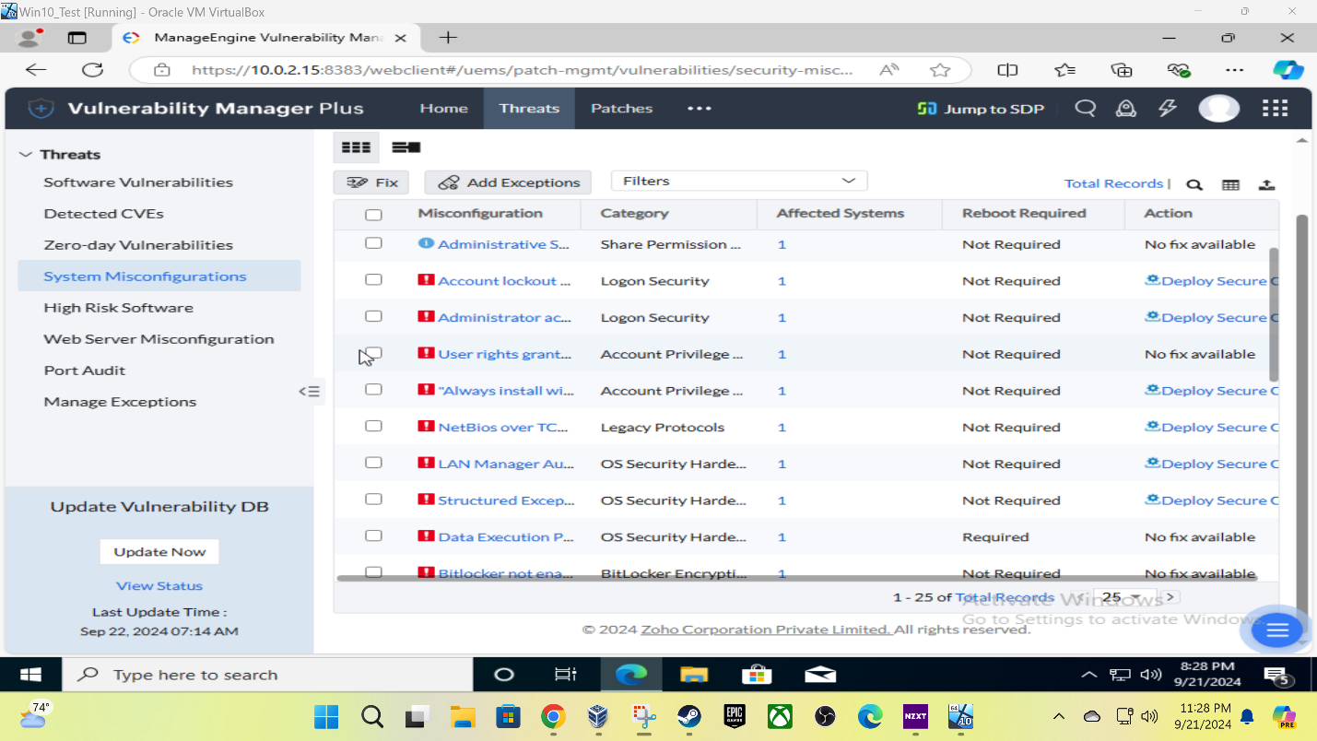
Vulnerability Scan – Sys Misconfigurations

Slide 14
References
Ninja, T. (2024, August 27). Systems hardening best practices to reduce risk [checklist]. NinjaOne. https://www.ninjaone.com/blog/complete-guide-to-systems-hardening/
Perception Point. (2024, September 3). Os hardening: 15 best practices. https://perception-point.io/guides/os-isolation/os-hardening-10-best-practices/
Intel. (n.d.). What is patch management? benefits and best practices. https://www.intel.com/content/www/us/en/business/enterprise-computers/resources/patch-management.html
Fortinet. (n.d.). What is network security? definition and types. https://www.fortinet.com/resources/cyberglossary/what-is-network-security

