Slide 1

Learning Software Security
Larry Baucum
9/28/2024
CTEC 450

Slide 2

What is Software Security?
Software security is the methods, procedures, and practices applied during the software development life cycle to protect software from attacks (Crowstrike, 2023).
The importance of software security is massive because having vulnerabilities in your software can lead to breaches that compromise critical data and damage the operational functions of the organization that uses your software.
If your software is known for being easy to breach you will lose your reputation in the industry and organizations will not do business with you.

Slide 3
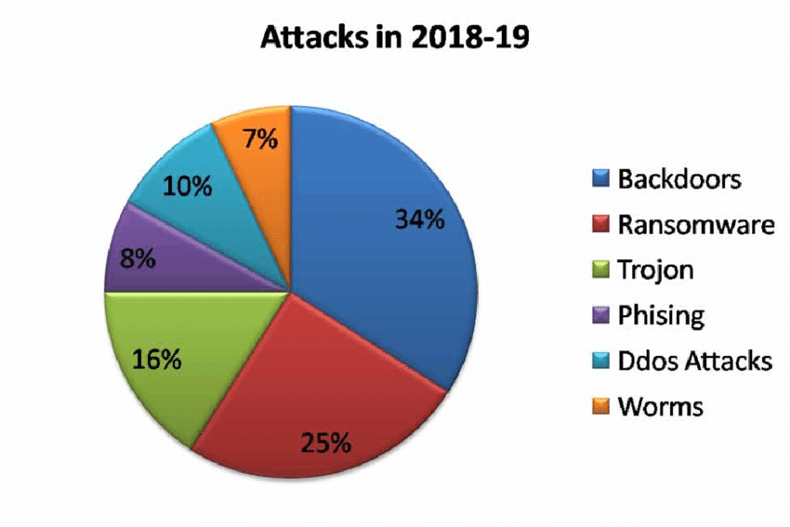
Software Vulnerabilities
Cross-site scripting (XSS) attacks have users click something in a website that activates scripts that cause unintended actions by the user (Fortinet, 2024).
Ransomware attacks encrypt a user’s machine until a ransom is paid. The user unknowingly downloads the malware and the malware exploits software vulnerabilities to lock down the system (Fortinet, 2024).
SQL Injection attacks inject a command into an SQL query and has the database server run the command to breach the database (Fortinet, 2024).

Slide 4
Real World Attacks
XSS Twitter worm – A worm was spread to users on Twitter via user messages with clickable videos, pictures, and software using a Twitter exploit (Constantin, 2024). The worm was further spread by infected users reposting the spam messages (Constantin, 2024).
Heartland Payment Systems SQL attack – A web form that linked to the organization’s internal network was targeted by an SQL injection attack (Chadran, 2020). The attackers were accessing the system for six months causing the organization’s stock to drop by 50 percent (Chadran, 2020).
WannaCry ransomware attack – A malicious group called the shadow brokers stole a vulnerability exploit called EternalBlue and leaked it to the public (Cloudflare, 2024). EternalBlue was used to spread the WannaCry Ransomware worm that affected over 200,000 computers and big organizations like Honda, Nissan, and FedEx (Cloudflare, 2024).

Slide 5
Impact and Cost
There are grave ramifications to an organization suffering a data breach. In 2022 83% of organizations suffered a data breach and that number will continue to increase as malicious users continue to learn new ways to attack (Wang et al., 2023).
Organizations that experience a data breach suffer from several losses, including reputation, operational disruption, stock price drop, consumer trust, research and development data, and financial loss.
To give you an idea of the real cost, the global average cost of a data breach is over four million dollars and in the U.S. that number is doubled (Wang et al., 2023).

Slide 6
Best Practices: Non-Technical Personnel
VPN
Always use your organization’s VPN when connecting to organizational resources. A secure connection is paramount to protecting your organization’s sensitive data.
MFA
Be sure to always use your organization’s multifactor authentication to ensure secure authentication. It may feel inconvenient, but it will be more secure.
Physical
Protect your device screens from unauthorized users. Ensure you use screen lock features, privacy screens on phones, and store devices securely when not in use.
Phishing
Look out for signs of fraudulent messages, emails, and links. They will have simple differences or make uncharacteristic requests. Please report these fraudulent items to your organization’s cyber security team.

Slide 7
Best Practices: Technical Personnel
Audit
Regularly audit procedures and policies to ensure that security is improving with the industry. It is important to continually review your policies and procedures for flaws.
Secure
Practice secure coding techniques such as input validation, error handling, code analysis tools, and create secure coding frameworks that fit the requirements of your organization.
Assess
Regularly conduct vulnerability assessments and perform security exercises like penetration testing to ensure that exploits are discovered and addressed.
Update
Ensure that your organization has good patch management to keep your software and systems updated. It is important to stay up to date because updates contain critical security patches to keep your systems safe.

Slide 8
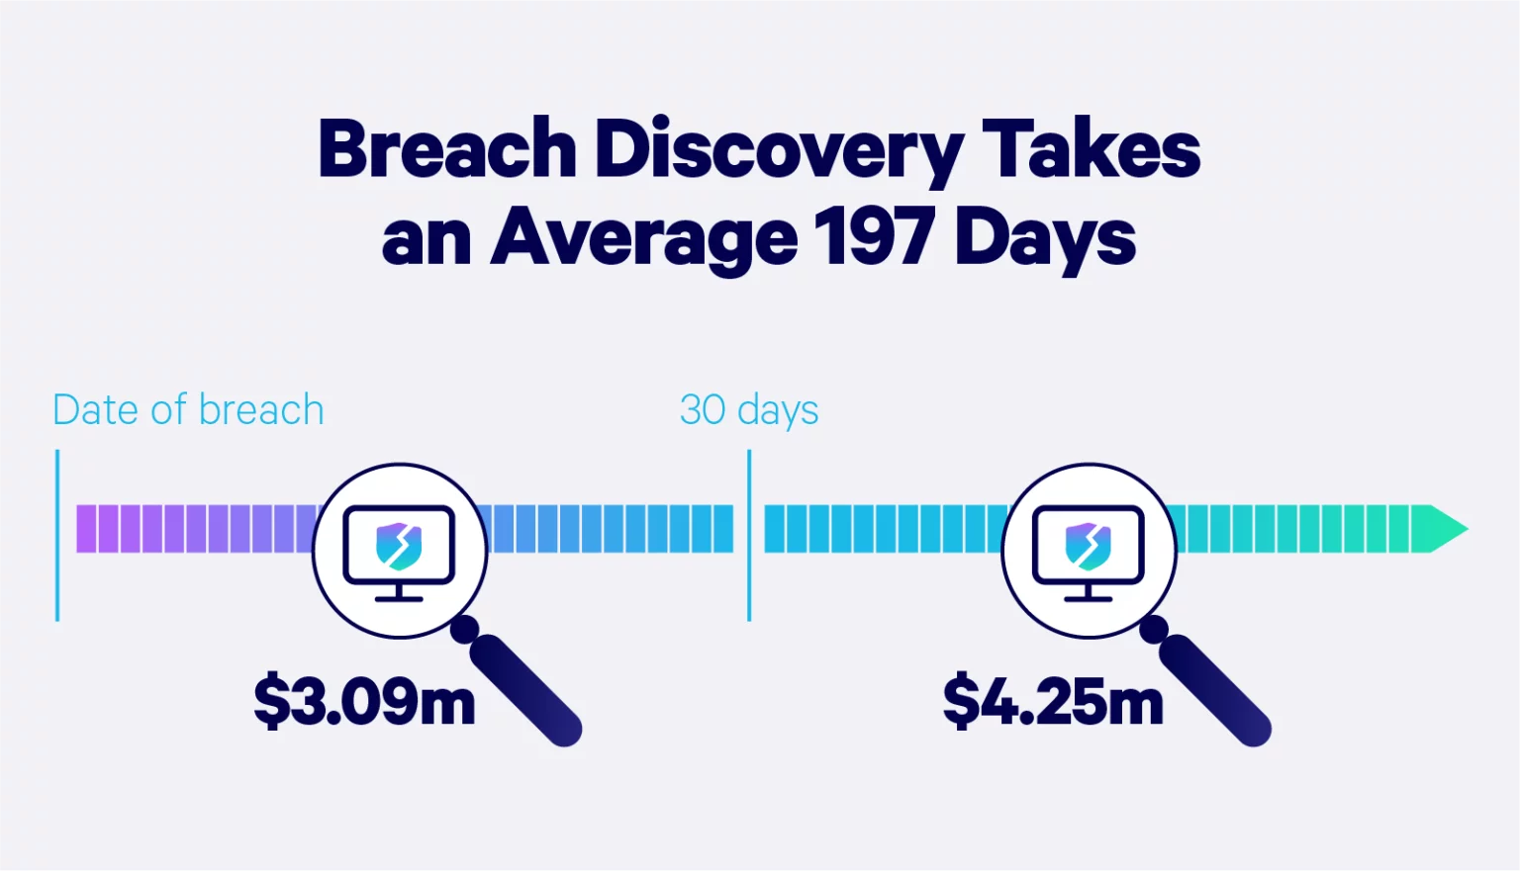
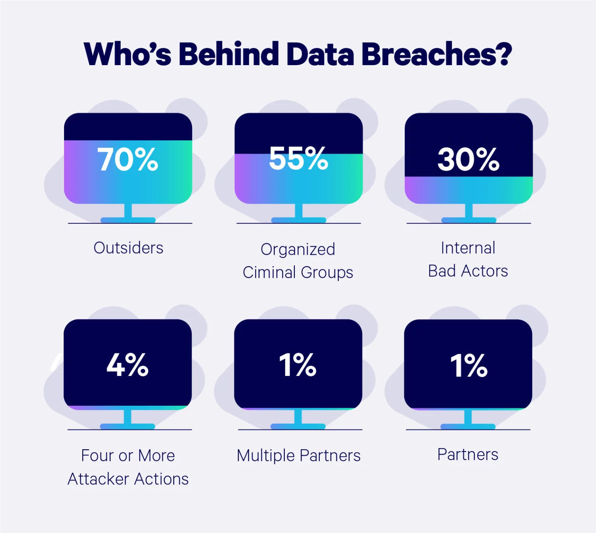
Visualize Software Security
It is important to properly scan for anomalous activity in your system to discover breaches and their sources quickly. Organizations that discover breaches within 30 days save over a million dollars (Embroker, 2024).
https://www.embroker.com/blog/cyber-attack-statistics/

Slide 9

Conclusions
In this software security presentation, you should have learned about software security, vulnerabilities, technical and non-technical best practices, various software attacks, and the impacts of data breaches. You should also have an idea of what attacks look like in the real world, what impacts come with those attacks, and how long recovery from an attack can take. Software security is fundamental to organizational security in the era of data. Software containing vulnerabilities can be catastrophic for both the organization using the software and the organization that created the software.

Slide 10
References
Pandey, A., Tripathi, A., Kapil, G., Singh, V., Khan, W., Agrawal, A., Kumar, R., & Khan, R. (2020). Trends in malware attacks: Identification and mitigation strategies. In Cybersecurity and Secure Information Systems (pp. 67-89). IGI Global. https://doi.org/10.4018/978-1-7998-1558-7.ch004
Fortinet. (n.d.). Top 20 most common types of cyber attacks. https://www.fortinet.com/resources/cyberglossary/types-of-cyber-attacks
Constantin, L. (n.d.). Facebook hit by XSS Worm - Softpedia News. https://news.softpedia.com/news/Facebook-Hit-by-XSS-Worm-192045.shtml
Chadran, A. (2020, July 13). The 3 worst data breaches of All Time (and the lessons learned). Smarter MSP. https://smartermsp.com/3-worst-data-breaches-time- learned/
Cloudflare. (n.d.). What was the WannaCry ransomware attack? | cloudflare. https://www.cloudflare.com/learning/security/ransomware/wannacry-ransomware/
Wang, X., Madnick, S., Wei, W., & Huang, K. (2023, May 4). The devastating business impacts of a cyber breach. Harvard Business Review. https://hbr.org/2023/05/
Embroker. (2024, January 4). 2024 must-know cyber attack statistics and Trends. https://www.embroker.com/blog/cyber-attack-statistics/

