Slide 1
HIVE PROJECT

Slide 2
Data Ingestion Workflow
Creating Dump of Local SQL Server DB
Imported the data into SQL Server using the dumped DB.
mysqldump -u root -p --port=3308 healthcare < healthcare.sql
Ingested the SQL DB’s tables into Hive Server using Sqoop
sqoop import-all-tables \
--connect jdbc:mysql://localhost:3306/healthcare \
--username root \
–password cloudera \
--hive-import \
--m 1
Check the data in Hive Server

Slide 3
Problem Statement 1
Jimmy, from the healthcare department, has requested a report that shows how the number of treatments each age category of patients has gone through in the year 2022.
The age category is as follows: Children (00-14 years), Youth (15-24 years), Adults (25-64 years), and Seniors (65 years and over).
Assist Jimmy in generating the report.

Slide 4
Solution 1 - Part 1
Creating Partitioned and Clustered Table
CREATE TABLE IF NOT EXISTS treatment_clus (treatment int, date date,diseaseId INT, claimId Bigint)
COMMENT 'Employee details'
PARTITIONED BY (patientId INT) CLUSTERED BY (diseaseId) INTO 3 BUCKETS
ROW FORMAT DELIMITED
FIELDS TERMINATED BY ','
LINES TERMINATED BY '\n'
STORED AS TEXTFILE;
Insert into treatment_clus partition(patientId) select treatmentid,date,diseaseid,claimid,patientId from treatment;
Create External Table
create external table problem_1
(age_category string, count int)
ROW FORMAT DELIMITED FIELDS TERMINATED BY ','
LINES TERMINATED BY '\n'
LOCATION '/user/hive/warehouse/project/problem1';

Slide 5
Solution 1 - Part 2
Insert Data Into External Table In Hive
INSERT OVERWRITE table problem_1
SELECT Age_Category, COUNT(treatmentID)
FROM
( SELECT t.treatmentID,
CASE
WHEN (year(current_date()) - year(dob)) <= 14 then 'Children'
WHEN (year(current_date()) - year(dob)) <= 24 then 'Youth'
WHEN (year(current_date()) - year(dob)) <= 64 then 'Adults'
ELSE 'Seniors'
END AS Age_Category
FROM Treatment t
JOIN Patient P ON t.PatientID = P.PatientID
WHERE year(date) = 2022
) a
GROUP BY Age_Category;
Create Output Table in Client DB
CREATE TABLE problem_1(
age_category VARCHAR(20),
count int
);
Move Data to Client DB using Sqoop Export
sqoop export \
--connect jdbc:mysql://localhost:3306/healthcare \
--username root \
--password cloudera \
--table problem_1 \
--export-dir /user/hive/warehouse/project/problem1/000000_0;

Slide 6
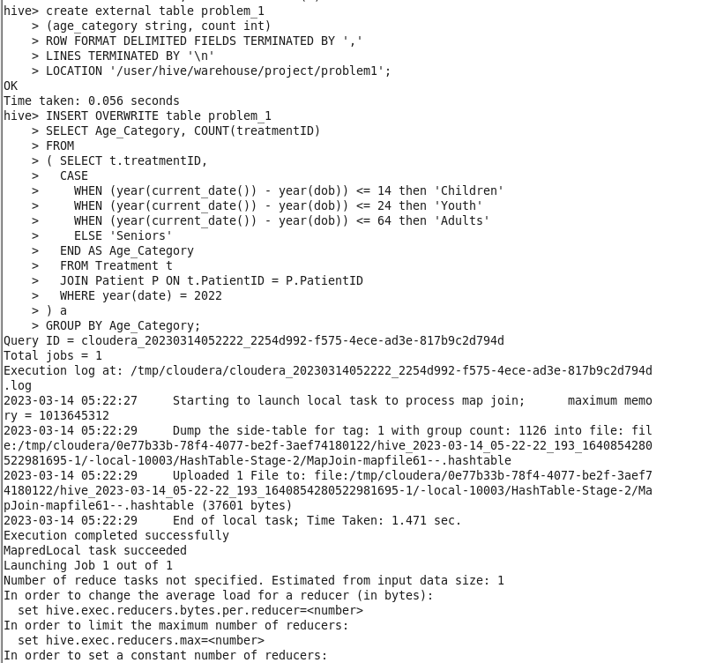
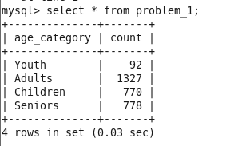
Solution 1 - Output

Slide 7
Problem Statement 2
Jimmy, from the healthcare department, wants to know which disease is infecting people of which gender more often.
Assist Jimmy with this purpose by generating a report that shows for each disease the male-to-female ratio. Sort the data in a way that is helpful for Jimmy.

Slide 8
Solution 2 - Part 1
Create External Table
create external table query_2
(diseaseName string, ratio double)
ROW FORMAT DELIMITED FIELDS TERMINATED BY ','
LINES TERMINATED BY '\n'
LOCATION '/user/hive/warehouse/project/problem2';
Insert Data Into External Table In Hive
INSERT OVERWRITE table query_2
SELECT d.diseaseName, ROUND(SUM(IF(p.gender='male',1,0))/(SUM(IF(p.gender='female',1,0))),2) as Ratio
FROM Treatment t
JOIN Disease d
ON t.diseaseID = d.diseaseID
JOIN Person p
ON p.personID = t.patientID
GROUP BY d.diseaseName
ORDER BY Ratio DESC;

Slide 9
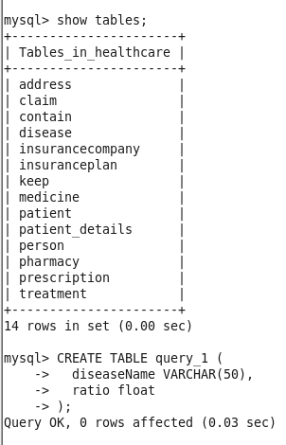
Solution 2 - Part 2
Create Output Table in Client DB
CREATE TABLE query_2 (
diseaseName VARCHAR(50),
ratio float
);
Move Data to Client DB using Sqoop Export
sqoop export \
--connect jdbc:mysql://localhost:3306/healthcare \
--username root \
--password cloudera \
--table query_2 \
--export-dir /user/hive/warehouse/project/problem2/000000_0;

Slide 10
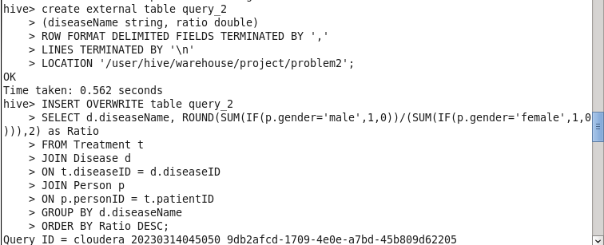
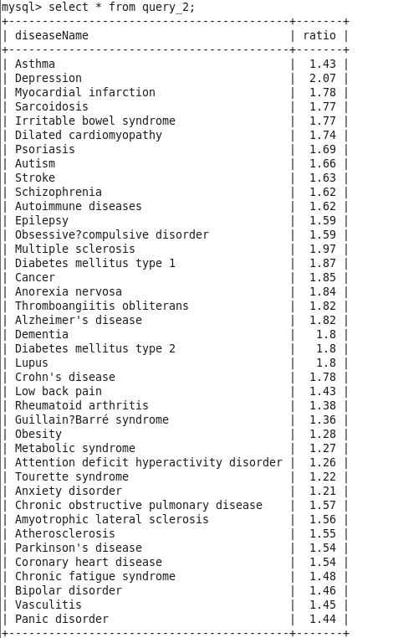
Solution 2 - Output

Slide 11
Problem Statement 3
Jacob, from insurance management, has noticed that insurance claims are not made for all the treatments. He also wants to figure out if the gender of the patient has any impact on the insurance claim. Assist Jacob in this situation by generating a report that finds for each gender the number of treatments, number of claims, and treatment-to-claim ratio. And notice if there is a significant difference between the treatment-to-claim ratio of male and female patients.

Slide 12
Solution 3 - Part 1
Create External Table
create external table problem3
(gender string, count_claims int, count_treatments int, ration double)
ROW FORMAT DELIMITED FIELDS TERMINATED BY ','
LINES TERMINATED BY '\n'
LOCATION '/user/hive/warehouse/project/problem3';
Insert Data Into External Table In Hive
WITH cte_table2 AS (
SELECT pe.`gender` AS Gender, c.`claimID` AS Claims, t.`treatmentID` AS treatments
FROM `claim` c
JOIN `treatment` t ON c.`claimID` = t.`claimID`
JOIN `patient` p ON p.`patientID` = t.`patientID`
JOIN `person` pe ON pe.`personID` = p.`patientID`
) INSERT OVERWRITE table problem3
SELECT Gender, COUNT(Claims) AS `Total Number of Claims`,
COUNT(treatments) AS `Total Number of treatments`,
COUNT(Claims) / COUNT(treatments) AS Ratio
FROM cte_table2
GROUP BY Gender;

Slide 13
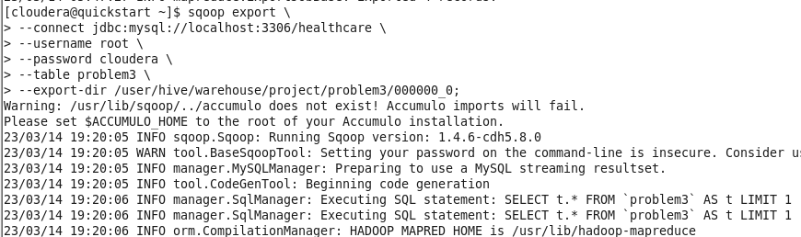
Solution 3 - Part 2
Create Output Table in Client DB
CREATE TABLE problem3(
gender varchar(10),
count_claims int,
count_treatments int,
ratio double
);
Move Data to Client DB using Sqoop Export
sqoop export \
--connect jdbc:mysql://localhost:3306/healthcare \
--username root \
--password cloudera \
--table problem3 \
--export-dir /user/hive/warehouse/project/problem3/000000_0;

Slide 14
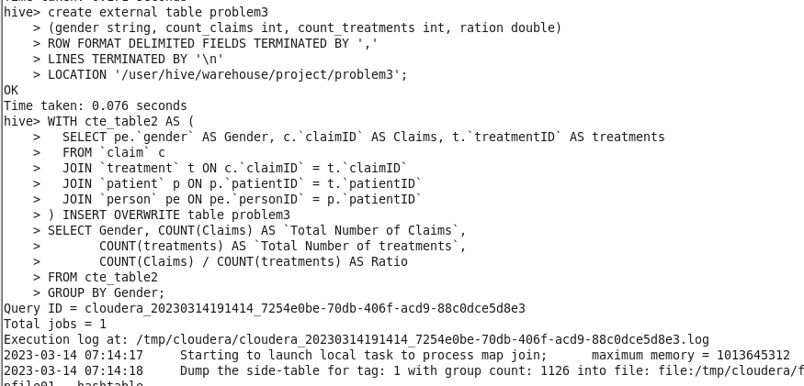
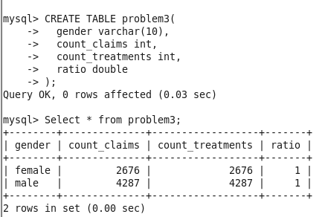
Solution 3 - Output

Slide 15
Problem Statement 4
The Healthcare department wants a report about the inventory of pharmacies. Generate a report on their behalf that shows how many units of medicine each pharmacy has in their inventory, the total maximum retail price of those medicines, and the total price of all the medicines after discount.
Note: discount field in keep signifies the percentage of discount on the maximum price.

Slide 16
Solution 4 - Part 1
Create External Table
create external table problem4
(pharmacyName String, count_medicines int, total_price double, total_discounted_price double)
ROW FORMAT DELIMITED FIELDS TERMINATED BY ','
LINES TERMINATED BY '\n'
LOCATION '/user/hive/warehouse/project/problem4';
Insert Data Into External Table In Hive
with cte_table3 as (
select `pharmacyName` as `Pharmacy Name`,
count(m.`medicineID`) as `Total number of Medicines`,
sum(m.`maxPrice`) as `Total Retail Price`,
sum(m.`maxPrice` - (k.`discount` * 0.01)) as `Total Price of Medicines after discount`
from pharmacy p
join `keep` k on p.`pharmacyID` = k.`pharmacyID`
join `medicine` m on m.`medicineID` = k.`medicineID`
where p.`pharmacyID` = k.`pharmacyID`
group by pharmacyName
)
INSERT OVERWRITE table problem4
SELECT * FROM cte_table3;

Slide 17
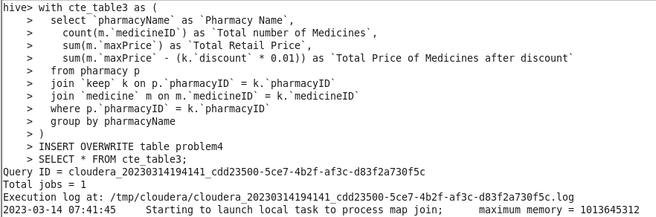
Solution 4 - Part 2
Create Output Table in Client DB
CREATE TABLE problem4(
pharmacyName Varchar(50),
count_medicines int,
total_price double,
total_discounted_price double
);
Move Data to Client DB using Sqoop Export
sqoop export \
--connect jdbc:mysql://localhost:3306/healthcare \
--username root \
--password cloudera \
--table problem4 \
--export-dir /user/hive/warehouse/project/problem4/000000_0;

Slide 18
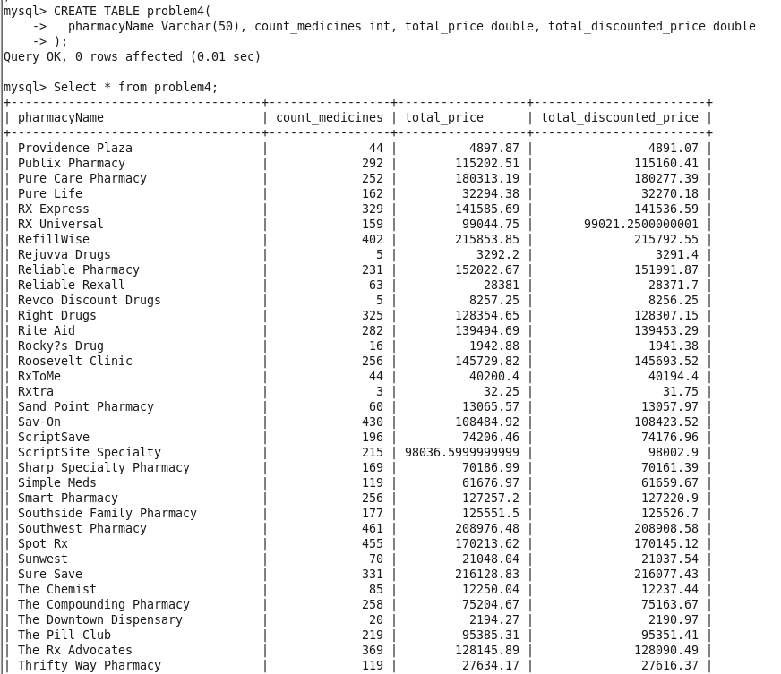
Solution 4 - Output

Slide 19
Problem Statement 5
The healthcare department suspects that some pharmacies prescribe more medicines than others in a single prescription, for them, generate a report that finds for each pharmacy the maximum, minimum and average number of medicines prescribed in their prescriptions.

Slide 20
Solution 5 - Part 1
Create External Table
create external table problem5
(pharmacyName String, max_count_medicines int, min_count_medicines int, avg_count_medicines double)
ROW FORMAT DELIMITED FIELDS TERMINATED BY ','
LINES TERMINATED BY '\n'
LOCATION '/user/hive/warehouse/project/problem5';
Insert Data Into External Table In Hive
INSERT OVERWRITE Table problem5
select pharmacyName, max(c.quantity) as `maximum number of medicines`,
min(c.quantity) as `minimum number of medicines`,
round(avg(c.quantity),0) as `average number of medicines`
from pharmacy p
join prescription pr on p.`pharmacyID` = pr.`pharmacyID`
join contain c on pr.`prescriptionID` = c.`prescriptionID`
group by pharmacyName;

Slide 21
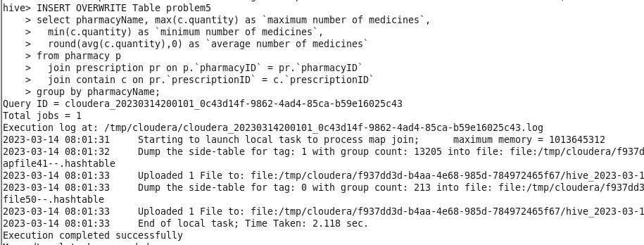
Solution 5 - Part 2
Create Output Table in Client DB
CREATE TABLE problem5(
pharmacyName Varchar(50),
max_count_medicines int, min_count_medicines int, avg_count_medicines double
);
Move Data to Client DB using Sqoop Export
sqoop export \
--connect jdbc:mysql://localhost:3306/healthcare \
--username root \
--password cloudera \
--table problem5 \
--export-dir /user/hive/warehouse/project/problem5/000000_0;

Slide 22
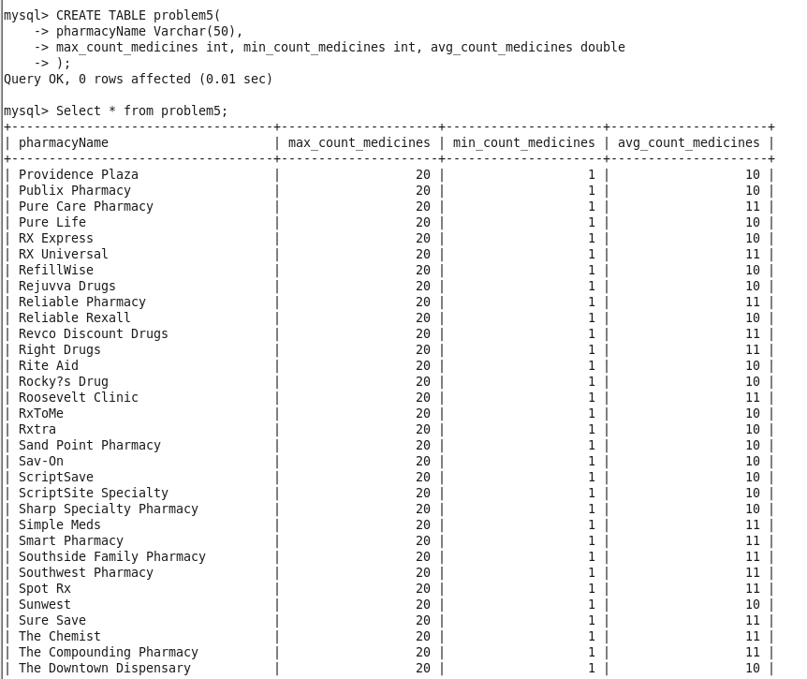
Solution 5 - Output

Slide 23
Problem Statement 6
A company needs to set up 3 new pharmacies, they have come up with an idea that the pharmacy can be set up in cities where the pharmacy-to-prescription ratio is the lowest and the number of prescriptions should exceed 100. Assist the company to identify those cities where the pharmacy can be set up.

Slide 24
Solution 6 - Part 1
Create External Table
create external table problem6
(city String, pharmacy_prescription_ratio double)
ROW FORMAT DELIMITED FIELDS TERMINATED BY ','
LINES TERMINATED BY '\n'
LOCATION '/user/hive/warehouse/project/problem6';
Insert Data Into External Table In Hive
INSERT INTO problem6
SELECT a.city,
ROUND(COUNT(DISTINCT pha.pharmacyID) / COUNT(DISTINCT pre.prescriptionID),4) AS pharmacy_prescription_ratio
FROM pharmacy pha
JOIN address a ON a.addressID = pha.addressID
JOIN prescription pre ON pha.pharmacyID = pre.pharmacyID
GROUP BY a.city
HAVING COUNT(pre.prescriptionID) > 100
ORDER BY pharmacy_prescription_ratio;

Slide 25
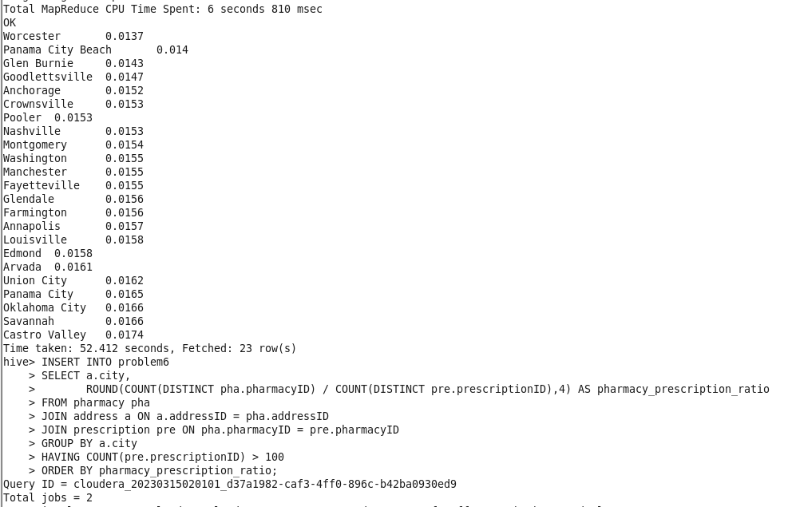
Solution 6 - Part 2
Create Output Table in Client DB
CREATE TABLE problem6(
city Varchar(50),
pharmacy_prescription_ratio double
);
Move Data to Client DB using Sqoop Export
sqoop export \
--connect jdbc:mysql://localhost:3306/healthcare \
--username root \
--password cloudera \
--table problem6 \
--export-dir /user/hive/warehouse/project/problem6/000000_0;

Slide 26
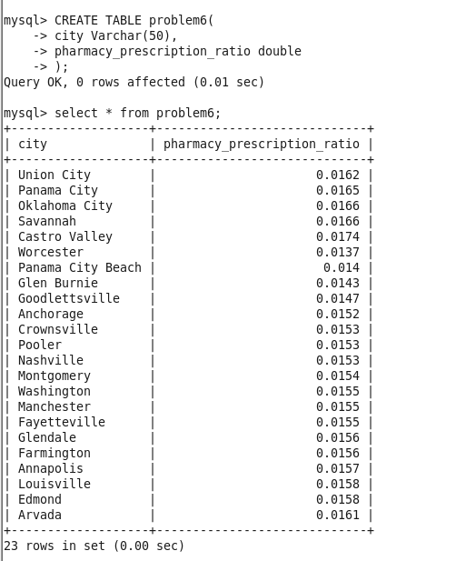
Solution 6 - Output

Slide 27
Problem Statement 7
The State of Alabama (AL) is trying to manage its healthcare resources more efficiently. For each city in their state, they need to identify the disease for which the maximum number of patients have gone for treatment. Assist the state for this purpose.
Note: The state of Alabama is represented as AL in Address Table.

Slide 28
Solution 7 - Part 1
Create Partitioned and Clustered table Address_clus
CREATE TABLE IF NOT EXISTS address_clus (addressid int, address1 string, state string, zip int)
COMMENT 'City Table With Partitions On City Column'
PARTITIONED BY (city String) CLUSTERED BY (addressid) INTO 3 BUCKETS
ROW FORMAT DELIMITED
FIELDS TERMINATED BY ','
LINES TERMINATED BY '\n'
STORED AS TEXTFILE;
Insert into address_clus partition(city) select addressid,address1,city,state,zip from address;
Create External Table
create external table problem7
(city String, diseaseName String, count_patients int)
ROW FORMAT DELIMITED FIELDS TERMINATED BY ','
LINES TERMINATED BY '\n'
LOCATION '/user/hive/warehouse/project/problem7';

Slide 29
Solution 7 - Part 2
Insert Data Into External Table In Hive
With cte as(
SELECT ad.city, d.diseasename, count(t.patientid) as patientcount
FROM address_clus ad
JOIN person p1 ON ad.addressid = p1.addressid
JOIN treatment t ON t.patientid = p1.personid
JOIN disease d ON d.diseaseid = t.diseaseid
WHERE ad.state = 'al'
GROUP BY ad.city, d.diseasename)
INSERT INTO table problem7
SELECT *
FROM (
SELECT *,
row_number() OVER(PARTITION BY x.ci ORDER BY x.patientcount DESC) rn
FROM (
SELECT city AS ci, diseasename, patientcount
FROM cte
) x
) y
WHERE y.rn = 1;
Create Output Table in Client DB
CREATE TABLE problem7(
city Varchar(50),
diseaseName Varchar(50),
count_patients int
);
Move Data to Client DB using Sqoop Export
sqoop export \
--connect jdbc:mysql://localhost:3306/healthcare \
--username root \
--password cloudera \
--table problem7 \
--export-dir /user/hive/warehouse/project/problem7/000000_0;

Slide 30
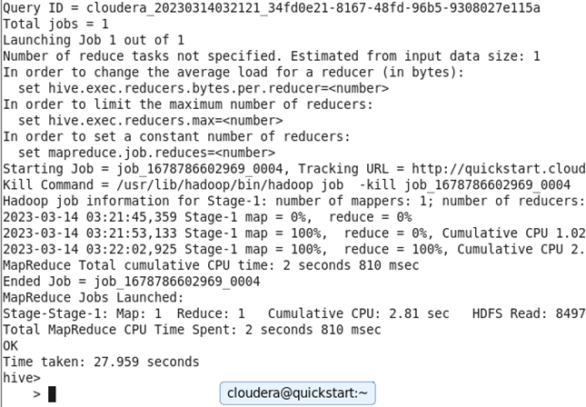
Solution 7 - Output

Slide 31
Problem Statement 8
The healthcare department needs a report about insurance plans. The report is required to include the insurance plan, which was claimed the most and least for each disease. Assist to create such a report.

Slide 32
Solution 8 - Part 1
Create External Table
create external table problem8
(diseaseName String, most_claimed_plan String, least_claimed_plan String)
ROW FORMAT DELIMITED FIELDS TERMINATED BY ','
LINES TERMINATED BY '\n'
LOCATION '/user/hive/warehouse/project/problem8';

Slide 33
Solution 8 - Part 2
Insert Data Into External Table In Hive
CREATE TEMPORARY TABLE temp_cte AS
SELECT D.diseaseName, IP.planName AS planName, COUNT(IP.planName) AS Count_Claim
FROM Disease D
LEFT OUTER JOIN Treatment T ON D.diseaseID = T.diseaseID
RIGHT OUTER JOIN Claim C ON C.claimID = T.claimID
RIGHT OUTER JOIN InsurancePlan IP ON IP.UIN = C.UIN
GROUP BY ROLLUP(D.diseaseName, IP.planName);
Insert OVERWRITE Table problem8
SELECT DISTINCT c1.diseaseName,
IF(c1.Count_Claim = (SELECT max(c2.Count_Claim) FROM temp_cte c2 WHERE c1.diseaseName = c2.diseaseName),c1.planName, NULL) AS 'Most claimed Plan',
IF(c1.Count_Claim = (SELECT min(c2.Count_Claim) FROM temp_cte c2 WHERE c1.diseaseName = c2.diseaseName),c1.planName, NULL) AS 'Least claimed Plan'
FROM temp_cte c1
GROUP BY diseaseName;
Create Output Table in Client DB
CREATE TABLE problem8(
diseaseName Varchar(50),
most_claimed_plan Varchar(50),
least_claimed_plan Varchar(50)
);
Move Data to Client DB using Sqoop Export
sqoop export \
--connect jdbc:mysql://localhost:3306/healthcare \
--username root \
--password cloudera \
--table problem8 \
--export-dir /user/hive/warehouse/project/problem8/000000_0;

Slide 34
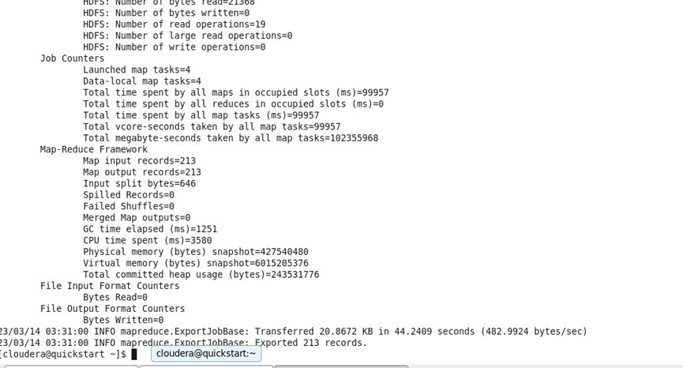
Solution 8 - Output

Slide 35
Problem Statement 9
The Healthcare department wants to know which disease is most likely to infect multiple people in the same household. For each disease find the number of households that has more than one patient with the same disease.
Note: 2 people are considered to be in the same household if they have the same address.

Slide 36
Solution 9 - Part 1
Create External Table
create external table problem9
(diseaseName String, addressId int, count_patients int)
ROW FORMAT DELIMITED FIELDS TERMINATED BY ','
LINES TERMINATED BY '\n'
LOCATION '/user/hive/warehouse/project/problem9';
Insert Data Into External Table In Hive
with temp_cte_table AS(
SELECT d.diseasename AS diseasename, pe.addressID, COUNT(p.patientID) AS `Number of Patients with same disease in same address`
FROM disease d
INNER JOIN treatment t ON d.diseaseID = t.diseaseID
INNER JOIN patient p ON p.patientID = t.patientID
INNER JOIN person pe ON pe.personID = p.patientID
GROUP BY d.diseasename, pe.addressID
HAVING COUNT(p.patientID) > 1)
INSERT INTO TABLE problem9
SELECT * FROM temp_cte_table;

Slide 37
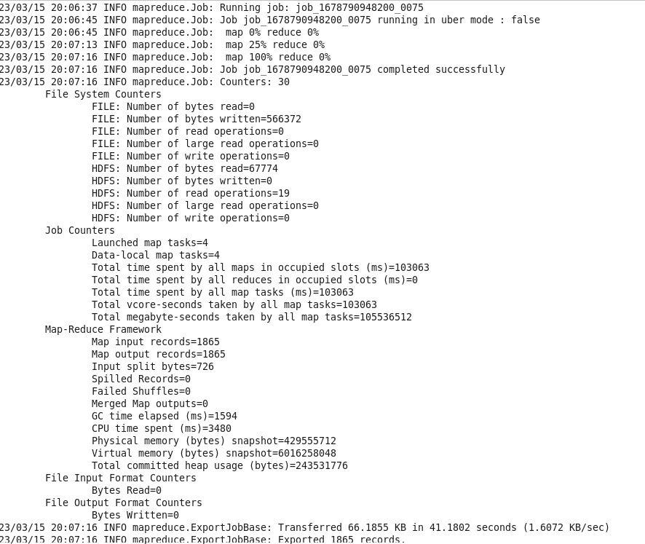
Solution 9 - Part 2
Create Output Table in Client DB
CREATE TABLE problem9(
diseaseName Varchar(50),
address int,
count_patients int
);
Move Data to Client DB using Sqoop Export
sqoop export \
--connect jdbc:mysql://localhost:3306/healthcare \
--username root \
--password cloudera \
--table problem9 \
--export-dir /user/hive/warehouse/project/problem9/000000_0;

Slide 38
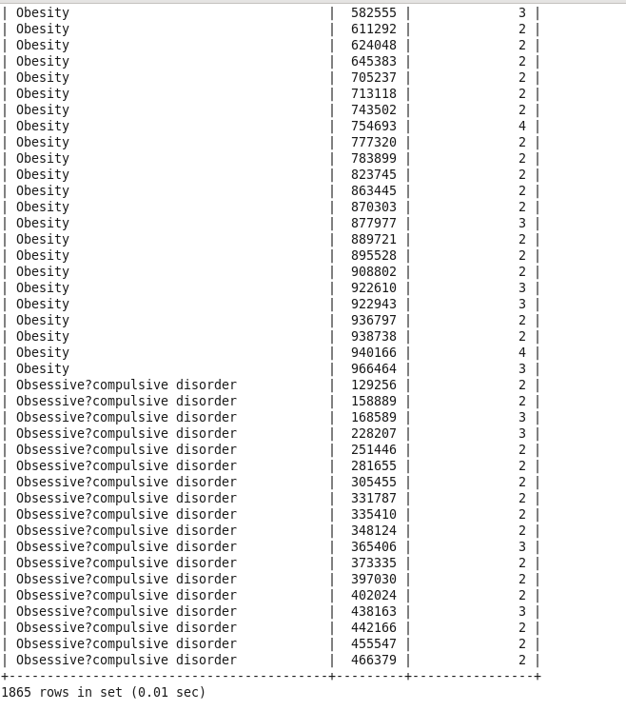
Solution 9 - Output

Slide 39
Problem Statement 10
An Insurance company wants a state wise report of the treatments to claim ratio between 1st April 2021 and 31st March 2022 (days both included). Assist them to create such a report.

Slide 40
Solution 10 - Part 1
Create External Table
create external table problem10
(state String, count_treatments int, count_claims int, treatment_claim_ratio double)
ROW FORMAT DELIMITED FIELDS TERMINATED BY ','
LINES TERMINATED BY '\n'
LOCATION '/user/hive/warehouse/project/problem10';
Insert Data Into External Table In Hive
with temp_cte_table AS(
SELECT a.state, COUNT(t.treatmentID) AS `No. of treatments`, COUNT(c.claimID) AS `No. of Claims`,
COUNT(t.treatmentID) / COUNT(c.claimID) AS `Treatment : Claim`
FROM address a
INNER JOIN person p ON a.addressID = p.addressID
LEFT OUTER JOIN treatment t ON p.personID = t.patientID
LEFT OUTER JOIN claim c ON t.claimID = c.claimID
WHERE t.date BETWEEN '2021-04-01' AND '2022-03-31'
GROUP BY a.state
HAVING COUNT(t.treatmentID) > 0)
INSERT INTO TABLE problem10
SELECT * FROM temp_cte_table;

Slide 41
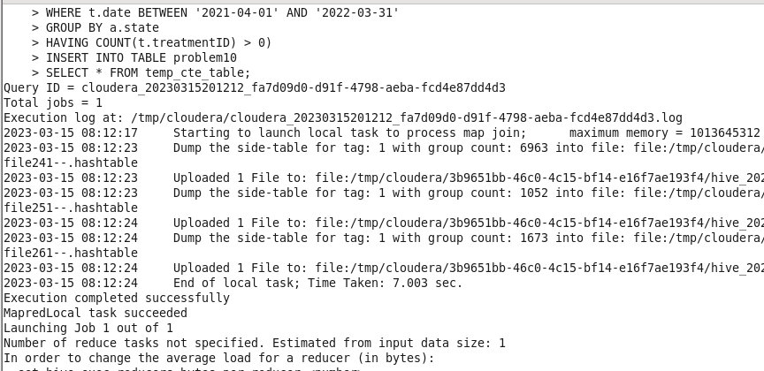
Solution 10 - Part 2
Create Output Table in Client DB
CREATE TABLE problem10(
state Varchar(50),
count_treatments int,
count_claims int,
treatment_claim_ratio double
);
Move Data to Client DB using Sqoop Export
sqoop export \
--connect jdbc:mysql://localhost:3306/healthcare \
--username root \
--password cloudera \
--table problem10 \
--export-dir /user/hive/warehouse/project/problem10/000000_0;

Slide 42
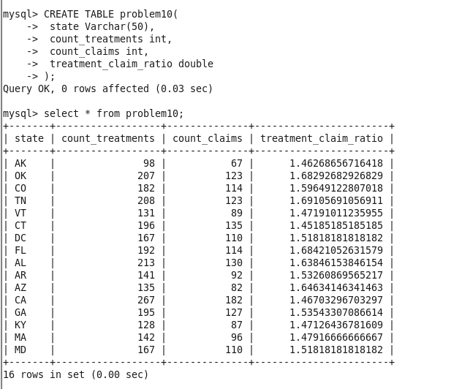
Solution 10 - Output

