Slide 1
Capstone Project
Supply Chain Management

Slide 2
Problem Statement
A FMCG company has recently started manufacturing instant noodles two years back.
The higher management in the company has noticed a mismatch between supply and demand.
Since, this can cause a considerable amount of inventory cost loss, higher management has decided to optimize the supply chain.
Objective: To predict the weight of instant noodles which is to be supplied each of these warehouses based on provided dataset
Scope: Since this is first phase of agreement, the company has shared limited information. Once the client sees any tangible impact, they will release 360 degree data lake.

Slide 3
Key Insights from Data Exploration
The ‘small’ warehouses are less than half in numbers compared to ‘large’ or ‘mid’ size warehouses.
Transport issues in last one year are having zero as mode value which is good for business.
For most of the warehouses, the competitors in the market are ranging between 2 to 4.
The target feature ‘product_wg_ton’ is having very high correlation (0.99) with ‘storage_issues_reported_l3m’ and moderate correlation (0.63) with ‘age_wh’
The average number of breakdowns for Urban area is more than rural area.
Product weight supplied to East-Zone 6 in Urban region is significantly high

Slide 4
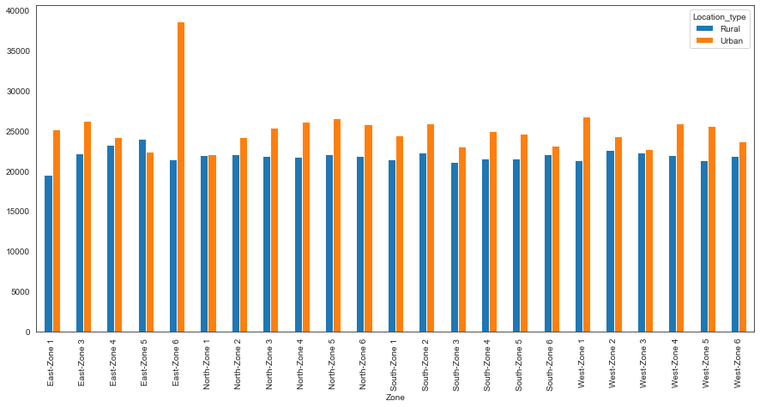
Product weight supplied to warehouses located in different pockets of the country

Slide 5
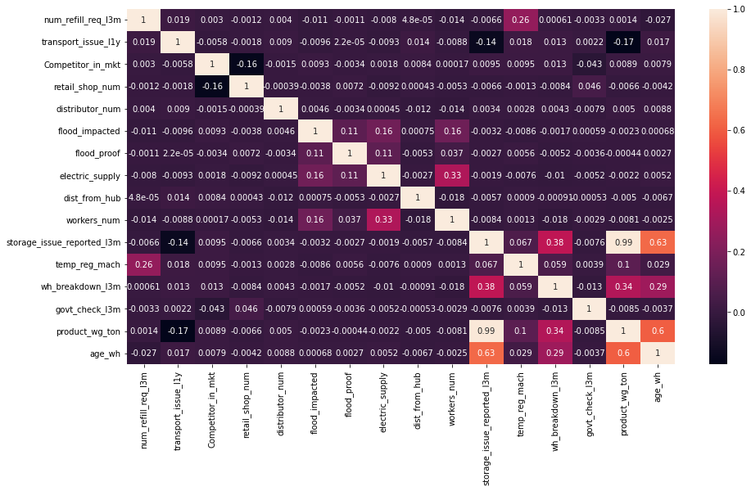
Correlation coefficients

Slide 6
Modelling Approach
One hot encoding and replacement of ordinal categorical features with suitable values was done before proceeding to modelling
Since there is one feature (storage_issues_reported_l3m) which is highly correlated with the target variable, two separate cases were considered. One with and one without this feature. (third case is just better tuned model for case-2)
The independent features were scaled before modelling.
Firstly, simple linear regression model was tried. For case 1, it was very good but for case 2 the model performance was very poor even after dropping all the insignificant variables
Random forest model was tried which was performing far better than linear regression
Further, SVR model was tried. Performance of SVR model was comparable to Linear Regression model in both cases.
Finally Xgboost model was tried. Xgboost model was the best performing among the models that were tried.

Slide 7
Comparison based on performance metrics for different models trained
Model | Case | RMSE |  | MAE |  | R2 Score
 |  | Train | Test | Train | Test | Train | Test
Linear Regression | 1 | 1740.299 | 1763.438 | 1279.83 | 1297.501 | 0.9775 | 0.976
 | 2 | 8611.683 | 8591.098 | 6784.787 | 6785.172 | 0.45 | 0.449
Random Forest | 1 | 342.651 | 902.136 | 249.438 | 667.316 | 0.999 | 0.993
 | 2 | 2972.476 | 7884.133 | 2253.387 | 6030.469 | 0.934 | 0.536
 | 3 | 7691.626 | 7796.901 | 5881.63 | 5979.351 | 0.561 | 0.546
Support Vector Regressor | 1 | 2728.826 | 2745.981 | 2059.239 | 2073.303 | 0.944 | 0.943
 | 2 | 8917.942 | 8885.69 | 7006.604 | 6988.947 | 0.41 | 0.411
 | 3 | 8651.03 | 8640.89 | 6757.336 | 6767.289 | 0.445 | 0.443
Xgboost | 1 | 613.097 | 883.778 | 466.266 | 652.411 | 0.997 | 0.994
 | 2 | 5903.952 | 8085.879 | 4463.193 | 6251.144 | 0.771 | 0.512
 | 3 | 7687.884 | 7744.525 | 5910.95 | 5962.276 | 0.562 | 0.552

Slide 8
Recommendations
For almost all the models feature importance of the variables:
Age_wh
Wh_breakdown_l3m
Transport_issues_l3m
Approved_wh_govt_certificate
Location_type
were coming out to be higher other than the highly correlated feature.
The above mentioned feature suggests that the issues related to the warehouse significantly impact the product weight to be shipped
Since ‘age_wh’ can play significant role in making good predictions, the client should provide accurate age of warehouses to get better results.

Slide 9
Thank you!

