Slide 1
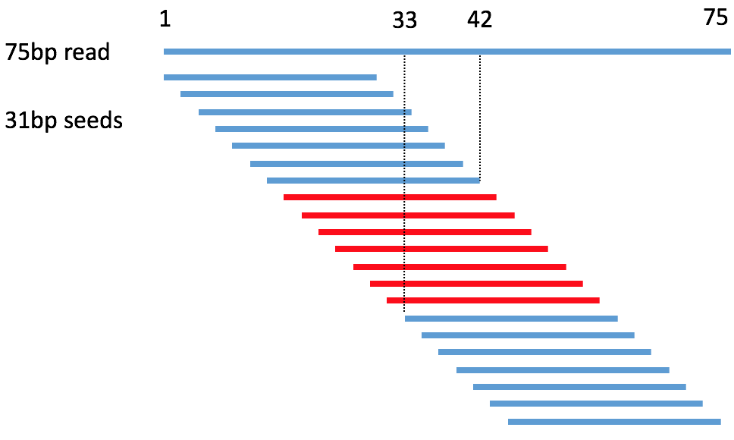
What we have now?
What’s in the left 18%?
BLAT Analysis
 | Reads number
LC | 1,285,502
PhiX | 502,225
Short20 | 2,648
Hg38 | 20,252,005
rRNA(LSU+SSU) | 183,332
Left? | 4,992,253
Total | 27,217,965
After running Kraken on the left reads, 87% reads(4,355,632) can be labeled as human.
Such weird read may be comprised of two or more sub-sequences locate at different place.
Among 4,355,632 reads, 2,706,760(62%) reads has features as follows:
tails(seeds, 31bp) extracted from both ends can be perfectly mapped to hg38, but those from read center can not.
Those seeds which can be mapped to hg38 can cover the whole read.
For example:
Blat 2,706,760 reads against hg38:
See the result table
Each read(actually, part of read) may have hundreds of candidate hits/locations in hg38.
We want to know which pieces compose the read. But there are too many combinations.
Limitations:
Two pieces: 0-m, n-75, m <= n
On same chromosome
In Blat, 100% identity, no gap for each piece
There are at most 8 patterns:
Unmapped reads distribution
In sample PD_BN04-42_SNDA_5_REP

Slide 2
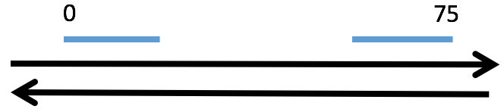
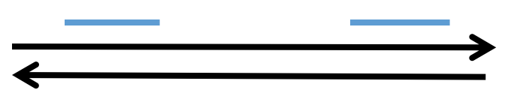
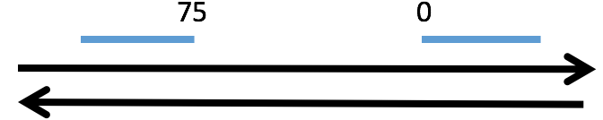
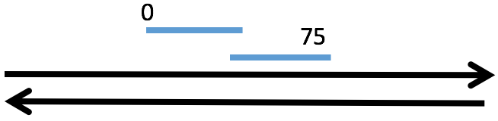
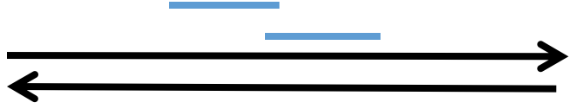
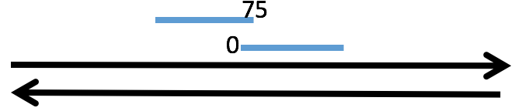
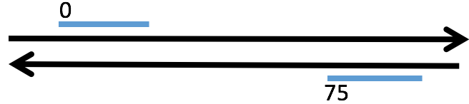
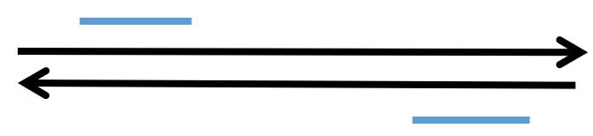
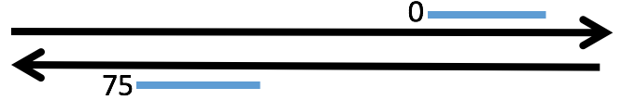
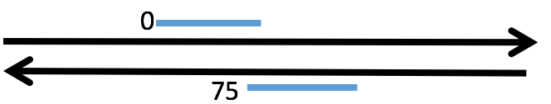
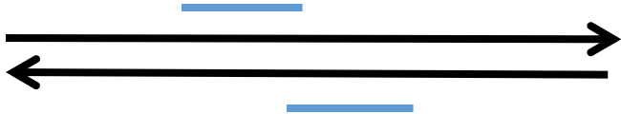
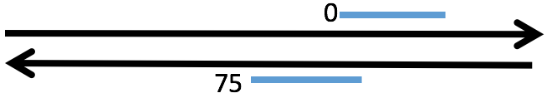
481,026
579,430
0
48
3,183,323
3,125,985
0
0

Slide 3
1
33
42
75
75bp read
31bp seeds
1
42
75
33

Slide 4
75
0
75
0
0
0
75
75

