Slide 1
COVID Vaccinations & Health Equity
Prince Emenalo, Ryan Hulett, Stormm Van Rooi

Slide 2
Table of Contents
🔘 Overview 🔘
🔘 Research Questions 🔘
🔘 Data Analysis 🔘
🔘 Insights🔘
🔘 Conclusion 🔘

Slide 3
Overview
The COVID‑19 vaccines are widely credited for their role in reducing the spread, severity, and have been administered worldwide based on official reports from national public health agencies.
For this project, we will be looking at the rate of vaccination based on age, gender, and socioeconomic status. Based on this data analysis, we will develop insights into the barriers to vaccination among these demographics, as well as reasons why the vaccine rate increases and decreases seasonally or based on events.

Slide 4
Data Sources
COVID Vaccine Hesitancy: https://vaccine.precisionforcovid.org
COVID-19 Vaccination Demographics in the United States, National: https://data.cdc.gov/Case-Surveillance/COVID-19-Case-Surveillance-Public-Use-Data-with-Ge/n8mc-b4w4
COVID-19 Vaccination and Case Trends by Age Group, United States: https://data.cdc.gov/Vaccinations/COVID-19-Vaccination-and-Case-Trends-by-Age-Group-/gxj9-t96f
Rates of laboratory-confirmed COVID-19 hospitalizations by vaccination status: https://covid.cdc.gov/covid-data-tracker/#covidnet-hospitalizations-vaccination
Rates of COVID-19 Cases and Deaths by Vaccination Status: https://covid.cdc.gov/covid-data-tracker/#rates-by-vaccine-status

Slide 5
Research Questions
1

Slide 6
Research Questions
Where are the highest and lowest rates of vaccination?
What are the barriers to getting vaccinated?
What are the death rates among vaccinated and unvaccinated individuals?
What are the hospitalization rates among vaccinated and unvaccinated individuals?

Slide 7
Data Analysis
2

Slide 8
Where are the highest and lowest rates of vaccination in the US?

Slide 9
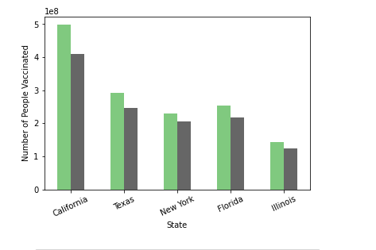
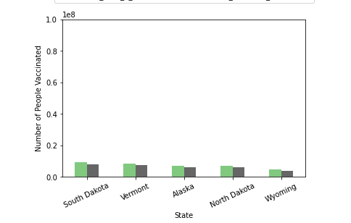

Highest & Lowest Rates of Vaccination in the US
Highest & Lowest Rates

Slide 10
Highest & Lowest Vaccination Rates
Top 5 States for
COVID Vaccinations
Bottom 5 States for
COVID Vaccinations
State | Number of People Who Received One Dose | Number of People Who Received Two Doses
California | 497,421,590 | 409,371,169
Texas | 291,050,286 | 246,451,751
Florida | 253,494,438 | 217,102,462
New York | 229,970,138 | 206,401,891
Illinois | 142,670,762 | 409,371,169
State | Number of People Who Received One Dose | Number of People Who Received Two Doses
South Dakota | 9,212,242 | 7,876,388
Vermont | 8,566,789 | 7,529,665
Alaska | 6,983,763 | 6,139,063
North Daktoa | 7,174,895 | 5,925,526
Wyoming | 4,740,793 | 4,046,196

Slide 11
What are the barriers to getting vaccinated?

Slide 12
Barriers to Vaccination
Historic Undervaccination
Standard vaccination coverage, vaccine exemption rate
Sociodemographic Barriers
Socioeconomically disadvantaged, lack of access to information
Resource-Constrained Healthcare System
Limited workforce, infrastructure and strength
Healthcare Accessibility Barriers
Underinsured, delayed care-seeking, lack of transport and limited connectivity
Irregular Care Seeking Behavior
Lack of personal doctor, failure to seek routine care

Slide 13
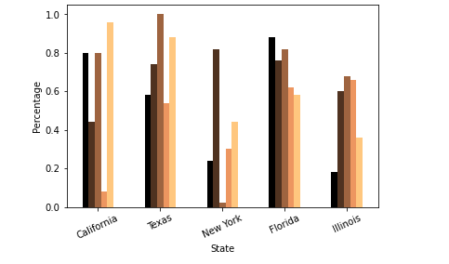
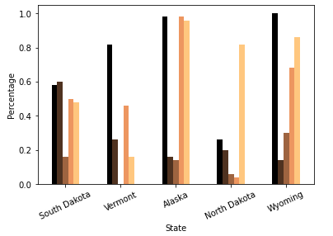
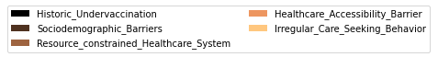
Barriers to Vaccination in Top 5 and Bottom 5 States
Barriers

Slide 14
Barriers to Vaccinations
State | Historic Undervaccination | Sociodemographic Barriers | Resource Constrained Healthcare System | Healthcare Accessibility Barrier | Irregular Care Seeking Behavior
South Dakota | 0.58 | 0.60 | 0.16 | 0.50 | 0.48
Vermont | 0.82 | 0.26 | 0.00 | 0.46 | 0.16
Alaska | 0.98 | 0.16 | 0.14 | 0.98 | 0.96
North Dakota | 0.26 | 0.20 | 0.06 | 0.04 | 0.82
Wyoming | 1.00 | 0.14 | 0.30 | 0.68 | 0.86

Slide 15
What are the death rates among vaccinated and unvaccinated individuals?

Slide 16
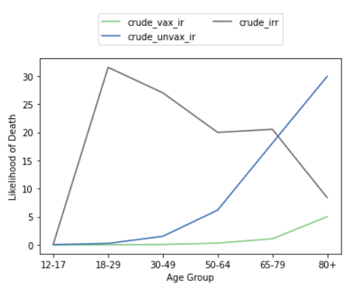
You can insert graphs from Excel or Google Sheets

Slide 17
Death Rates
Death Rates in Unvaccinated and Vaccinated
Outcome | Month | MMWR Week | Week Date | Age Group | Crude Vaccianation Incident Rate | Crude Unvaccination Incident Rate | Crude Incident Rate Ratio
death | APR | 14 | Apr 04-Apr 10 | 12-17 | 0.000000 | 0.027533 | NaN
death | APR | 14 | Apr 04-Apr 10 | 18-29 | 0.000000 | 0.120537 | NaN
death | APR | 14 | Apr 04-Apr 10 | 30-49 | 0.037839 | 0.575598 | 15.211755
death | APR | 14 | Apr 04-Apr 10 | 50-64 | 0.258194 | 2.653614 | 10.277589
death | APR | 14 | Apr 04-Apr 10 | 65-79 | 0.589517 | 9.412042 | 15.96569
death | APR | 14 | Apr 04-Apr 10 | 12-17 | 0.000000 | 0.027533 | NaN
death | SEP | 35 | Aug 29-Sep 04 | 12-17 | 0.000000 | 0.000000 | NaN
death | SEP | 35 | Aug 29-Sep 04 | 18-29 | 0.014941 | 0.472142 | 31.600086
death | SEP | 35 | Aug 29-Sep 04 | 30-49 | 0.075200 | 2.669165 | 35.494153
death | SEP | 35 | Aug 29-Sep 04 | 50-64 | 0.526543 | 11.332073 | 21.521644
death | SEP | 35 | Aug 29-Sep 04 | 65-79 | 2.036556 | 33.835951 | 16.614299
Notes:
MMWR - Morbidity and Mortality Weekly Report

Slide 18
What are the hospitalization rates among vaccinated and unvaccinated individuals?

Slide 19
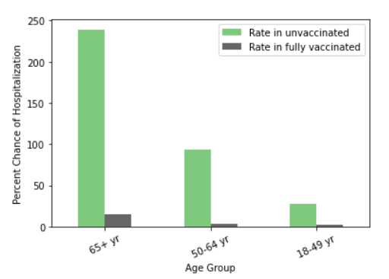
You can insert graphs from Excel or Google Sheets

Slide 20
Hospitalization Rates
Hospitalization Rates in Unvaccinated and Vaccinated
Week Ending | Age Group | Rate in Unvaccinated | Rate in Fully Vaccinated
1/30/21 | 65+ yr | 34.4 | 0.0
1/30/21 | 50-64 yr | 21.2 | 1.2
1/30/21 | 18-49 yr | 6.3 | 0.0
2/6/21 | 65+ yr | 43.2 | 6.4
2/6/21 | 50-64 yr | 15.4 | 0.0
... | ... | ... | ...
8/21/21 | 50-64 yr | 92.3 | 2.7
8/21/21 | 18-49 yr | 25.4 | 0.9
8/28/21 | 65+ yr | 239.0 | 14.8
8/28/21 | 50-64 yr | 93.8 | 3.0
8/28/21 | 18-49 yr | 27.4 | 1.8

Slide 21
Insights
3

Slide 22
Insights
States with higher incomes per capita have higher rates of vaccinations compared to states with lower incomes.
Individuals that are 65+ and unvaccinated have a higher mortality rate than those in the same age group that are vaccinated.
Individuals in all age groups that are unvaccinated and contract COVID-19 are more likely to be hospitalized during their illness.
States with lower barriers to healthcare accessibility have higher rates of COVID-19 vaccinations. Meanwhile, states with historic undervaccination trends typically have lower rates of COVID-19 vaccinations.

Slide 23
Limitations
The data analysis is based on raw numbers of vaccinations and not proportional to populations in each state.
There are a significant amount of missing values for sex and ethnicity making it difficult to accurately analyze trends among these groups.
For hospitalizations, we are not taking co-morbidities/co-infections into consideration.
Socioeconomic barriers captures 28 supply and demand factors through five different themes. Not all supply-and-demand side factors driving COVID-19 vaccine coverage are available at a granular level across geographies.

Slide 24
Conclusion
4

Slide 25
191,252,000 Vaccinated
58 % of the US Population
is Vaccinated

Slide 26
Conclusion
Getting vaccinated reduces your risk of hospitalization and mortality if you contract COVID-19.
States with higher incomes have higher vaccination rates than those with lower incomes.
There are many barriers, aside from vaccine hesitancy, that challenge widespread COVID-19 vaccine coverage in the United States. More research needs to be done to address socioeconomic barriers to increase the rate of vaccination across the United States.

Slide 27
THANKS!
Any questions?
Notes:
Orange #ff9e00
Dark gray #434343

