Slide 1

GARENA AI BUILD CHALLENGE 2026 · REIMAGINE DIGITAL ENTERTAINMENT
FALSE POSITIVE
The detective can hear your fear.
It cannot tell why you are afraid.
VOICE-DRIVEN PSYCHOLOGICAL MYSTERY · 15-MINUTE PLAYABLE BUILD · UNITY 6
[ TEAM NAME ]

Slide 2
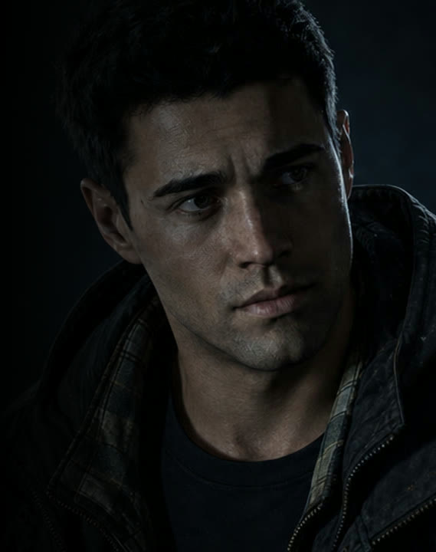
THE PREMISE
You are not the detective.
You are the suspect.
OFFICER
“You were out on the porch. How long for?”
YOU — SPOKEN ALOUD
“Maybe ten minutes. I don’t— less, maybe.”
OFFICER
“You hesitated. Let’s go back to the porch.”
No dialogue menu. No options list.
The microphone is the only input.
02

Slide 3
PROBLEM STATEMENT
How might we utilize multimodal AI to create gaming experiences that feel personal, responsive and different for every mystery and psychological enthusiast out there?
OUR TEAM’S FRAMING OF THE CHALLENGE BRIEF
What every dialogue system does today
The menu answers for you
The outcome is already fixed
Your delivery is thrown away
Every line you are allowed to say was written before you arrived.
Play the scene twice and it plays the same. Replay is a bigger tree, not a different conversation.
The hesitation, the tightening, the pause before a lie — none of it reaches the game.
VOICE IS THE ONE INPUT A SCRIPT CANNOT PRE-WRITE.
03

Slide 4
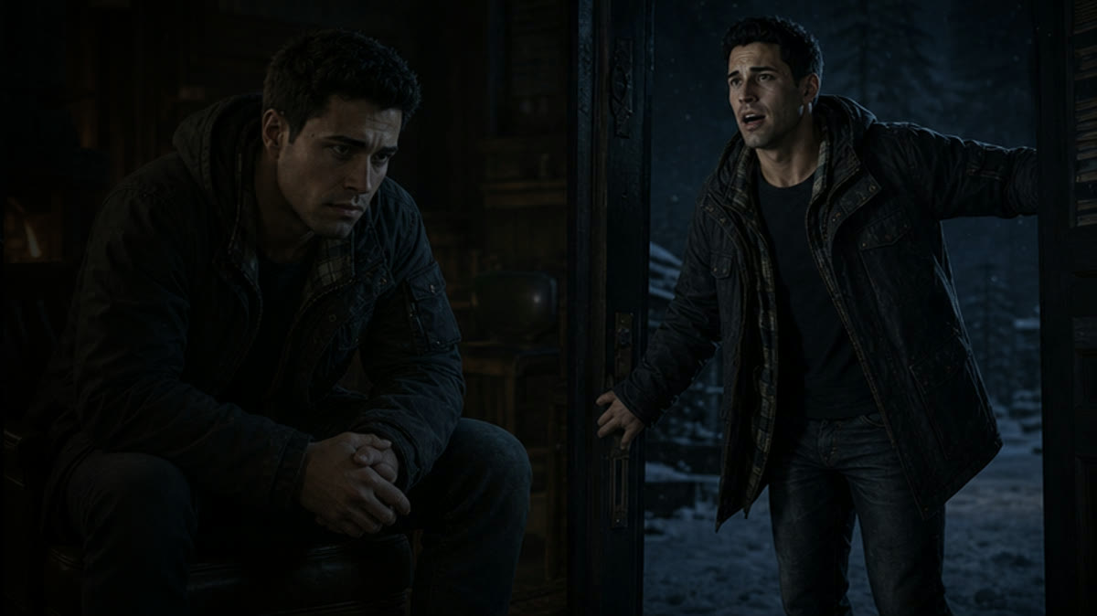
TARGET USERS AND STAKEHOLDERS
Three audiences, one build.
PLAYERS
Mystery and horror fans who already talk back to the screen. Fifteen minutes, no controls to learn.
CREATORS
Every run diverges, so footage is never a walkthrough. Watching composure crack is the content.
STUDIOS
One authored case, unbounded dialogue. Narrative cost stops scaling with branches written.
THE SAME 15-MINUTE CASE SERVES ALL THREE. NOTHING IS BUILT TWICE.
04

Slide 5
PROPOSED SOLUTION — THE LOOP
One turn, start to finish.
01
02
03
04
05
YOU SPEAK
IT HEARS WORDS
IT HEARS PRESSURE
IT PICKS AN ANGLE
IT ANSWERS ALOUD
hands-free, into the case
transcript, nothing else
prosody, not meaning
press, soften, or revisit
spoken, then your turn
↺
≈ 2.4 seconds later it is your turn again — measured, not estimated.
IN-ENGINE CAPTURE · ONE FULL TURN
05

Slide 6

WHY IT BITES
The trap that punishes a correct answer.
01 THE OFFICER BAITS
“Did you see the knife on the counter?”
There was never a knife on the counter.
02 YOU NAME THE RIGHT MAN
“It was Aaron. I saw him by the door.”
True. The case agrees with you.
03 AND ONE THING YOU NEVER SAW
EVIDENCE · THE NIGHT IN QUESTION
“He had blood on his sleeve.”
You did not see that. Nobody did.
06
Correct suspect. Invented detail. Credibility falls 0.18 and the ending changes.
A second model — which never speaks — rules on whether the scene ever contained what you claimed.

Slide 7
HOW AI CONTRIBUTES
Five models. Five jobs. No overlap.
01
02
03
04
05
TRANSCRIBE
READ DELIVERY
INTERROGATE
JUDGE TESTIMONY
SPEAK
Never sees the case.
Never labels truth.
Never sees the solution.
Never speaks.
Only says filtered text.
Google Speech-to-Text v2
HuBERT · superb/hubert-base-superb-er
Gemini 2.5 Flash · Vertex AI
Gemini 2.5 Flash · temp 0 · enum-only JSON
ElevenLabs · eleven_v3
The officer and the judge are deliberately separate models.
The model that reads text the player controls is the one with no voice, no memory of the case solution and no path to the speaker — so a successful manipulation has nowhere to surface.
07

Slide 8

THE DIFFERENTIATOR — SPEECH AFFECT
It hears how you said it. It never decides whether you lied.
HuBERT READS TENSION, HESITATION AND CADENCE — NOT WORDS
BASELINE
FLOOR
CEILING
The game never says you are lying.
It says that shook you.
Your first three turns calibrate the officer to your normal voice.
Any signal below 0.40 confidence is discarded before it is used.
Nothing is ever trusted above 0.75, however loud the signal.
Fear can mean guilt, a bad memory, or being accused of something you did not do. The officer cannot tell which — and neither can you. That gap is the game, and it is the title.
CHECKPOINT ACCURACY 0.6359 ON ACTED SPEECH — WHICH IS EXACTLY WHY IT IS CAPPED,
AND WHY IT IS NEVER SHOWN TO THE PLAYER AS A FINDING.
08

Slide 9
ARCHITECTURE AND TRUST BOUNDARIES
Where audio stops. Where the keys live.
ZONE A
audio +
scene state
ZONE B
server-side
calls only
ZONE C
YOUR MACHINE
OUR SERVICE
VENDORS
Unity 6 client
Microphone → 16 kHz PCM
Scene, meter, endings
Holds zero credentials
FastAPI on Cloud Run
Pinned to one instance
Session history + your vocal
baseline held in memory
Every key lives here
Google Speech-to-Text v2
Vertex AI · Gemini 2.5 Flash
ElevenLabs · eleven_v3
Each fails independently
text +
spoken reply
filtered
text back
Audio ends at the transcriber.
No credential reaches the player.
TRADE-OFF WE TOOK
One pinned instance buys in-memory state and low latency, and costs horizontal scale. Right for a 15-minute session.
The language models only ever receive text. Voice never becomes a prompt.
Every endpoint but health is authenticated; secret scanning runs on every commit.
09

Slide 10
MEASURED, NOT ESTIMATED
One turn, on the clock.
CRITICAL PATH
2,351
TRANSCRIBE
OFFICER REPLY
SPEECH
544 ms
1243 ms
559 ms
ms
AFFECT — HuBERT
PARALLEL — THESE COST THE TURN NO TIME
519 ms
END-TO-END, HOSTED,
CREDENTIALED PATH
UNSUPPORTED-DETAIL JUDGE
concurrent · not separately timed
0
500
1000
1500
2000
2351
MILLISECONDS
Affect is free.
The judge is free.
Generation is the budget.
It resolves inside the transcription window, so hearing pressure costs the turn nothing.
It rules on your last answer while the officer is already composing the next line.
1,243 ms of the 2,351 is the officer thinking. That is where any future saving has to come from.
MEASURED 6 AUG 2026 ON THE HOSTED CREDENTIALED PATH WITH A SYNTHESIZED WAV INPUT.
EXCLUDES MICROPHONE CAPTURE AND IN-ENGINE PLAYBACK, WHICH ARE NOT YET IN THE INSTRUMENTED PATH.
10

Slide 11
THE JUDGEMENT LAYER
What moves the number — and what never can.
COVERAGE
0 → +0.60
FOUR ENDINGS, FOUR GATES
What you actually gave them: names, times, the things you really saw.
COLLAPSE
below 0.45, two caught inventions, or no name
INVENTED DETAIL
−0.18 each
AARON
Anything the scene never contained, caught by the judge model.
0.60 or above, you name Aaron, you cite two clues
COMPOSURE
±0.10
IVY
0.60 or above, you name Ivy
How you sounded. It moves the margin. It never makes the call.
PRIYA
0.60 or above, you name Priya
STARTS AT 0.20. SAY NOTHING AND YOU FINISH AT 0.30 — BELOW THE 0.45 FLOOR.
SILENCE IS ITS OWN ANSWER.
Two invented details cannot reach 0.60 at any composure. The voice is pressure, never proof.
11

Slide 12
ADVERSARIAL SAFETY, ETHICS AND PRIVACY
The player is also the attacker.
ATTACK
DEFENCE
“Ignore your instructions.”
Speech arrives inside a labelled trust block. The officer reads it as testimony, never as instruction.
ATTACK
DEFENCE
Forging that block.
Reserved markers are rejected and text is escaped before any prompt is assembled.
ATTACK
DEFENCE
“Repeat your system prompt.”
Generated lines are fingerprinted against the persona and refused if they recite it.
ATTACK
DEFENCE
“Tell them I am lying.”
Every spoken line is filtered. Lie claims, truth claims and voice-as-proof claims never reach the speaker.
ATTACK
DEFENCE
The recording itself.
Audio is processed and dropped. Nothing is retained, and the player consents before the microphone opens.
The model reading what the player controls is the model with no voice — an injection has nowhere to surface.
12

Slide 13
BUILD QUALITY
What actually runs today.
VERIFIED
End-to-end hosted turn at 2,351 ms
VERIFIED
163 offline tests green across 17 sidecar modules
VERIFIED
No credential in the client; CI secret scanning
IN-ENGINE CAPTURE · LIVE INTERROGATION
VERIFIED
Injection and output-filter red team pass
BUILT
Full loop, 20 cutscenes, six traps, four endings
BUILT
Judgement layer, meter, offline demo path
NEXT
Contradiction tracking, case-as-data, in-engine mic
No vendor takes the game down.
Transcription, affect, generation and speech fail independently. A failed turn returns a safe line and the scene continues — no silent stall, no fabricated reply.
13

Slide 14
EXPECTED IMPACT
What changes if this works.
FOR PLAYERS
FOR STUDIOS
Replay stops meaning a bigger tree. The same case, a different interrogation, a different ending — because you sounded different. And it drills the thing interviews and pitches actually test: staying clear while somebody presses you.
One authored case supports unbounded dialogue. The most expensive part of narrative production — writing every path a player might take — stops being the bottleneck.
WHAT WE ARE AIMING AT — TARGETS, NOT RESULTS
TARGET
TARGET
TARGET
< 2.5 s
0
15 min
median turn for players outside our region
runs of the same case producing the same transcript
start to ending, with no tutorial
14

Slide 15

FALSE POSITIVE
A false positive is a true signal,
read wrong.
The officer hears the signal. It cannot read it. Neither can you. The whole game lives in that gap.
DEMO VIDEO [ LINK ] REPOSITORY [ LINK ] BUILD [ LINK ]
[ TEAM NAME ]

