Slide 1


Result Prediction & Analysis
Sarth Desai CSE-1
Arunuday Ganju CSE-2
Sanjana Udar CSE-2
Perin Shah CSE-2
Dr. Avani Vasant

Slide 2
Outline
Abstract
Introduction
Scope
Objective
Usability
Tools and Technology
Algorithms Used
Screenshots

Slide 3
Abstract
The ability to predict a student’s performance on a given concept is an important tool for the Education industry; it allows one to understand what types of students there are and what are key concepts that will help to shape the understanding of another.
These are important factors for educators to know in order to constantly modify and improve educating tools (such as text books and lecture plans).
This project aims to build a predictor, by finding similar group of student’s for a given candidate and predicting their performance on a concept they have not explored based on past performance.

Slide 4
Introduction
Education is one of the most important industries in today’s world, and while it continues to develop in meaningful ways, finding the best practices for teaching and the best evaluation tools is still a difficult problem.
This project aims to predict a student’s performance or score on the concept of Machine Learning, and their own performance on any previous grades. This can naturally lead into improvement in the score of the student by using the analysis provided.

Slide 5
Scope
This would be an extremely helpful tool in the education industry to predict how a student will perform as it can help shape educational tools to provide a better learning experience.
Many experiments have already been done to show that things like location, wealth, and students who are better at math and science will perform better than their counterparts, but this project aims to move away from these evaluations to find more a different result.

Slide 6
Objective
Main objective of Result Prediction is to use various algorithms to successfully access the students grade by analysing their grades from the earlier examinations.
Enabling the machine to learn from the provided data set.

Slide 7
Usability
Identifying weak students and clubbing them together according to their analysed result. This would help the faculty members to provide extra focus and attention.
Extra attention can be given to students who have a tendency to likely perform poorly in the upcoming tests.
Students can evaluate themselves and work on areas that they lack in.

Slide 8
Tools and Technology
Machine Learning: Enabling the task machine to perform a task (T) whose performance (P) can be measured and is based on the previous experience (E).
Python: is a widely used high-level programming language for general-purpose programming language.
Scikit-learn: is a free software machine learning library for the Python programming language. It features various classification, regression and clustering algorithms.

Slide 9
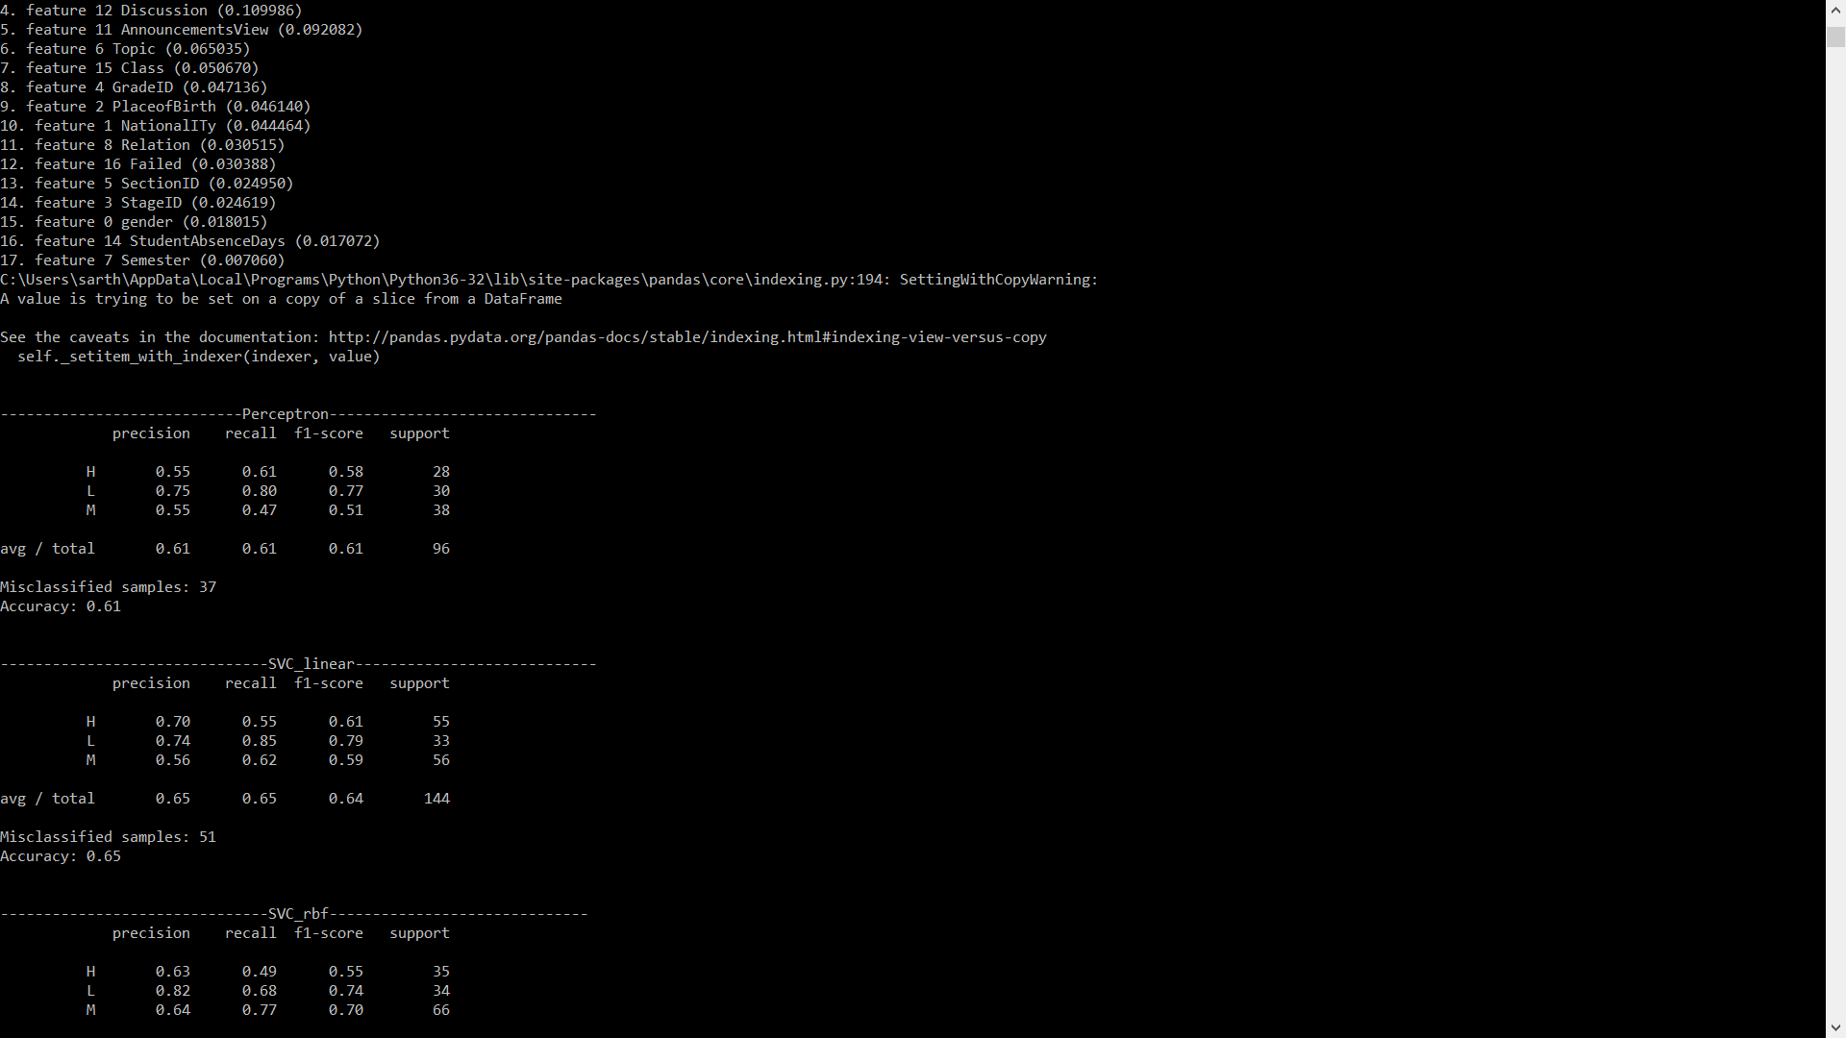
Algorithms Used
Perceptron: In machine learning, the perceptron is an algorithm for supervised learning of binary classifiers (functions that can decide whether an input, represented by a vector of numbers, belongs to some specific class or not). It is a type of linear classifier, i.e. a classification algorithm that makes its predictions based on a linear predictor function combining a set of weights with the feature vector.

Slide 10

Algorithms Used
Support Vector Machine(SVM-SVC): A support vector machine constructs a hyperplane or set of hyperplanes in a high or infinite-dimensional space, which can be used for classification, regression, or other tasks like outliers detection.

Slide 11
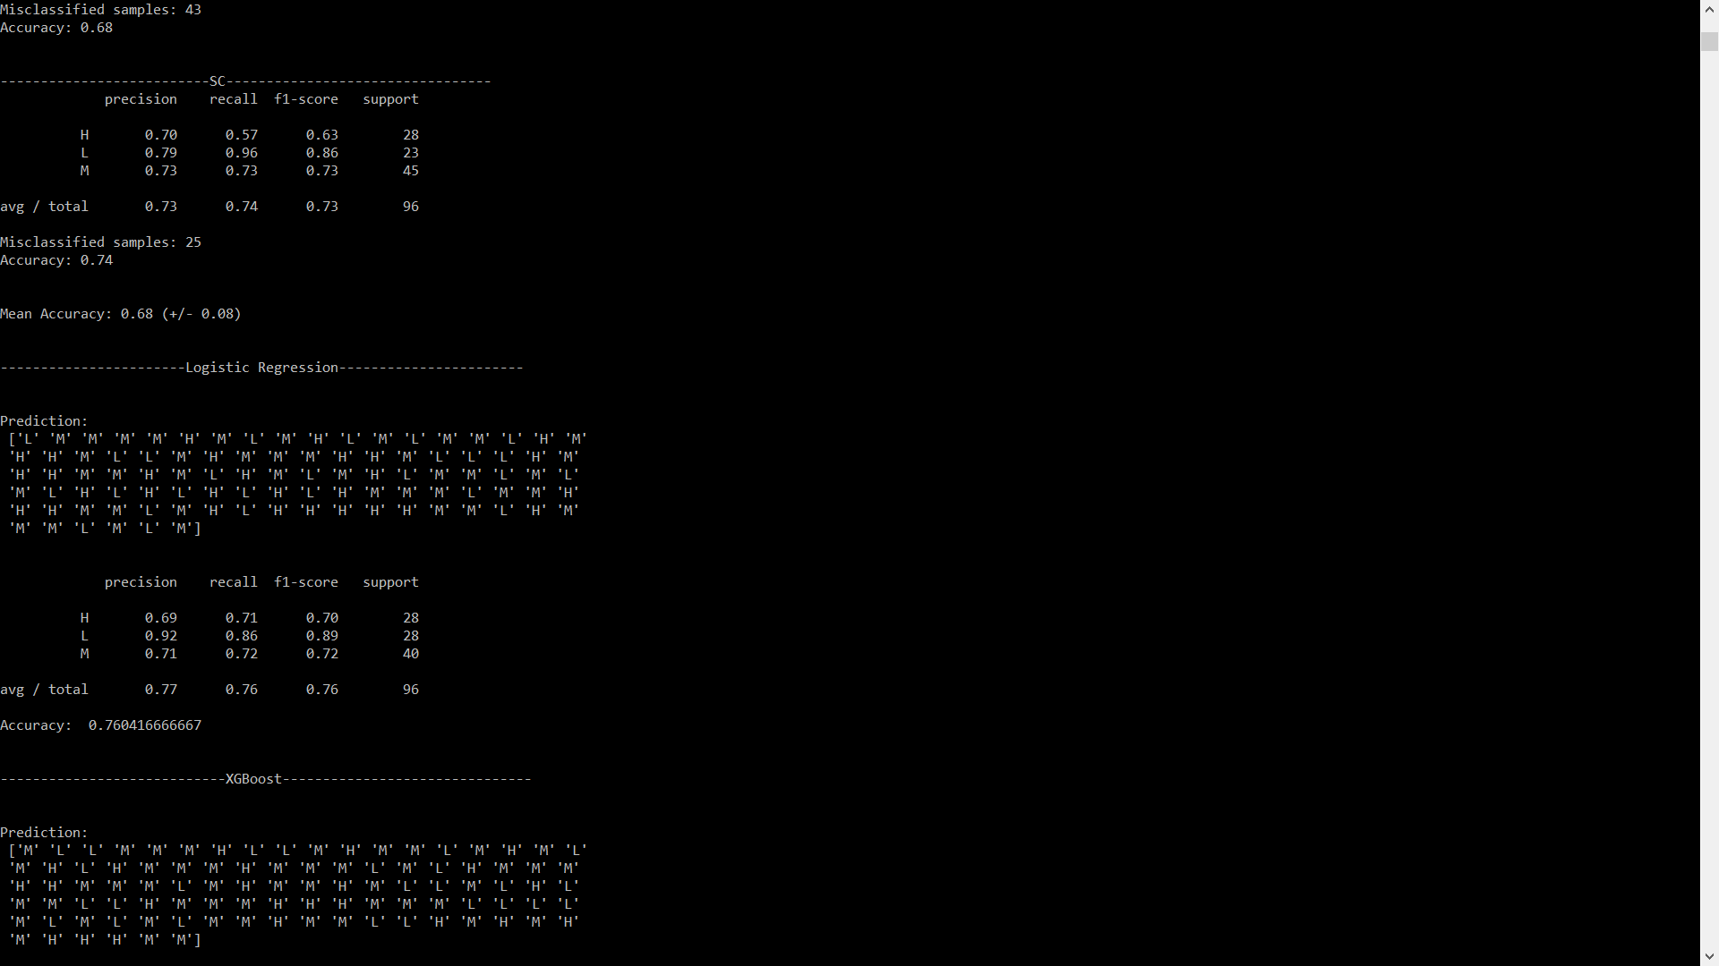
Algorithms Used
StandardScaler: It standardize the features by removing the mean and scaling to unit variance. Centering and scaling happen independently on each feature by computing the relevant statistics on the samples in the training set. Mean and standard deviation are then stored to be used on later data using the transform method.

Slide 12
Algorithms Used
Logistic Regression: Logistic regression falls under the category of supervised learning; it measures the relationship between the categorical dependent variable and one or more independent variables by estimating probabilities using a logistic/sigmoid function. In spite of the name ‘logistic regression’, this is not used for regression problem where the task is to predict the real-valued output.

Slide 13
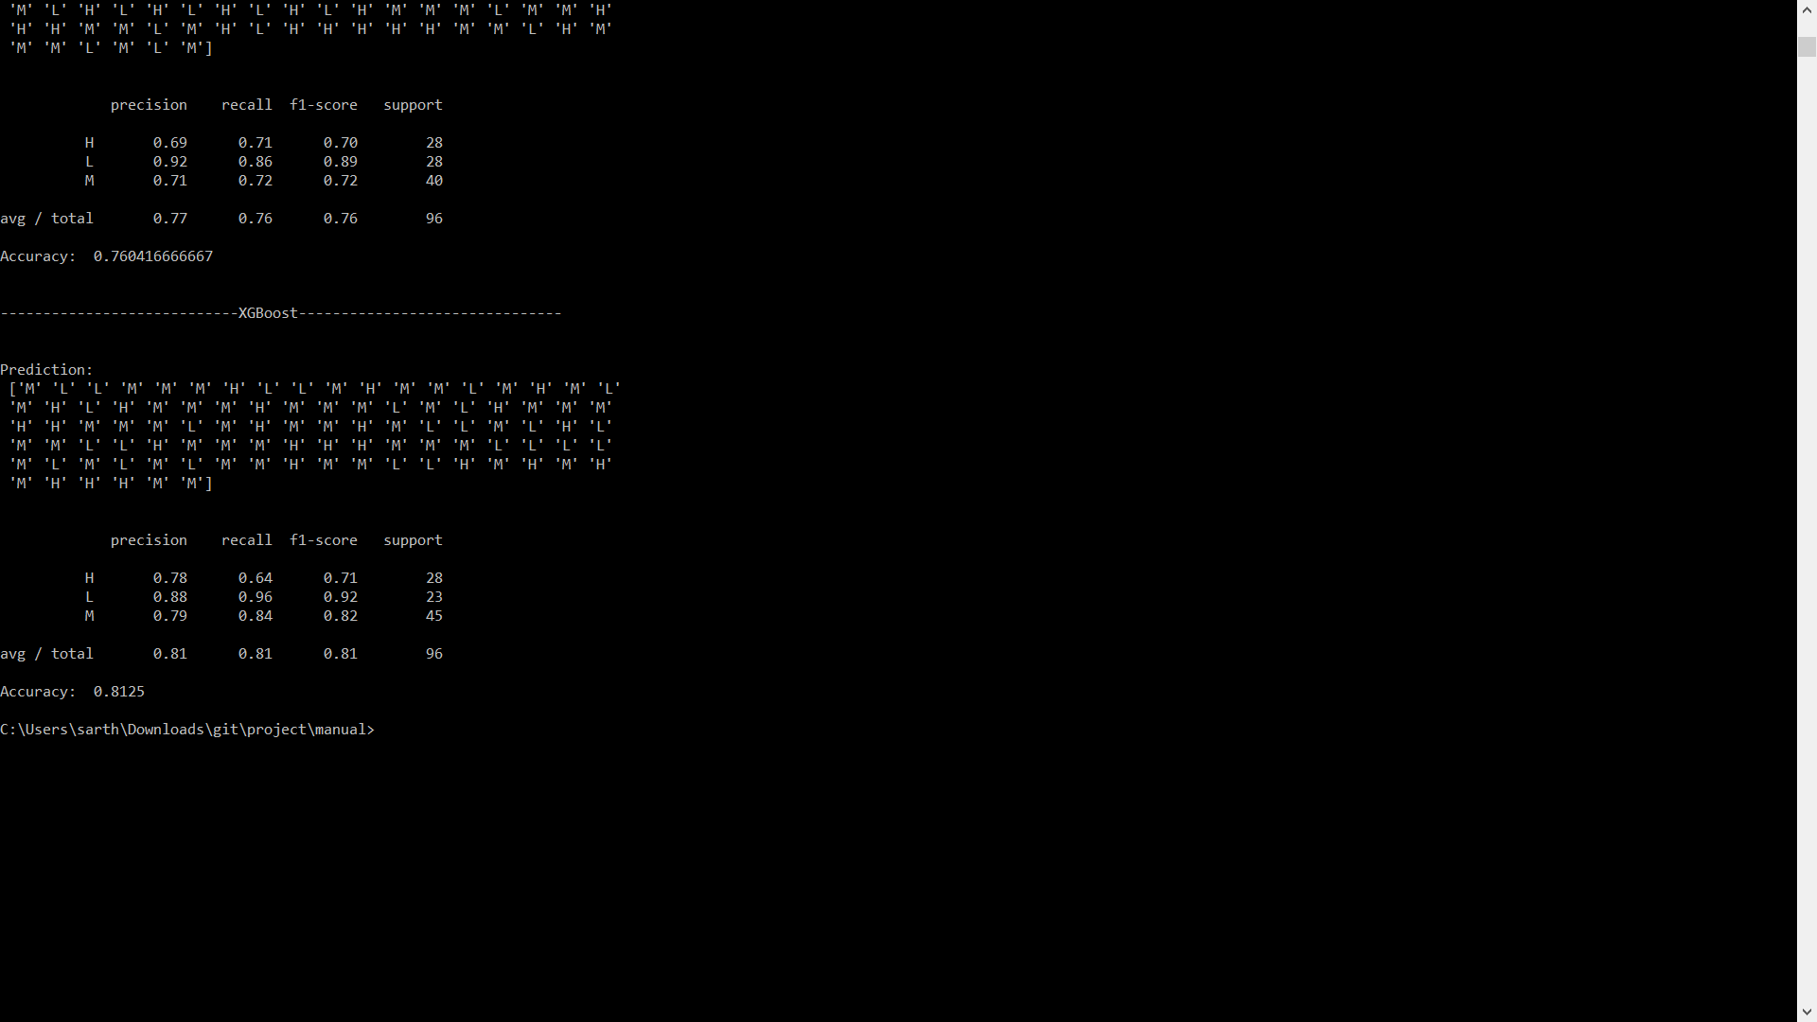
Algorithms Used
Xgboost: It is short for ‘Extreme Gradient Boosting’. It is an open-source software library which provides the gradient boosting framework. It is used for supervised learning problems, where we use the training data (with multiple features) xi to predict a target variable yi.

Slide 14
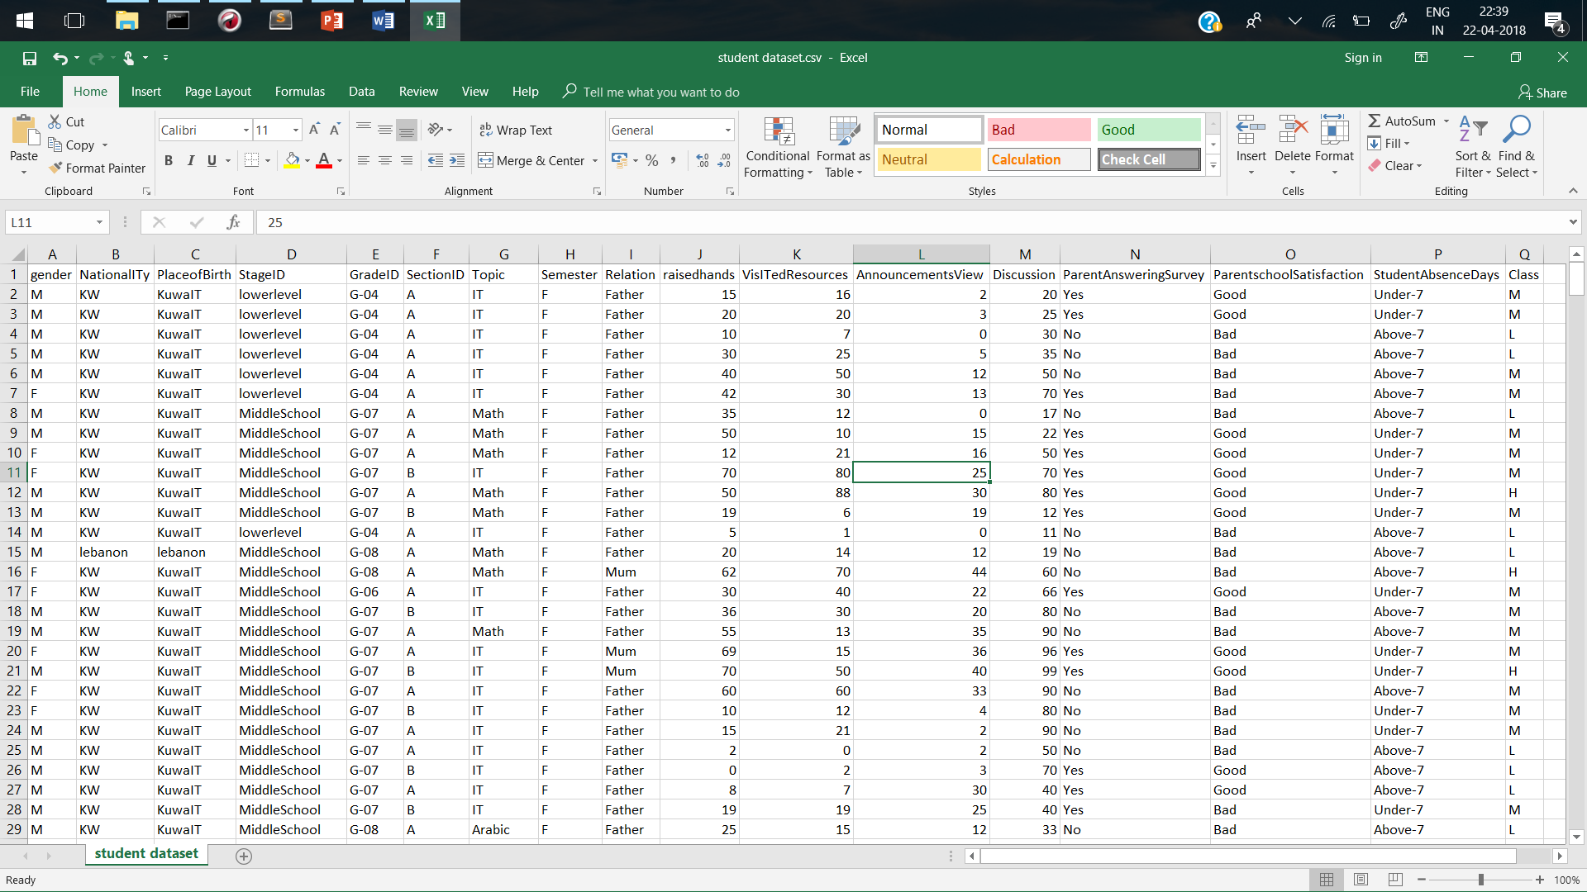
Screenshots

Slide 15
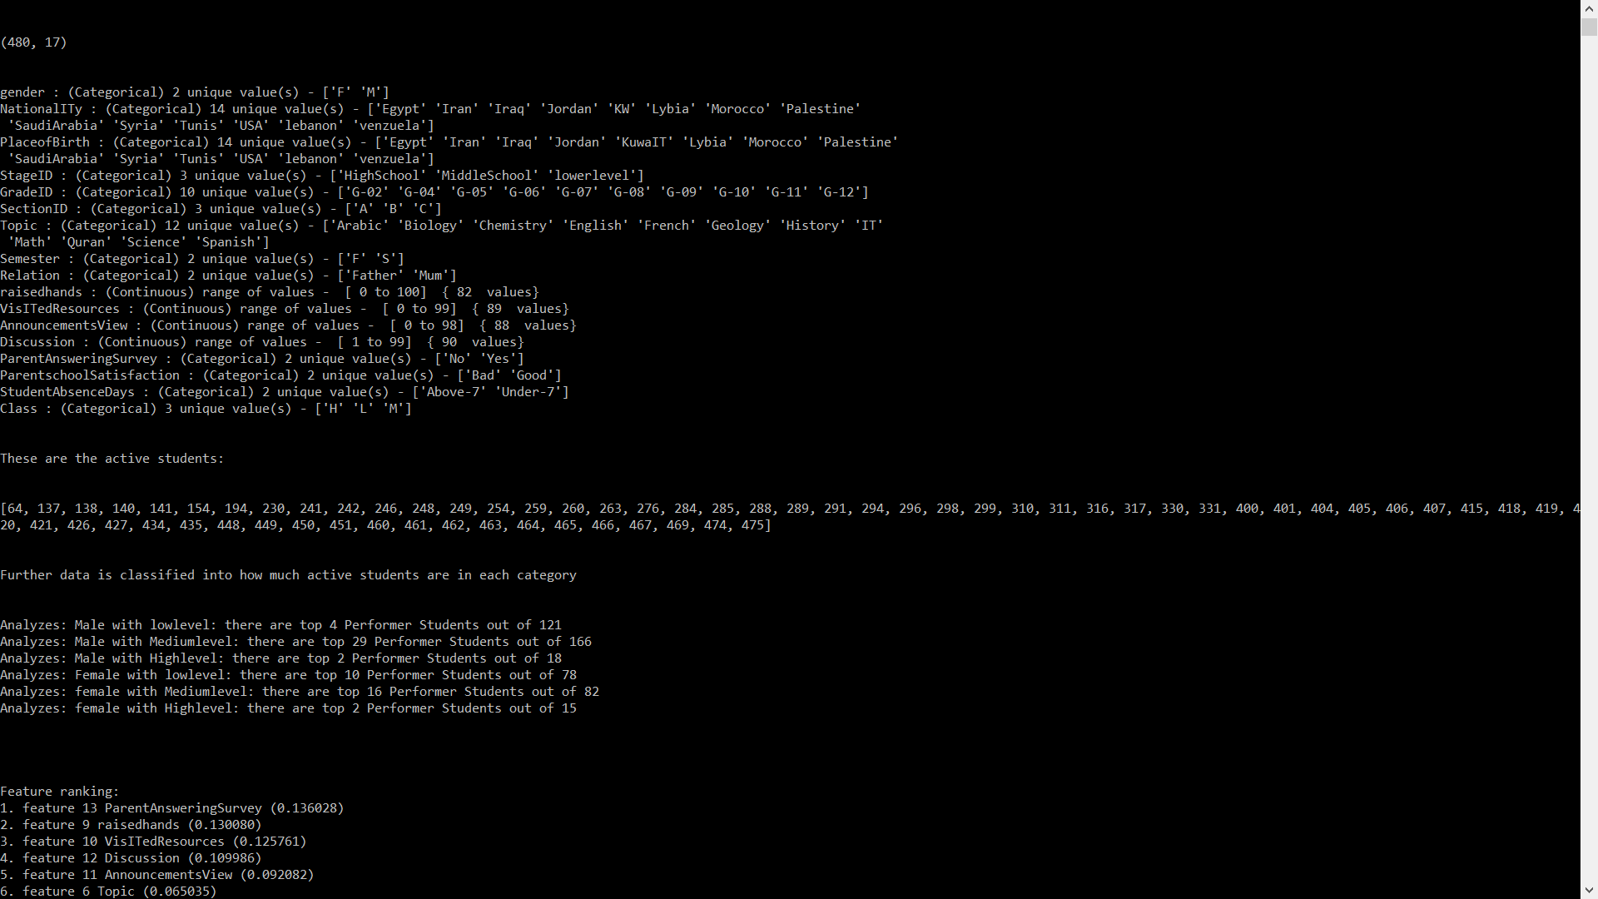
Screenshots

Slide 16
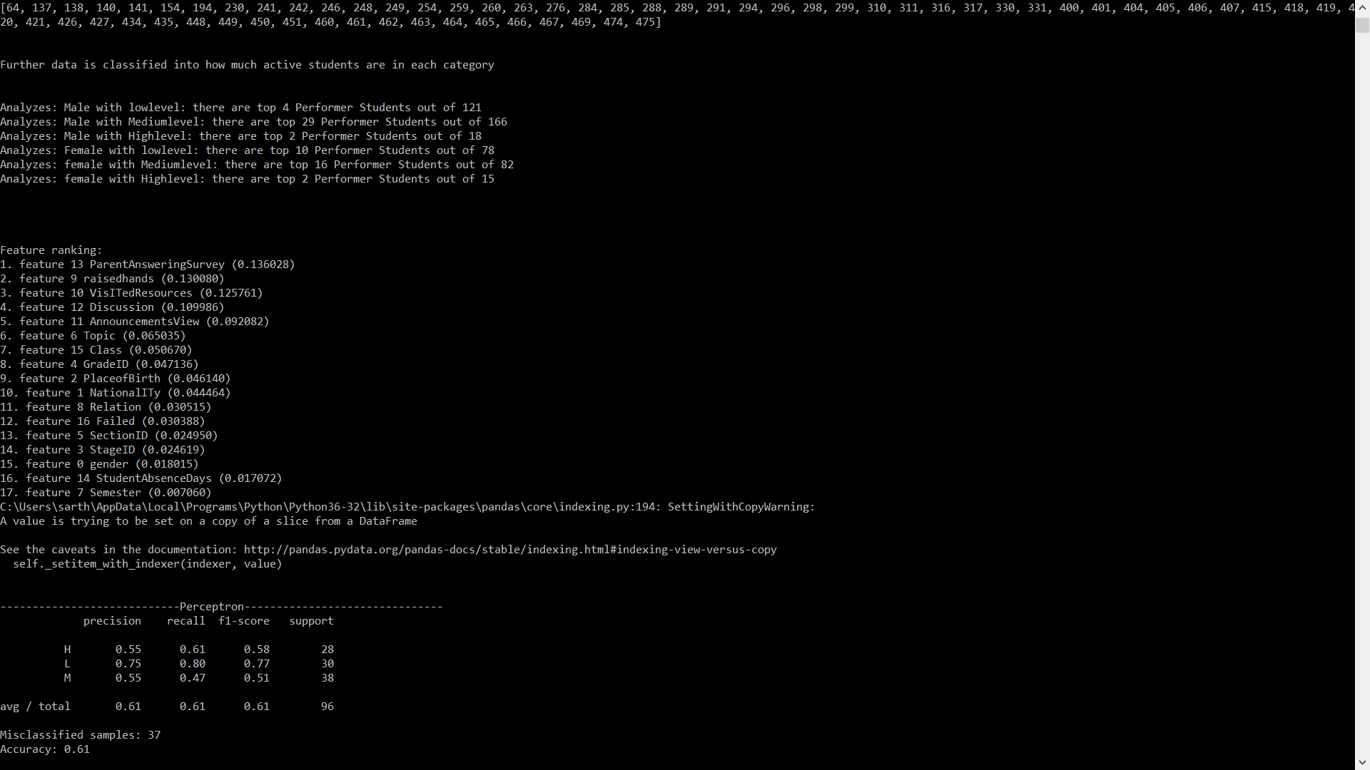
Screenshots

Slide 17
Thank You !!

