Slide 1
Cyber-enabled Real Time Rain Gauge Quality Control and Radar Bias Adjustment
David J. Hill
djhill1@ncsa.uiuc.edu
July 28, 2009

Slide 2
Overview
Modeling urban drainage
Virtual sensors
  What is a virtual sensor
  Prototype virtual sensor system
Real Time Rain Gauge Quality Control and Radar Bias Adjustment
  Dynamic Bayesian Network based anomaly detection
  Case study: Error detection in rain gauges
Future work

Slide 3
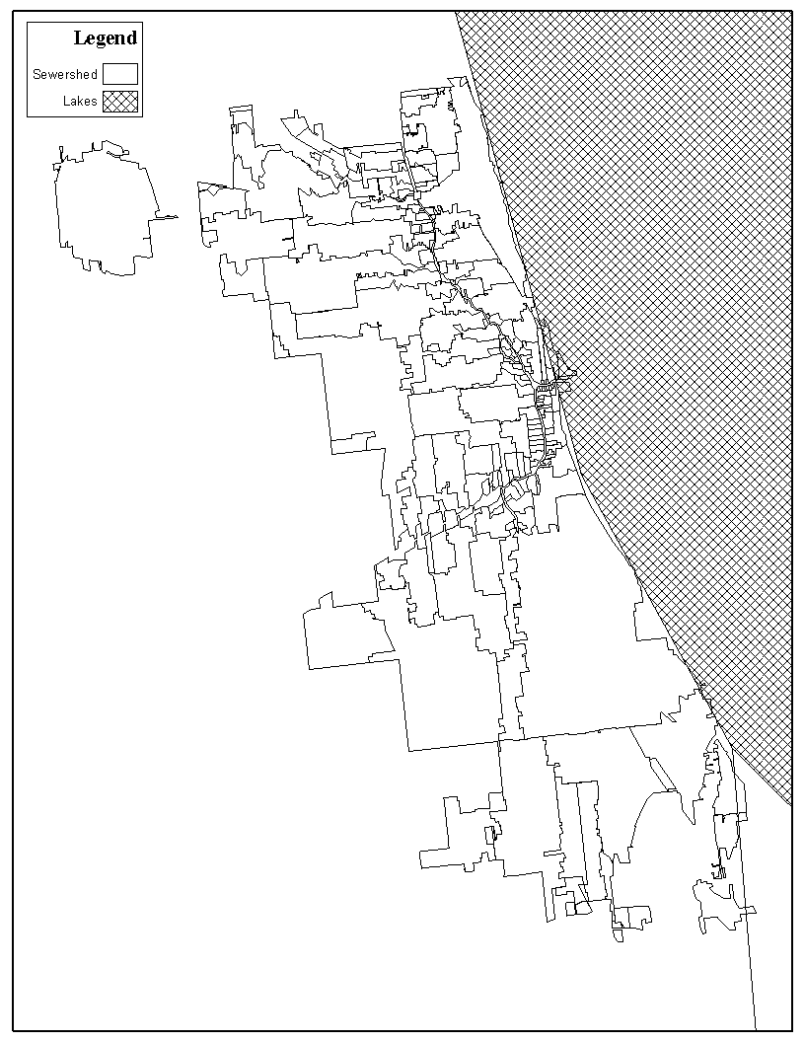
Modeling Urban Drainage in Chicago
City covers ~500 km²
Divided into ~200 hydrologic units (sewersheds)
  Area: 0.5–70 km²
Response time of sewersheds is very short (~minutes)
Existing rain gauge networks do not provide sufficient spatial and temporal resolution
Employ real-time radar-rainfall estimates

Slide 4
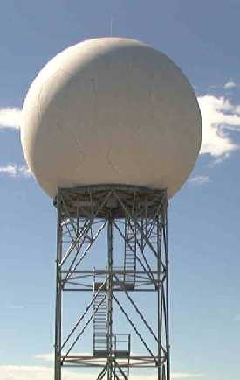
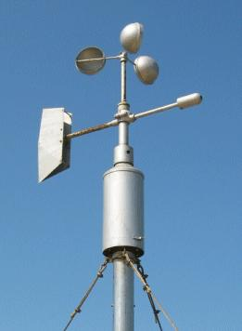

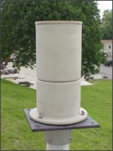

Virtual Sensors
What are virtual sensors?
  Abstraction of physical sensors/sensor networks that facilitates customization, cleaning, integration, fusion, and repurposing of real-time data streams
What can virtual sensor data streams represent?
  Indirect measurements (i.e., measurements of processes/conditions that are not directly measured by a physical sensor) derived from physical sensor data streams
  Fused measurements from a group of heterogeneous physical sensors
  Aggregated measurements from one or more physical sensors
  Cleaned measurements from physical sensors
  Meta-data tagged measurements indicating observations of interest
Real-time Physical Sensor
Data Streams
Real-time Virtual Sensor
Data Streams
Data cleaning
Transformation
Aggregation
Fusion

Slide 5
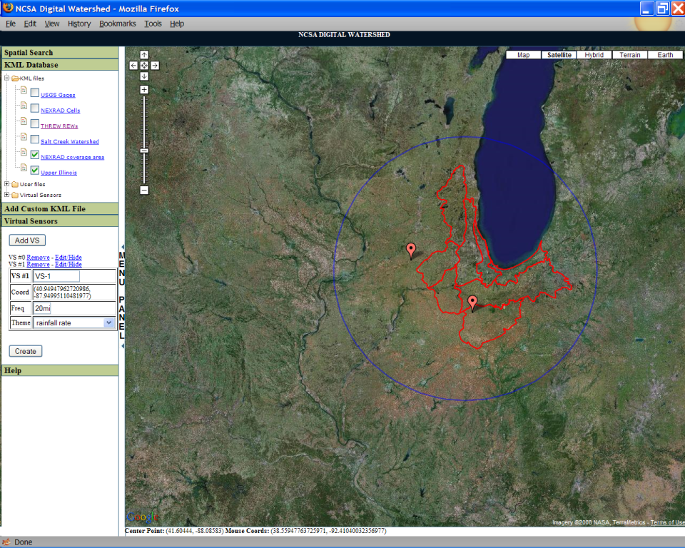
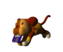

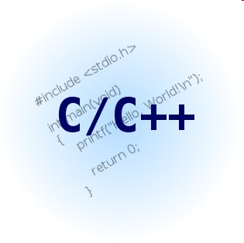

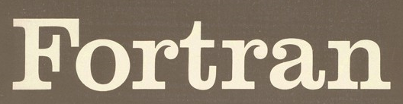





Prototype Virtual Sensor System
Virtual sensors are implemented as a workflow within the semantically enhanced digital watershed
VSM
Data Fetcher
Customizable Anomaly Filtering, Indirect Measurement Derivation, Fusion, or Aggregation Modules
Virtual Sensor Middleware
External Data Repositories
Google Map/AJAX Interface
CyberIntegrator Workflow
RESTfull webservice
Tupelo Managed Local Repositories

Slide 6
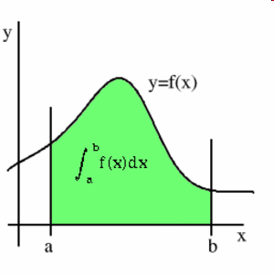
Virtual Point Precipitation Sensor
Define transformation when initializing new instance of virtual sensor
User specified point locations (GPS)
User specified time interval
User specified Z-R params
Interpret Radar Volume Scan
Interpolate reflectivity at points
LDM
Z-R
Data fetcher scours LDM repository every minute to see if new data have arrived
Interpreter reads Archive II file and extracts volume scan reflectivity data. Tested on Archive II V02 and Archive II V03 files
Perform Z-R conversion
Unidata Local Data Manager (LDM) repository receives Level II NEXRAD data from radar stations
Convert from local plane to WGS-84 coordinates.
Project lowest volume scan to ground
Distance weighted interpolation of Z
Integrate Z over time interval

Slide 7
Virtual Polygon Precip. Sensor
Define transformation when initializing new instance of virtual sensor
User specified geospatial polygon
User specified time interval
User specified Z-R params
Interpret Radar Volume Scan
Average reflectivity over polygon
LDM
Z-R
Data fetcher scours LDM repository every minute to see if new data have arrived
Interpreter reads Archive II file and extracts volume scan reflectivity data. Tested on Archive II V02 and Archive II V03 files
Perform Z-R conversion
Unidata Local Data Manager (LDM) repository receives Level II NEXRAD data from radar stations
Convert from local plane to WGS-84 coordinates.
Project lowest volume scan to ground
Uniformly sample polygon on 0.5x0.5km grid
Integrate Z over time interval

Slide 8
Radar/Raingauge-Based Rainfall Virtual Sensors
Get next available gauge measurements
Average over time period (ΔT)
Fuse Radar and Rainfall Data
Get next available radar image
Register radar pixels with gauge locations
Average over time period (ΔT)

Slide 9
Real-Time Fusion of Radar and Rain Gauge Measurements
Benefits
  Mitigate measurement errors associated with radar rainfall estimation
  Retain spatial resolution of radar measurements
Challenges
  Spatiotemporal varying relationship between radar and rain gauge measurements
    Z(i,t) = a(i,t)R(i,t)^{b(i,t)}
  Errors in rain gauge measurements can have significant impact on result

Slide 10
Real Time Rain Gauge Quality Control and Radar Bias Adjustment
Real-time Data Streams
Real-time assimilation of data into model of the sensor network
Estimate Z-R parameters for each gauge/radar pair
Create adjusted radar rainfall estimate
Real-Time Sensors
Estimate likelihood that gauge i is malfunctioning
Repair rain gauge i
Sensor error
Generate alerts to indicate that anomalies have been found
Human evaluation of anomalies
Modify sensing to observe phenomena in greater detail
Unusual phenomena

Slide 11
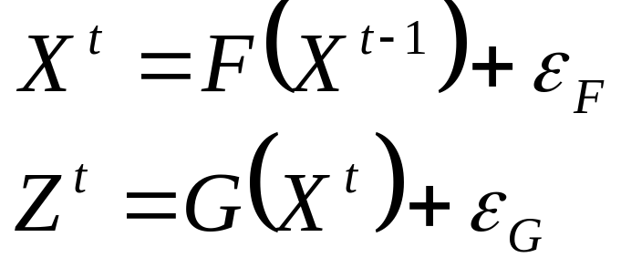
State-Space Modeling
Treats the true state of the real world as an uncertain quantity that is observable by noisy sensors
X^{t} is a vector of the system state variables at time t
F(…) is a model of the system dynamics
Z is a vector of measurements of the state variables
G(…) is a model of the relationship between the sensor observations and the true (but unknown) system state

Slide 12
Dynamic Bayesian Network (DBN)
F(X⁰)
F(X¹)
F(X^{t-1})
P(X⁰)
P(X¹|X⁰)
●●●
P(X^{t}|X^{t-1})
G(X⁰)
G(X¹)
G(X^{t})
P(Z⁰|X⁰)
P(Z¹|X¹)
P(Z^{t}|X^{t})
F(X^{t}) : Model of the temporal dynamics of the conditional distribution of X
G(X^{t}) : Model of the relationship between the state variables X and their measurements
DBNs are graphical representations of state space models and facilitate their solution
DBNs are “dynamic” because new nodes are added sequentially as time progresses

Slide 13
Learning Model Parameters Online
DBNs can model non-stationary processes and update forecasts given new data using a dynamics model F(X) and a measurement model G(X).
Parameters of these models (β_{F} and β_{G}, respectively) are learned online during anomaly classification using Expectation-Maximization (EM)
F(X^{t-1}, β^{t-1}_{F})
F(X^{t}, β^{t}_{F})
F(X^{t}, β^{t+1}_{F})
● ● ●
X_{t}
X_{t+1}
G(X^{t}, β^{t-1}_{G})
G(X^{t+1}, β^{t}_{G})
Z^{t}
Z^{t+1}
Max Pr( X⁰, … X^{t}, Z⁰, Z^{t}| β^{t}_{F}, β^{t}_{G})
Max Pr( X⁰, … X^{t+1}, Z⁰, Z^{t+1}| β^{t+1}_{F}, β^{t+1}_{G})

Slide 14
Model of Radar Rain Gauge Pairs
Maximum likelihood estimates of parameters A, B, Σ_{p,} Σ_{Z}, σ_{G,i}, and σ_{z,i} are learned on-line via expectation maximization
Model measurements with Gaussian Noise
Model time dynamics of log(Z_{t}) as 1st-order Markov process with log-normal noise – Solve sequentially via Kalman filtering
m_{R}^{t,0}
log(m_{R}^{t,i}) = log(z^{t,i}) + N[0,σ_{R,i}]
Use power law relationship between Z^{t} and P^{t} with log-normal noise
m_{R}^{t,N}
z^{t,0}
log(Z^{t}) = log(Z^{t-1}) + N[0,Σ_{Z}]
Model time dynamics of log(P_{t}) as 1st-order Markov process with log-normal noise – Solve sequentially via Kalman filtering
Convert ground-based rainfall P and atmospheric reflectivity Z into Gaussian random variables using log transform
z^{t,N}
log(Z^{t}) = Alog(P^{t}) + B + N[0,Σ_{z}]
p^{t,0}
log(P^{t}) = log(P^{t-1}) + N[0,Σ_{p}]
log(m_{G}^{t,i}) = log(p^{t,i}) + N[0,σ_{G,i}]
p^{t,N}
m_{G}^{t,0}
m_{G}^{t,N}
Z^{t} = [z^{t,0},…,z^{t,N}]^{T} : Reflectivity of atmosphere at time t at all gauge locations (i=0→N)
P^{t} = [p^{t,0},…,p^{t,N}]^{T}: Rainfall rate at ground at time t at all gauge locations (i=0→N)
m_{G}^{t,i}: Gauge measurement of ground level rainfall rate at time t, and i^{th} gauge location
m_{R}^{t,i}: Radar measurement of atmospheric reflectivity at time t, and i^{th} gauge location
Notes:
Rainfall is commonly modeled as a log-normal process (I gave a reference on the slide) – Thus, it can be transformed into a Gaussian process through a log transform (again a common practice among rainfall modelers).
Time dynamics of log(P) as a 1st order Markov process: Basically we are modeling the rainfall time-series as an ARMA-1 process. This type of model has been used for short lead-time (e.g. hours) forecasts of precipitation with some success. Beyond that, ARMA-1 models are have been successful for modeling other complex processes (especially financial data).
The accepted standard relationship between radar and rainfall is a power law (Z-R) relationship. It has a physical justification that relates to the drop-size distribution, and is used by the National Weather Service and atmospheric researchers alike (I gave a reference on the slide)
Rainfall is commonly modeled as a log-normal process (I gave a reference on the slide) – Thus, it can be transformed into a Gaussian process through a log transform (again a common practice among rainfall modelers).
Time dynamics of log(P) as a 1st order Markov process: Basically we are modeling the rainfall time-series as an ARMA-1 process. This type of model has been used for short lead-time (e.g. hours) forecasts of precipitation with some success. Beyond that, ARMA-1 models are have been successful for modeling other complex processes (especially financial data).
The accepted standard relationship between radar and rainfall is a power law (Z-R) relationship. It has a physical justification that relates to the drop-size distribution, and is used by the National Weather Service and atmospheric researchers alike (I gave a reference on the slide)

Slide 15
Anomaly Detection via Bayesian Filtering
Filtering infers the distribution of the current system state variables given all previous and current measurements
Anomaly classification performed using Bayesian Credible Interval (BCI)
  BCI indicates range of plausible values for observed variables
  Measurements that fall outside of p% BCI classified as anomalous
Notes:
Bayesian filtering is a promising approach for performing real-time anomaly detection on streaming data

Slide 16
Case Study
Detecting errors in five real-time, telemetered, tipping bucket rain gauges
  Failed transmission – identified by telemetry software
  Missed tips – rare
  False zeros – primary concern
Currently error detection is performed by manual comparison of the gauge data to radar-rainfall estimates
These data are used for real-time flood forecasting by the USGS

Slide 17
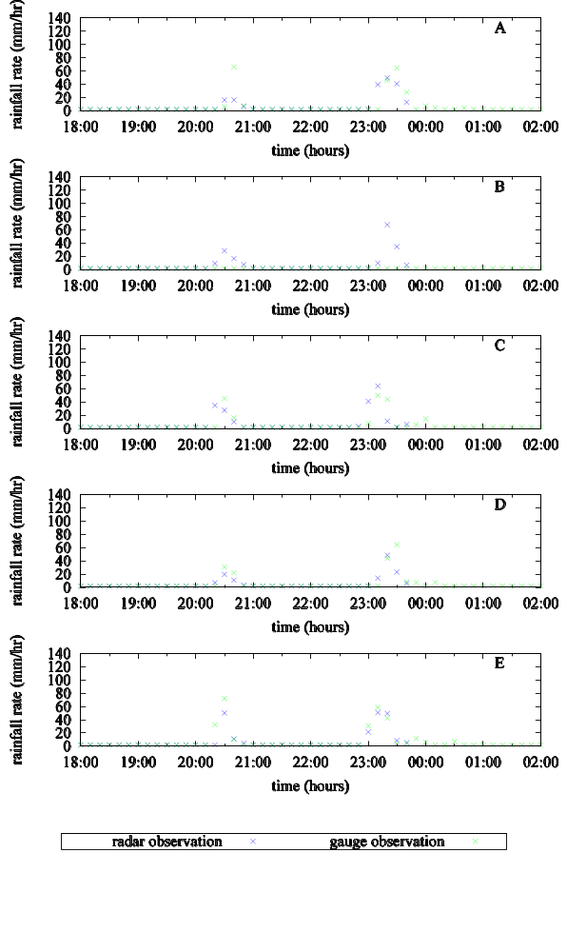
Example Data Including Sensor Malfunction
Gauge and radar data are highly correlated
Radar goes offline around 00:00
Gauge B is not operating properly and fails to measure any rain during event between 20:00 and 00:00

Slide 18
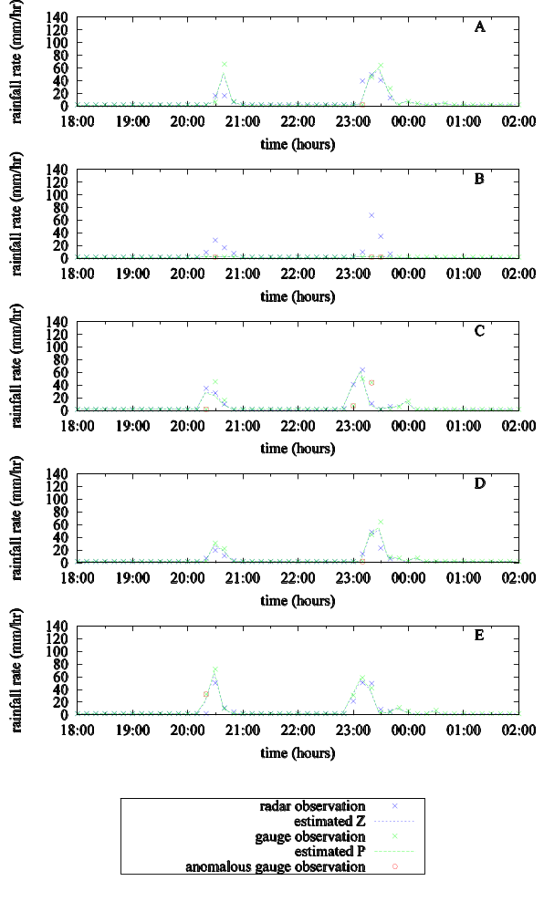
Anomaly Classification
Correctly identifies many of the errors associated with the gauge B failure
Classifies several other data as anomalous because of large deviations between gauge and radar observations
Except for gauge B, the estimates of the rainfall are plausible
  Estimator is not robust to errors in gauge (not explicitly modeled)

Slide 19
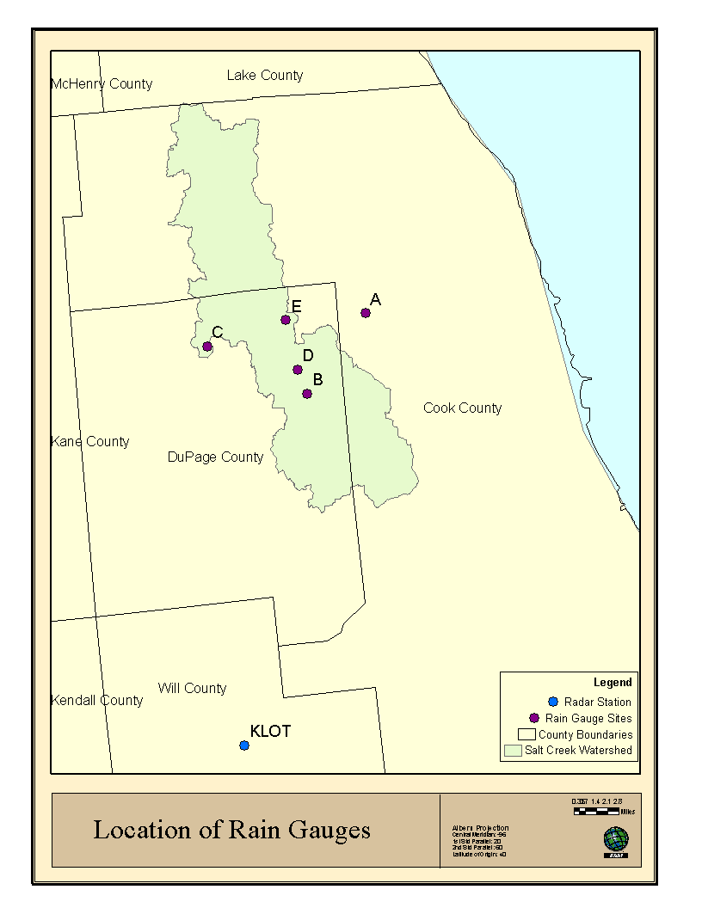
Gauge Adjustment of Z-R Parameters
Table 1: Parameters for the relationship Z=aR^{b} learned by EM for May-August for each gauge location compared with the standard convective parameters.
Gauge Location | a | b
A | 304 | 1.30
B | 306 | 1.40
C | 304 | 1.40
D | 304 | 1.40
E | 304 | 1.40
standard convective | 300 | 1.40

Slide 20
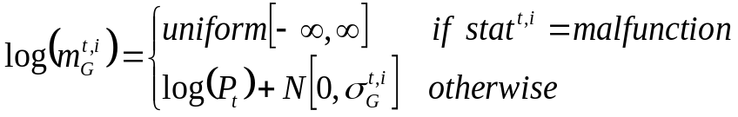
Improved Radar RainGauge Model
m_{R}^{t,0}
m_{R}^{t,N}
log(m_{R}^{t,i}) = log(z^{t,i}) + N[0,σ_{R,i}]
z^{t,0}
log(Z^{t}) = log(Z^{t-1}) + N[0,Σ_{Z}]
z^{t,N}
log(Z^{t}) = Alog(P^{t}) + B + N[0,Σ_{z}]
p^{t,0}
log(P^{t}) = log(P^{t-1}) + N[0,Σ_{p}]
p^{t,N}
log(m_{G}^{t,i}) = log(p^{t,i}) + N[0,σ_{G,i}]
m_{G}^{t,0}
m_{G}^{t,N}
stat^{t,0}
stat^{t,N}
Z^{t} = [z^{t,0},…,z^{t,N}]^{T} : Reflectivity of atmosphere at time t at all gauge locations (i=0→N)
P^{t} = [p^{t,0},…,p^{t,N}]^{T}: Rainfall rate at ground at time t at all gauge locations (i=0→N)
m_{G}^{t,i}: Gauge measurement of ground level rainfall rate at time t, and i^{th} gauge location
m_{R}^{t,i}: Radar measurement of atmospheric reflectivity at time t, and i^{th} gauge location
Notes:
Rainfall is commonly modeled as a log-normal process (I gave a reference on the slide) – Thus, it can be transformed into a Gaussian process through a log transform (again a common practice among rainfall modelers).
Time dynamics of log(P) as a 1st order Markov process: Basically we are modeling the rainfall time-series as an ARMA-1 process. This type of model has been used for short lead-time (e.g. hours) forecasts of precipitation with some success. Beyond that, ARMA-1 models are have been successful for modeling other complex processes (especially financial data).
The accepted standard relationship between radar and rainfall is a power law (Z-R) relationship. It has a physical justification that relates to the drop-size distribution, and is used by the National Weather Service and atmospheric researchers alike (I gave a reference on the slide)
Rainfall is commonly modeled as a log-normal process (I gave a reference on the slide) – Thus, it can be transformed into a Gaussian process through a log transform (again a common practice among rainfall modelers).
Time dynamics of log(P) as a 1st order Markov process: Basically we are modeling the rainfall time-series as an ARMA-1 process. This type of model has been used for short lead-time (e.g. hours) forecasts of precipitation with some success. Beyond that, ARMA-1 models are have been successful for modeling other complex processes (especially financial data).
The accepted standard relationship between radar and rainfall is a power law (Z-R) relationship. It has a physical justification that relates to the drop-size distribution, and is used by the National Weather Service and atmospheric researchers alike (I gave a reference on the slide)

Slide 21
Improved Radar Rain Gauge Model
Benefits:
  Make estimator robust to errors in gauge
  Permit estimation of the likelihood that a gauge has failed
  Gauge failure can be estimated using maximum a posteriori (MAP) estimate of the variable stat^{t,i}
Drawbacks:
  Estimation must employ approximations
  Estimation will be more costly in terms of time

Slide 22
Non-Stationary Model Parameters
Z-R relationship can change dynamically
Use moving window of size (w) for learning DBN parameters with EM
X^{t-w+1}
X^{t-w+2}
X^{t}
F(X^{t}, β^{t}_{F})
X^{t+1}
F(X^{t+1}, β^{t+1}_{F})
● ● ●
G(X^{t}, β^{t-1}_{G})
G(X^{t+1}, β^{t}_{G})
Z^{t-w+1}
Z^{t-w+2}
● ● ●
Z^{t}
Z^{t+1}
Max Pr( X^{t-w+1}, … X^{t}, Z^{t-w+1}, Z^{t}| β^{t}_{F}, β^{t}_{G})
Max Pr( X^{t-w+2}, … X^{t+1}, Z^{t-w+2}, Z^{t+1}| β^{t+1}_{F}, β^{t+1}_{G})

Slide 23
Conclusions
DBN modeling of radar rain gauge pairs shows promise for real-time gauge QA/QC
By learning DBN parameters on-line using EM we can determine “best” Z-R relationship over learning window

Slide 24
Future Work
Implement version of DBN that includes random variable for status of each rain gauge.
Investigate the use of finite windows for learning the Z-R parameters.
Test our method on a larger gauge network to investigate the effect of spatially varying biases which were not apparent the case study presented here.
Test our method on a suite of storms with different characteristics to investigate the behavior of the method when faced with different types of rainfall events and to investigate the behavior of the radar biases during these storms.
Develop virtual sensor based on radar and gauges employing on-line bias adjustment procedure
Harden current virtual sensor software and deploy in research community
Notes:
Precip dynamics: The modeling part isn’t too difficult – use a full rank matrix instead of a diagonal one. However, inserting this model into the parameter learning framework is the difficult part.
Reflectivity dynamics: This is twice difficult. First the Bayesian updates will have to be changed, because information will now flow from the previous time to the current time and from one physical property (e.g. rainfall) to another (e.g. reflectivity), so the value of these information sources will have to be determined and a robust estimate created before the measurement update is performed. Second, inserting this model into the parameter learning framework will be even more challenging than for the precip dynamics model.

Slide 25
Acknowledgements
Department of Civil and Environmental Engineering at the University of Illinois at Urbana Champaign.
  Barbara Minsker
National Center for Supercomputing Applications
  Yong Liu, Jim Myers, Luigi Marini, Joe Futrelle, Alejandro Rodriguez, Terry McLaren
United States Geological Survey Illinois Water Science Center
  Tom Over, David Fazio, Terry Ortel, and Audrey Ishii
This work is supported by the University of Illinois Vice Chancellor for Research (VCR), the National Center for Supercomputing Applications (NCSA), and the Department of Civil and Environmental Engineering.

