Slide 1
When Being Right Doesn't Pay
"The Brier score is an absolute metric, while the averaged return score is a relative metric."
— Sida Li, Prophet Arena Team (PM-RANK 0.3.1)
ProphetHacks 2026 · Forecasting Track · University of Chicago
Built on Snowflake · Wafer.ai · Kalshi · Prophet Arena

Slide 2
Two Metrics. Opposite Incentives.
Brier Score
AVER
Absolute accuracy
Relative edge vs the market
How close were your probabilities to the actual outcome?
Strategy that works:
Copy the market price — it already reflects collective wisdom.
Problem:
If you are the market, you earn nothing above the market.
How much did you profit vs. just copying the Kalshi market price?
Key property:
If p = q (market), AVER = 0 by definition. You need to deviate correctly to win.
Problem:
Every wrong deviation from the market burns both AVER and Brier.
⚡
Tension
PM-RANK 0.3.1 puts it directly: "A has a higher Brier Score, but lower returns." — This is the design brief.

Slide 3
Every Naive Approach Fails on One Metric — or Both
❌ "Just copy Kalshi"
❌ "Ask one LLM"
Brier: decent (~0.41)
AVER: 0.000 (zero edge, always)
You cannot beat a market by being a market.
If p = q, then log(p/q) = 0 every time. You earn nothing above the baseline.
Brier: burns when it drifts (~0.53)
AVER: −0.31 (deviates wrong)
LLMs deviate from markets without any ground truth to anchor them.
No memory of resolved markets. No sense of where the market is already right.
VS
You can't be a forecaster by being a mirror. But you can't win by guessing, either.

Slide 4
Our Solution: A Market-Aware Meta-Calibrator
Question + Market Price
3 LLM Models (parallel)
Snowflake Memory
Calibrator (AutoML #1)
α-Policy (AutoML #2)
Final Prob.
Judge harness sends OpenAI request
GLM-5.1 · Qwen 397B Qwen 35B · disagreement σ²
2,548 resolved markets vector similarity · base rate
Trained on resolved labels. Brier-aware.
"When to trust us vs. trust the market"
The α-policy is the key innovation:
p_final = α × p_calibrated + (1 − α) × q_market
α is learned per-market — based on model disagreement, neighbor count, and question category.

Slide 5
Snowflake Is the Brain — Not the Filing Cabinet
①
HISTORICAL_MARKETS
2,548 resolved Kalshi markets — question text, market prices, outcomes, timestamps. The ground truth every model trains on.
Institutional Memory
②
EMBED_TEXT_768 (Cortex)
Question embeddings computed natively by Snowflake Cortex. No data leaves Snowflake. 768-dimensional vectors, per market.
Vectorised Inside the Warehouse
③
VECTOR_COSINE_SIMILARITY
At inference: embed the new question, find top-15 similar resolved markets, aggregate their outcomes into a base rate.
Live Neighbor Retrieval
④
ML.CLASSIFICATION + ML.REGRESSION
One model corrects raw LLM probabilities (Brier). A second learns when to deviate from the market price (AVER).
Two AutoML Models — Calibrator & α-Policy
⑤
Streamlit-in-Snowflake (SiS)
Live forecast · Brier vs AVER Pareto · By-category results · Institutional Memory search — all reading the same Snowflake tables.
Judge-Facing Dashboard — 4 Tabs
Five distinct Snowflake surfaces. One shared catalog. No shadow databases.

Slide 6
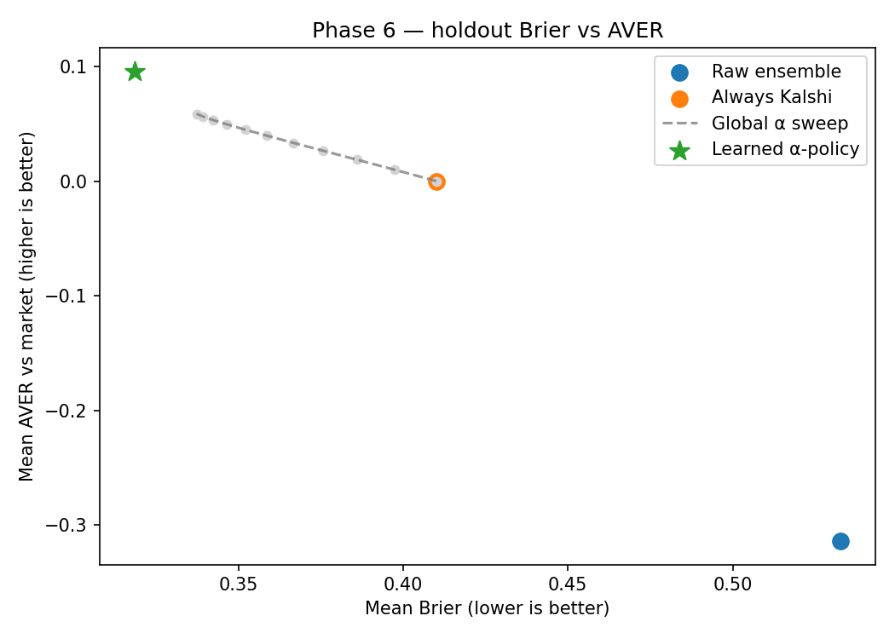
Result: We Win on Both Metrics — Simultaneously
Strategy
Brier ↓
AVER ↑
Raw Ensemble (3 LLMs)
0.533
-0.314
Always Kalshi (baseline)
0.410
+0.000
Best Fixed Global α
0.337
+0.059
★ Learned α-Policy (ours)
0.319
+0.096
22% better Brier than the market
AND positive AVER — both at once.
The learned policy beats a fixed dial on both axes.

Slide 7
Built to Be Judged — Three Ways to Verify
🔌
📊
📋
OpenAI-Compatible Endpoint
Streamlit-in-Snowflake
Full Audit Trail
POST /v1/chat/completions
4-tab live dashboard
AGENT_PREDICTIONS table
Plug-and-play with the Prophet Arena judge harness. No custom glue required.
Live forecast · Pareto plot · By-category · Institutional Memory search — same Snowflake tables.
Every request logged to Snowflake: ensemble, neighbors, calibrator output, alpha, final prob.
curl -sS -X POST http://localhost:8000/v1/chat/completions \ -H "Content-Type: application/json" \ -d @tests/fixtures/sample_event.json # → {"probabilities": [0.48, 0.52], "prophet_debug": {...}}

Slide 8
Thank You
ProphetHacks 2026 — University of Chicago
Snowflake
Wafer.ai
Kalshi
Prophet Arena
Compute · Cortex · AutoML · SiS
Multi-model LLM ensemble
Historical market data
Evaluation harness & benchmark
Brier ↓ 22% vs market baseline · AVER +0.096 vs 0.000 · Both, simultaneously.
github.com/[your-repo] · ./run.sh → agent live in under 30 seconds
UncommonHacks 2026

