Slide 1
Capstone Project - The Battle of Neighborhoods
Vegan/Vegetarian restaurants in New York

Slide 2
Bussiness Purposes
Find is the best location for a Vegan/Vegetarian restaurant in New York City
In what Neighborhood should I open a Vegan/Vegetarian restaurant to maximize chance of being successful?
The hint map where tourists/natives can find the biggest number of Vegan/Vegetarian restaurants
According to Top Trends in Prepared Foods 2017 report 8% of the US population is vegeterian and 6% of the US population is vegan.

Slide 3
Data Acquisition
Data Source containing information about NY neighborhoods: https://cocl.us/new_york_dataset
Foursquare API: get venues with vegan/vegatarian restaurants

Slide 4
Algorithms steps
Collect the New York city data
Using Foursquare API get all venues for each neighborhood. Filter out all venues which are under category id for Vegetarian/Vegan food.
Data Visualization and some statistical analysis.
Visualize the neighborhood with several Vegan/Vegetarian Restaurants.
Compare the Neighborhoods to Find the Best Place for Starting up a Restaurant

Slide 5
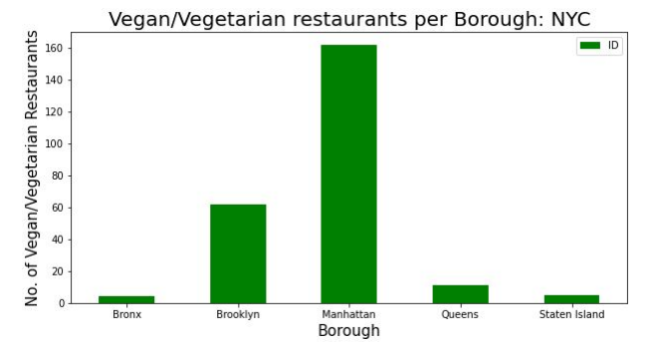
Vegan/Vegetarian restaurants per Borough

Slide 6
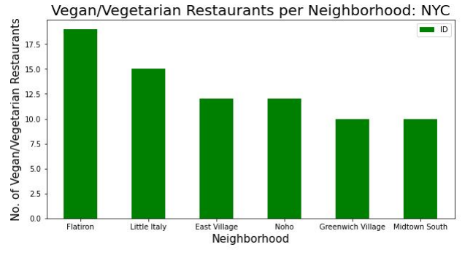
Vegan/Vegetarian restaurants per Neighborhood

Slide 7
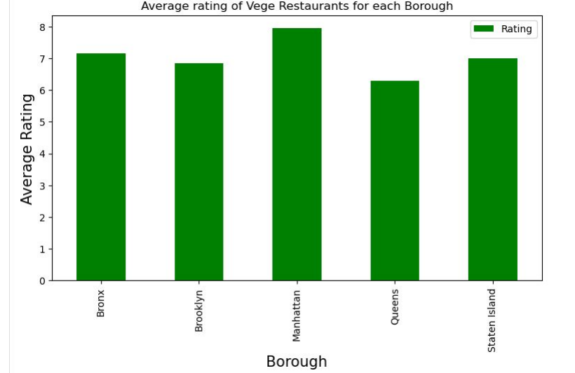
Rating vs Borough

Slide 8
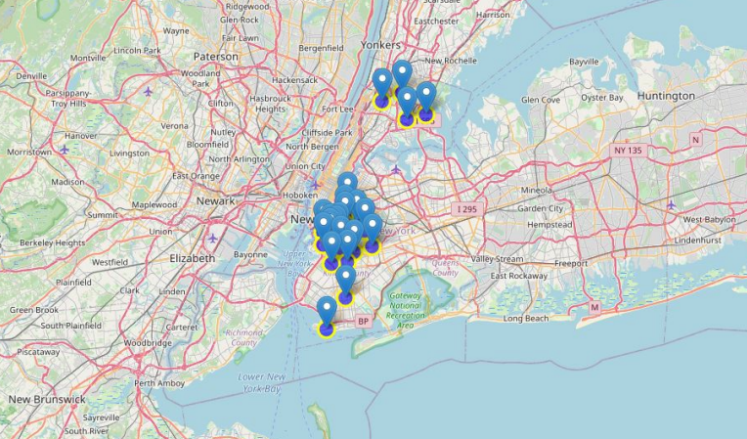
The distrubition of vegan/vegetarian restaurants

Slide 9
Results
The best place to run or find a vegan/vegetarian in NY restaraunt is Manhattan
Green restaurants cound be open in Manhattan or Brooklyn
Brooklyn has multiple neighborhoods with average ratings exceeding 8.0 on a scale of 1.0 to 10.0 and has a smaller number of Vege food than Manhattan, making competition easier

