Slide 1
Data Visualization
data
visual
encodings
graphic

Slide 2
viz libraries implement the arrows
Assemble
Transform

Slide 3
Constraint Preserving Arrows

Slide 4
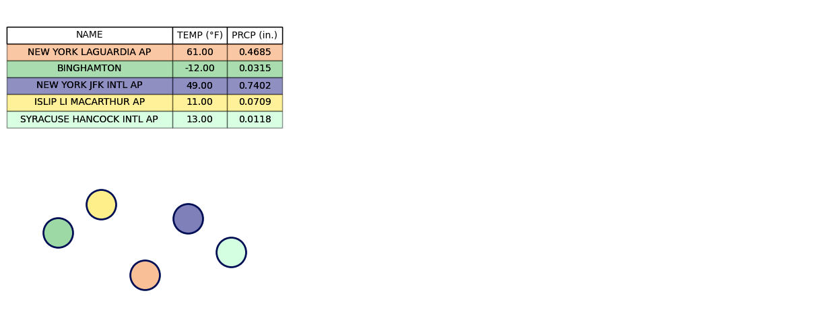

Slide 5
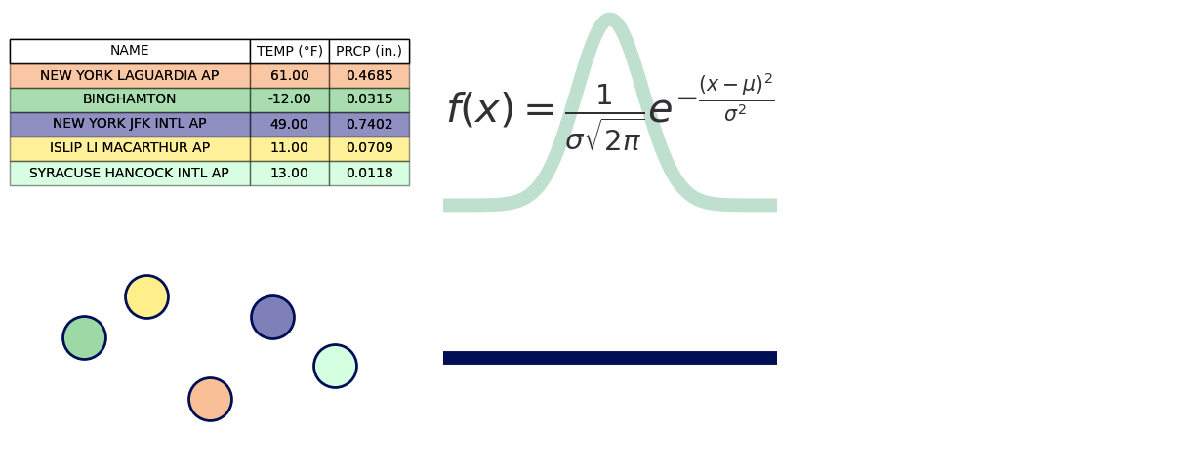

Slide 6
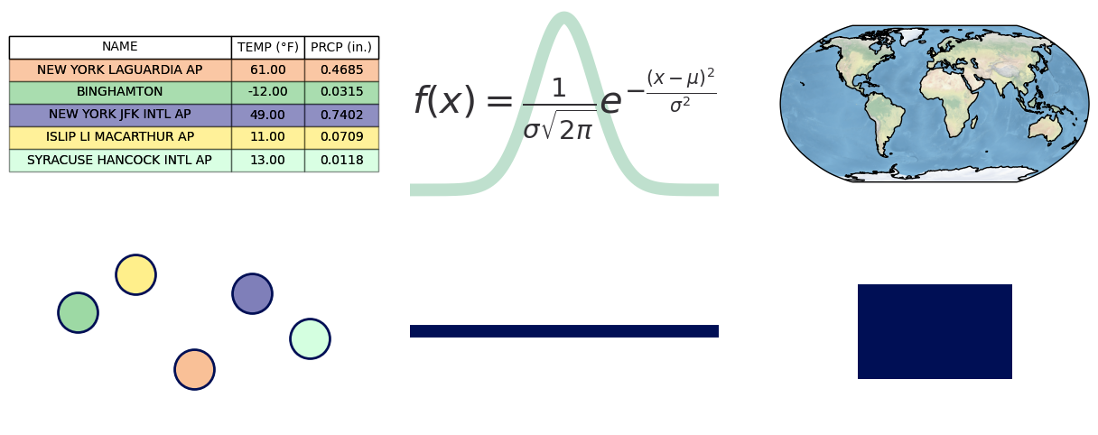

Slide 7
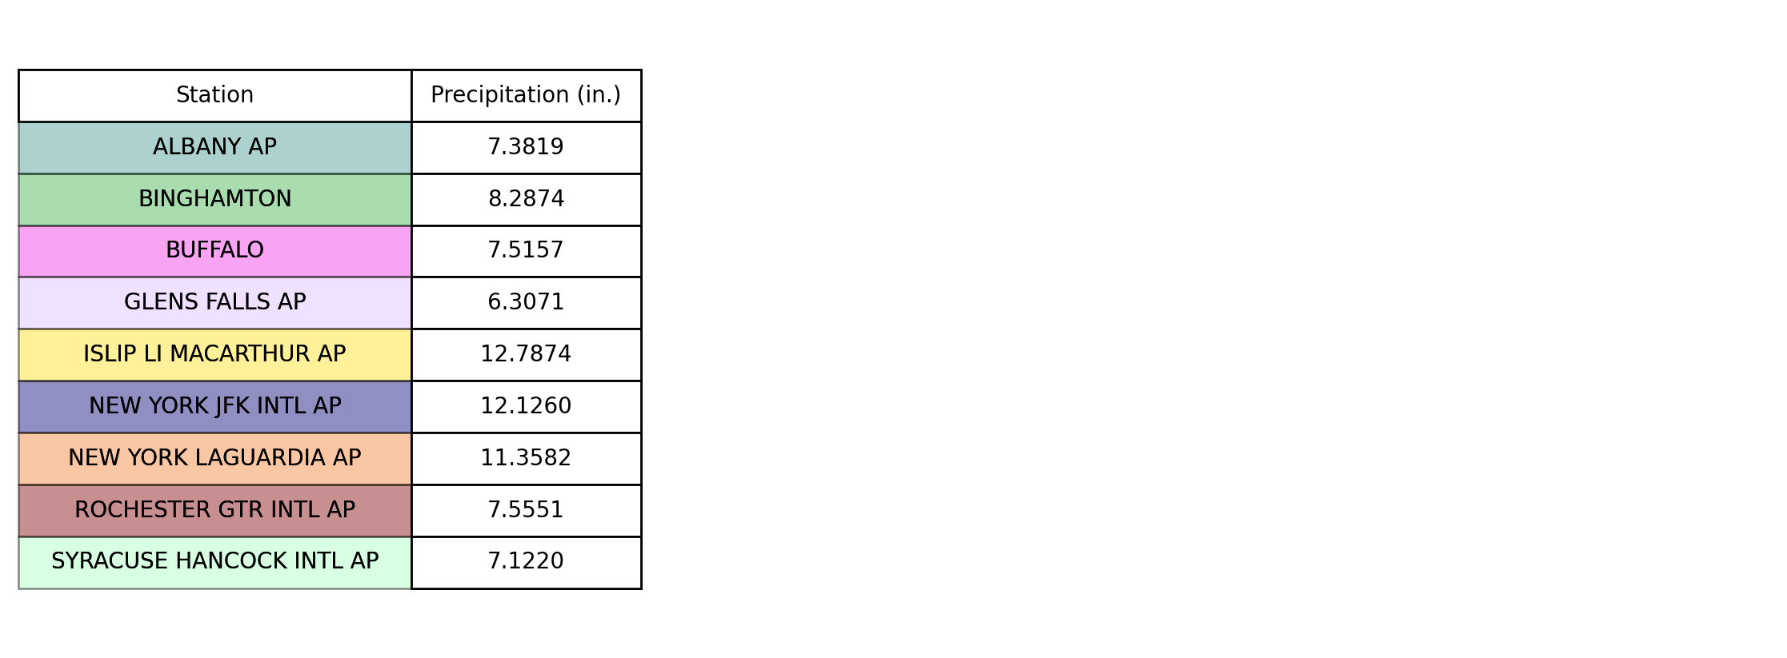

Slide 8
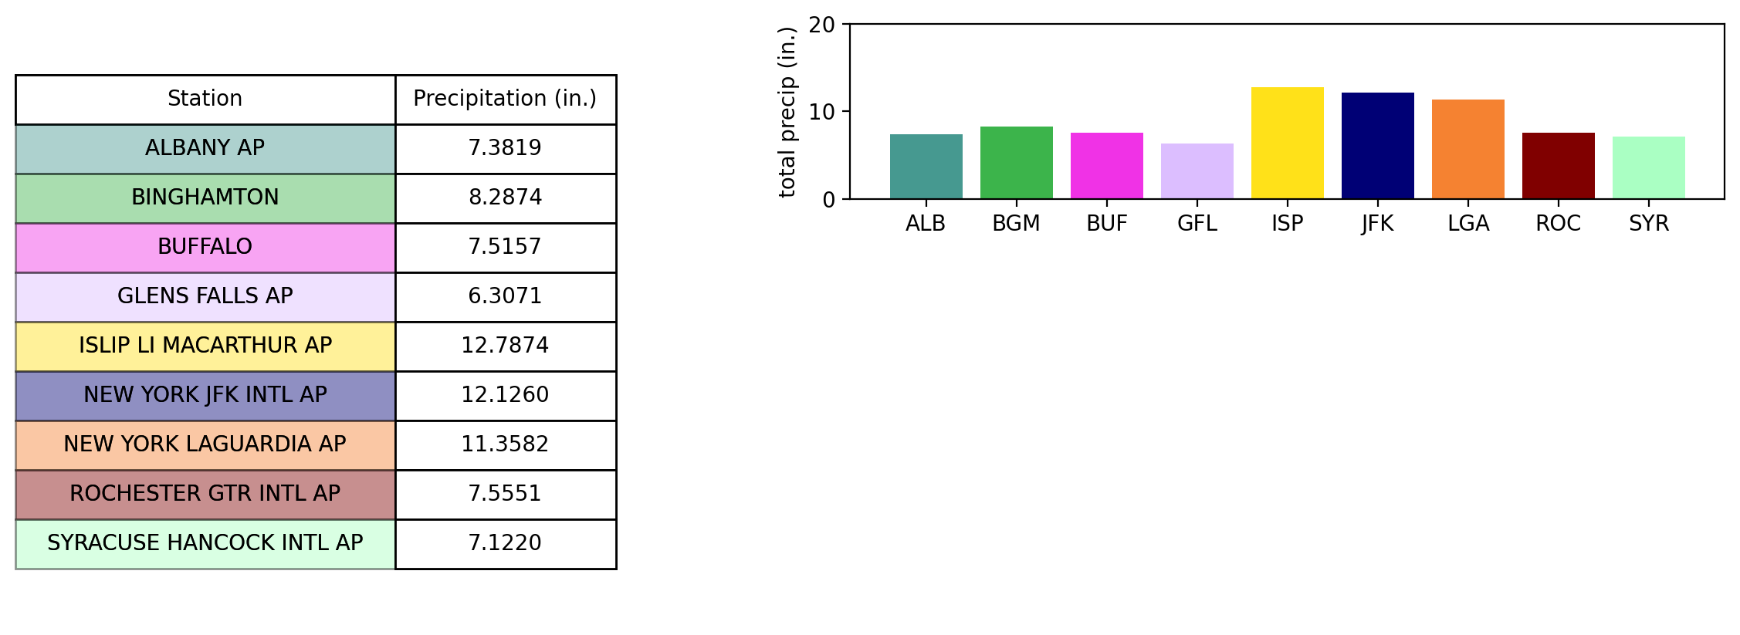

Slide 9
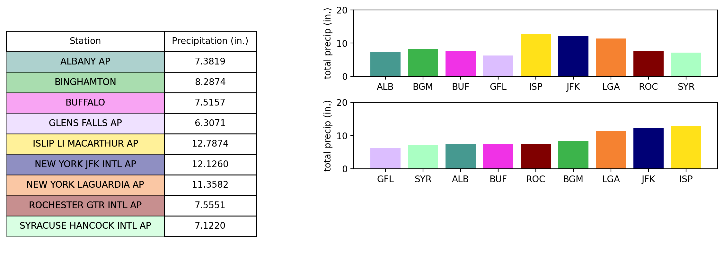

Slide 10
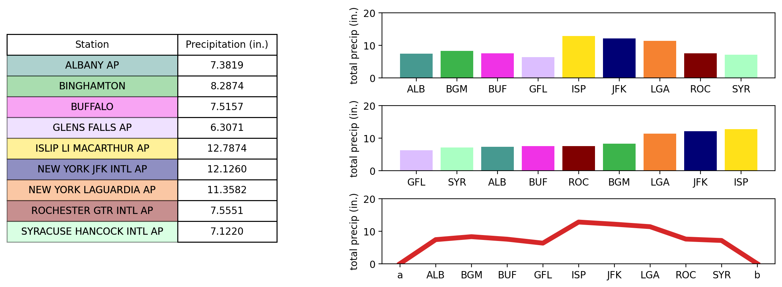

Slide 11
How is this continuity preserved
Data
Graphic

Slide 12
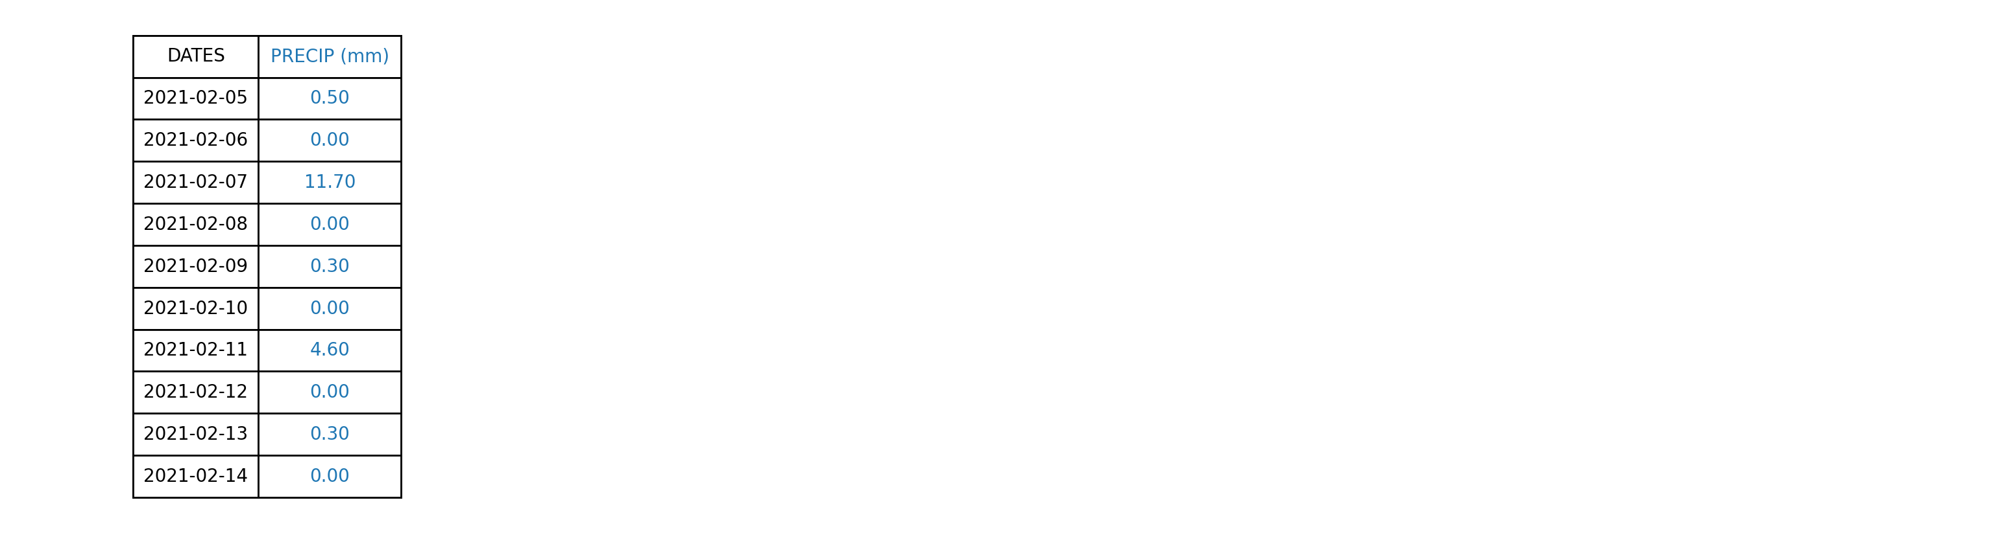

Slide 13
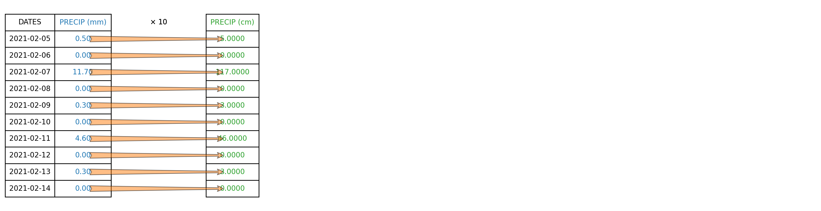

Slide 14
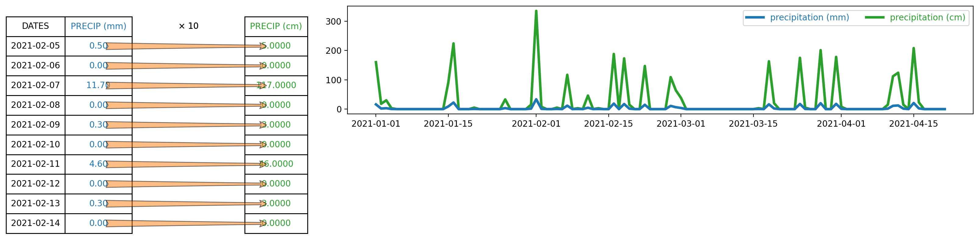

Slide 15
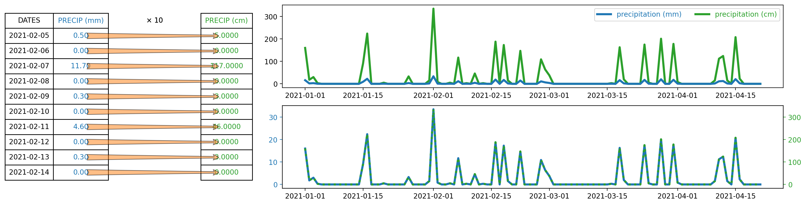

Slide 16
viz libraries implement the arrows
Data
Visual
Assemble
Graphic
Transform

Slide 17
What sorts of viz are easier in this framework?

Slide 18
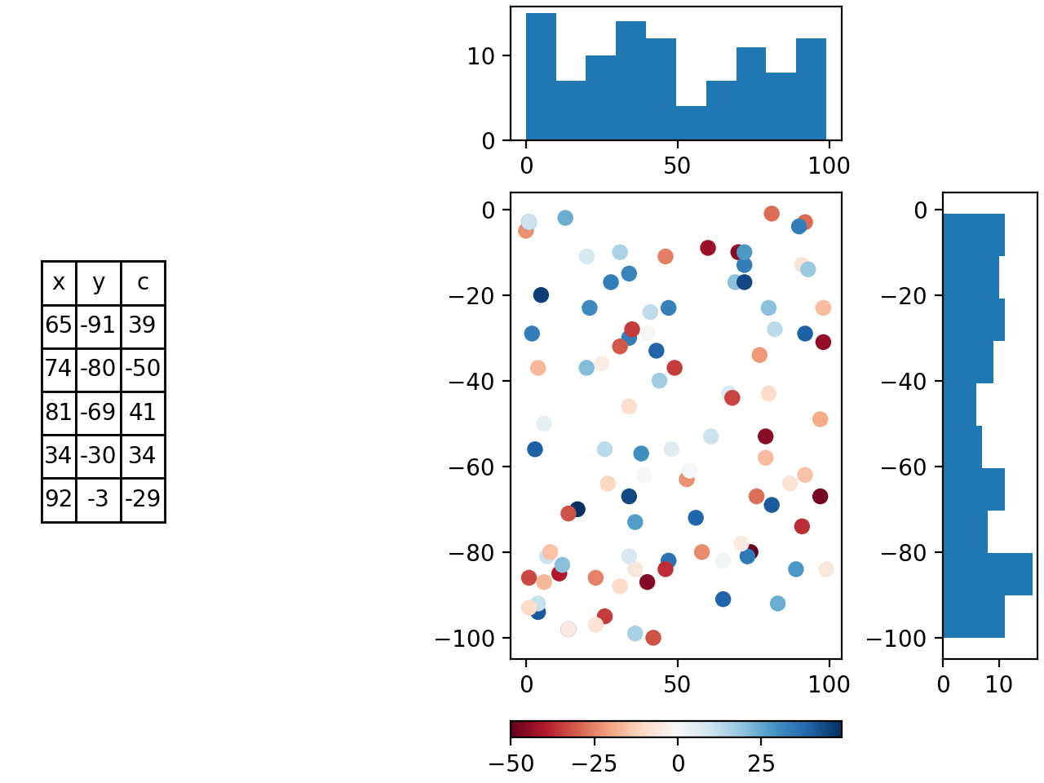

Slide 19


Slide 20






Slide 21
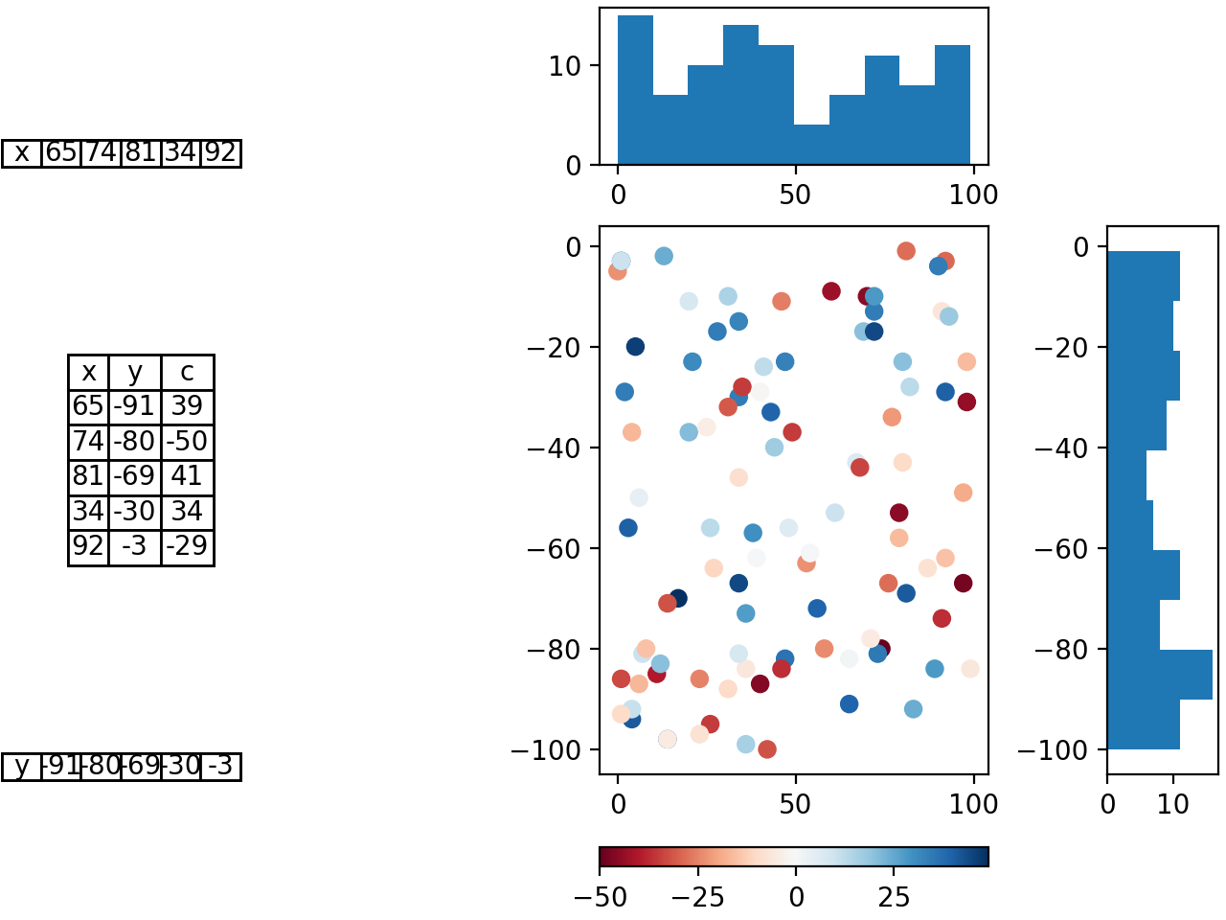





Slide 22










Slide 23
Artist

Slide 24
Equivariant Continuity Preserving Maps

Slide 25
Topological Equivariant Artist Model

Slide 26
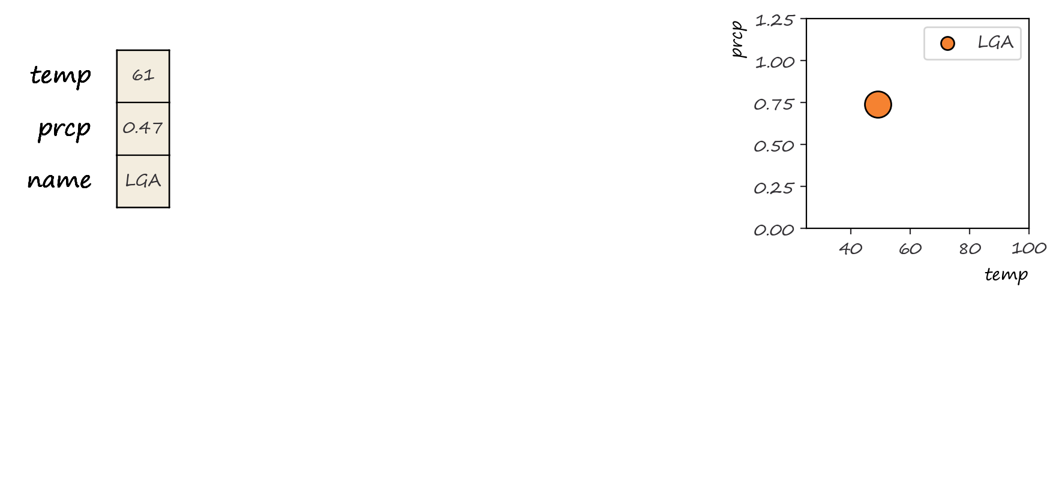
Notes:
How do we go from data to graphic? Here, we drill down to a single data point and its equivalent graphic

Slide 27
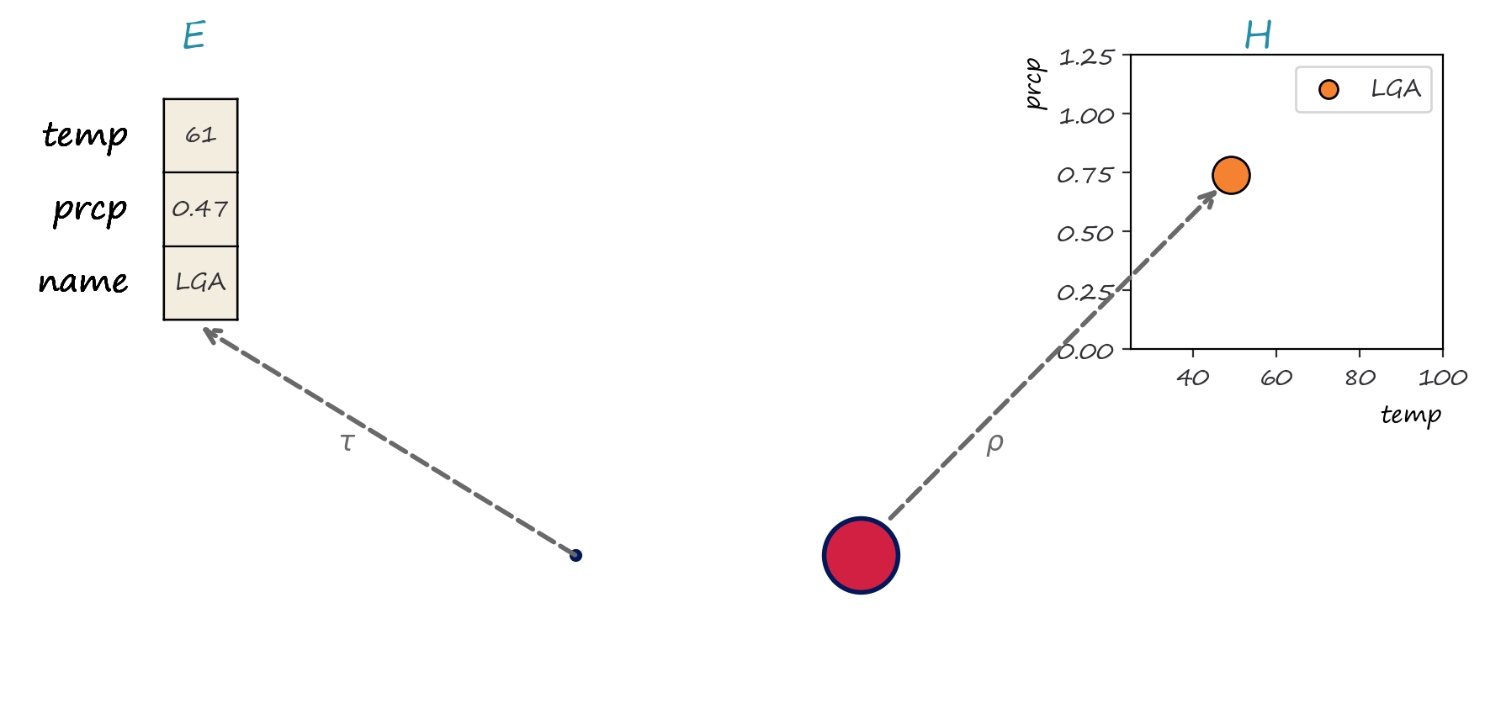
Notes:
We model the data and graphic using fiber bundles. Fiber bundles are topolological structures that allow us to encode the schema as the fiber, the continuity as the base space of the bundle, and binding maps between the two as sections

Slide 28
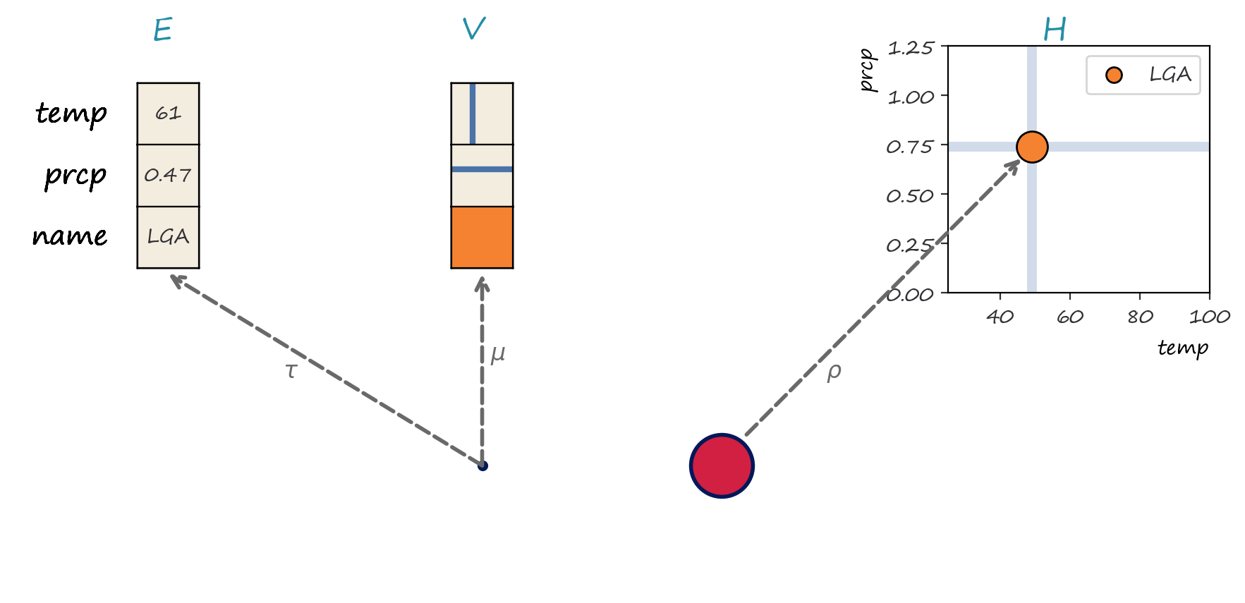
Notes:
To get from data to graphic, are architecture separates visual encodings into a stand alone intermediate bundle

Slide 29
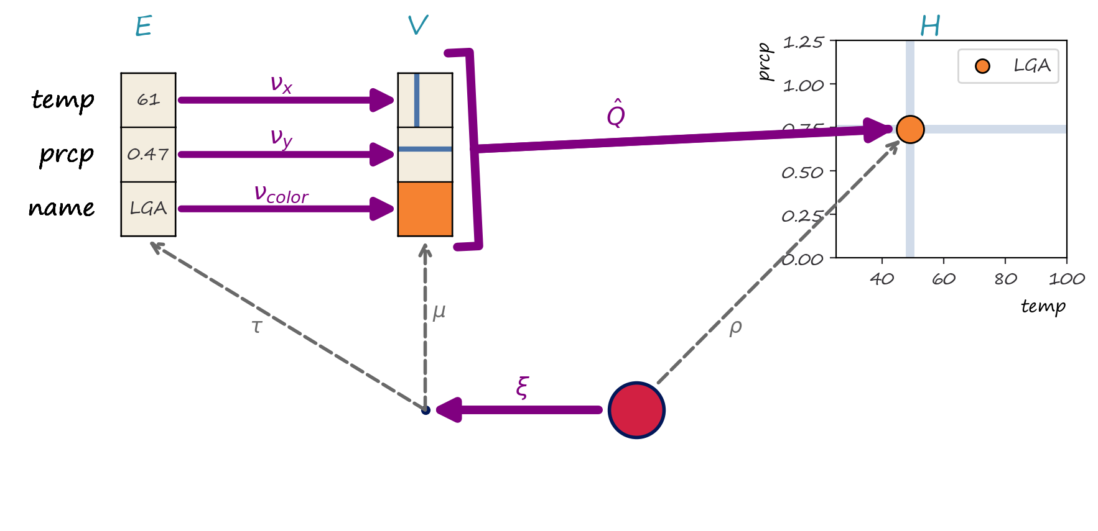
Notes:
We then model the data to graphic transformation as the set of maps between bundles. As shown here, these maps act on sections, which means that every field in the data point is included in the visual encoding and assembly into visual element stages. Components that map graphic to data, such as many interactiions, are constrained such that the have to preserve the location of every point k relative to the other points in the map

Slide 30
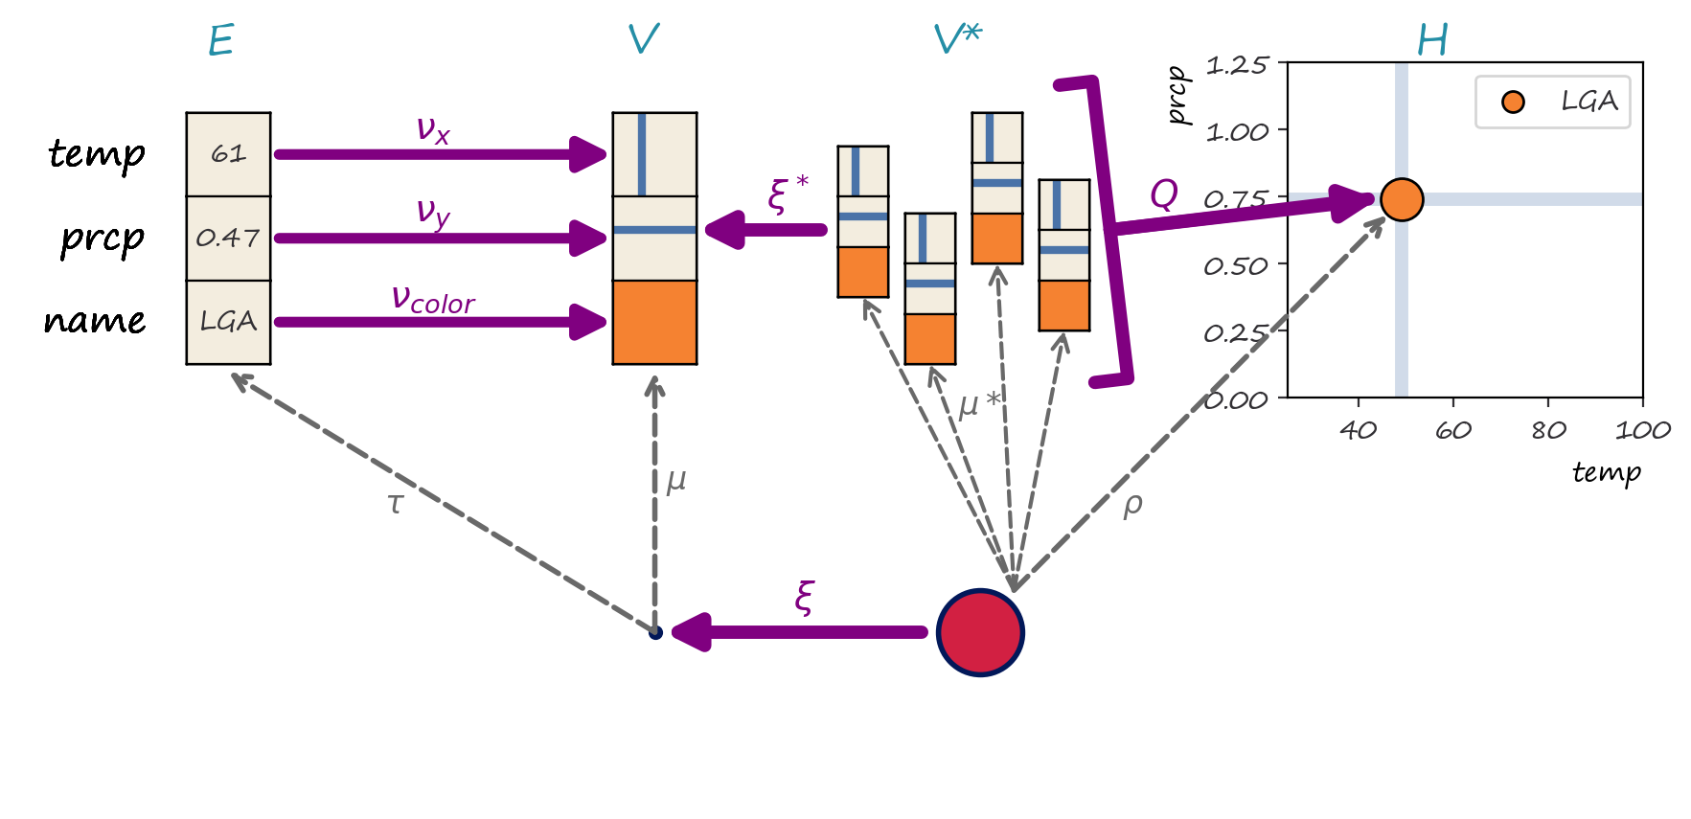
Notes:
Every data point takes up a region in screen space, so the visual encoding for the data is mapped over the whole region S and then assembled into the visual element.

