Slide 1
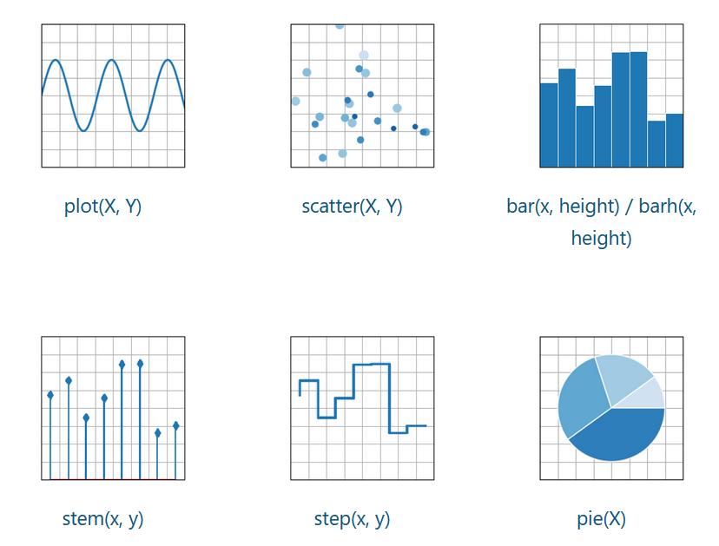
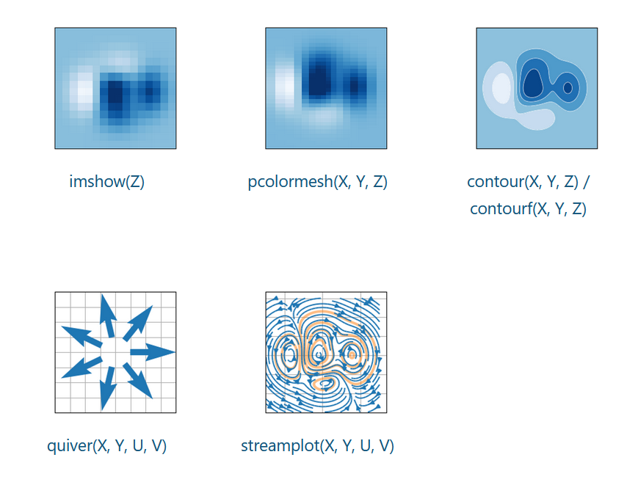
What does a visualization library do?

Slide 2
What does a visualization library do?
data
visual
encodings
graphic

Slide 3
map from data to graphic

Slide 4
What is a visualization library?
Assemble
Transform

Slide 5
can we improve how these maps are implememented?

Slide 6
What properties do these arrows preserve?
Assemble
Transform

Slide 7
Topology
Data
Graphic

Slide 8
Topology

Slide 9
Topology

Slide 10
Topology
Data
Graphic

Slide 11
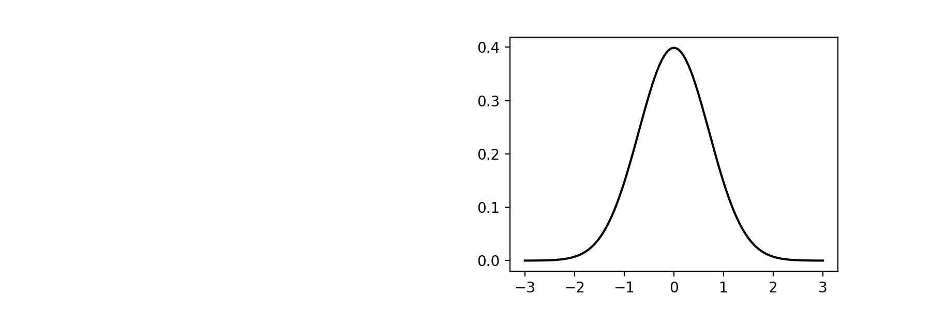
What does it mean to preserve topology?

Slide 12
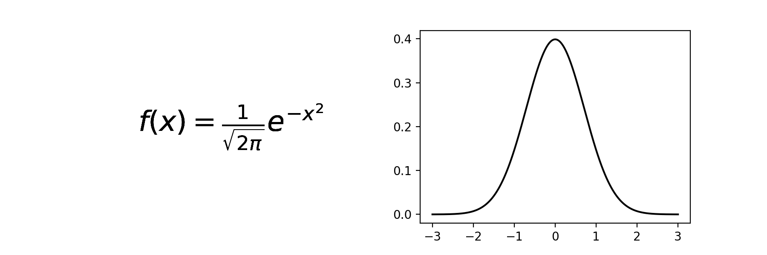

Slide 13
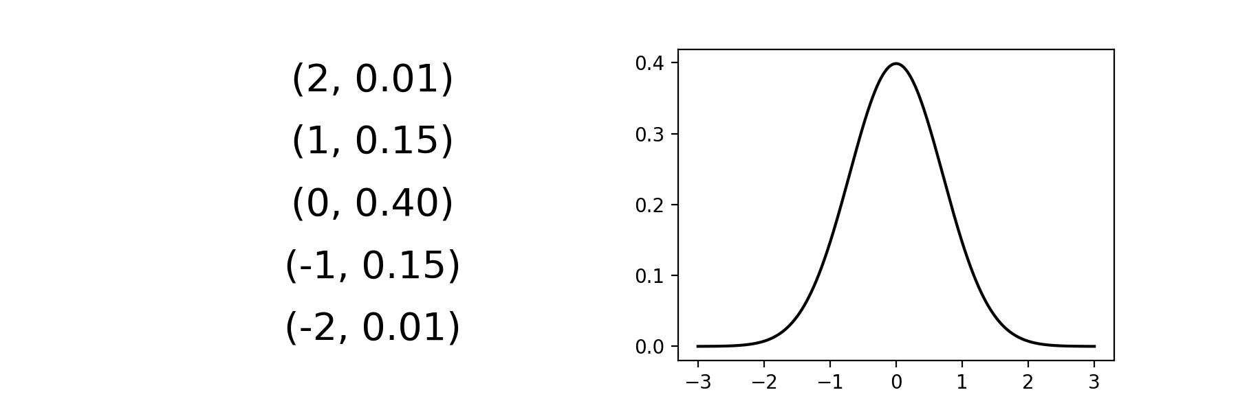

Slide 16

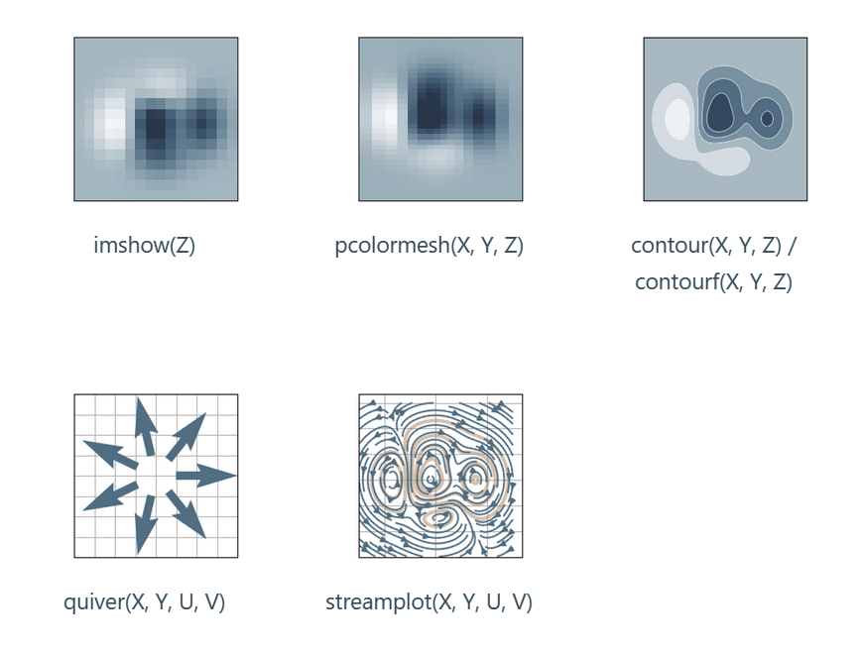
Equivariance

Slide 17
Equivariance
Data
Visual
Assemble
Graphic
Transform

Slide 18
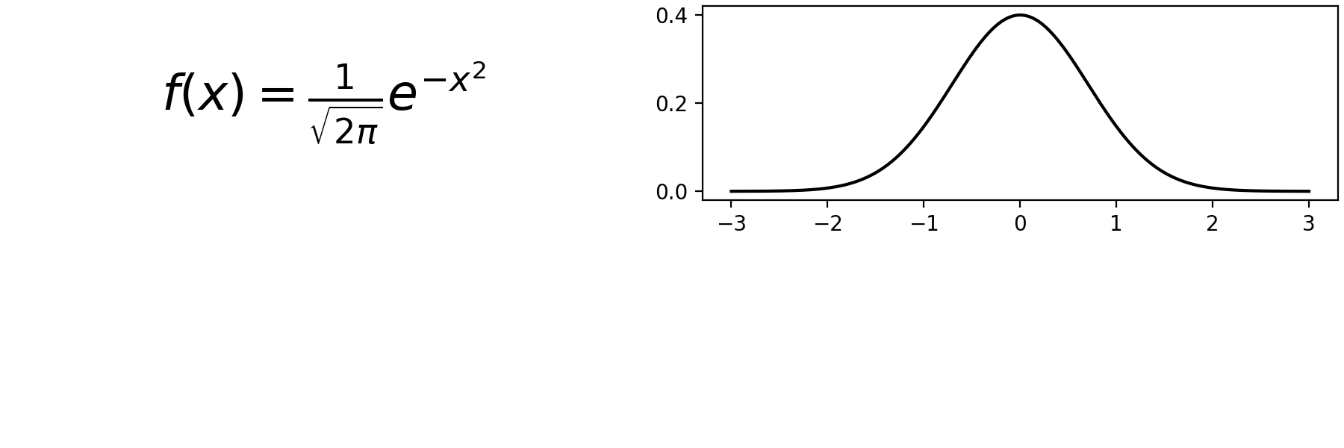

Slide 19
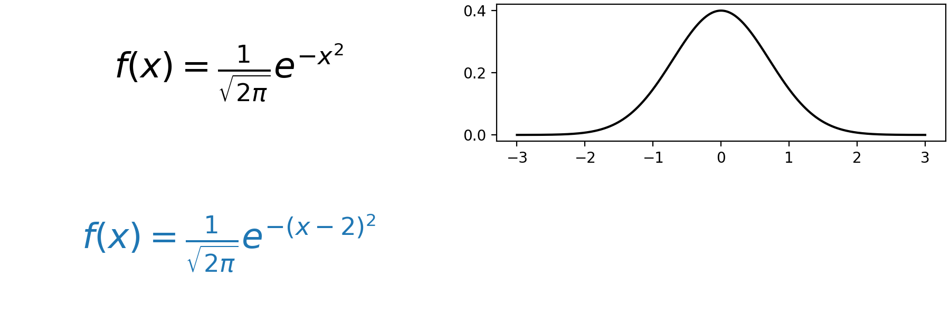
shift in x

Slide 20
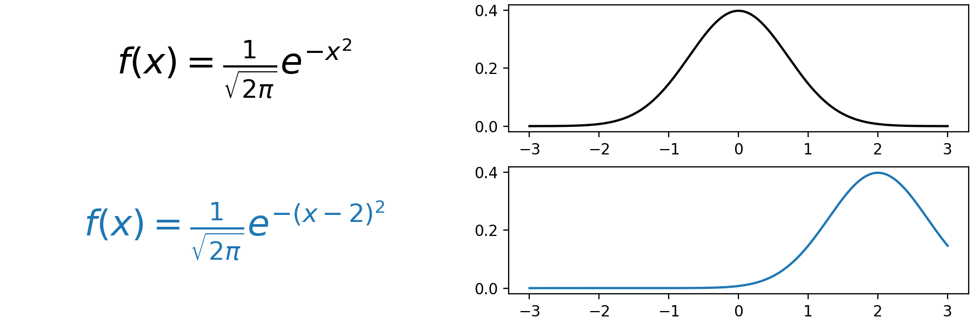
shift in x

Slide 21
shift in x
shift in x

Slide 22
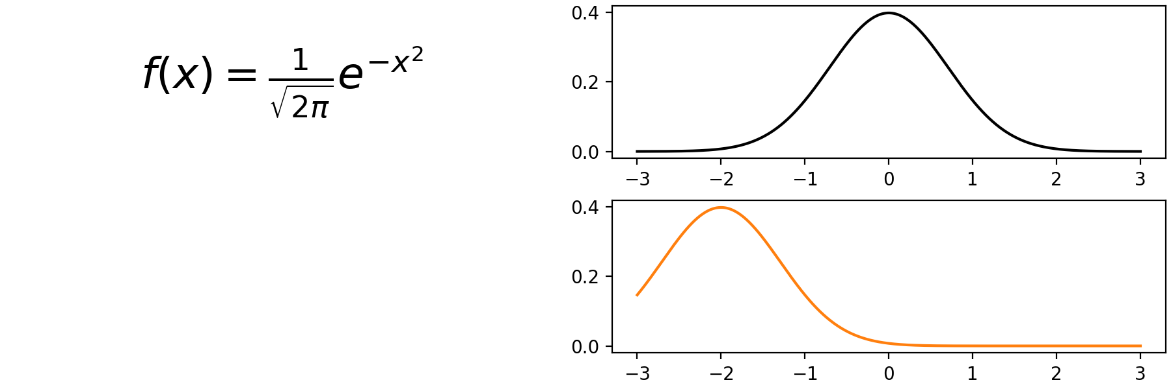
shift in x

Slide 23
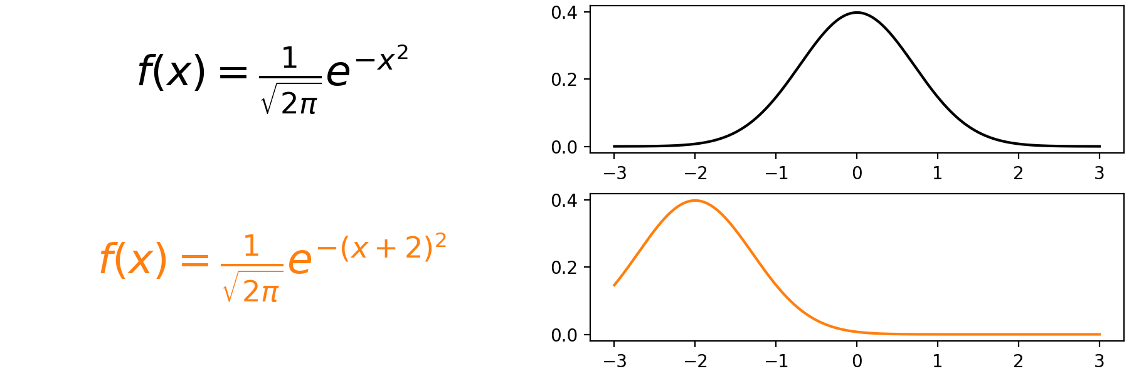
shift in x
shift in x

Slide 24
How are topology preserving equivariant maps implemented?
Assemble
Transform

Slide 25
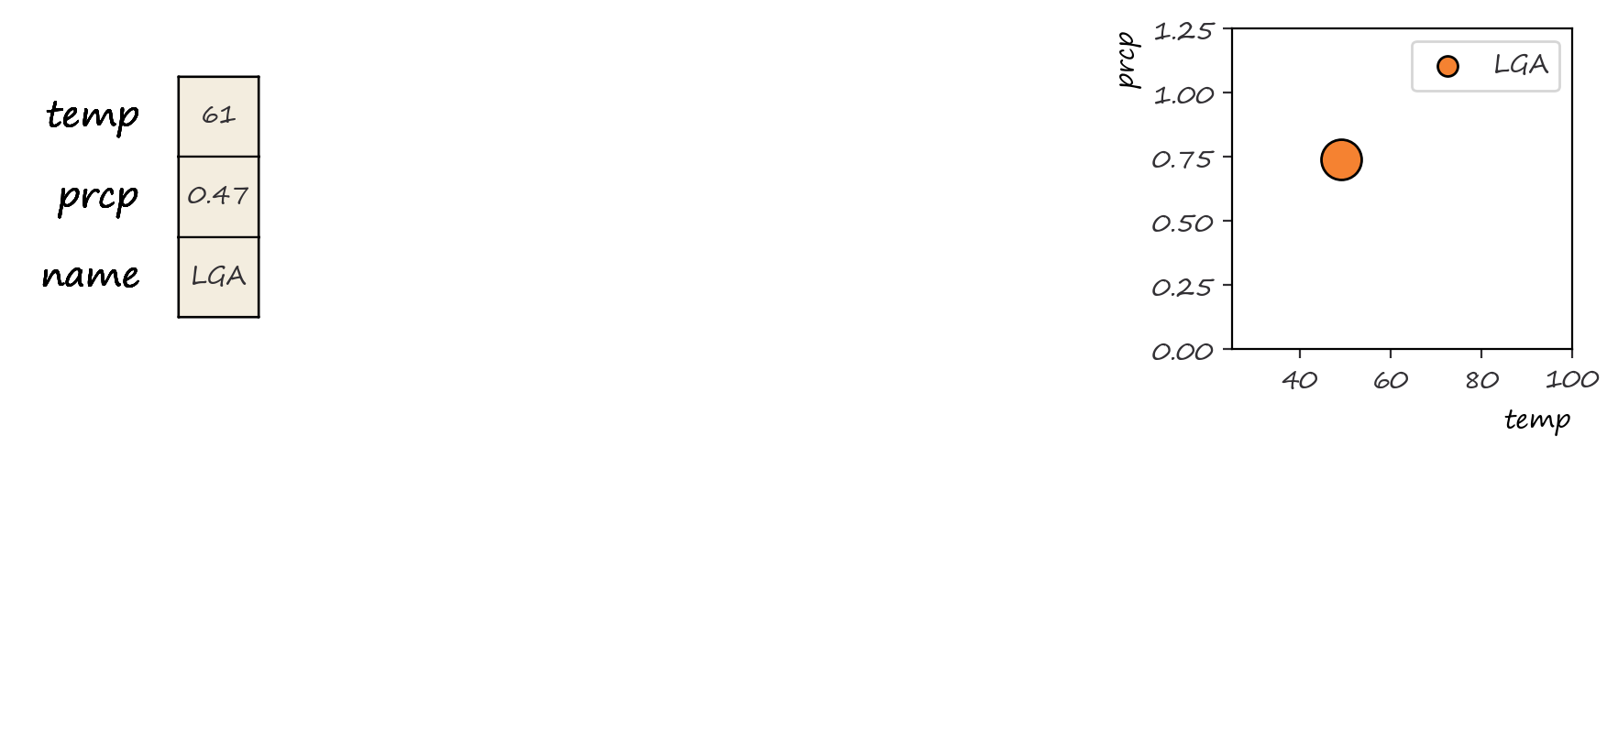
Notes:
How do we go from data to graphic? Here, we drill down to a single data point and its equivalent graphic

Slide 26
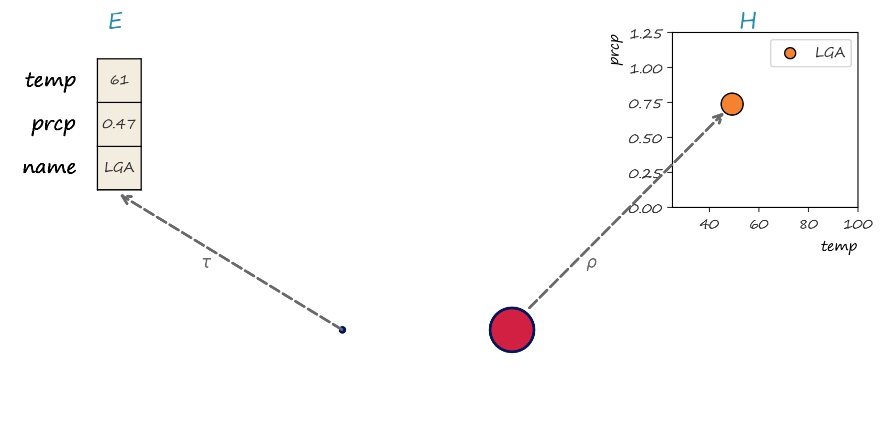
Notes:
We model the data and graphic using fiber bundles. Fiber bundles are topolological structures that allow us to encode the schema as the fiber, the continuity as the base space of the bundle, and binding maps between the two as sections

Slide 27
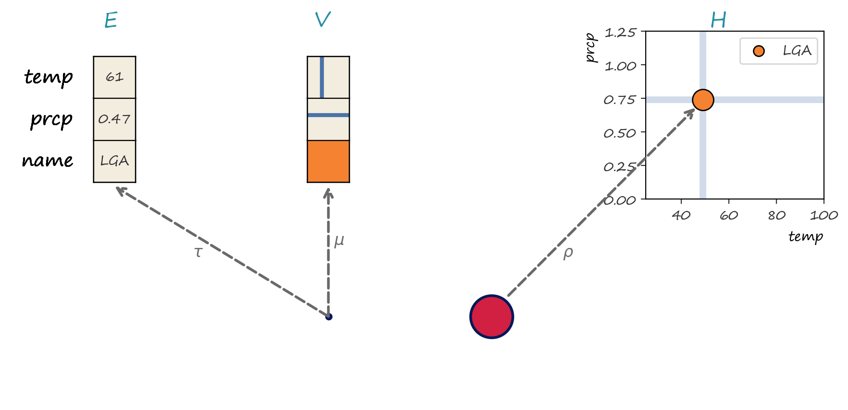
Notes:
To get from data to graphic, are architecture separates visual encodings into a stand alone intermediate bundle

Slide 28
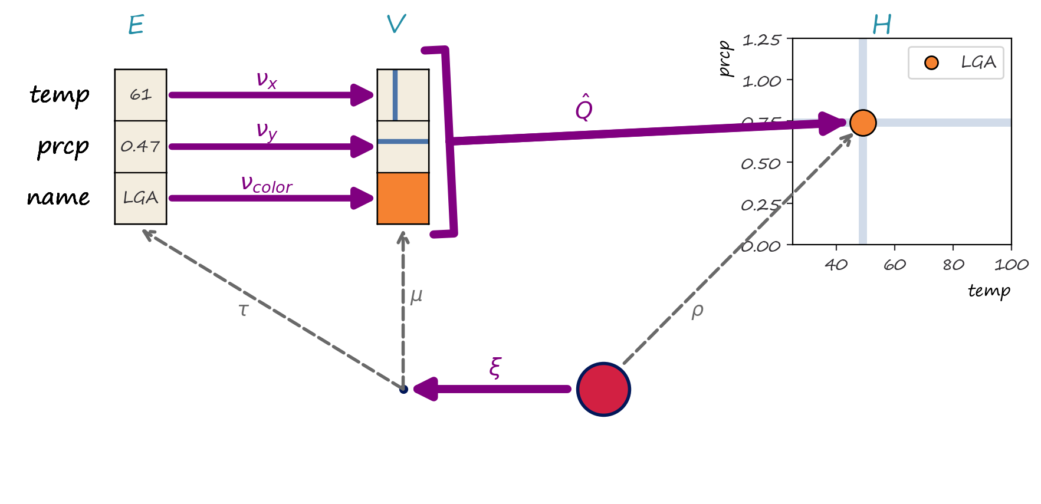
Notes:
We then model the data to graphic transformation as the set of maps between bundles. As shown here, these maps act on sections, which means that every field in the data point is included in the visual encoding and assembly into visual element stages. Components that map graphic to data, such as many interactiions, are constrained such that the have to preserve the location of every point k relative to the other points in the map

Slide 29
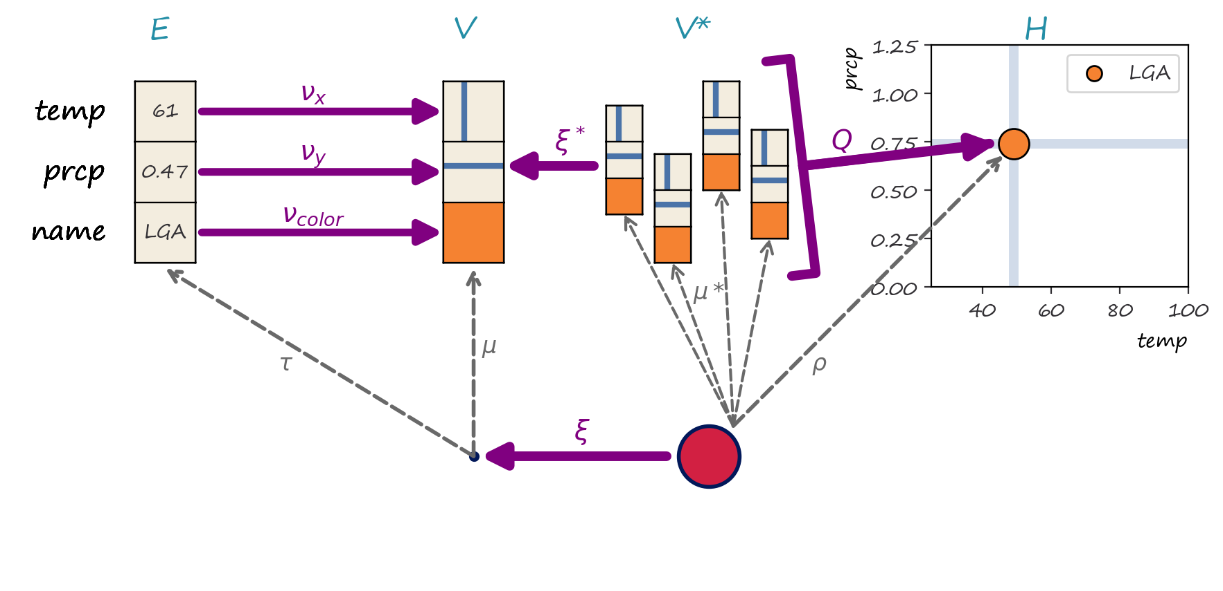
Notes:
Every data point takes up a region in screen space, so the visual encoding for the data is mapped over the whole region S and then assembled into the visual element.

Slide 30
Appendix:
What does it mean for data to have topology?

Slide 31
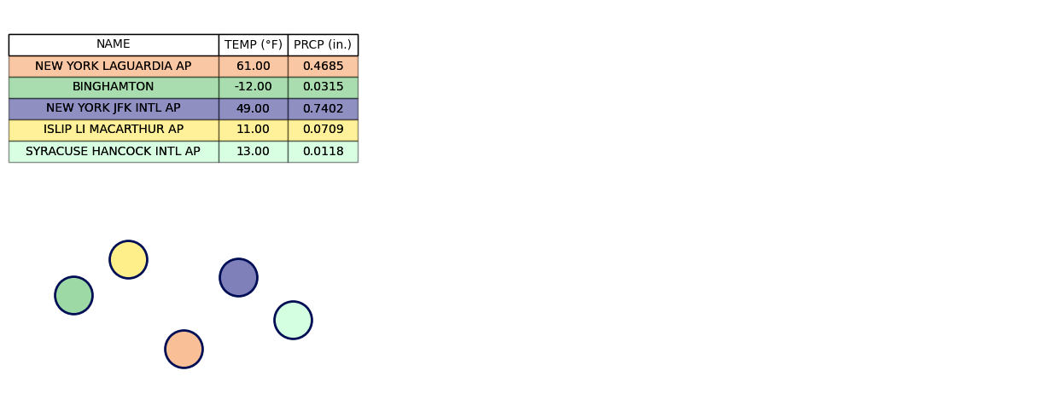

Slide 32
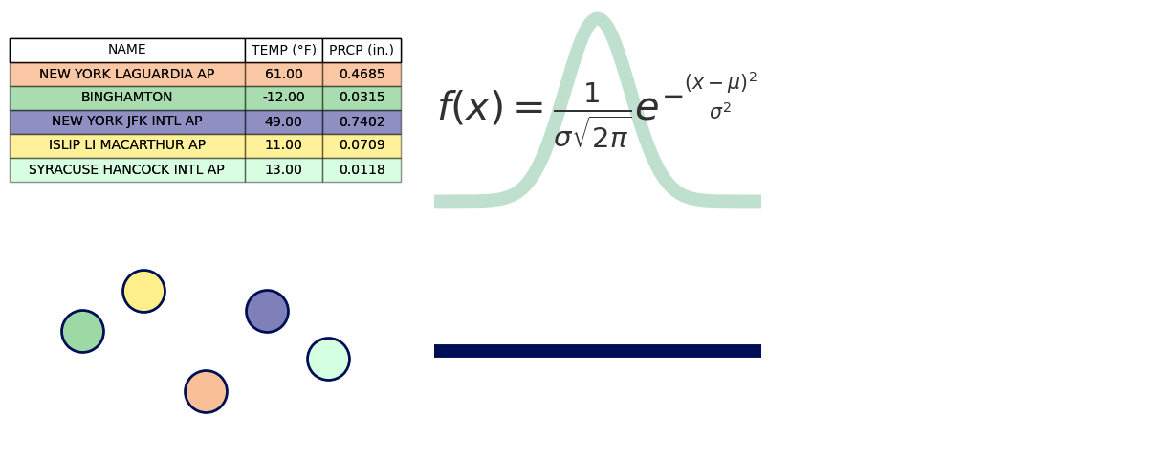

Slide 33
