Slide 1
Insights from Exploratory Analysis of the 2006 Pike’s Peak 10k Race
By Jeff Gross
3/7/2018

Slide 2
N, Mean, Median, Mode, and Range of the Race Results for all Racers by Gender
 | Male (Hour:Min:Sec) | Female (Hour:Min:Sec)
N (# of racers) | 1265 | 1105
Mean | 00:52:08 | 00:58:29
Median | 00:51:23 | 00:57:51
Mode | 00:35:28 | 00:48:06
Range | 1:12:00 Min=00:28:47 Max=01:40:38 | 1:13:48 Min=00:32:50 Max=01:46:49

Slide 3
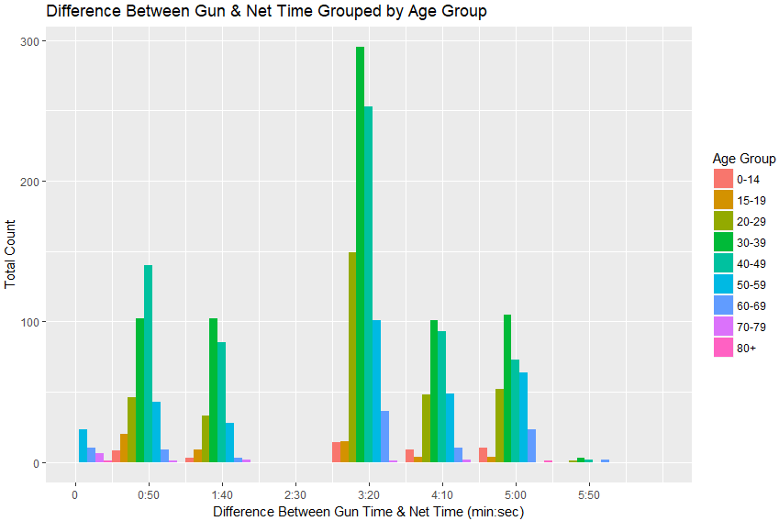
Difference between Gun Time and Net Time was Largest for Ages 30-39 & Indicates Starting in Waves
Measures of Centrality | Gun Time – Net Time (Min:Sec)
Mean | 02:51
Median | 03:16
Range | 09:20 Min=00:00 Max=09:20

Slide 4
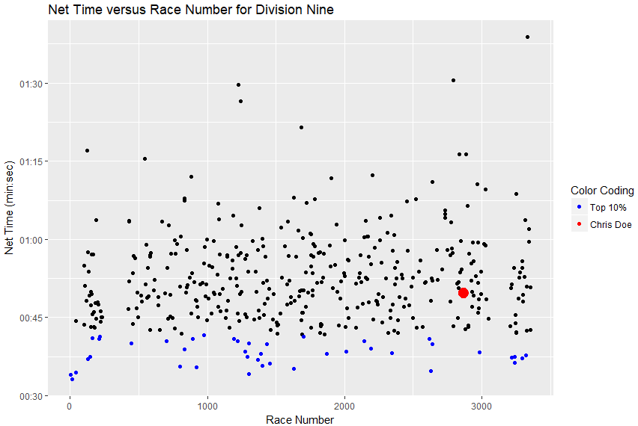
Chris Doe’s Percentile & Amount of Time vs Top 10 Percentile in His Division
New division column was based upon two facts:
“A division comprises racers of the same gender and age group”
“The two youngest age groups are 0-14 and 15-19; the remaining age groups are separated by 10 year increments (e.g. 20-29, 30-39, etc.)”
Chris Doe was in division 9
Division 9 is males ages 40-49 with 415 runners
Missed top 10 percentiles in his division by 00:08:04 (Hrs:Min:Sec)
He was in the top 50 percentile for his division
Chris Doe

Slide 5
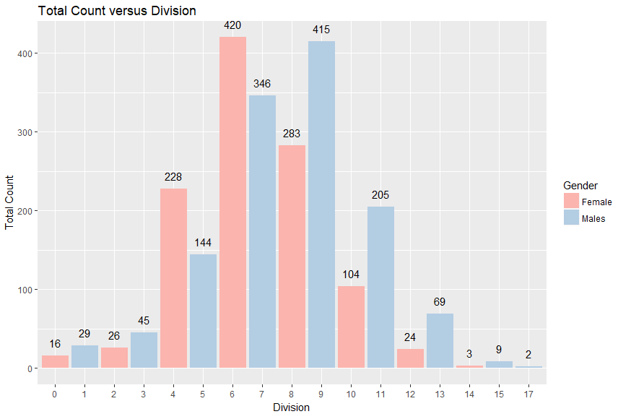
Compare Division by Gender: More Males Than Females
Division Construction Only Included One Gender
More Males than Females except divisions 4 & 5 (20-29 years of age) and 6 & 7 30-39 years of age)

Slide 6
Further Work Regarding the 2006 Pike’s Peak 10k Race
Determine Relationship Among Variables
Fit a Predictive Model

