Slide 1
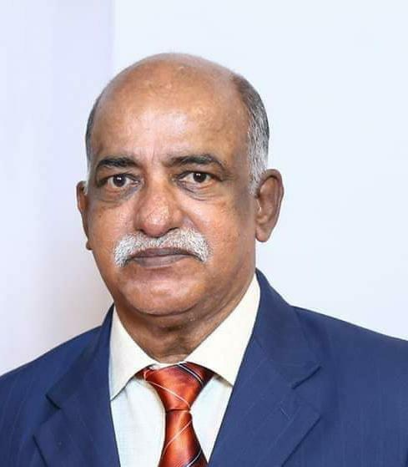

OBITUARY
Mr. P. V. Alexander (A010) father of SHINU and SHINEY ALEXANDER was called to heavenly abode on NOV 10th, 2020.
The funeral was HELD in Singapore on Nov 12th, 2020.
The cathedral expresses its deepest condolences. May the departed soul rest in peace.

Slide 2
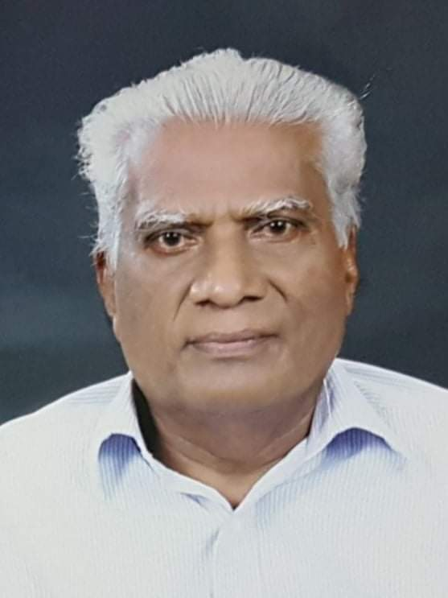
OBITUARY
Mr. Mathew V Philip (88), father of Usha Elizabeth Mathew (R006), was called to the heavenly abode, at Kozhencherry on Nov 10th, 2020. The funeral was HELD on Nov 16th, 2020.
The cathedral expresses its deepest condolences. May the departed soul rest in peace.

