Slide 1
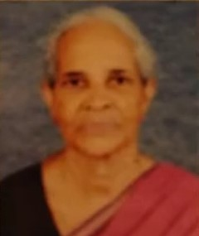

OBITUARY
Mrs. Achamma Varghese (86 yrs), Mother of Mrs. Sheela Reuben (R015) was called to Heavenly Abode on May 6th. The funeral WAS held at St. Gregorius Syrian Cathedral, Bangalore at 1130 IST on May 7th.
May Her Soul find Solace with GOD & Rest In Peace. We, the Cathedral express our Heartfelt Condolences & Praying for the Bereaved Family.

Slide 2
OBITUARY
Mr Varghese Francis (68 yrs), Father of Mrs. Minu Naveen (N004) was called to Heavenly Abode at 12:45AM Today at Bangalore.
May HIS Soul find Solace with GOD & Rest In Peace. We, the Cathedral express our Heartfelt Condolences & Praying for the Bereaved Family.

Slide 3
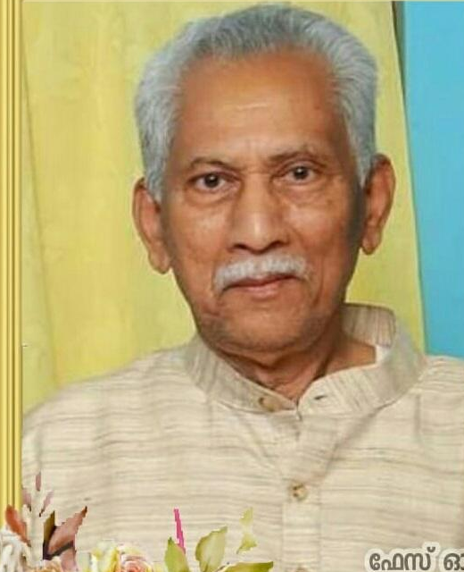
OBITUARY
Mr. Josey Abraham (83 yrs) father of Mrs Susan Markose (M029) was called to heavenly abode on May 8th. The Funeral will be held today at Bangalore.
THE Cathedral expresses our heartfelt condolences. May the departed soul rest in peace.

Slide 4
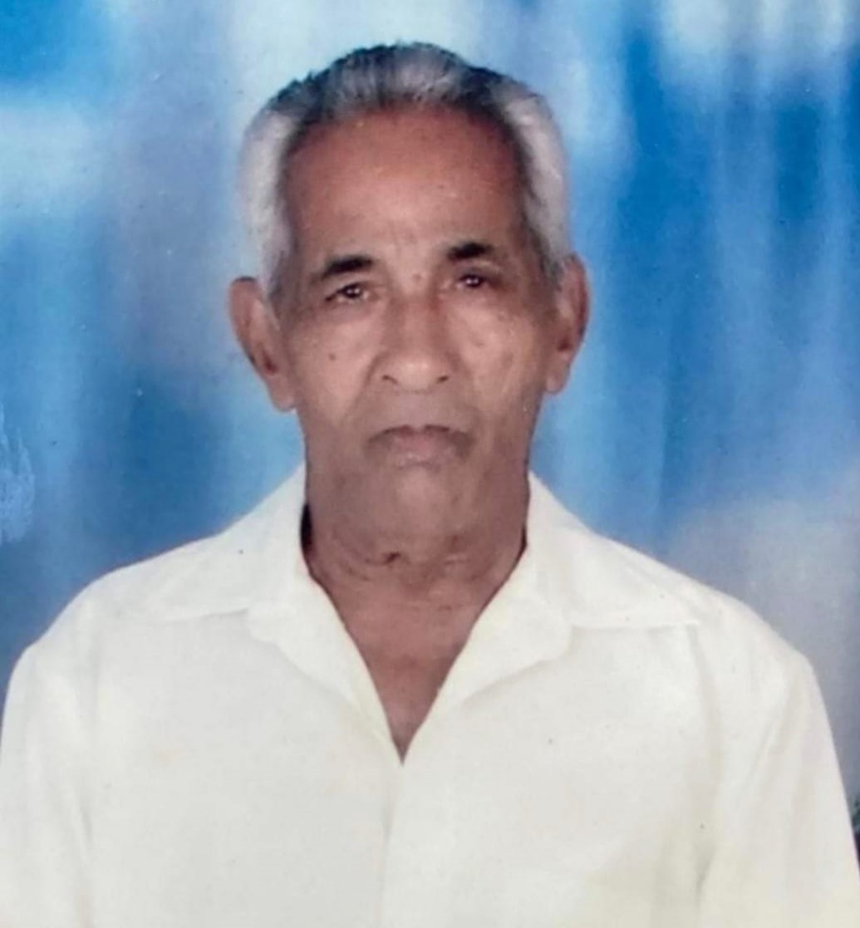
OBITUARY
Mr. P. G. Abraham (96 yrs) father of Mrs. Molly Alexander (S074) Was called to heavenly abode on May 6th. The Funeral was held on May 7th in Delhi.
The Cathedral expresses our heartfelt condolences. May the departed soul rest in peace.

