Slide 1
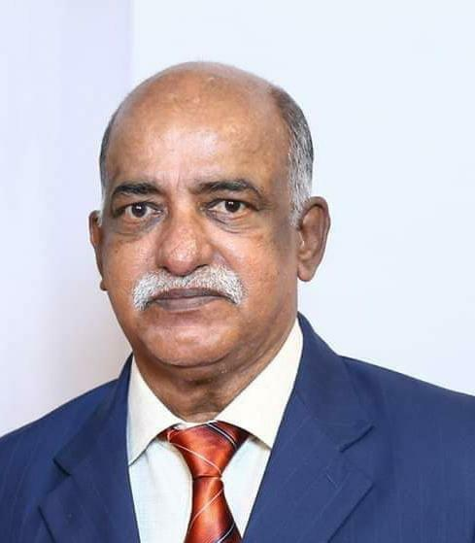

OBITUARY
Mr. P. V. Alexander (A010) father of SHINU and SHINEY ALEXANDER was called to heavenly abode on NOV 11th, 2020. The cathedral expresses its deepest condolences. May the departed soul rest in peace.

