Slide 1

Walking Through The Woods
An Introduction To Git

Slide 2
Who is Git?
A distributed revision control and source code management system.
Designed and developed by Linus Torvalds for Linux Kernel development.
Development began on 3rd April 2005.
Became self-hosting on 7th April 2005.

Slide 3

How does Git look like?

Slide 4
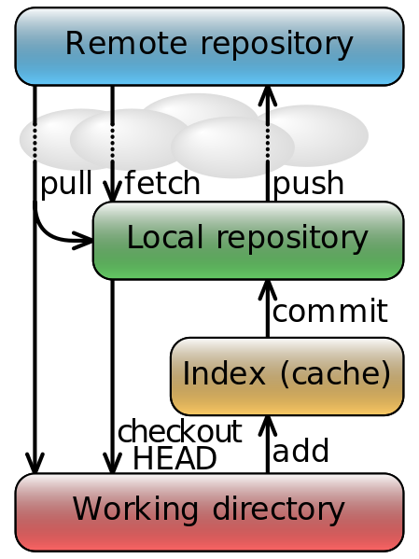
How does Git work?

Slide 5

How can Git help us?

Slide 6
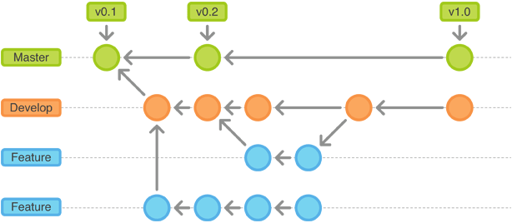
What is Git workflow?

Slide 7

Lets write our first story…

Slide 8

More questions?
Tutorial : http://www.atlassian.com/git

Slide 9

Ready for a new start

Slide 10
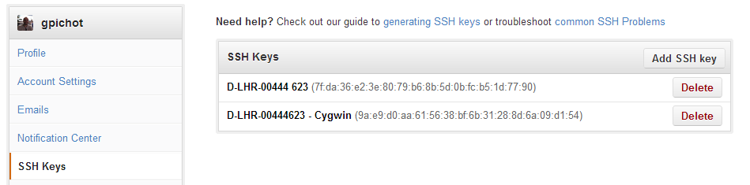
Annexes
Configuring git to use SSH:
Directory: {USER_HOME}/.ssh/
Generate key pair: ssh-keygen -t rsa
Edit public key: cat id_rsa.pub
Copy the content to your profile on GitHub

