Slide 1
Chieko Asakawa
By: Carter, Owen, Stella, and Quinten

Slide 2
Biography
Was an athletic sprinter-had dreams of going pro
Pool incident at the age of 11-caused her to go blind
Inspired to further develop technology accessibility because of blindness
Born in Osaka, Japan in 1958

Slide 3
Contribution
Studied computer programming
Joined the IBM full time
Developed home page
Developed screen readers and voice-based web technology
Major impact world-wide

Slide 4
Future Promise
Accessibility for disabled users is only set to increase
Evolution of AI
Notes:
Her already successful Braille editing system can become even more easy to use once AI is integrated into it. This will allow visually impaired users to go beyond just editing and reading documents. For example, AI could interpret a graph on screen and tell the user aloud the highlights so they will be able to visualize it.

Slide 5
Selection
Chieko Asakawa
Blind female computer scientist
Helped grow disability accessibility
Katherine Johnson
Black female mathematician
Helped NASA put the first man on the moon
Notes:
Ultimately chose Chieko due to the fact the Katherine Johnson’s story was recently told in the movie ”Hidden Figures”, which came out in 2016

Slide 6
Underrepresentation
Computer science is heavily male dominated
Accident caused her to become blind at a young age
Notes:
Computer science is a heavily male dominated field, especially in leadership roles, so Asakawa holding the high position of IBM fellow is very rare.
Computer science being a highly visual field of work makes it difficult for someone who is blind to excel, however, Chieko has been involved in the expansion of disability accessibility in computing.

Slide 7
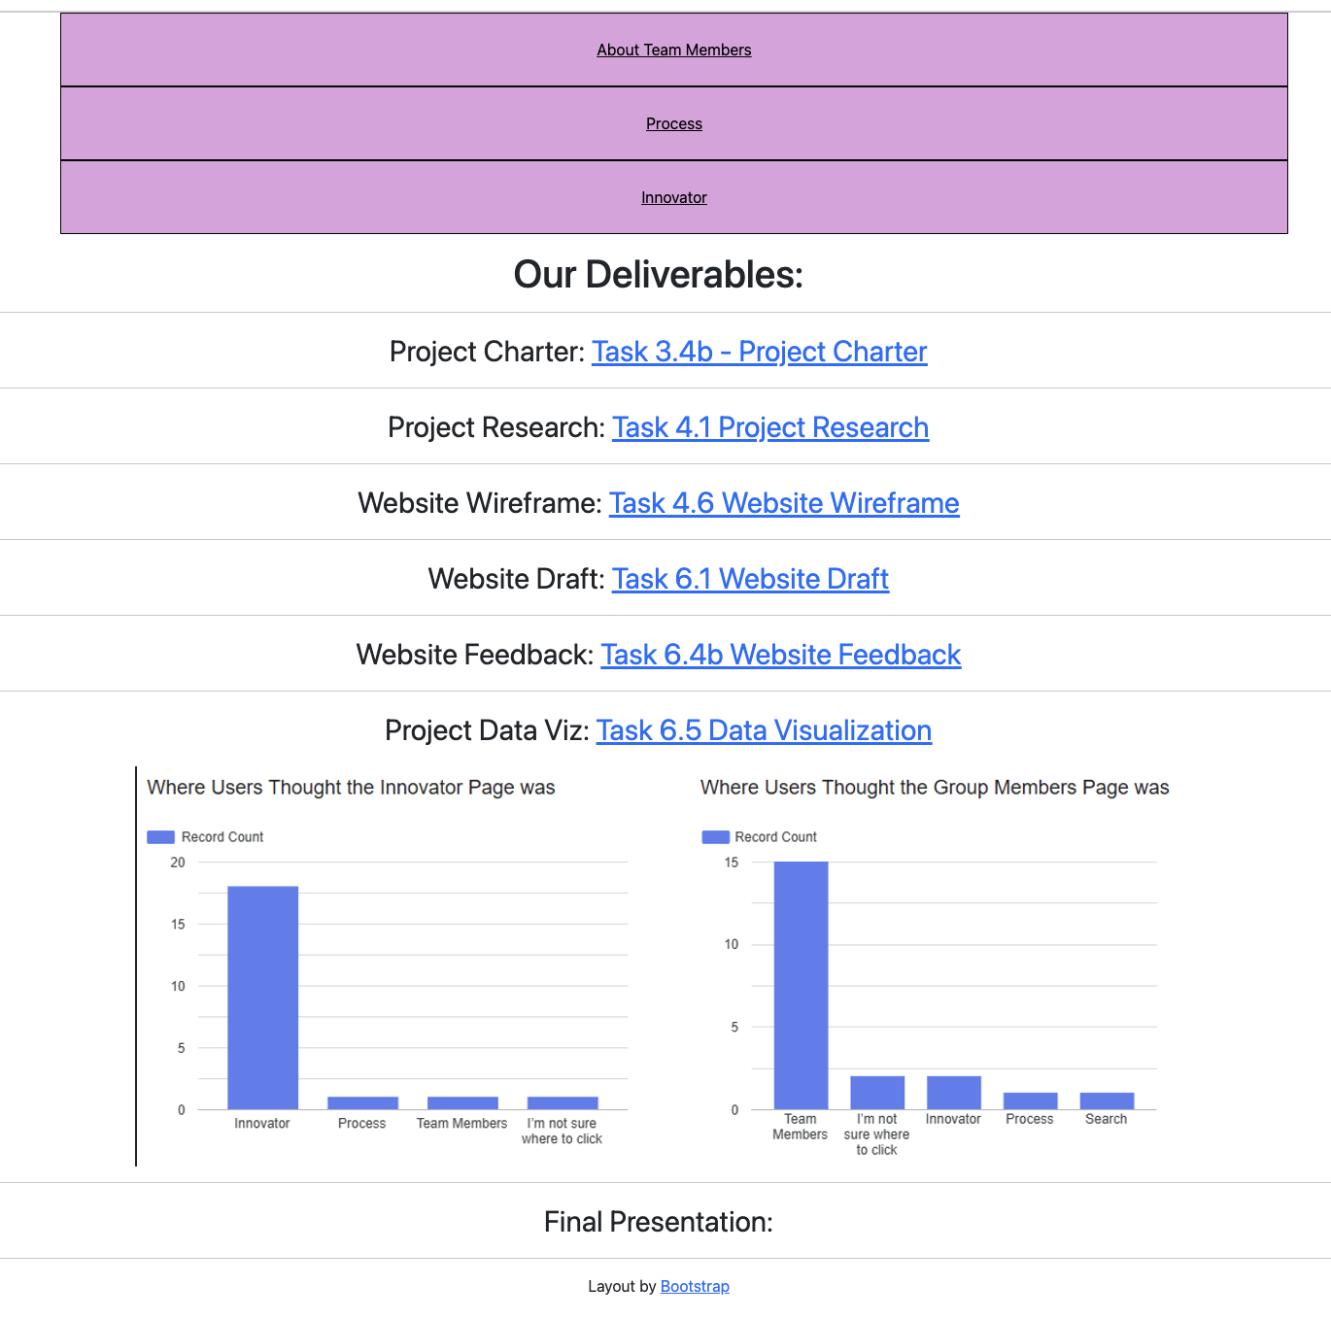
Our Process

Slide 8
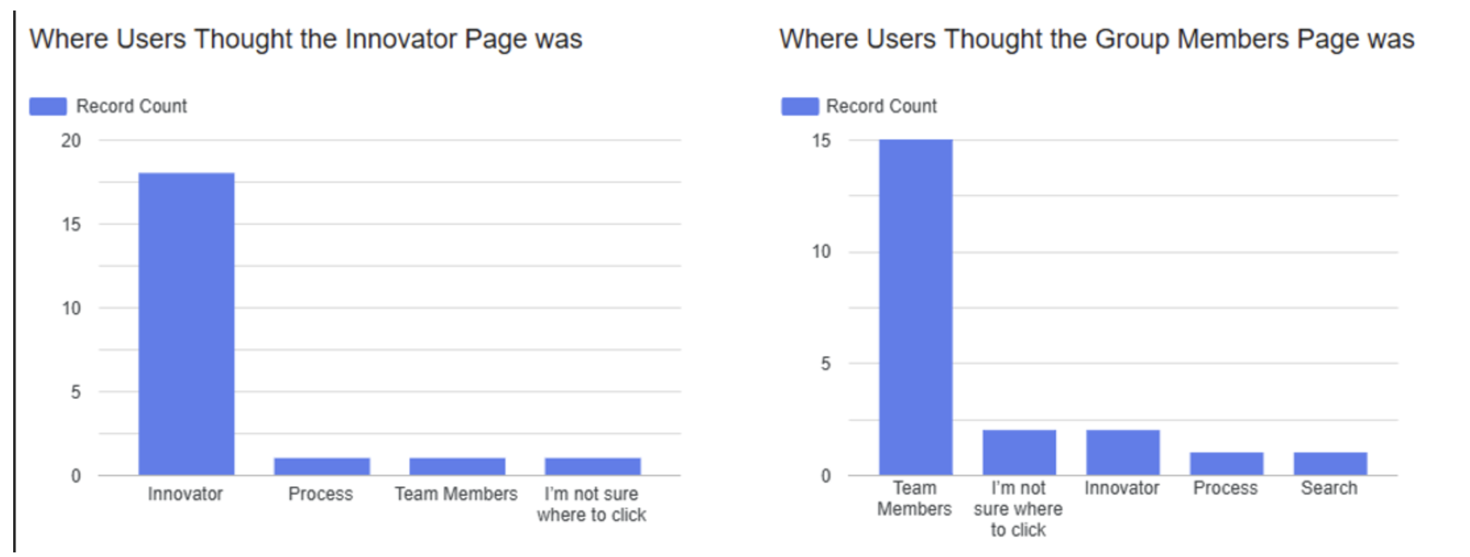

Slide 9


