Slide 1
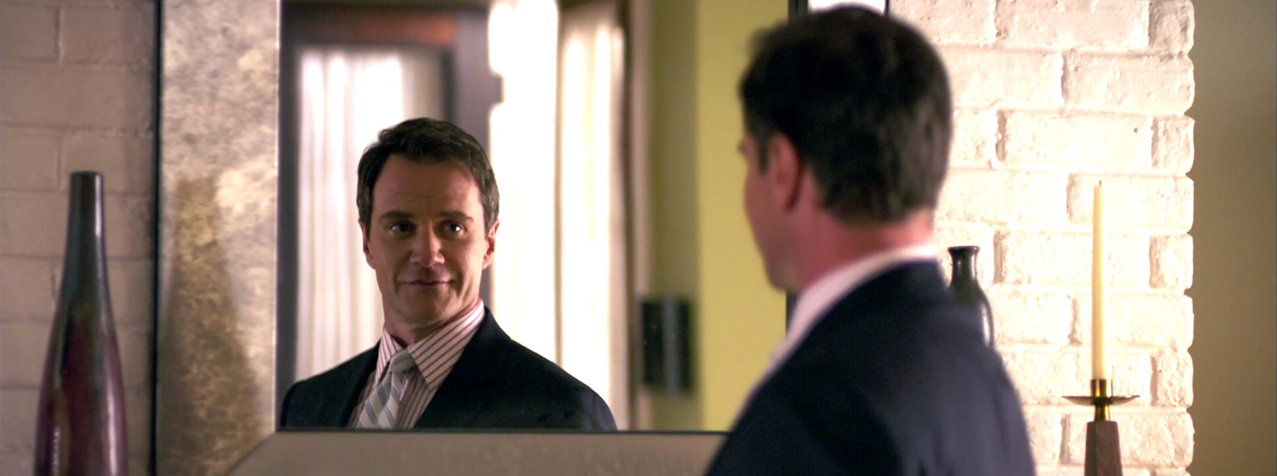

Narcissist
1.0

Slide 2
Narcissist
1.0

Slide 3

Team “Hello World”
Project Presentation
Johnathan
Erick
Sam
Zach
Team Leader
Graphics/UI
Code Block 1
Code Block 2
/user name
@user name
www.domain.com
/user name
@user name
www.domain.com
/user name
@user name
www.domain.com
/user name
@user name
www.domain.com
Narcissist
1.0
2

