Slide 1

Employment and Estimated Salary in the Data Science Field
Final Project Presentation
Team #33
Andrew Tindell, Alex Stowe, William Loveless, Anna Olefir, Mojtaba Taghipour Kaffash

Slide 2

Introduction
The field of data has been rapidly changing in recent years
Job titles such as Data Analyst, Data Scientist, and Data Engineer may represent synonymous or completely different roles at various companies
Difficult for employers and applicants to determine appropriate salaries for various jobs in the current market
How much should each position be paid?
What skills are important for each role?
Notes:
The field of data science has been changing rapidly in recent years. And we know that job titles such as Data Analyst, Data Engineer, and Data Scientist may represent synonymous or completely different functions at various companies. With all the change and uncertainty, it is difficult both for employers and applicants to determine appropriate salaries for different data science positions on the market.
And our project aimed to identify and quantify how location, title, skills and other job attributes influence the remuneration of data science professionals. This should help companies attract talent without overspending. And candidates will be able to assess their value on the market for the skills and knowledge they possess and bring to the company.

Slide 3

Approach/Methodology
Linear regression model building on early compensation models
Early compensation models predict salary as a function of schooling & years of experience (Mincer, 1974)
Regress Salary on predictors such as job title, required skills, role location & company size
Test model effectiveness using test and validation sets
Notes:
For our approach, we decided to use a linear regression model with salary being the response variable building on compensation research boosted by Jacob Mincer following his book on Schooling, Experience and Earnings (1974). This study provided the general framework for compensation research around the globe.
An example of the equation we used is presented on this slide. We tested the effectiveness of our models, reconsidering their specifications, adding and removing predictors, training our models and looking into other ways to enhance their accuracy. We will discuss this in depth on the next slides/going forward.

Slide 4
Initial Hypotheses
Expect specific factors to influence salary
Different skills/skill sets will impact salary differently
Higher number of skills results in higher salary
Data Engineer & Data Scientist job postings will have higher average salaries than Data Analyst postings
Position’s location will be significant predictor of salary
Certain parts of the country are hotspots for data positions
These areas will have higher salaries even after cost of living adjustments
Notes:
Our initial hypotheses envisaged that the more skills or more advanced skills are required for a job, the more likely the applicant will be paid at a higher rate.
Also, higher wages will likely be tied to Data Engineer and Data Scientist positions (and not for Data Analyst role).
In addition, we believed that location should play a significant role. Certain parts of the country are hotspots for data science professionals. Even after the cost-of-living adjustments, these areas could provide higher remuneration as companies compete to attract top talent.

Slide 5
Data Sources
Data Scientists Jobs from Kaggle (742 observations)
Data Scientist (18%)
Data Engineer (7%)
Other (75%)
Data Engineer Jobs from Kaggle (2528 observations)
Data Engineer (19%)
Senior Data Engineer (4%)
Other (77%)
Data Analyst Jobs from Kaggle (2253 observations)
Data Analyst (18%)
Senior Data Analyst (4%)
Other (78%)
Notes:
Alll the job posting data we used for our analysis was sourced from Kaggle.
We used three job posting data sets, all posted by the same author, that scraped Glassdoor for job postings for data scientists, data engineers, and data analysts
Less than 20% of data points in each data set contained the exact titles we were looking to analyze, so we knew we would have to focus a lot of our data cleaning efforts on normalizing these job titles.

Slide 6
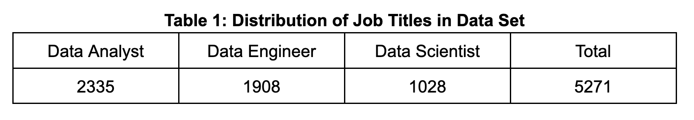
Data Cleaning
Standardizing Job Titles
Hundreds of unique job titles
Too many titles leads to overfitting models
Removed industry & function
Filtered out managerial positions
Identified entry-level & senior positions with binary variable
Result: single dataset containing only 3 job titles
Notes:
At the onset of our data cleaning, we had several hundred unique job titles. We knew using all these as predictors would lead to an extremely overfit model, so we needed to standardize them.
First we removed components of the title that included industries or functions, like healthcare or marketing
Then we removed leadership positions like Vice President, Director, Manager, because these salaries are influenced by managerial skills, not just data skills
Lastly, we identified entry-level and senior positions with a dummy variable
After modifying and removing job titles, we were left with about 5000 job postings to be used in our analysis.

Slide 7
Data Cleaning
Skill Variables
Created dummy variables for 16 popular data skills:
Additional Data Cleaning Steps
Separated city & state, minimum & maximum salary
Removed null values, duplicates & irrelevant columns
Normalized average salary based on cost of living data
Python | Hadoop | Spark | MongoDB
SQL | Tableau | Kafka | Visualization
Azure | Pandas | Excel | Machine Learning
AWS | SAAS | ETL | Warehousing
Notes:
Next we focused on adding dummy variables for specific skills
Based on insights gained from inspecting our data and performing research, we created a list of 16 skills (defined as the ability to use a software, programming language, or similar technology) to look for in our dataset
We created a column for each of the 16 skills, then we scraped each data point’s description field to search for any of the listed skills. If the skill was mentioned in the Description, we gave the corresponding column a value of 1, otherwise, a zero.
This allowed each of the 16 identified skills to be used as predictors in our regression model.
After removing null values, duplicate data points, and irrelevant columns, we normalized the average salaries based on cost of living indexes provided by the (Missouri Economic Research & Information Center). This allowed us to estimate the value of a salary if location were not a factor
At this point our data was cleaned and ready for use in the analysis
Predictors: Job Title, Location, Company Name & Size, Seniority, Raw Salary, Normalized Avg. Salary, and Skills

Slide 8
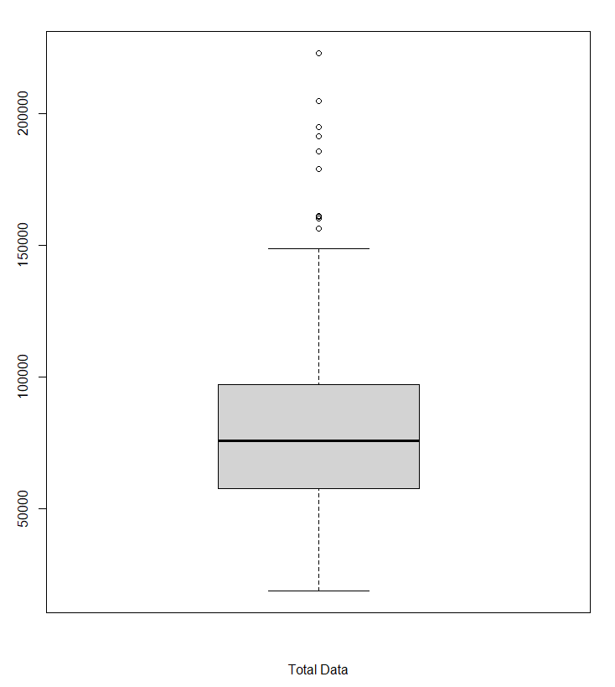
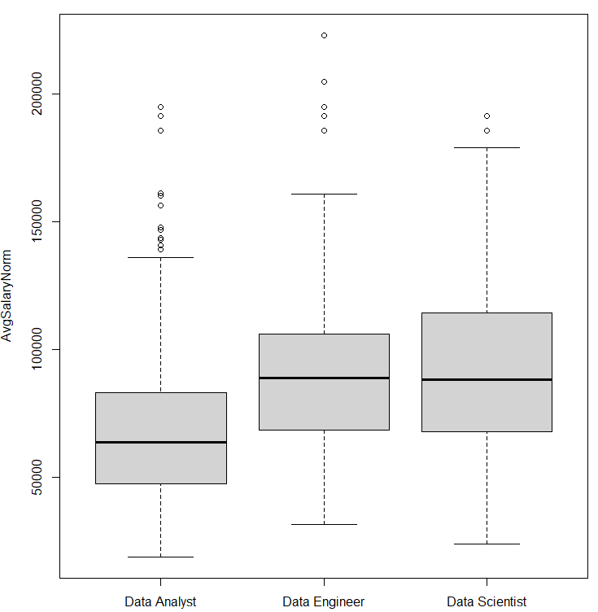
Investigating Data Set - Box Plots and Outliers
Final data contained 136 outliers
Assumed Glassdoor data is accurate & retained all outliers
Significant salary difference between each job title
Notes:
In investigating the data set and looking for the potential outliers, we used Boxplot of salary which shows 136 outliers with these all being on the higher end.
We did not believe it was legitimate to remove these outliers as we are assuming this data from Glassdoor is correct. The boxplots for both the total dataset (on the left) and each of the three job titles (on the right) are displayed.
Also, there is a significant difference in salaries based off of job title alone - Data Scientists seem to have the highest salaries, followed by data engineers, and finally data analysts.

Slide 9
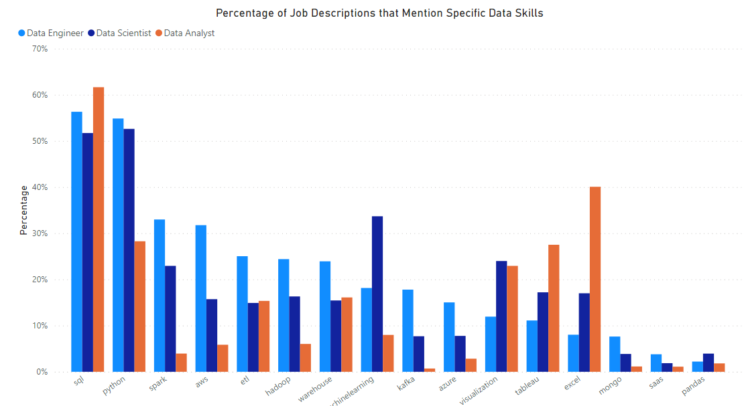
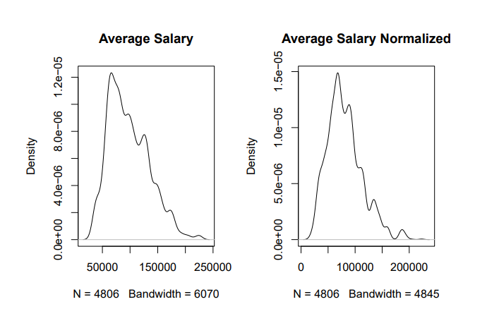
Investigating Data Set
Normality
Distributions were not normal with both the total distribution and the individual job title distributions slightly skewed to the left
Most Common Skills
SQL (all three job titles)
Python (most prevalent for data scientists & engineers)
Excel (most prevalent for data analysts)
Notes:
The distributions of this dataset were almost not normal with both the total distribution and the individual job title distributions slightly skewing to the left due to outliers as can be seen from Density charts for Average salary and Normalized Average salary (as shown on the left).
Moreover, the bar plot on the right shows the most common skills among different job titles. For example, SQL is a required skill in a majority of job postings for all three positions. Additionally, Python is a very in demand skill for data scientists and engineers, but not so much analysts. On the other hand, Excel is frequently required for data analysts, but not scientists or engineers.

Slide 10
Modeling Overview
Utilized different types of linear regression models and decision trees predicting the average normalized salary based on different combinations of skills, location, company size, job title and whether the position is a senior
Focused on 5 different linear regression models to cover all predictors that we were researching
The linear and tree based models did not use specific skills as predictors because none were significant in the presence of the other variables and we did not want to overfit our model
Top 3 most common skills for each job title were used in the individual title analyses to look for any significance on these skills.
Notes:
We utilized different types of linear regression models and decision trees predicting the average normalized salary based on different combinations of skills, location, company size, job title and whether the position is a senior position. We focused on 5 different linear regression models that we felt covered all predictors that we were researching. The locations of the jobs in the listings heavily influenced the overall salary and the final R2 values, so we decided to run models both with and without this predictor to determine what other predictors were affecting the salary. The linear and tree based models did not use specific skills as predictors because none were significant in the presence of the other variables and we did not want to overfit our model. The top 3 most common skills for each job title were used in the individual title analyses to look for any significance on these skills.

Slide 11
Modeling: Linear Regression & Regression Trees using all Job Titles
Including the States predictor significantly improves models
Jobs locations heavily influenced the overall salary and the final R^2 values
The linear and tree based models did not use specific skills as predictors because none were significant in the presence of the other variables and we did not want to overfit our model
Model Summary | Significant Predictors | R² Value (Test Set) | R² Value (Validation Set)
Linear Regression with no States | Company Size (All), Job Titles (All) | 0.1442 | 0.1296
Linear Regression with States (Final Model) | Job Titles (All), States - CA,FL,IL,IN,NY,TX,UT,WA | 0.3838 | 0.3683
Tree Regression with no States | Data Analyst (yes/no) | 0.1051 | 0.1238
Tree Regression with States | Job Titles, States | 0.3638 | 0.3671
Notes:
Moving onto models: After running models briefly testing for different significant variables, we honed in our models to the 4 main models displayed in the table displayed as well as a model focused on each job title displayed on the following slide. The inclusion of the state where the job is located in had a huge effect on the R^2 as well as the salary estimation.The 4 models that used all job titles did not include specific skills as predictors because none were significant in the preliminary models but did include a sum of total skills predictor. We chose to go with the linear model including states that we will talk about on the following slide.

Slide 12
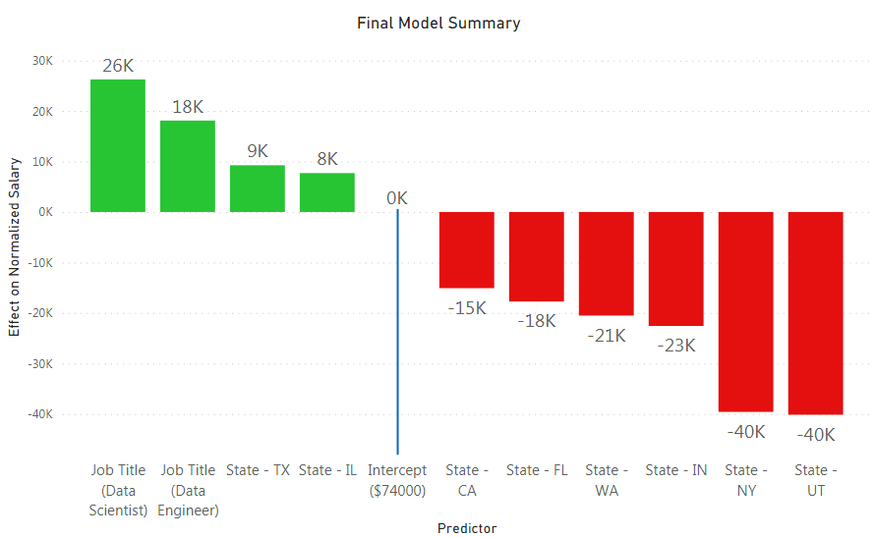
Modeling: Final Model
All significant predictors are shown in this chart:
R-squared on Test Set: 0.3838
R-squared on Validation Set: 0.3683
*Base model is Data Analyst located in AZ
Notes:
Our final model had an R^2 of 0.38 on the test set and 0.37 on the validation set and the significant predictors effects are displayed in the figure. A job title of data scientist and data engineer both increase the salary compared to the data analyst base case. Surprisingly states like CA, FL, and NY have a smaller average adjusted salary compared to the base case of AZ.

Slide 13
Overview of Modeling: Linear Regression using Specific Job Titles
Models included top 3 most common skills for each title:
Data Analyst
SQL
Python
Excel
Data Scientist
SQL
Machine Learning
Python
Data Engineer
SQL
Spark
Python
Job Title | Significant Predictors* | R² Value
Data Analyst | States: CA,DE,FL,IL,NJ,NY,OH,UT,VA,WA Skill - Python (Almost significant (p=0.10) | 0.2636
Data Scientist | Company Size(Small), States: CA,FL,IL,NY,OH,PA,UT | 0.3240
Data Engineer | States: CA,FL,IL,NY,TX,UT | 0.3739
*Skills were insignificant when location was taken into account
Notes:
On top of our selected model we also looked into specific models for each job title for more insights into skills/company size. In these models we used the 3 most common skills for the title on top of the predictors we had been using before and found that they were mostly insignificant when used in the same model as locations so we took it one step further AND…….

Slide 14
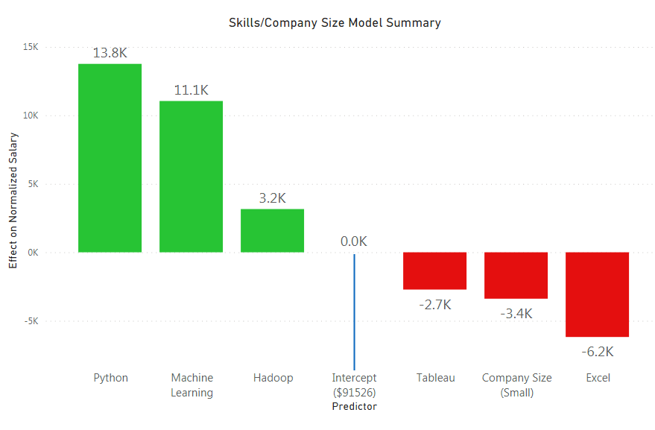
Modeling: Linear Regression Using Skills
Regressed Salary on only Skills and Company Size:
Python, Machine Learning & Hadoop lead to substantial increases in Salary
Tableau & Excel (more basic, common programs) led to a small decrease in Salary
Small sized companies pay less than large and medium
Notes:
Created models without states or job titles as predictors to look solely at skills and company size. This model had a very bad R^2 but gave some insight into what skills generally lead to higher salaries which were: Python, hadoop and machine learning. Excel and tableau being more basic skills led to a smaller average adjusted salary and one interesting insight is that smaller companies (Less than 500) employees actually tend to pay less on average, especially to the Data Scientist job title.

Slide 15
Findings
Strongest predictors of Salary: Job Title and Location
Unlike expectation, technical skills did not influence salary significantly
model could not be used effectively by students or employers to estimate salary
Likely reason: we were not working with great data
Glassdoor provides large salary ranges when there is not actual salary contained in the posting
Data is not normal and contains outliers
We normalized the salaries based on States’ cost of living indices
Being state-centric can pose problems for states such as Florida where the cost of living is drastically different outside of major cities
Notes:
Based on the results of the models we created throughout our analysis, job title and job location are the strongest predictors of salary for data-related positions. While we anticipated that these two predictors would significantly contribute to salary, we expected that technical skills contained in job descriptions would also influence salary significantly. Overall, we would say that at this time, the model could not be used effectively by students or employers to estimate salary.
One likely reason that we did not get the results we anticipated is because we were not working with great data. The salary datasets we were working with contained job posting from Glassdoor. While Glassdoor is one of the largest and most reputable sources for job postings and salary information, it has some flaws. One main issue is that Glassdoor will provide salary ranges when there is not actual data for a specific position. They generally provide a large range that is based on similar job titles and may have also led to the data not being normal and containing quite a few outliers.
Also, we normalized the salaries based on cost of living indices. We are confident in the methodology, however, the data is based on each state rather than city. Being state-centric can pose problems for states such as Florida where the cost of living is drastically different outside of major cities.

Slide 16
Recommendations
Filtering the dataset down to cities that have cost of living data available could increase the accuracy of the model rather than assigning a statewide cost of living adjustment to each observation
Look into remote work effects
Since the salary is skewed, one potential improvement can be trying the log-linear model. This improved:
Normality assumption of the residual analysis
R-squared (On training set)
BUT, we did not include it since the it did not improve when testing model on the test set when validating. Also, linear-linear model is easier to explain than log-linear model
Notes:
If we had more time to work on this project, filtering the dataset down to cities that have cost of living data available could increase the accuracy of the model rather than assigning a statewide cost of living adjustment to each observation. Also, we may look into how remote work affects these salary estimates with the world moving to a more remote environment. Finally, since our dataset distribution was not normal, we may look into performing a non-parametric test/model instead, although this was outside of the scope of this project.

Slide 17
Conclusion
Significant difference in salary based off of job title
Data scientists and data engineers have a significantly higher max salary than data analysts
Unlike expectation, technical skills did not influence salary significantly
Most common skills:
SQL (all 3 job titles)
Python (more prevalent in data scientists and engineers)
excel (more prevalent in data analyst positions)
Spark
Including the States predictor significantly improves models
Jobs locations heavily influenced the overall salary and the final R^2 values
Strongest predictors of Salary: Job Title and Location

Slide 18
References:
Lemieux, T. (2006). “The ‘Mincer equation’ thirty years after Schooling, Experience, and Earnings.” In: Grossbard, S. (ed.). Jacob Mincer: A Pioneer of Modern Labor Economics. New York: Springer, 2006; pp. 127−145.
Mincer, J. (1974). Schooling, Experience and Earnings. New York: National Bureau of Economic Research.
Missouri Economic Research and Information Center. (n.d.). Cost of living data series. Cost of Living Data Series | Missouri Economic Research and Information Center. Retrieved July 1, 2022, from https://meric.mo.gov/data/cost-living-data-series

