Slide 1
A Bottom-Up Approach to Job Recommendation System
(RecSys Competition 2016)
Stoyan Eftimov
Hrizantema Stancheva

Slide 2
Problem
Recommender Systems held during 15-19th September 2016, Boston @ MIT & IBM
RecSys Challenge:
● Build a job recommendation system for XING
● Given a XING user, the goal is to predict those job postings that a user will positively interact with (e.g. click, bookmark)

Slide 3
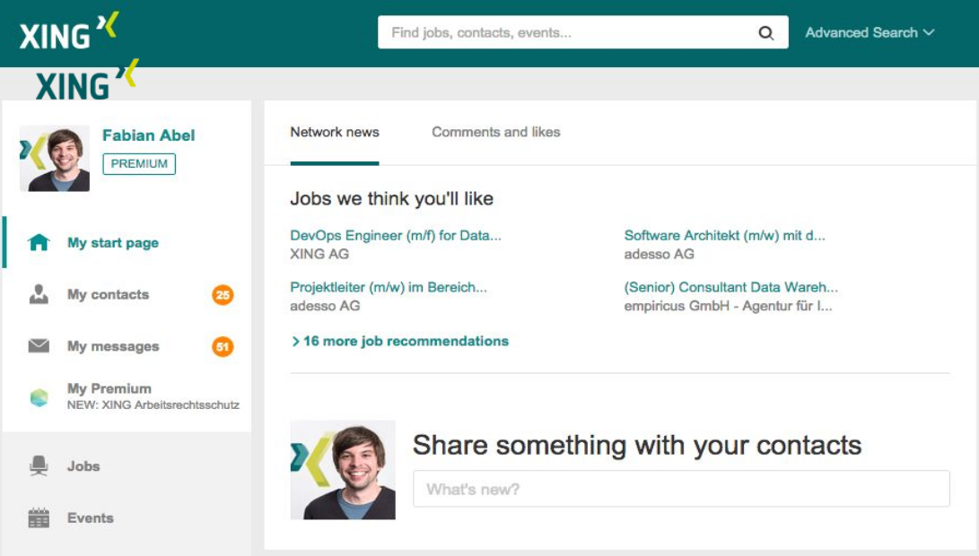

Slide 4
Datasets
Users
Job roles
Career level
Discipline
Industry
Country
Region
Work experience
Education
Items
Title
Discipline
Industry
Country
Region
Type of employment
Tags
Creation time
Interactions
User_ID
Item_ID
Time
Interaction_type

Slide 5
Interactions Data
Purely focus on interactions
1 – user clicked on the item
2 – user bookmarked the item on XING
3 - user clicked the reply button or application form button
4 - user deleted the recommendation
Issues:
Data is sparse and doesn’t include all users
Not every user has at least 30 positive interactions

Slide 6
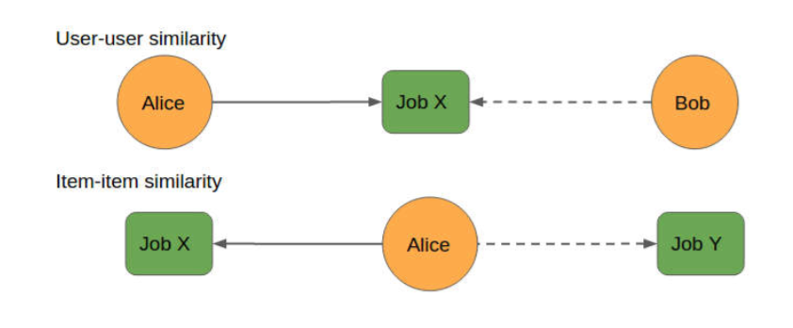
Collaborative Filtering
Leverages the notion of homophily
User-user similarity
Item-item similarity
Challenges:
Sparsity
Definition of Similarity

Slide 7
Collaborative Filtering
For similarity, we use K-Means clustering with cosine similarity
Impute the interaction of user u with item i as average of interactions of other users v, in the same cluster, weighted by cosine similarity

Slide 8
Collaborative Filtering
How to we know if two items or users are similar?
K-means Clustering
● Number of clusters: 100, 1K, 5K
● Distance measure : Euclidean distance
● Library: SciPy.kmeans2

Slide 9
Collaborative Filtering
Cosine Similarity
● Similarity (U i , U j ) = U i .U j / |U i | |U j |
● Similarity (I i , I j ) = I i .I j / |I i | |I j |
Q: What are we using?
A: Both. Cosine similarity, but limited to the cluster

Slide 10
Scoring
Given a user, score each job and finally rank based on score:
Score = w1(Interaction score) + w2(no. of overlaps in user job-roles and item-titles) + w3 (I[career level match]) + w4 (I[discipline IDs match]) + w5(I[industry IDs match] + w6 (I[regions match])
Weights
Heuristic: w1 = 1, w2 = 100, w3 = 10, w4 = 12, w5 = 10, w6 = 5 & w7 = 2
Linear Regression: Learn the weights

Slide 11
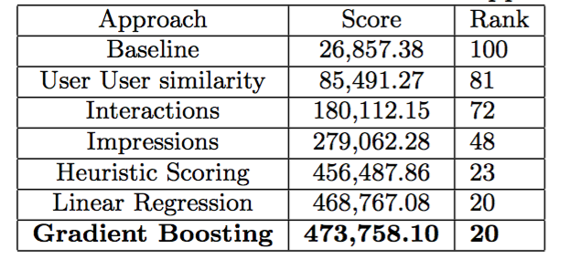
Evaluations

Slide 12
Conclusion

