Slide 1


JavaScript Applications: Course Introduction
JS Course Program, Evaluation, Exams, Resources
Doncho Minkov
Technical Trainer
http://minkov.it
Telerik Software Academy
academy.telerik.com

Slide 2

Table of Contents
JavaScript Applications
The JS Apps Course Program
Exams and Evaluation
Standard Criteria
Bonuses
Resources for the Course

Slide 3

JavaScript Applications
The Course to become a real JS Ninja

Slide 4

What's Coming Next?
JavaScript Applications
The next course from JavaScript development
Building a client-side application with JavaScript
Lectures twice a week
Practical exam after a month
The course exam?
One big problem for 5-6 hours

Slide 5

JavaScript Applications: Course Program
What Will We Cover in the JavaScript Course?

Slide 6


JavaScript Applications: Course Program
JS Applications Introduction
Course program, exams, evaluation
JavaScript: Good Practices
Naming identifiers, Strict mode, scoping, the this object

Slide 7


JavaScript Applications: Course Program (2)
Advanced OOP
OOP
Classical and Prototypal Inheritance
Namespaces
Modules

Slide 8
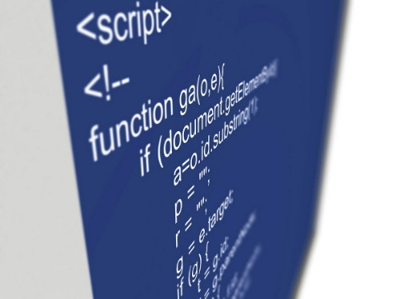
JavaScript Applications: Course Program (3)
JavaScript Libraries
What are JS libraries?
A quick overview of libraries
DOM manipulation, OOP, AJAX, structure and more
jQuery Overview
Selectors, DOM manipulation, events, DOM traversal

Slide 9


JavaScript Applications: Course Program (4)
Promises and Asynchronous programming
Callback-oriented design
Promises
jQuery Plugins
Usage of plugins
Developing Custom Plugins
Unit Testing
Libraries for Unit Testing
JsUnit, QUnit, Jasmine

Slide 10
JavaScript Applications: Course Program (5)
HTTP and AJAX
The HTTP protocol, HTTP Requests
Data transfer formats - json, xml, jsonp
Consuming External Data and AJAX
Creating HTTP requests with pure JS and with jQuery
Using third-party JavaScript APIs
Working with famous JavaScript APIs
Facebook Open Graph, Google API, Twitter, etc…

Slide 11
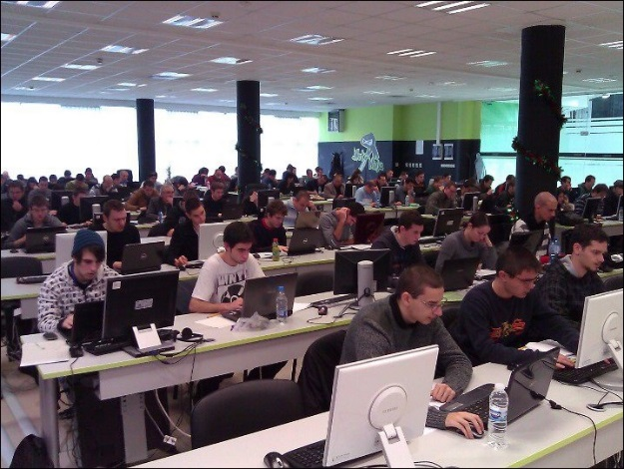

JavaScript Applications: Course Program (5)
Exam preparation
Developing single-page application with jQuery
Consuming REST web services with jQuery
Exam
Developing single-page application with jQuery

Slide 12

The Trainers Team

Slide 13

Trainers Team
Doncho Minkov
Technical Trainer @ Telerik Software Academy
Informatics competitions contestant
Graduate from the first season of Telerik Software Academy
Email: doncho.minkov [at] telerik.com
Web site and blog: http://minkov.it
Twitter: @donchominkov

Slide 14
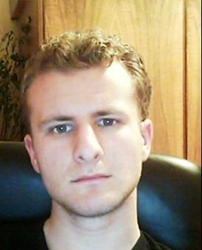
Trainers Team (2)
George Georgiev
Technical Trainer @ Telerik Corp.
Informatics and IT competitions contestant and winner
Student in Sofia University
Software engineering
Graduate from the third season of Telerik Software Academy
E-mail: georgi.georgiev [at] telerik.com
Blog: http://itgeorge.net

Slide 15

Trainers Team (3)
Pavel Kolev
Web Developer and Tech Lead @ ISG Technology
Champion in Telerik Academy web and mobile courses
NASA champion
E-mail: i.pavelkolev [at] gmail.com
Web Site: http://pavelkolev.com
LinkedIn: http://www.linkedin.com/pub/pavel-kolev/35/913/126

Slide 16





Evaluation
Thank God There Are Bonuses!

Slide 17

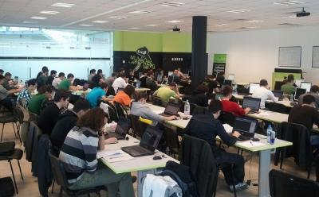
JavaScript Applications: Evaluation
Evaluation components
Practical exam – 50%
Teamwork – 20%
Homework – 10%
Homework evaluation – 10%
Attendance in class – 10%
Bonuses
Forums activity – bonus up to 10%
Helping the other students – bonus up to 10%
PC Magazine contest – bonus up to 15%

Slide 18








Resources
What We Need in Addition to this Course Content?

Slide 19
Telerik Academy Resources
Web Design with HTML5, CSS3 and JavaScript
All Software Academy courses in one place
HTML, CSS, JavaScript and JS Libraries
Web Client-Side Development
A basic and very similar course
http://academy.telerik.com/student-courses/ archive/web-design-html-5-css-3-javascript
http://academy.telerik.com/student-courses/archive/web-client-side-development

Slide 20
Online JavaScript Resources
Mozilla Development Network (MDN)
https://developer.mozilla.org
Mostly used for the presentations
Web Platform
http://www.webplatform.org
The place where all masters contribute
Adobe, Apple, Facebook, Google, HP, Intel, Microsoft, Mozilla, Nokia, Opera, W3C

Slide 21
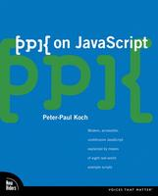


Recommended Books
“PPK on JavaScript”, Peter Paul-Koch, New Riders Press, 2006, ISBN 9780321423306
Eloquent JavaScript Marijn Haverbeke Free Book
JavaScript: The Good Parts, O’Reilly Media/Yahoo Press, 2008, ISBN: 9780596517748

Slide 22
Course Web Site & Forums
Register for the "Telerik Academy Forums":
Discuss the course exercises with your colleagues
Find solutions for the exercises
Share source code / discuss ideas
The JavaScript Applications official web site:
forums.academy.telerik.com/web-design-with-html5-css-and-javascript
http://academy.telerik.com/student-courses/web-design-and-ui/javascript-applications

Slide 23
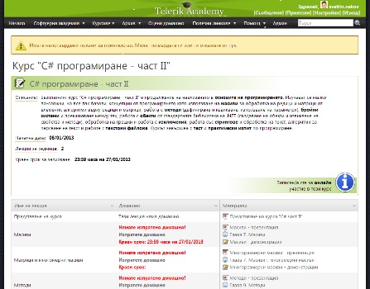
Telerik Integrated Learning System (TILS)
The Telerik Integrated Learning System (TILS)
www.telerikacademy.com
Important resource for all students
Homework submissions
Homework peer reviews
Presence cards with barcode
Reports about your results
telerikacademy.com/Courses/Courses/Details/87

Slide 24



Required Software
Software needed for this course:
Microsoft Visual Studio 2012 or Visual Studio Express 2012 (free version of VS 2012)
Sublime Text 2
Komodo IDE
Notepad ++

Slide 25



JavaScript Applications: Course Introduction
http://academy.telerik.com

Slide 26



Free Trainings @ Telerik Academy
Web Design and UI Technologies @ Telerik Academy
html5course.telerik.com
Telerik Software Academy
academy.telerik.com
Telerik Academy @ Facebook
facebook.com/TelerikAcademy
Telerik Software Academy Forums
forums.academy.telerik.com

