Slide 1
jQuery Plugins
Expanding the functionality of jQuery
Doncho Minkov
Technical Trainer
http://minkov.it
Telerik Software Academy
http://academy.telerik.com

Slide 2
Table of Contents
jQuery Plugins
jQueryUI
Creating Plugins
Chaining
Plugins Options

Slide 3
jQuery Plugins

Slide 4
jQuery Plugin
A Plugin is just a method that extends the jQuery objects prototype
Enabling all jQuery objects to use this method
Once a plugin is imported, it is used as regular jQuery method
Like addClass(), fadeout() and hide()

Slide 5
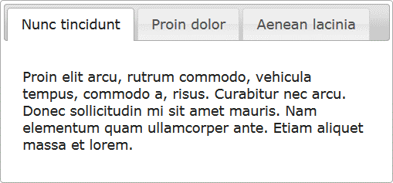
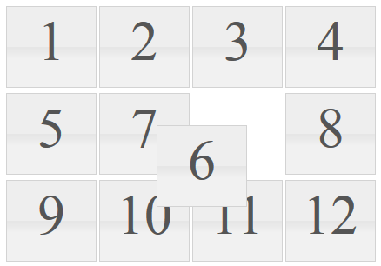
jQuery Plugins
jQuery has many ready-to-use plugins
A library jQueryUI for UI controls
Plugins for UI
Tabs
Arrangeable elements
$("#tabs-holder").tabs();
$("#grid" ).sortable();

Slide 6
jQuery Plugins
Live Demo

Slide 7
Creating Custom jQuery Plugins

Slide 8
Creating jQuery Plugins
jQuery has an easy way to extend the initial functionality with plugins
Just create a plain old JavaScript method and attach it to jQuery.fn object
(function($){
$.fn.zoom = function(){
var element = this;
element.on("mouseover", function() {
//zoom in element
});
element.on("mouseout", function() {
//zoom out element
});
}
}(jQuery));
$(".image").zoom();

Slide 9
Zoom Plugin
Live Demo

Slide 10
Element Chaining
One of the best things about jQuery is its chaining
When a method executes, it returns its object scope, etc…
$("ul.widget li")
.on("click", onWidgetItemClick)
.first()
.addClass("selected")
.click();
//select the nodes
//attach them handler
//get the first
//set its class
//click it

Slide 11
Element Chaining
Live Demo

Slide 12
Chaining in Plugins
Chaining is pretty good and useful feature, so it is best if we can make our plugin to implement it
Done easy, just return this at the end of the plugin function
(function($){
$.fn.zoom = function(){
var element = this;
element.on("mouseover", function() {…});
element.on("mouseout", function() {…});
return this;
}
}(jQuery));
$(".image")
.zoom()
.addClass("zoom");

Slide 13
Chaining in Plugins
Live Demo

Slide 14
Plugins with Options

Slide 15
Plugins with Options
Plugins can also be provided with options
Just pass regular function parameters
(function($){
//zoom with size percents
$.fn.zoom = function(size){
var element = this;
element.on("mouseover", function() {…});
element.on("mouseout", function() {…});
return this;
}
}(jQuery));

Slide 16
Plugins with Options
Live Demo

Slide 17
Plugins Options
Yet the options sometimes become too many
When too many arguments, just use a options object
Give the options as a JSON-like object

Slide 18
Options Object
Live Demo

Slide 19
jQuery Plugins

Slide 20
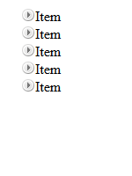
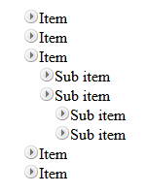
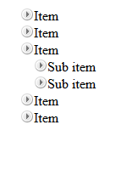
Homework
Create a TreeView jQuery Plugin
Initially only the top items must be visible
On item click
If its children are hidden (collapsed), they must be made visible (expanded)
If its children are visible (expanded), they must be made hidden (collapsed)
Research about events
Initial
Sub item expanded
Top level expanded

